Slide 1


Spatial and temporal variability in zooplankton-mediated carbon export
Maya Thomas
Ph.D. Candidate, Virginia Institute of Marine Science
Palmer LTER
Mid-Term Review 2024

Slide 2
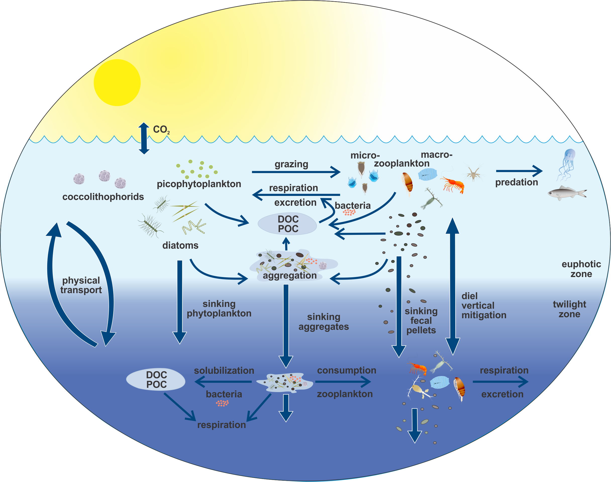
Zooplankton production of particulate and dissolved organic matter in the WAP
Krill and salp fecal pellet production
Zooplankton-mediated carbon export
Zooplankton respiration and dissolved organic matter production
Modified from Steinberg, Buesseler, and EXPORTS team

Slide 3
Zooplankton production of particulate and dissolved organic matter in the WAP
Krill and salp fecal pellet production
Zooplankton-mediated carbon export
Zooplankton respiration and dissolved organic matter production
Modified from Steinberg, Buesseler, and EXPORTS team

Slide 4
Primary research questions
How does fecal pellet carbon export in the WAP vary spatially and interannually, and what environmental factors contribute to changes?
How does the change in zooplankton community structure affect fecal pellet carbon export throughout the austral summer near Palmer Station, Antarctica?

Slide 5
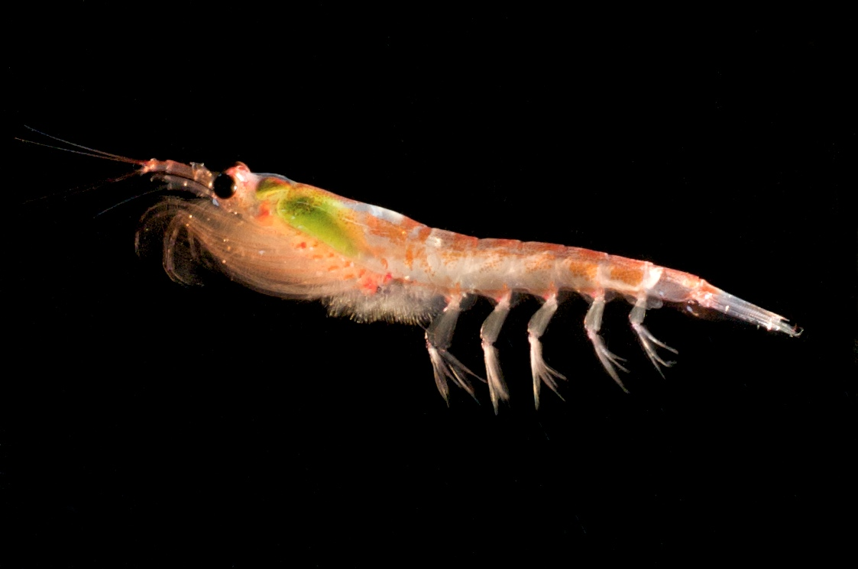
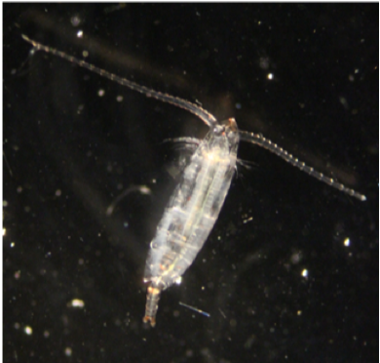
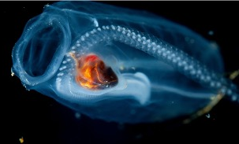
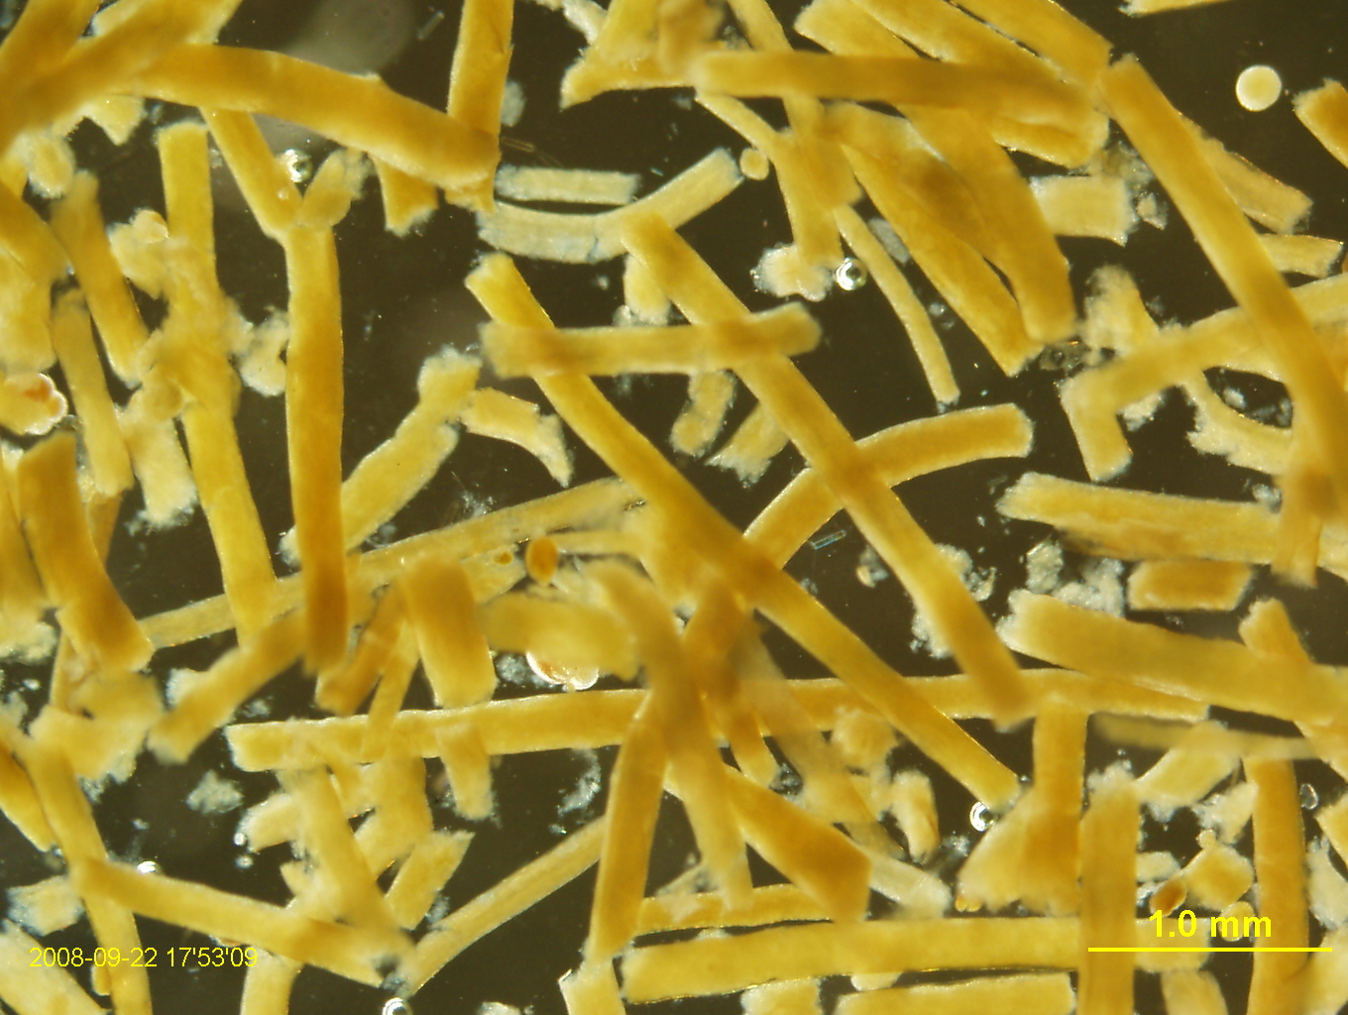
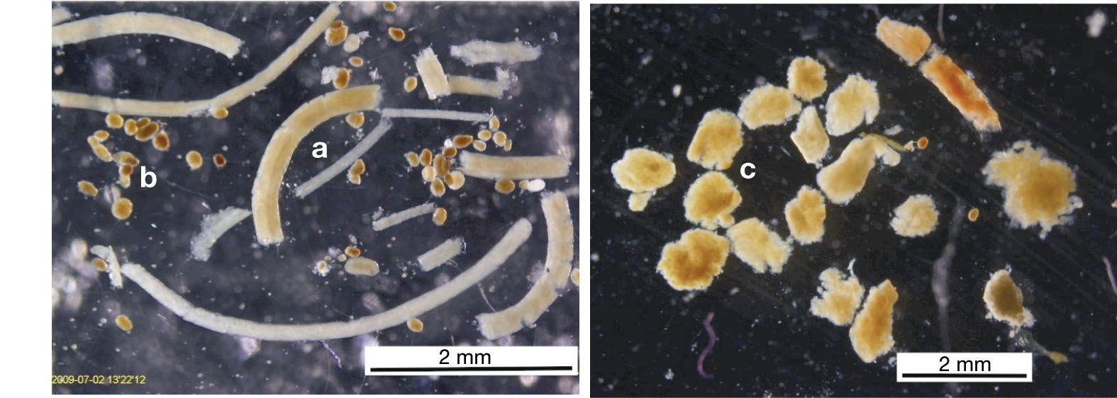
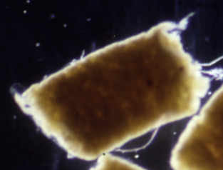
Key zooplankton fecal pellets
Krill
Copepods
Salps
Euphausia superba
A. McDonnell
Calanoides acutus
Salpa thompsoni
M. Gleiber
M. Stukel
Cylindrical Ovoid Tabular
0.25 mm
2 mm
2 mm
Mean sinking rate:
197 m d⁻¹ 50-100 m d⁻¹ 700 m d⁻¹

Slide 6
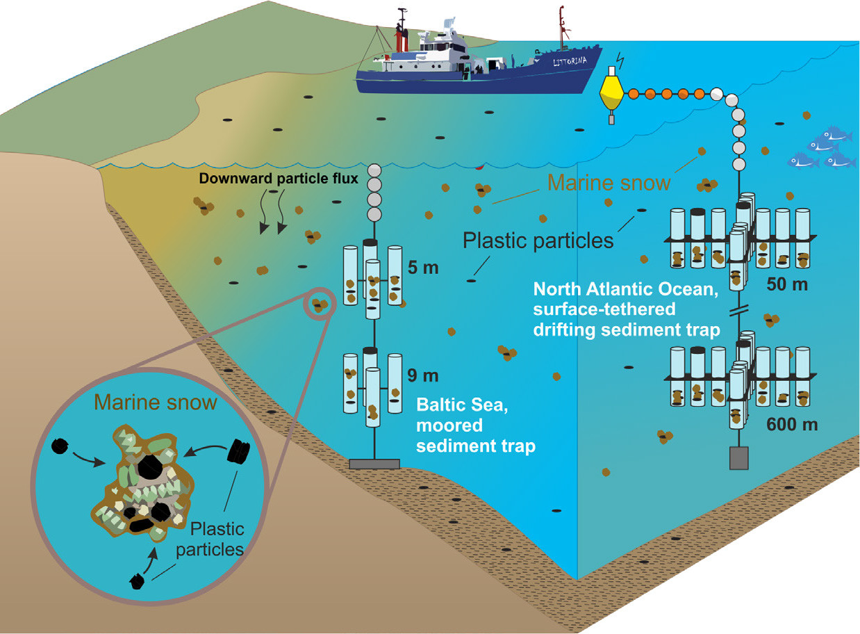
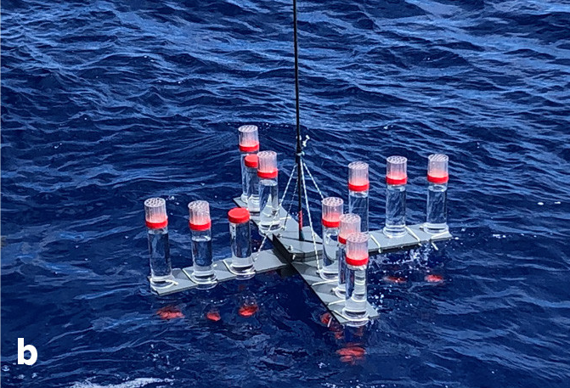





Sediment traps
Drifting traps for spatial analysis along the WAP via PAL LTER cruises
Moored traps for seasonal analysis near Palmer Station
100 m
200
Modified from Galgani et al. (2023)

Slide 7
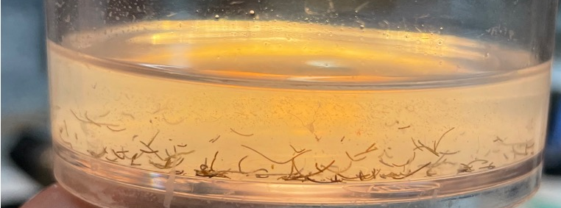
Sediment traps
Drifting traps for spatial analysis along the WAP via PAL LTER cruises
Moored traps for seasonal analysis near Palmer Station
100 m
200
Modified from Galgani et al. (2023)

Slide 8
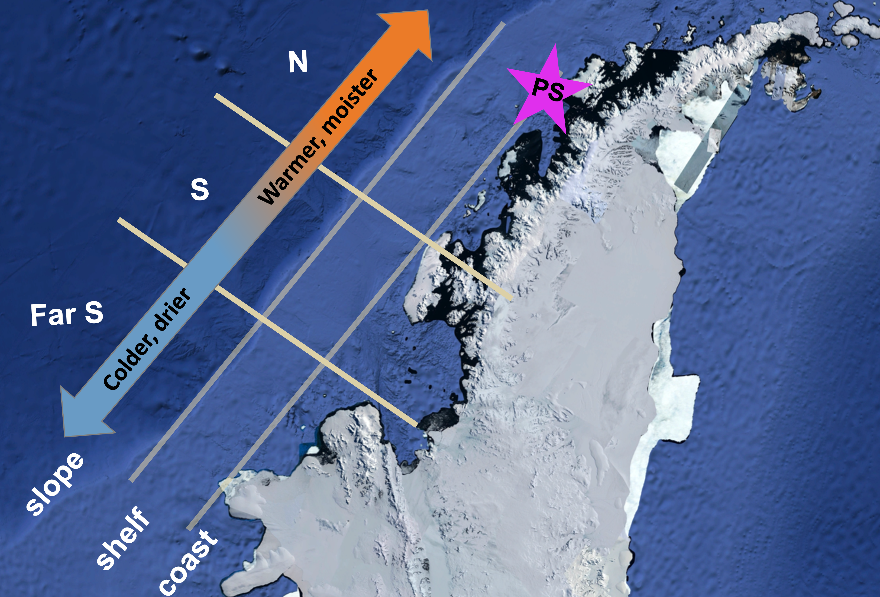
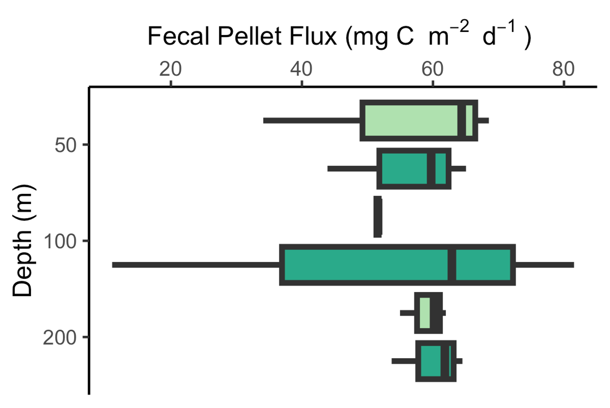
Total fecal pellet flux in North, Coastal WAP
2023
2024
n = 3
Notes:
Add map

Slide 9
Fecal pellet composition in North, Coastal WAP
2022-2023
2023-2024
Cylindrical
Ovoid
Tabular
4.24%
4.58%
6.18%
3.40%
91.1%
90.4%
Notes:
Add picture of krill

Slide 10
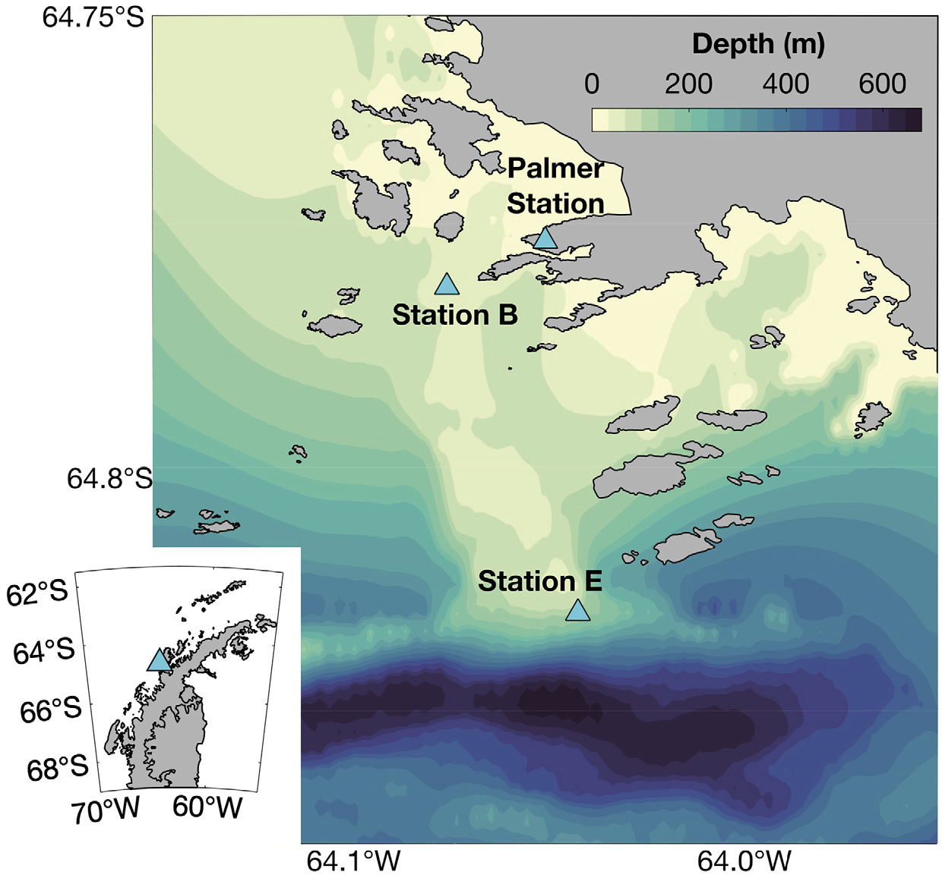
Fecal pellet flux at Station E
Conroy et al. 2023
Cylindrical
Ovoid
Tabular
n = 1

Slide 11
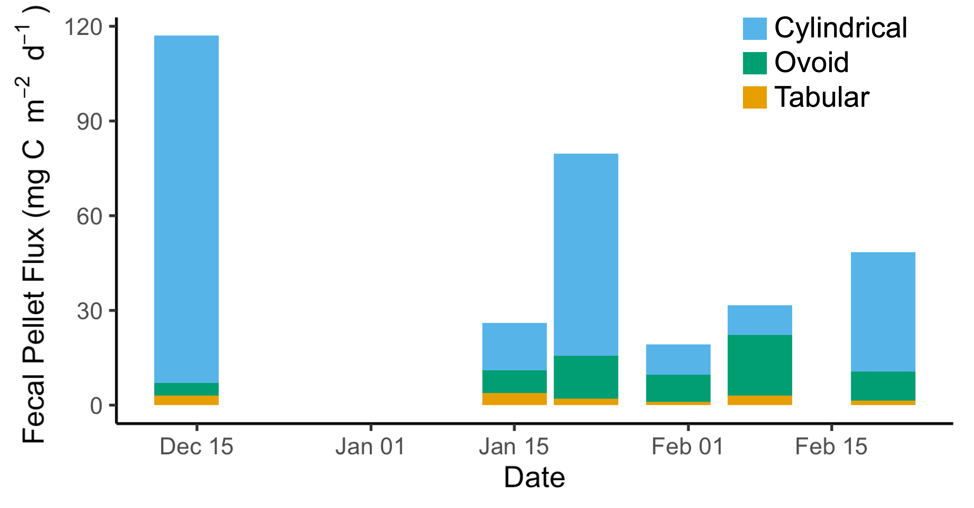
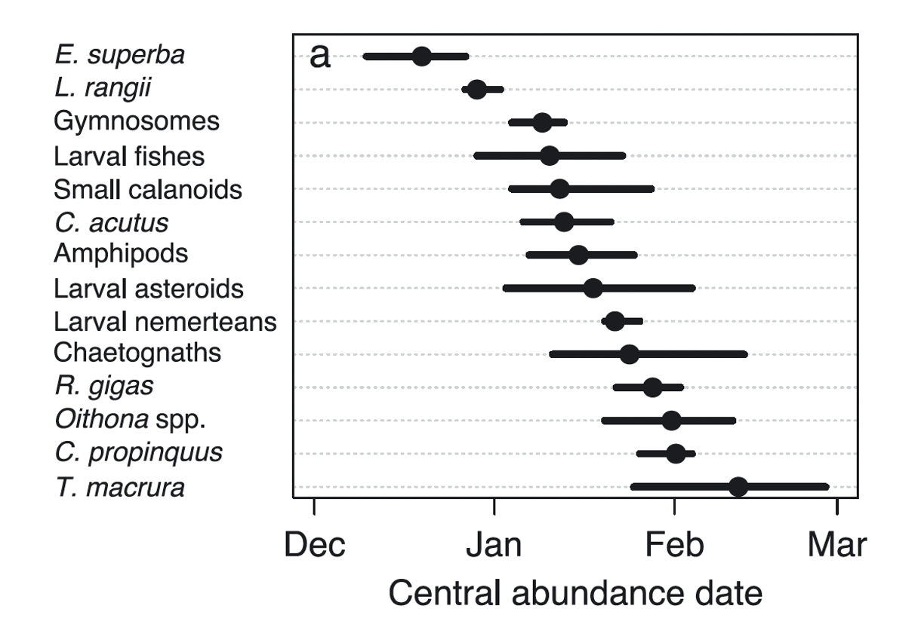
Zooplankton community seasonal succession near Palmer Station
Conroy et al., 2023
Notes:
e. Superba, t mac
And drawing

Slide 12
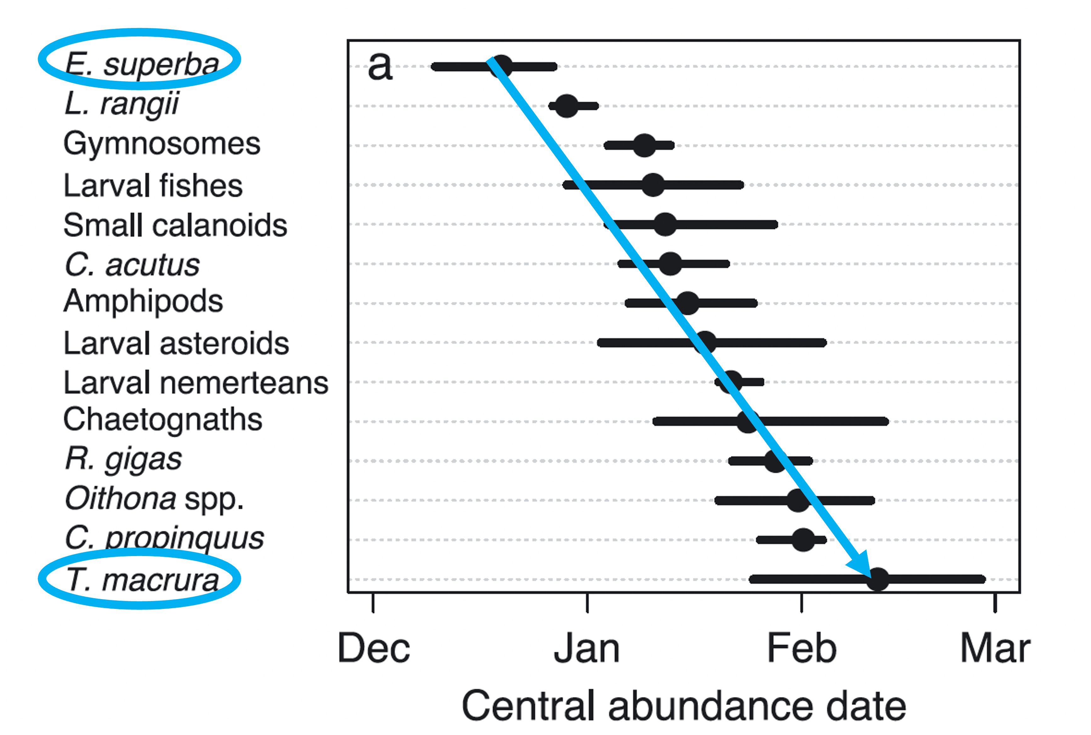
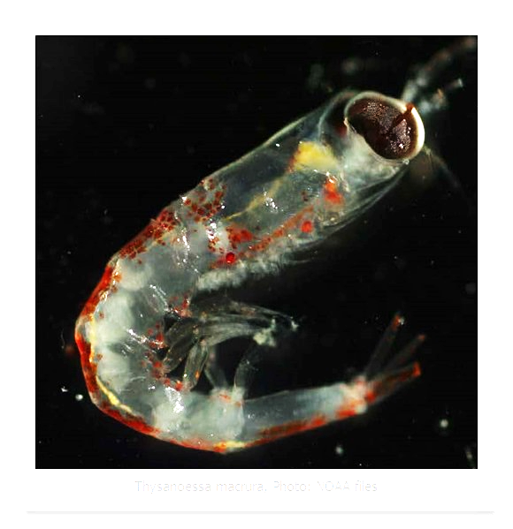
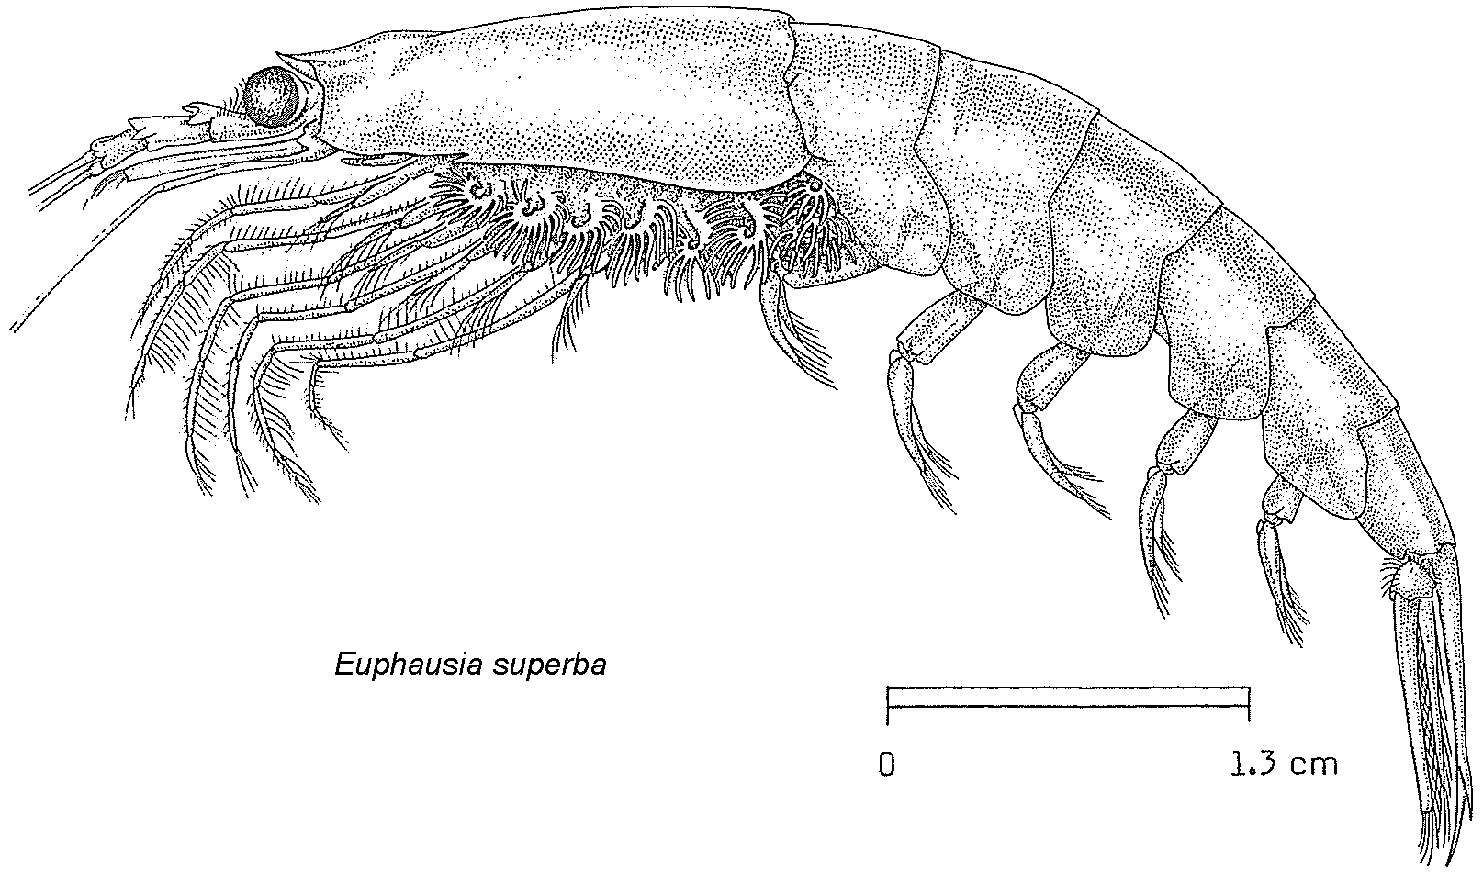
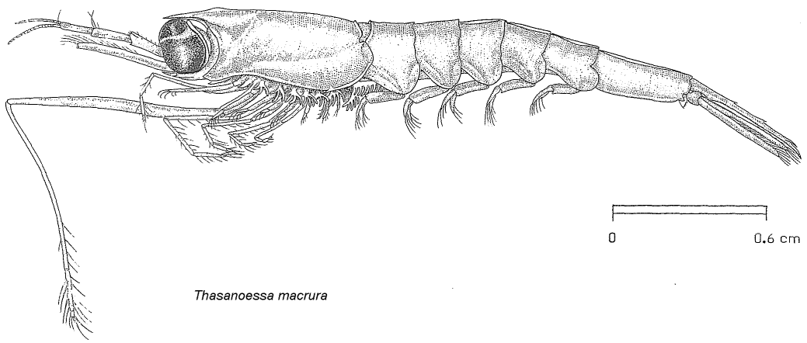
Zooplankton community seasonal succession near Palmer Station
Conroy et al., 2023
E. superba
T. macrura
3 cm

Slide 13
Abundance shift in krill species
E. superba
T. macrura
Copepods
Salps
Larval Fish
Animal biovolume 1000 m⁻³
n = 1
Notes:
Animal biovolume 1000m3

Slide 14
Abundance shift in krill species
E. superba
T. macrura
Copepods
Salps
Larval Fish
Animal biovolume 1000 m⁻³
n = 1
Notes:
Animal biovolume 1000m3

Slide 15


Conclusions
North, Coastal WAP Cruise Traps
  Flux & composition are very similar between years
  Significant increase in ovoid flux with depth
Palmer Station E Traps
  Total flux decreases throughout the summer
  Zooplankton community structure and seasonal succession trends reflected in export
Notes:
Same slide
Work in progress, traps to analyze from southern and offshore to tie into climate gradient

