Slide 1
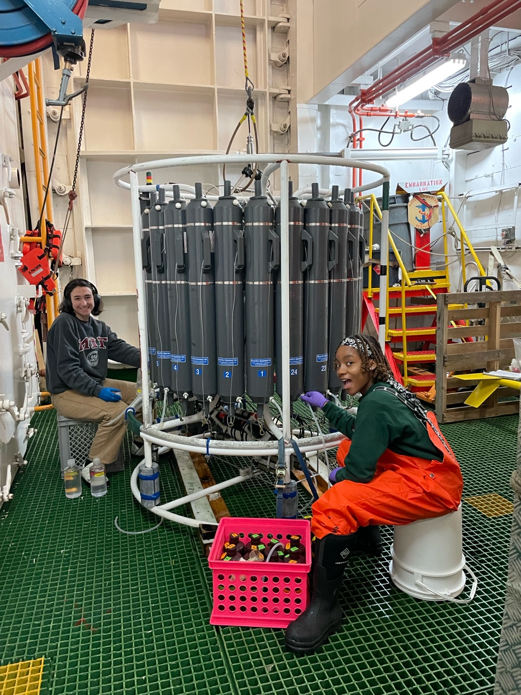


Primary core measurements/sampling and signature data sets
Palmer LTER
Mid-Term Review 2024

Slide 2
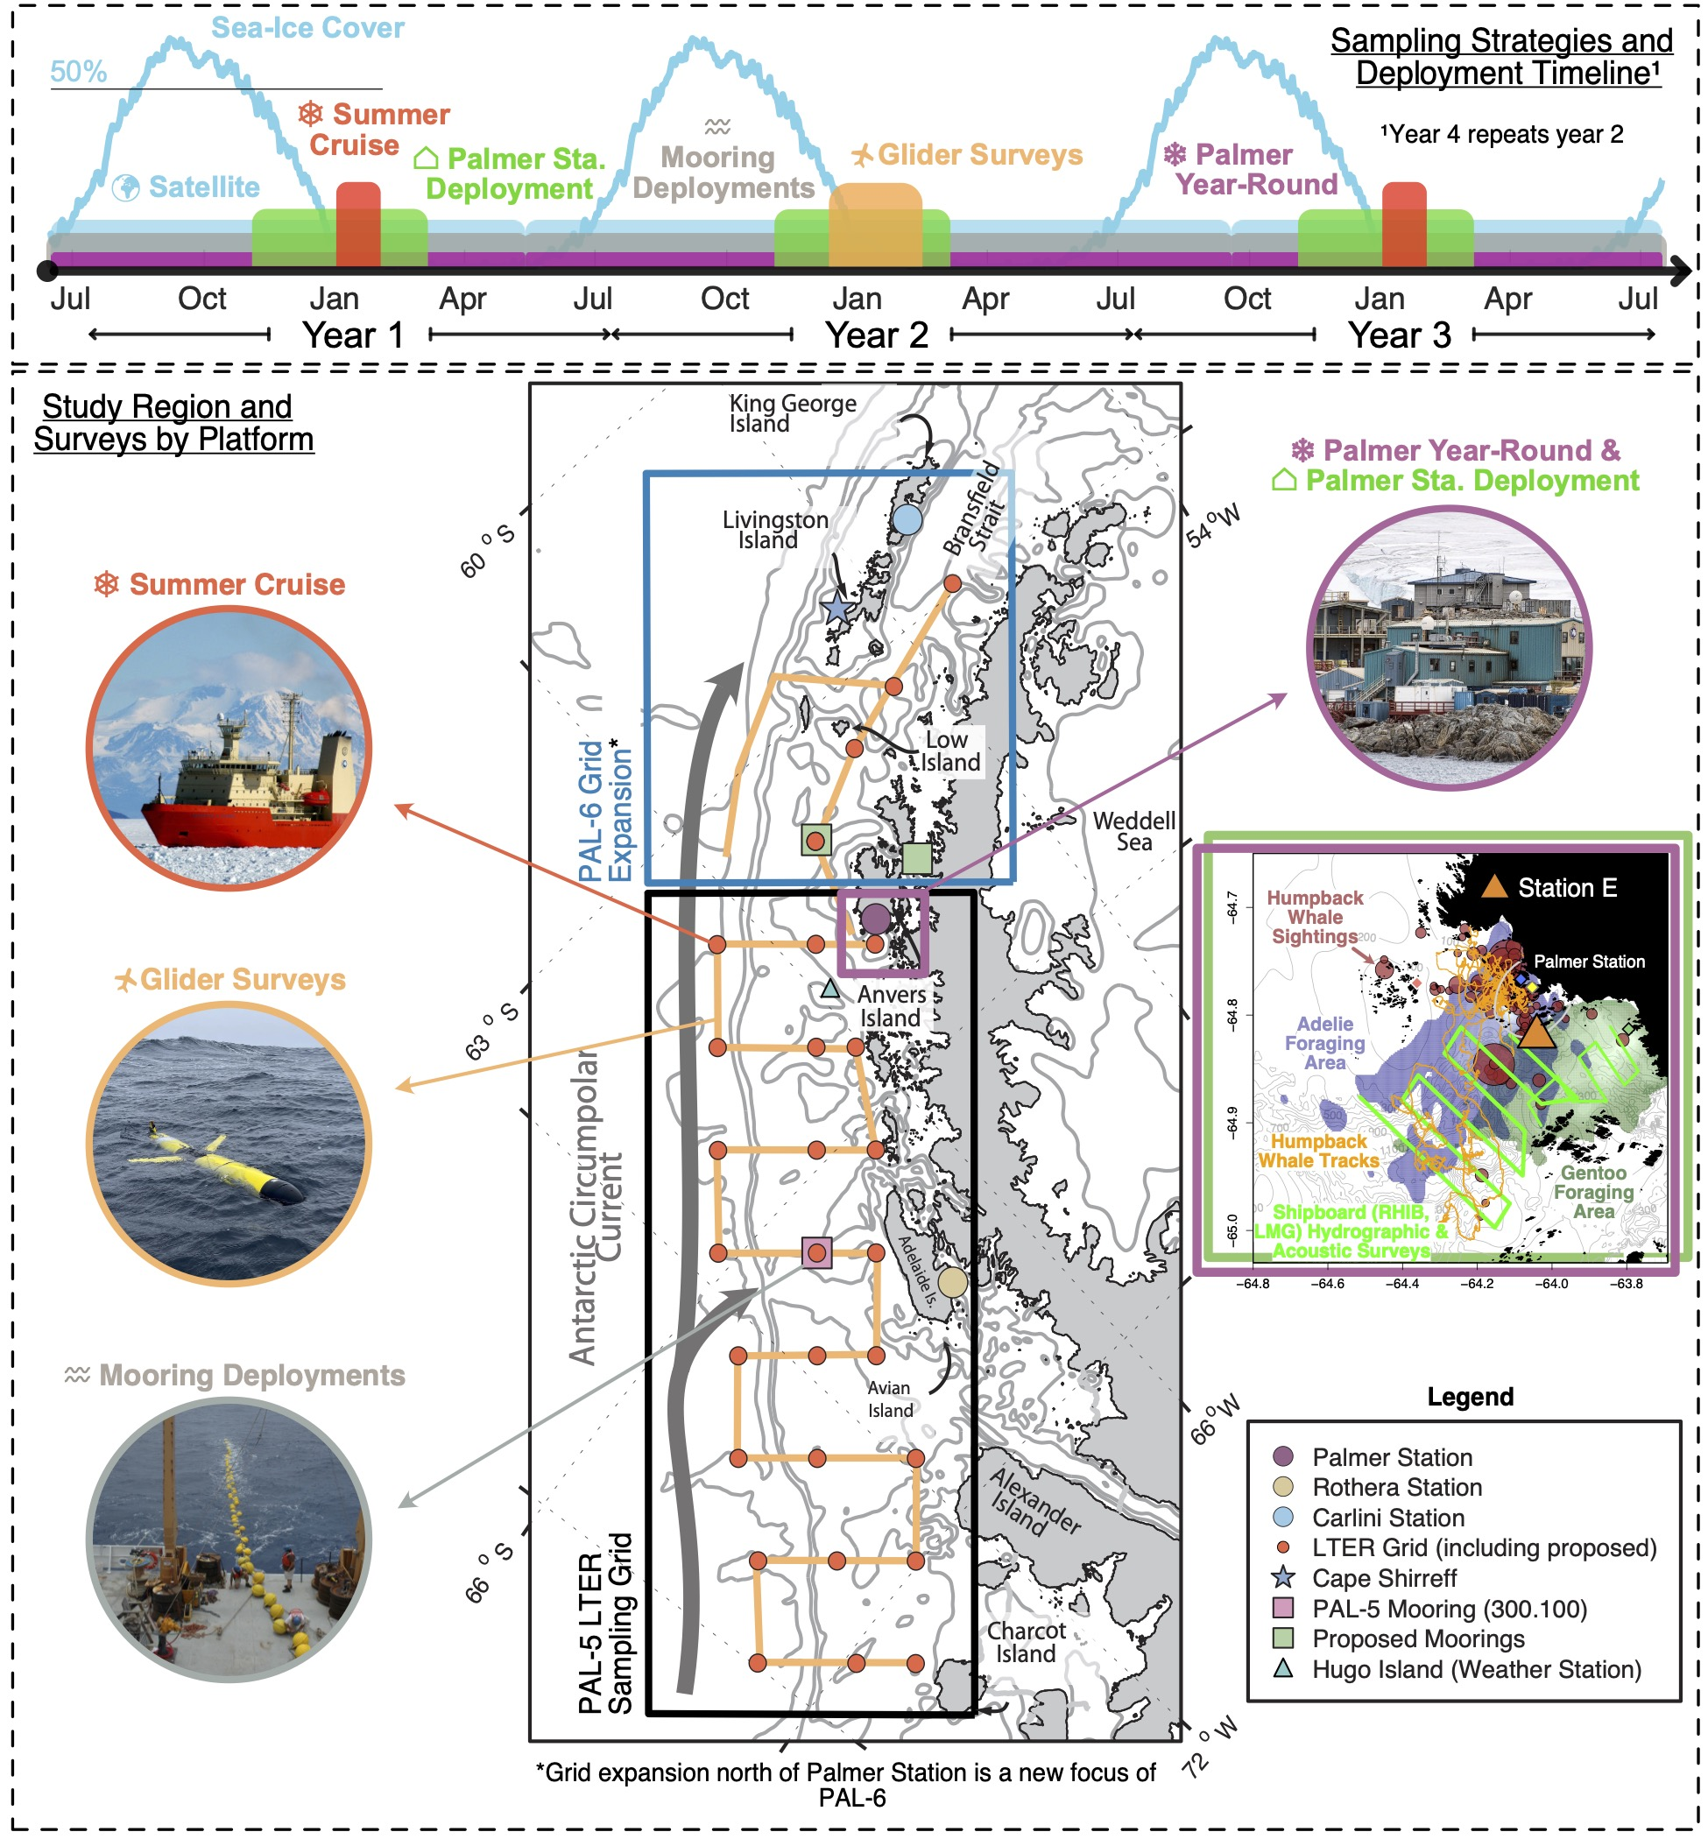
PAL study region and sampling strategy
Notes:
Top panel: timeline of sampling from Palmer Station and the regional survey platforms (cruise, gliders, moorings, satellites). Also shown is the climatological mean of sea ice cover near Palmer Station. Bottom Panel: Study region showing the previous grid and our PAL-6 (current) grid expansion, cruise and gliders, moorings, sampling sites and key partner research stations. Map inset on right shows typical local-scale presence/foraging of whales, penguin colonies, acoustic surveys and sampling at Palmer Station..

Slide 3
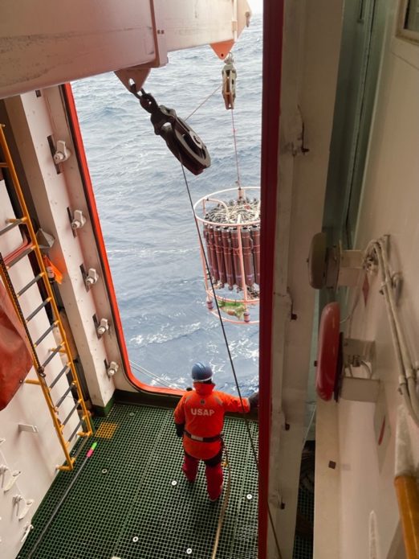
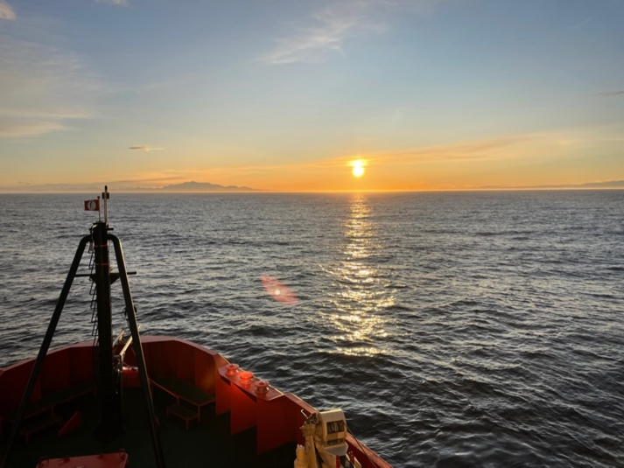
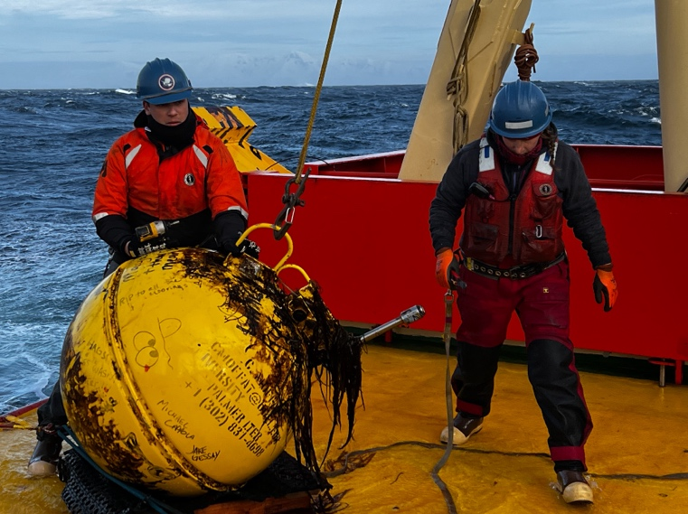
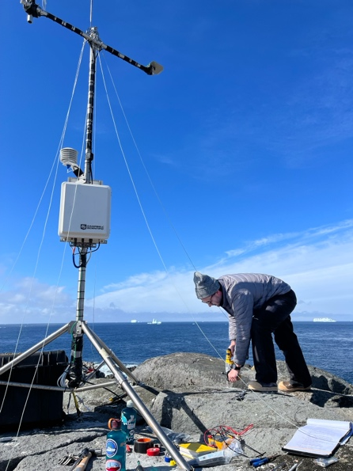
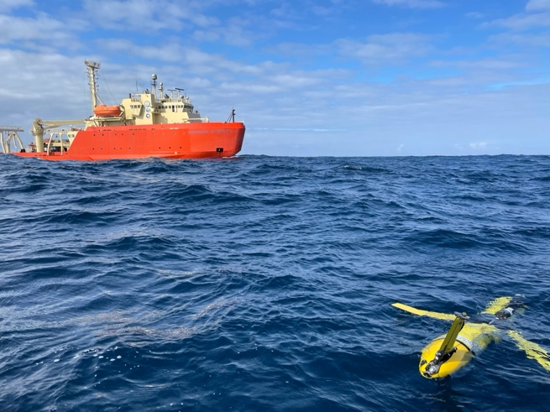
Physical Oceanography
Annual summer PAL grid cruise Jan/Feb since 1993
Subsurface Ocean Moorings* (Since 2007)
Shipboard CTD/Rosette, Shipboard ADCP (Since 1997)
*year-round
Measurements:
Profiles & Time Series: Salinity, Temperature, Pressure, Water velocity, Backscatter
Time series of wind speed and direction, barometric pressure, air temperature
Weather Station* (Since 2024)
Gliders (Since 2008)
Notes:
Yr round important bu challenging because of sea ice

Slide 4
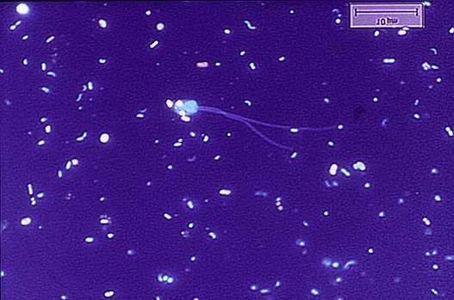
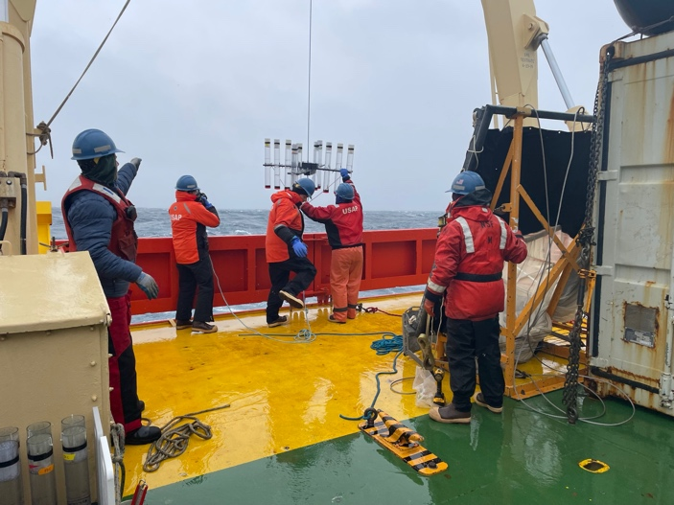
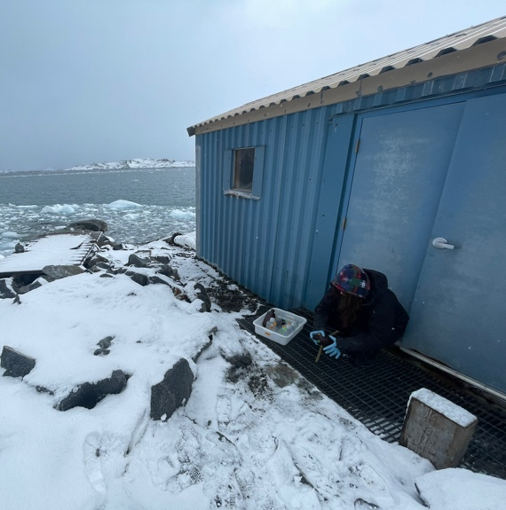
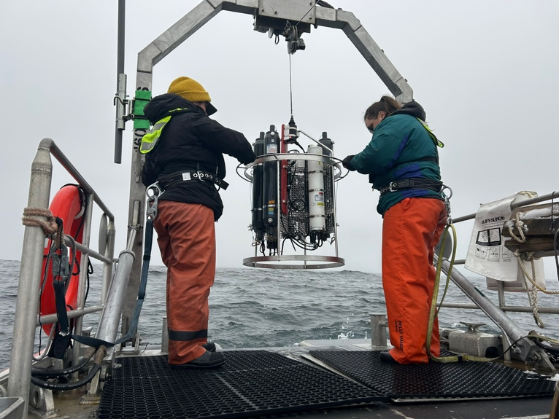
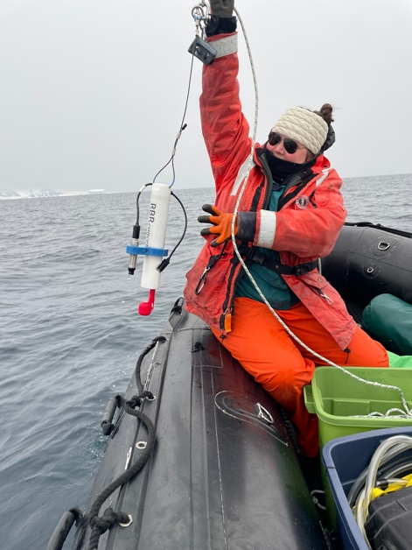
Microbial Ecology, Chemical Oceanography
Time series (Palmer Station: Station E and Pumphouse, biweekly)
δ¹⁸O
Lipids (added 2021)
Carbohydrates (added 2021)
Cell abundances
Nutrients (N and P)
Particulate organic carbon (POC)
Time series LTER grid – water column
δ¹⁸O
Lipids (added 2021)
Carbohydrates (added 2021)
Bacteria cell abundances
Nutrients (N and P)
Particulate organic carbon (POC)
DIC/Alkalinity (surface only)
Sediment Traps (opportunistically during cruises since 2021)
Lipids
Carbohydrates
Particulate organic carbon (POC)
Sediment Traps (Station E, weekly goal)
Lipids
Carbohydrates
Particulate organic carbon (POC)

Slide 5
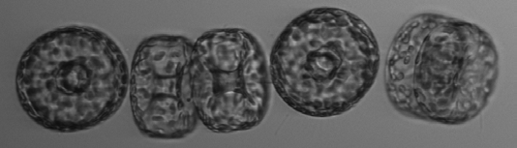
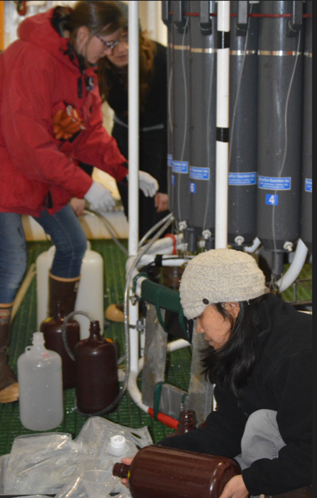
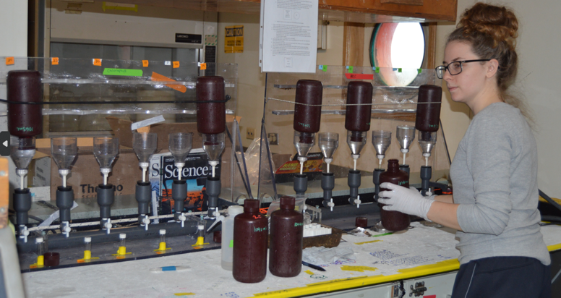
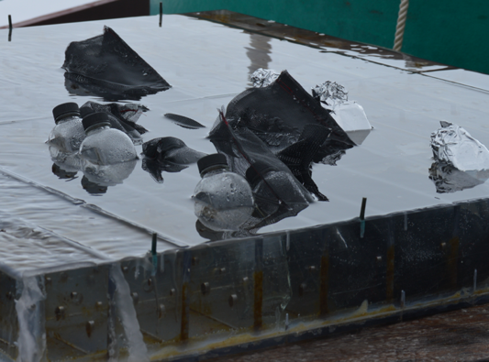
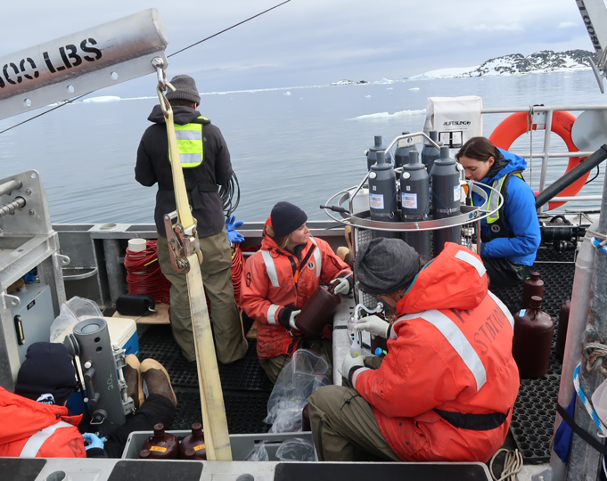
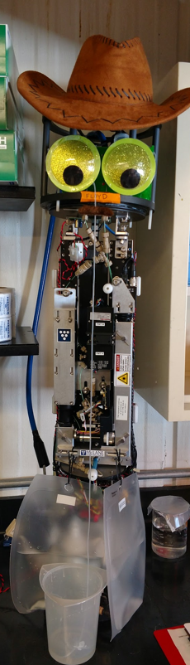
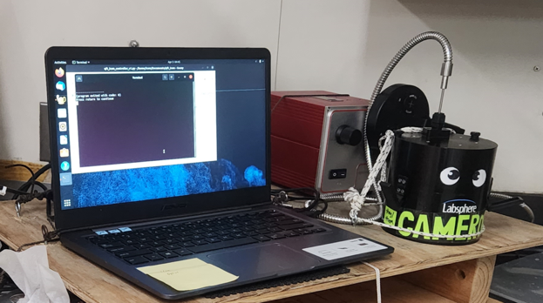
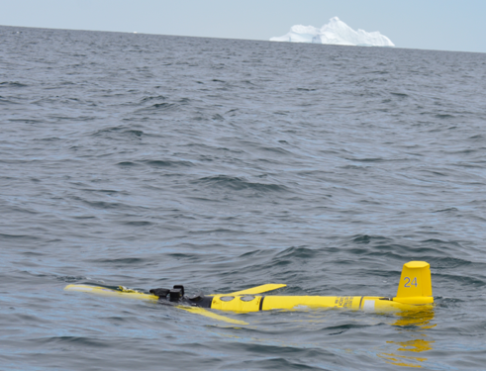
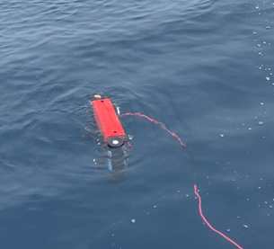
Phytoplankton and primary production
Annual summer PAL grid cruise Jan/Feb since 1993
Palmer Station, Oct - Apr: Station E and Pumphouse, biweekly (since 1993)
Primary Productivity incubations
Water filtration for Chl and pigment analysis
QFT-ICAM
Gliders
Measurements:
Fluorometric Chlorophyll
HPLC accessory pigments
Primary Production
FIRe fluorometry (since 2009)
Phytoplankton species abundance and size(since 2018)
Spectral Light Absorption of phytoplankton (since 2022)
Bio-optical and radiometry water properties (since 2009)
C-OPs
Imaging Flow Cytobot
Notes:
Quantitative filter technique measurements of spectral light absorption by aquatic particles using a portable integrating cavity absorption meter (QFT-ICAM)

Slide 6
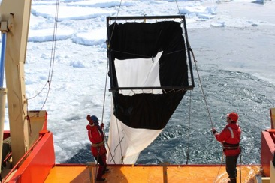
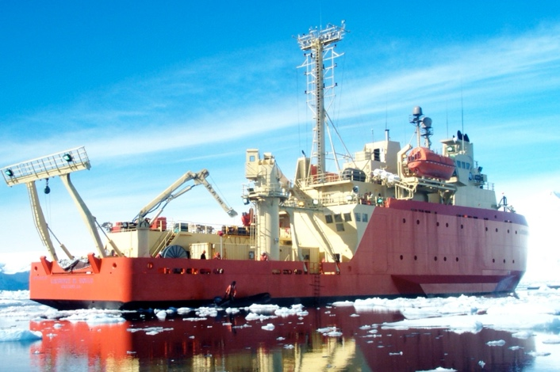
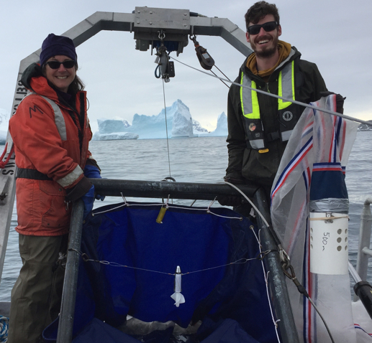
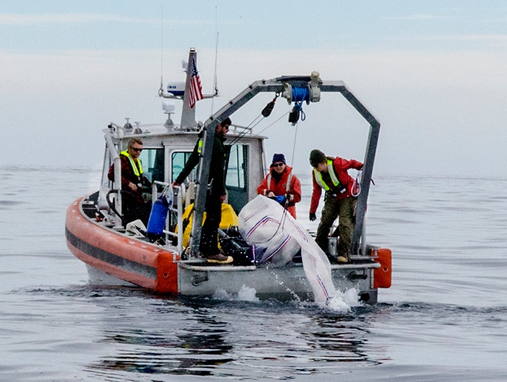
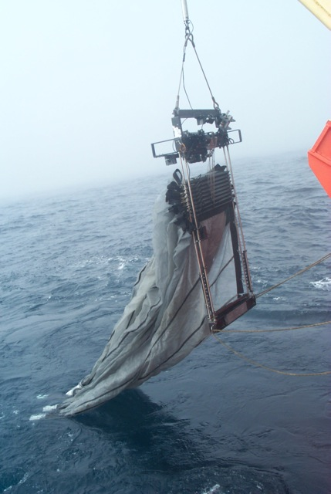
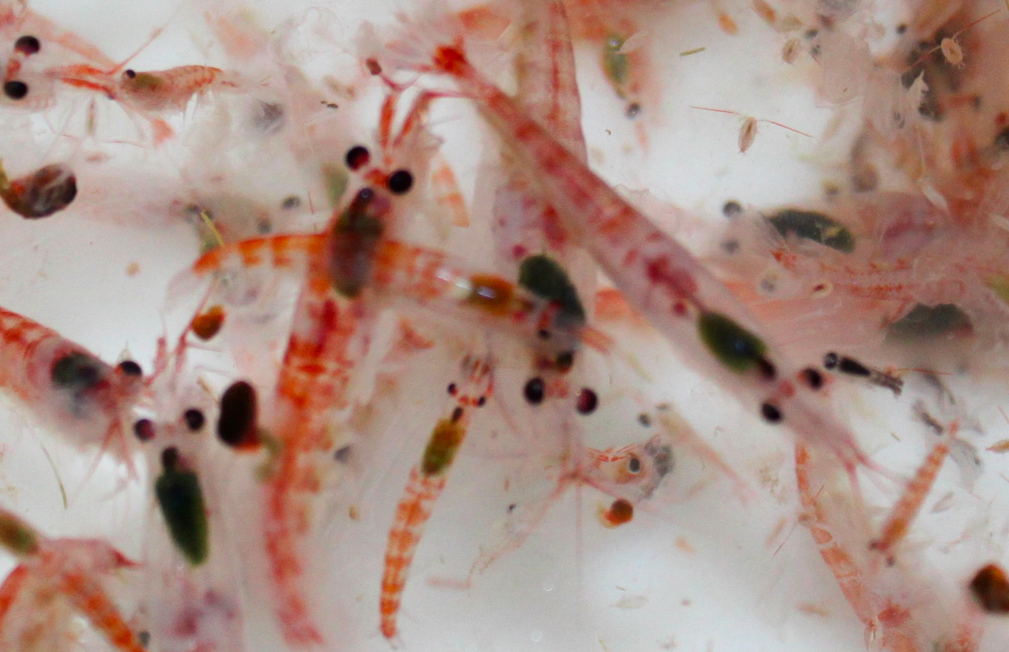
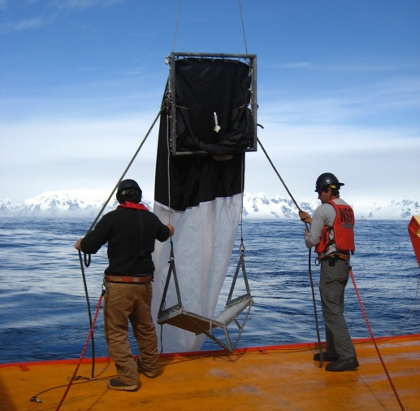
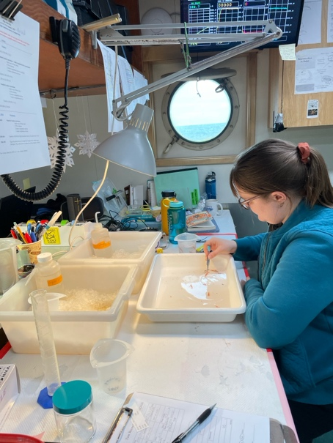
Zooplankton (& ichthyoplankton)
Annual summer PAL grid cruise Jan/Feb since 1993
Palmer Station Nov-March
(since 2019)
2 m² frame,
700 μm, 0-120 m
Towing aboard RHIB; 0-50m
1 m² frame, 700 μm
1 m diameter, 200 μm
Measurements:
Abundance (each species)
Biovolume (each species)
Length (E. superba, salps)
Mature & gravid females (E. superba)
Size-fractionated biomass
Sorted live on board
or at station (big nets)
1 m² frame,
333 μm, 0-300 m
1m² MOCNESS
500 μm; 0-500m;1000 m

Slide 7
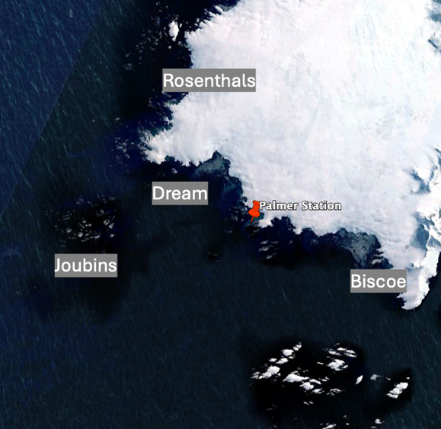
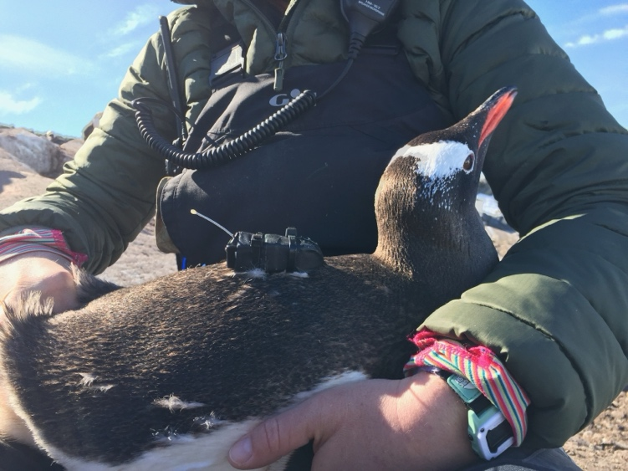
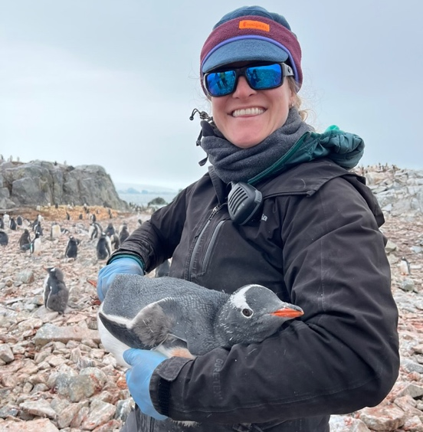
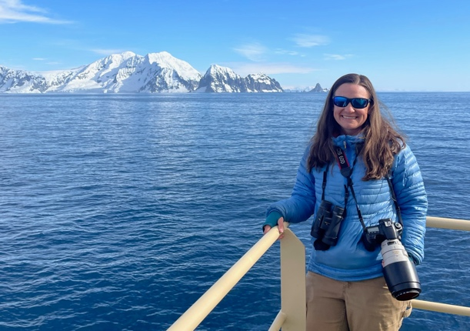
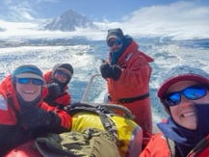
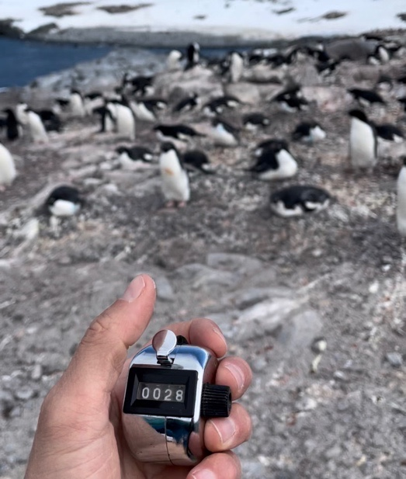
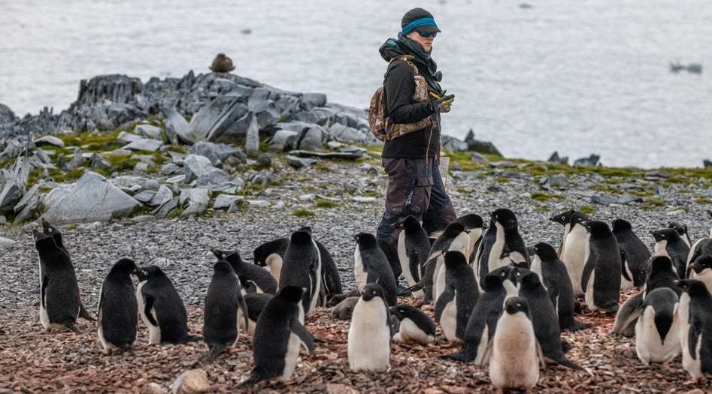
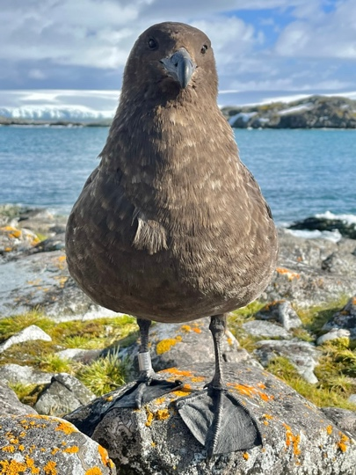
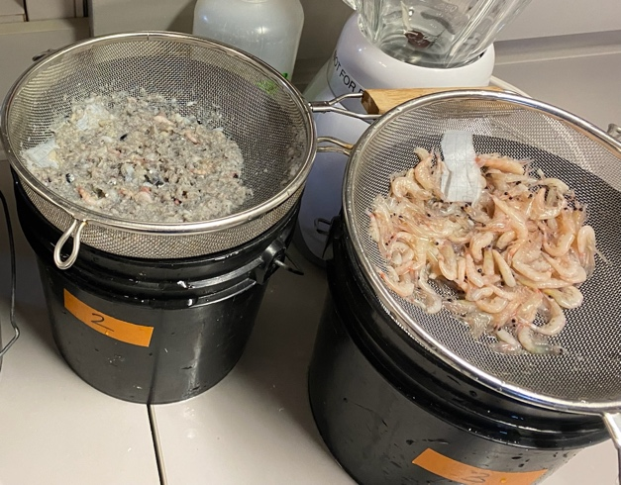
Penguins and other seabirds
Use small boats to survey 30+ islands near Palmer Station
Foraging ecology
Chick fledgling mass
Underway predator sightings on annual cruise
Population census and chick count
Banding of predators/competitors
Phenology & indicator colony counts for egg lay/hatch/fledge dates and breeding success
Diet sampling

Slide 8
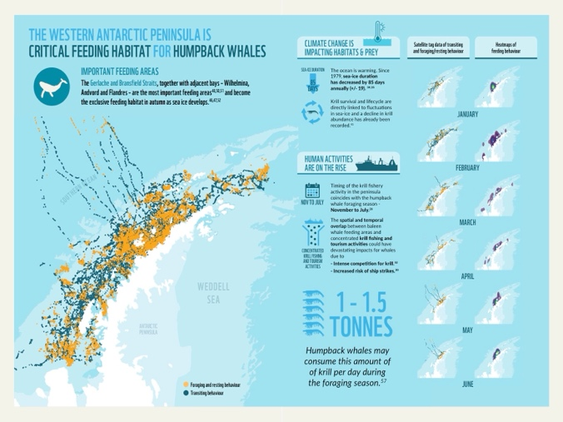
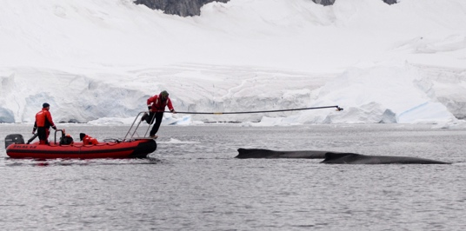
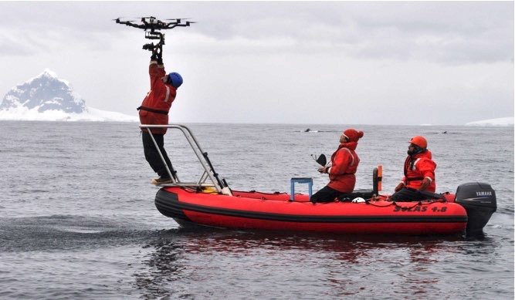
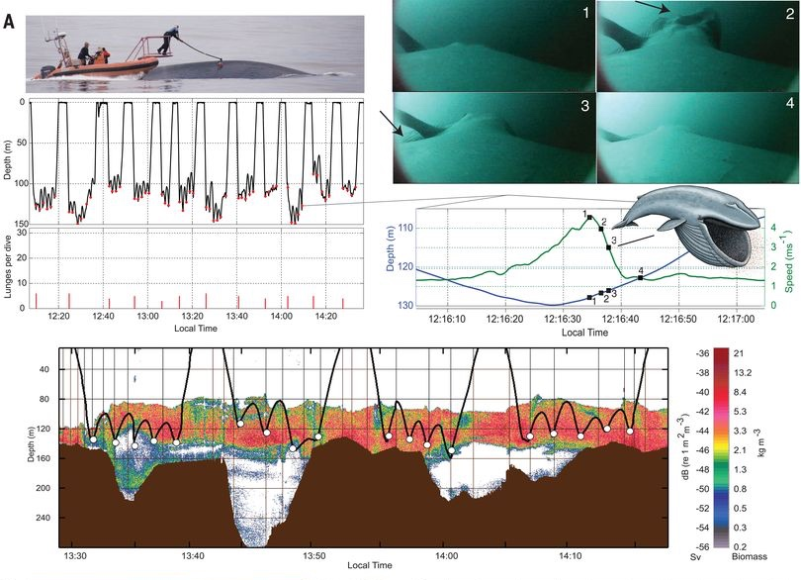
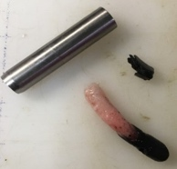
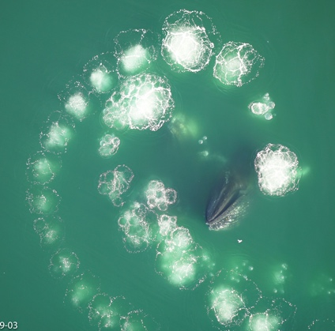
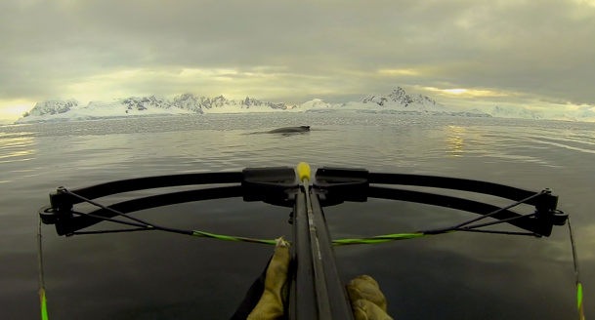
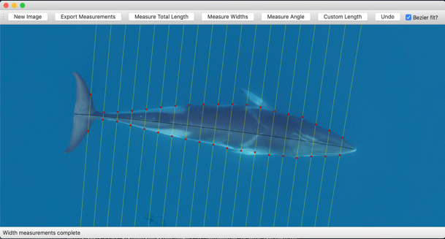
Marine Mammals (Annual cruise & Palmer Station since 2013)
A suite of adaptive sampling strategies
Broad-scale movement patterns and migration
Passive acoustic monitoring of phenology
Fine-scale foraging In relation to krill
Tissue biopsy sampling:
Sex ratios, pregnancy,
nutrition, stress
UAS-derived changes in body condition & novel foraging behavior
Notes:
A suite of adaptive sampling strategies to understand the ecology of marine mammals and response to disturbance

Slide 9
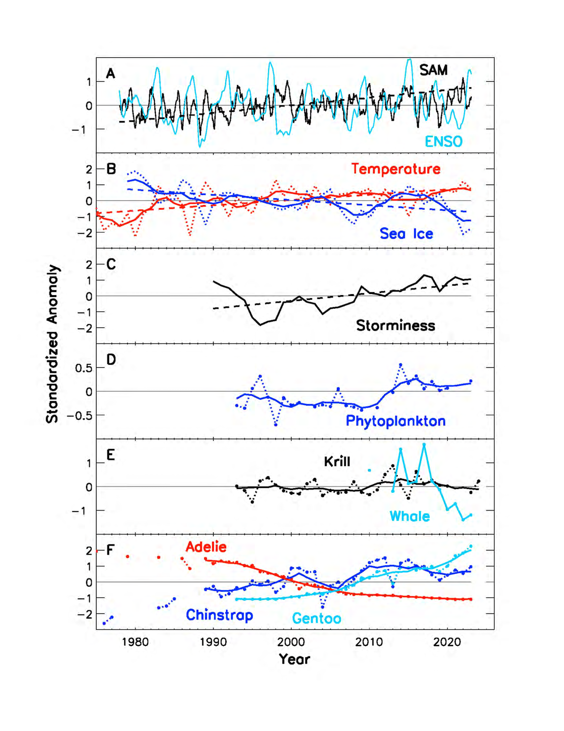
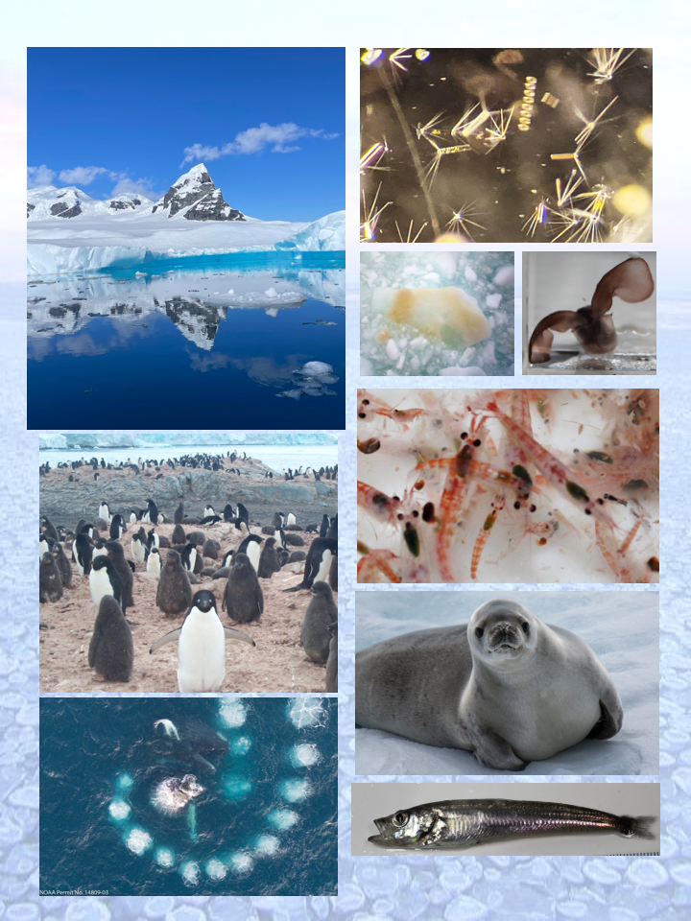
Long-term trends in signature data sets
Increasing positive SAM, interacts with ENSO; more, stronger, warmer wind
Warming temperature, decreasing sea ice duration
Increased storminess
Phytoplankton increase; reduced ice -more sunlight to fuel photosynthesis
Krill ~stable, 5-year recruitment cycle; although decline in north
Humpback whale pregnancy rates tied to krill availability
Ice-dependent Adélie penguins decreasing; other ice intolerant species increasing and expanding breeding range
Schofield et al. (2024) TREE
Notes:
Long term trends in (A) climate cycles; (B) physical drivers: winter air temperature, sea ice duration, and (C) summer storminess from reanalysis; (D) January depth-integrated phytoplankton; (E) January Antarctic krill abundance and whale pregnancies; and (F) penguin breeding pairs at Palmer. Shown are standardized anomalies (dotted), smoothed multi-yearly variability (solid), and long-term trends (dashed) for those series with trends at p < 0.05 significance.
Decadal variability along the West Antarctic Peninsula. Long-term trends observed in (A) climate cycles, (B) physical drivers (winter air temperature and sea ice duration), (C) summer storminess derived from ERA5
reanalysis from the European Centre for Medium-Range Weather Forecast weather reanalysis, (D) January depthintegrated phytoplankton, (E) January Antarctic krill (Euphausia superba) abundance and whale pregnancies, and (F) penguin (Adélie, Pygoscelis adeliae; gentoo, Pygoscelis papua; and chinstrap, Pygoscelis antarcticus) breeding pairs at Palmer Station. Shown are standardized anomalies (dotted), smoothed multi-yearly variability (unbroken), and long-term trends (broken) for those series with trends at P <0.05 significance. (Schofield et al. 2024)

