Slide 1
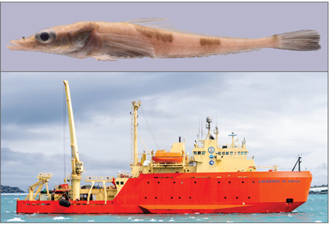
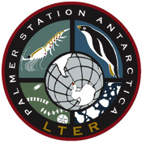

PAL LTER Synthesis Efforts
Palmer LTER
Mid-Term Review
2024
Akarotaxis gouldae

Slide 2

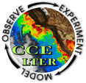
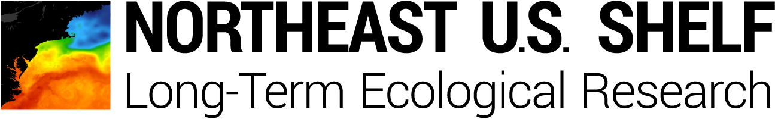
Interannual variability and long‐term change in pelagic community structure across a latitudinal gradient
Funded in 2024, 2-year LTER Network Proposal
The four pelagic sites within the LTER networks
Research Themes
Do marine ecosystems exhibit?
Trophic Amplification
Linear Tracking, Double Integration
Size Spectra Log-Linearity

Slide 3
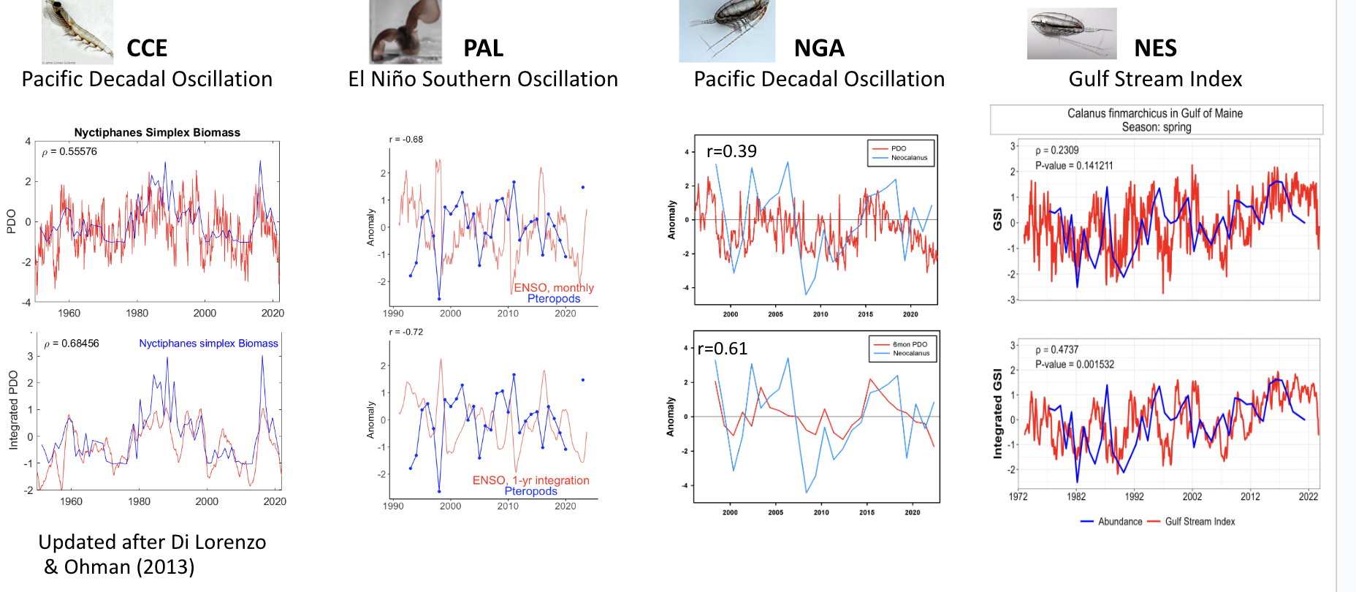
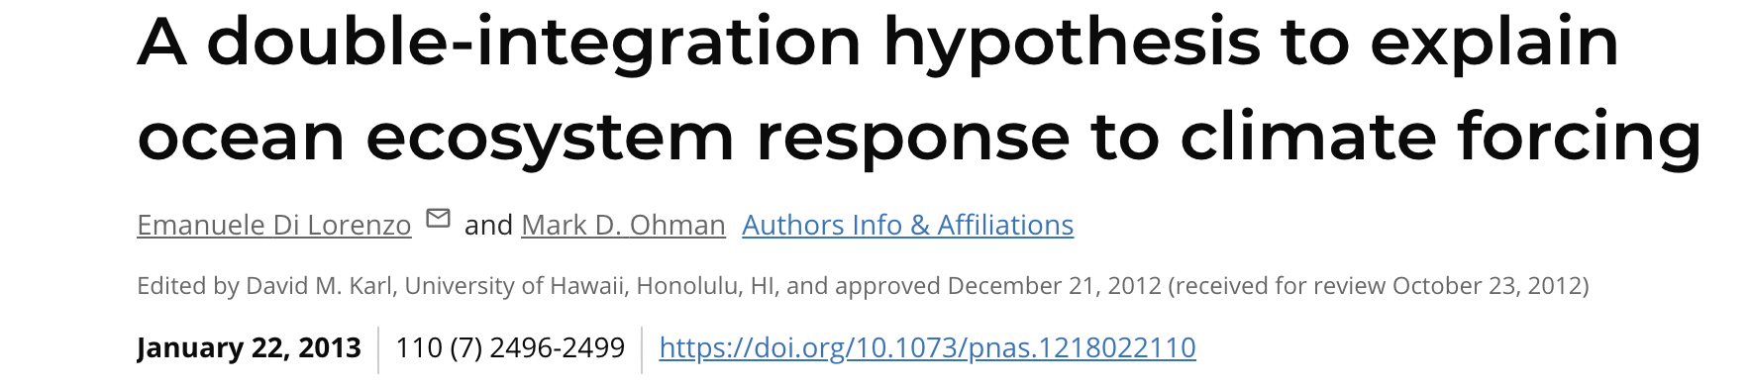
Double Integration Hypothesis
Marine ecosystems exhibit large-amplitude. Cumulative atmospheric “noise” can be amplified through food webs.
“When an ecological regime shift is really just stochastic noise” Doney and Sailley (PNAS)

Slide 4
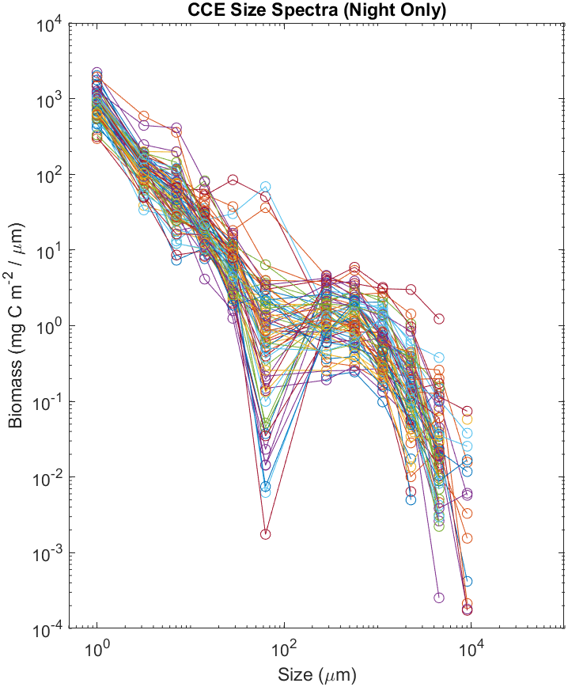
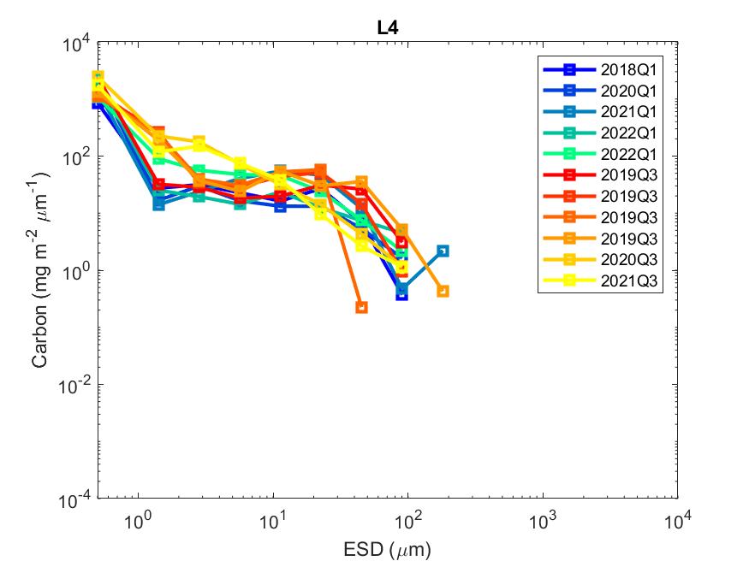
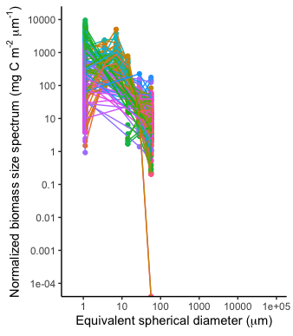
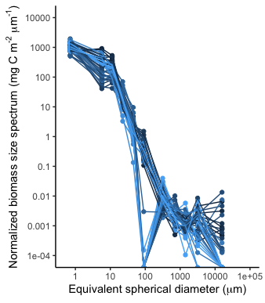
Use of Size Spectra to Infer Ecosystem Properties
l Plankton size spectra are used to model trophic transfer efficiency in marine ecosystems.
l Slopes of size spectra have been related to abiotic factors such as nutrient concentration and temperature, as well as primary productivity, fish biomass, and carbon export.
l Flatter slopes suggesting more efficient transfer of carbon from smaller to larger organisms.
CCE
NGA
NES
PAL

Slide 5
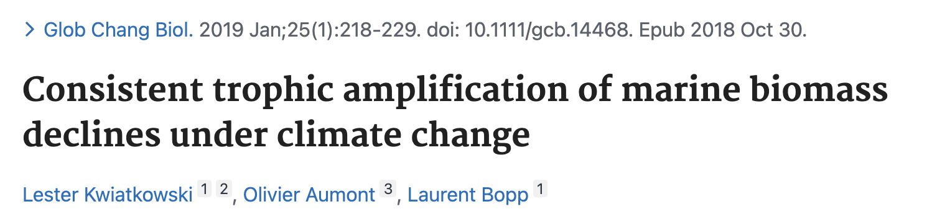
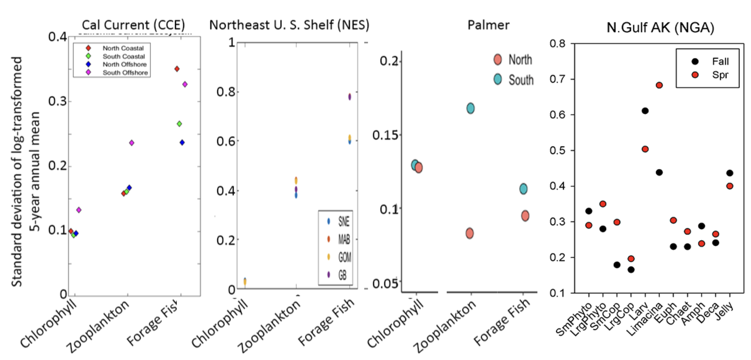
Trophic Amplification
The trophic amplification hypothesis suggests that climate-driven alterations at the base of marine ecosystems (i.e,. phytoplankton) will be amplified by food-web processes.
Thus decreases (or increases) in net primary production will lead to proportionally greater decreases (or increases) in higher trophic levels and fisheries production.
Preliminary results show variable amplification as a function of latitude

Slide 6
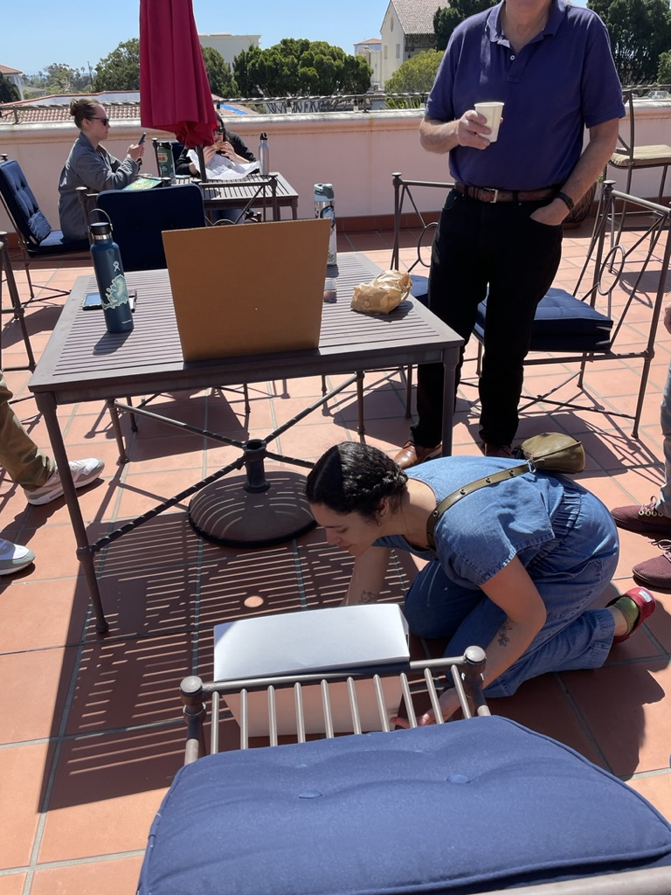
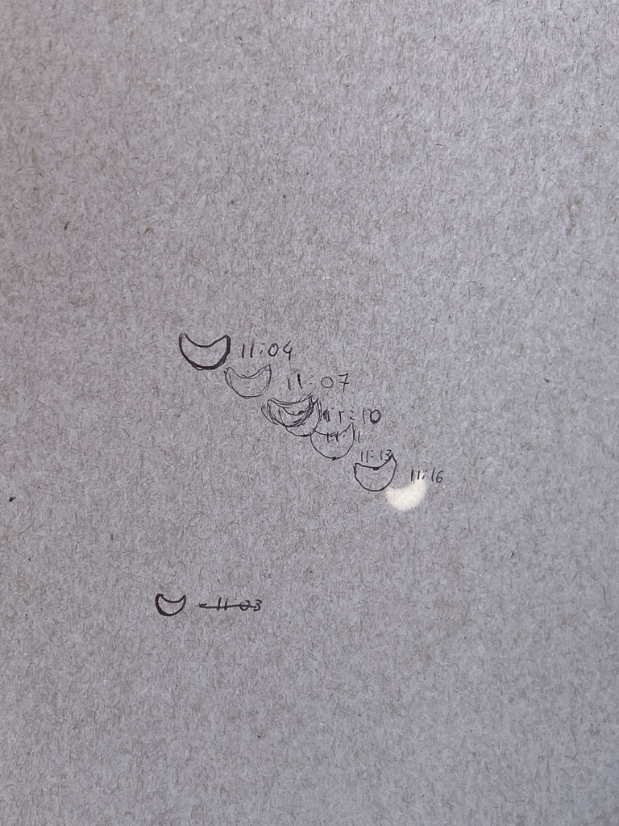
Goals for the coming year
Our fourth face to face meeting at NCEAS (focused on the manuscript preparation)
A session highlighting science themes at ASLO in March
Expansion to the other long term pelagic ecosystem time series (HOT, BATS, K2, etc) to expand latitudinal variability
Science in Action
Nerds tracking solar eclipse at
NCEAS during solar eclipse with boxes

Slide 7
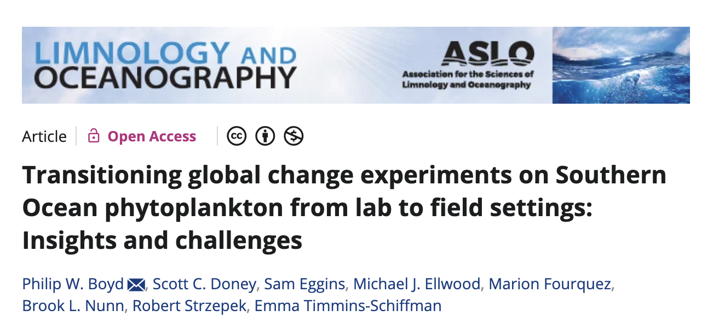
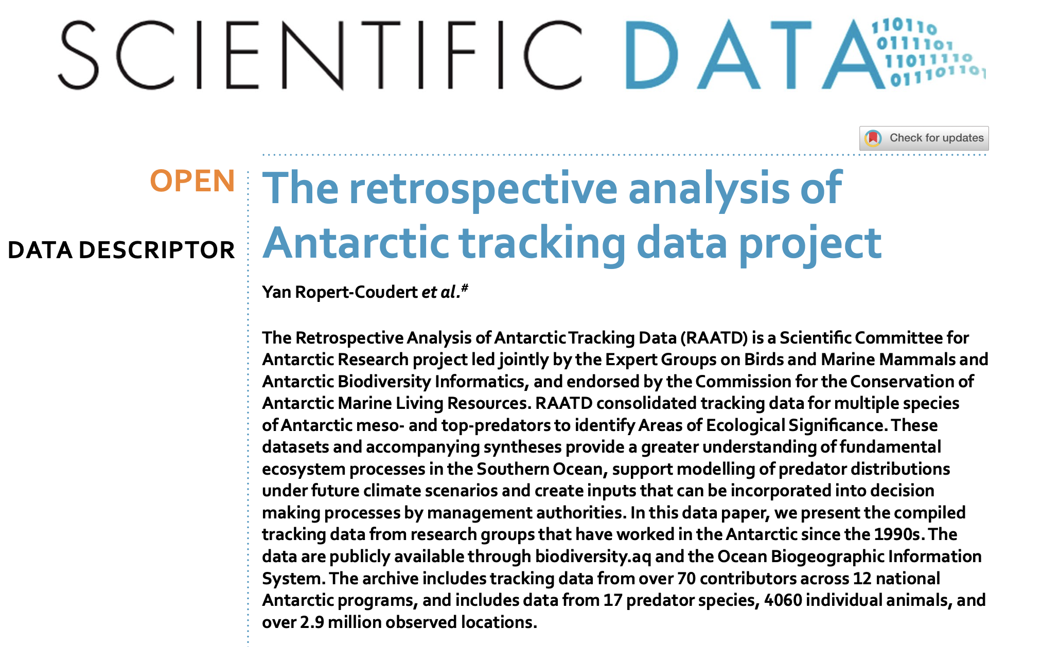
Other Broader Synthesis Efforts
Proposal for Review Paper, for Science
Life really does begin at forty, up until then, you are just doing research: Insights from 40 years of the U.S. National Science Foundation Long Term Ecological Research network
Submitted Oct 19th 2024
Peter M. Groffman¹, Deron Burkepile², Frank W. Davis³, Marty Downs⁴, David R. Foster⁵, Michael N. Goosef⁶, Corinna Gries⁷, Sarah E. Hobbie⁸, Jennifer A. Lau⁹, James W. McClelland¹⁰, Diane M. McKnight¹¹, Oscar M. Schofield¹²,

