Slide 1


Palmer LTER Modeling
Hierarchy of modeling capabilities for targeted studies with differing model complexity based on science questions
Biology/Ecology
Population & Community
Food-web & Ecosystem
box & 1-D column models
3-D regional & basin ocean models
Biophysics & Biogeochemistry
Time-Space
Scale
Palmer station, trap & mooring time-series
Regional LTER grid
& gliders
Remote sensing & basin-scale

Slide 2
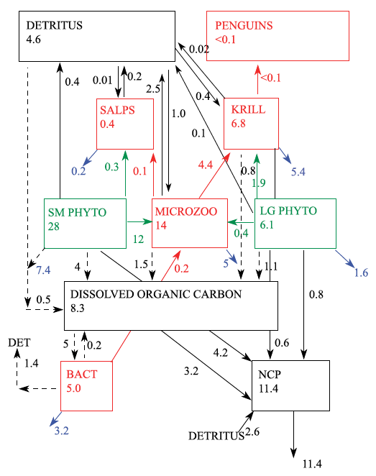
Palmer LTER Modeling
Inverse model reconstruction of steady-state, end-to-end food web
observed stocks & limited number of flows
simple allometric relationships
Ducklow, H.W., S.C. Doney, and **S.F. Sailley, 2015: Ecological controls on biogeochemical fluxes in the western Antarctic Peninsula studied with an inverse food-web model, Advances in Polar Science, 26, 122–139

Slide 3
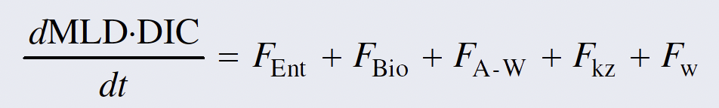
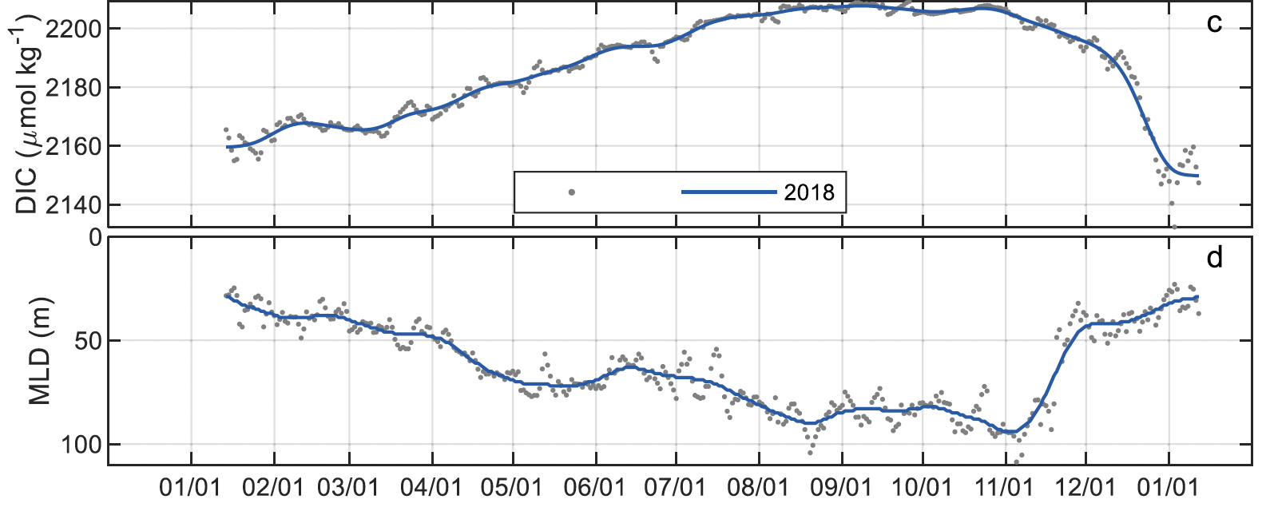
Palmer LTER Modeling
Inorganic Carbon Inventory
Physical & Biological Terms
Diagnostic model of mixed layer dissolved inorganic carbon (DIC) budget
mooring physics & pH
Yang, B., E.H. Shadwick, C. Schultz, and S.C. Doney, 2021: Annual mixed layer carbon budget for the West Antarctic Peninsula continental shelf: Insights from year-round mooring measurements, J. Geophys. Res. Oceans, 126, e2020JC016920

Slide 4
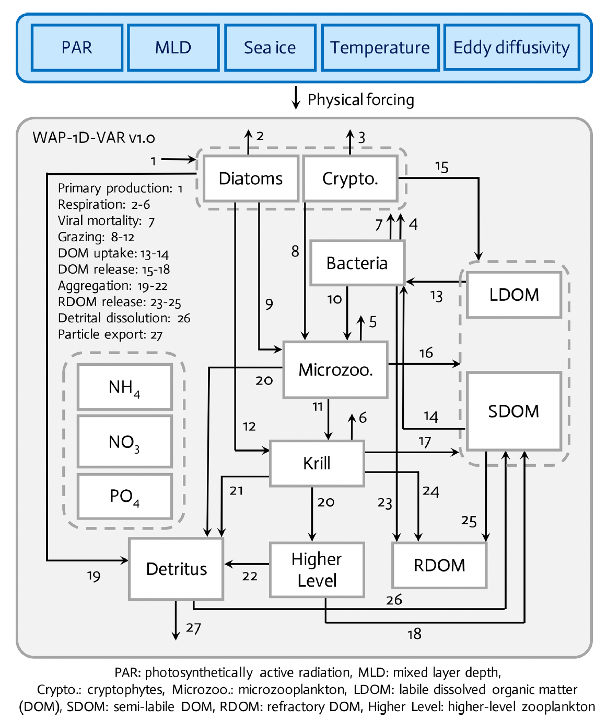
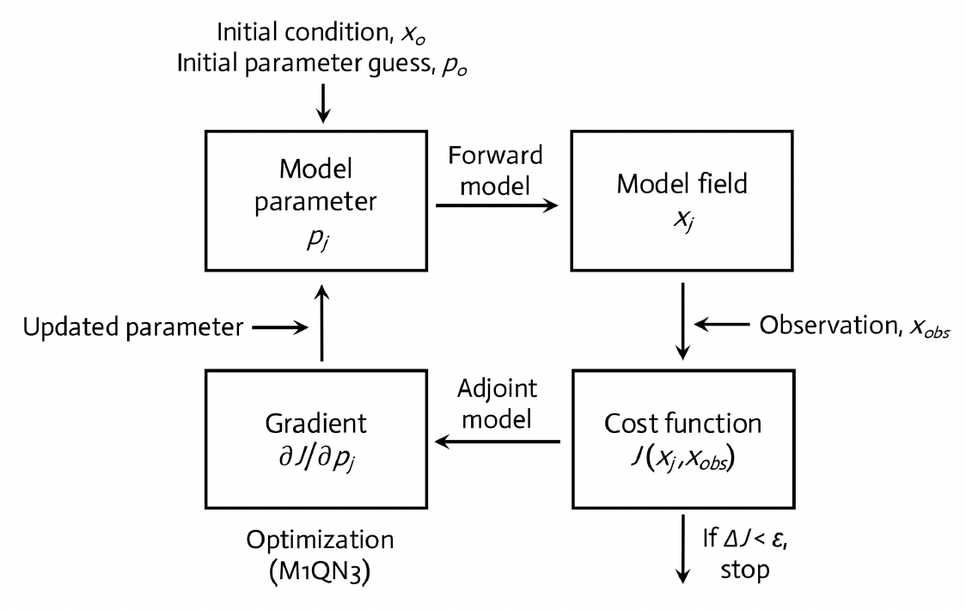
Palmer LTER Modeling
Prognostic 1-D ecosystem model
variational data assimilation model
prescribed mixed layer physics
Kim, H.H., Y.-W. Luo, H.W. Ducklow, O.M. Schofield, D.K. Steinberg, and S.C. Doney, 2021: WAP-1D-VAR v1.0: Development and evaluation of a one-dimensional variational data assimilation model for the marine ecosystem along the west Antarctic Peninsula, Geosci. Model Dev., 14, 4939–4975

Slide 5
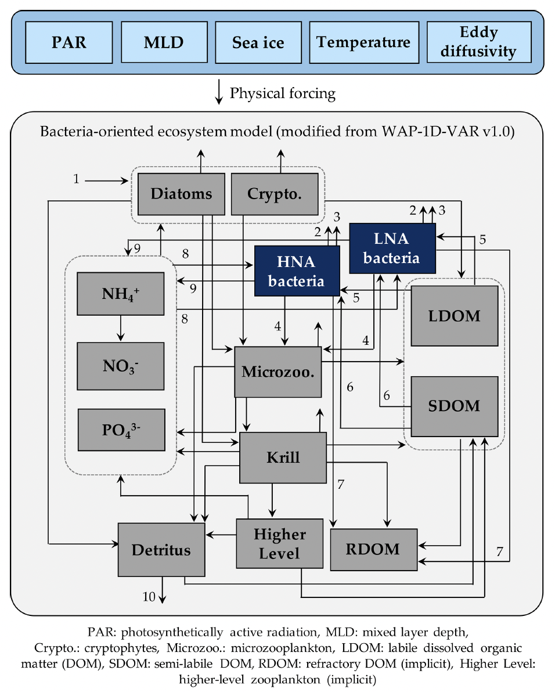
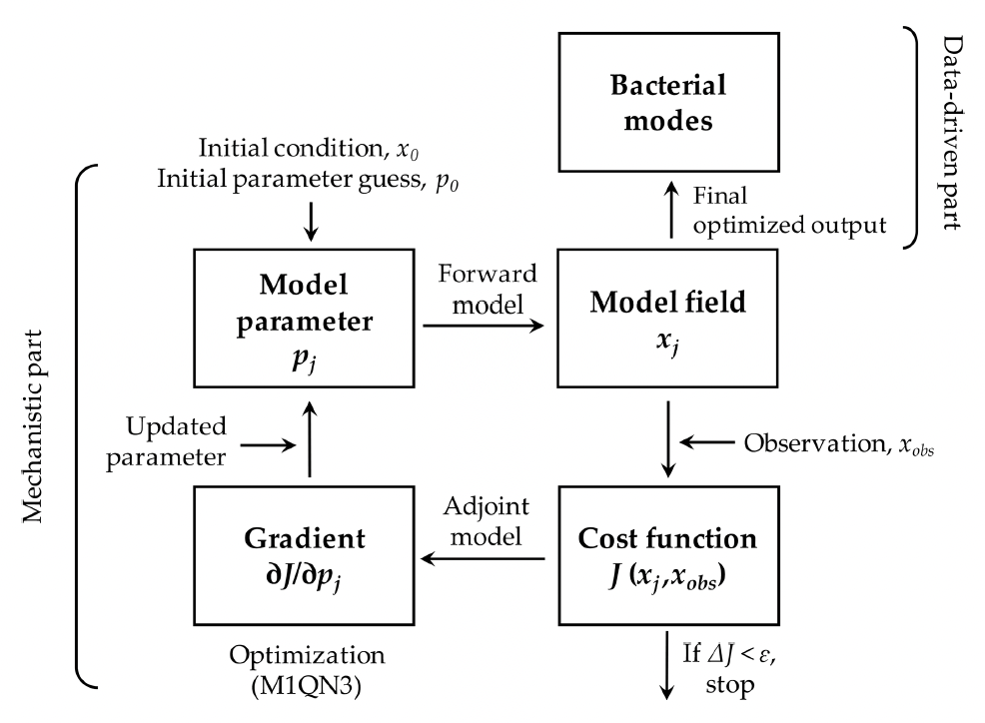
Palmer LTER Modeling
Prognostic 1-D ecosystem model
add bacterial group-specific traits for high versus low nucleic acid bacteria
Kim, H.H., J.S. Bowman, Y.-W. Luo, H.W. Ducklow, O.M. Schofield, D.K. Steinberg, and S.C. Doney, 2022: Modeling polar marine ecosystem functions guided by bacterial physiological and taxonomic traits, Biogeosciences, 19, 117–136

Slide 6
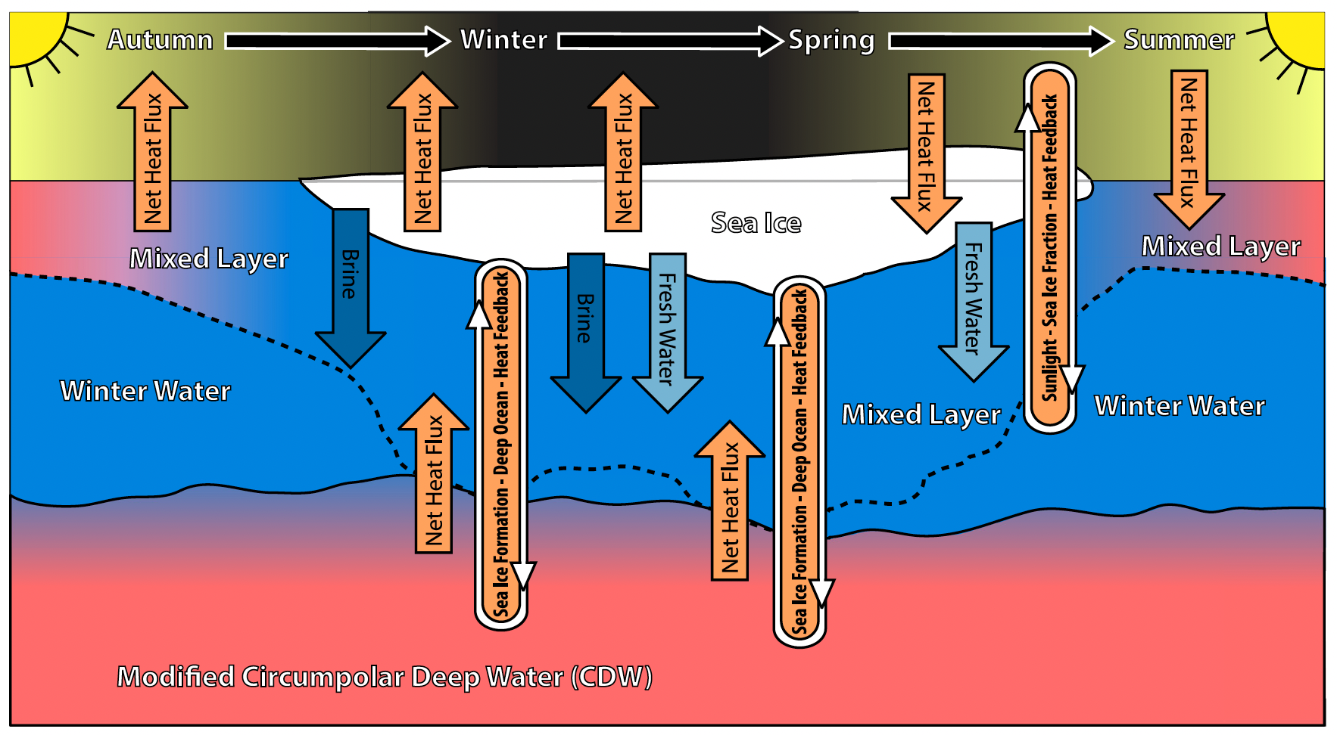
Palmer LTER Modeling
Prognostic 1-D ocean physics & sea ice model dynamics
atmosphere forcing
assimilation of sea-ice extent & sub-surface heat
plankton ecosystem module in testing
Saenz, B.T., D.C. McKee, S.C. Doney, D.G. Martinson, and S.E. Stammerjohn, 2023: Influence of seasonally varying sea-ice concentration and subsurface ocean heat on sea-ice thickness and sea-ice seasonality for a 'warm-shelf' region in Antarctica, J. Glaciology, 69(277), 1466–1482

Slide 7
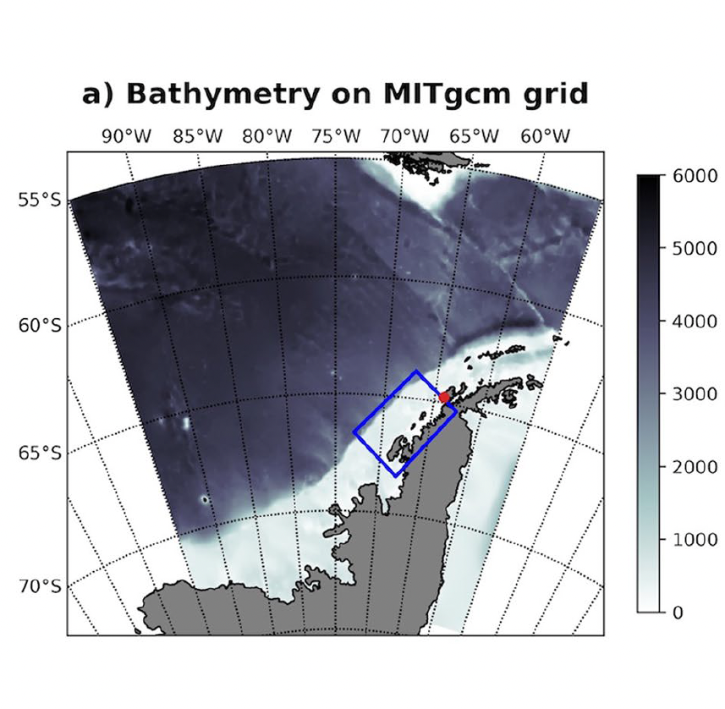
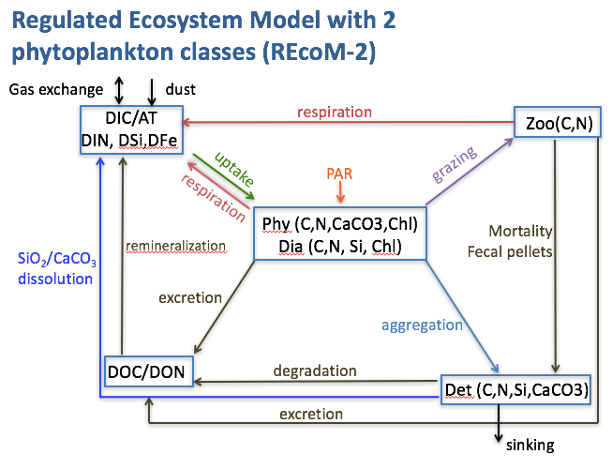
Palmer LTER Modeling
Regional & basin-scale 3-D ocean models
Coupled with biogeochemical module
Ocean physics & sea-ice from MIT ocean general circulation model
Schultz, C., S.C. Doney, J. Hauck, M.T. Kavanaugh, and O. Schofield, 2021: Modeling phytoplankton blooms and inorganic carbon responses to sea-ice variability in the West Antarctic Peninsula (WAP), J. Geophys. Res. Biogeosci., 126, e2020JG006227

Slide 8
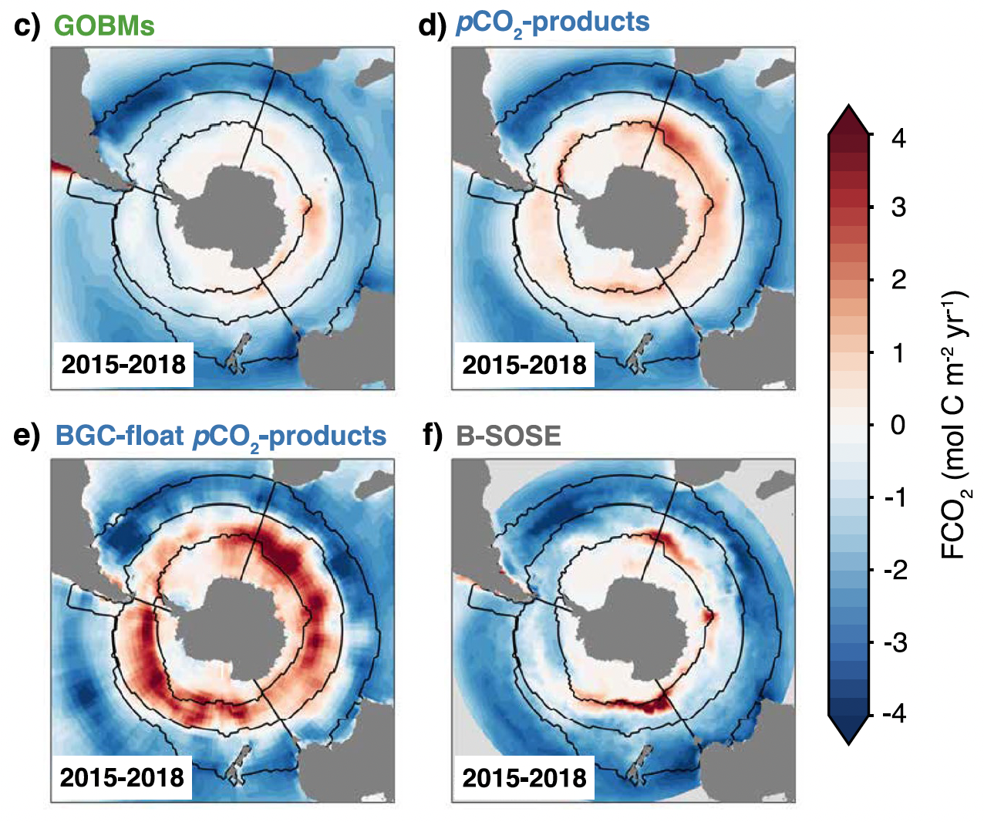
Palmer LTER Modeling
Regional & basin-scale 3-D ocean models
Hauck, J., et al. 2023: The Southern Ocean carbon cycle 1985-2018: mean, seasonal cycle, trends, and storage, Global Biogeochem. Cycles, 37, e2023GB007848

Slide 9
Palmer LTER Modeling
Hierarchy of modeling capabilities for targeted studies with differing model complexity based on science questions
Biology/Ecology
Population & Community
Food-web & Ecosystem
box & 1-D column models
3-D regional & basin ocean models
Biophysics & Biogeochemistry
Time-Space
Scale
Palmer station, trap & mooring time-series
Regional LTER grid
& gliders
Remote sensing & basin-scale

