Slide 1
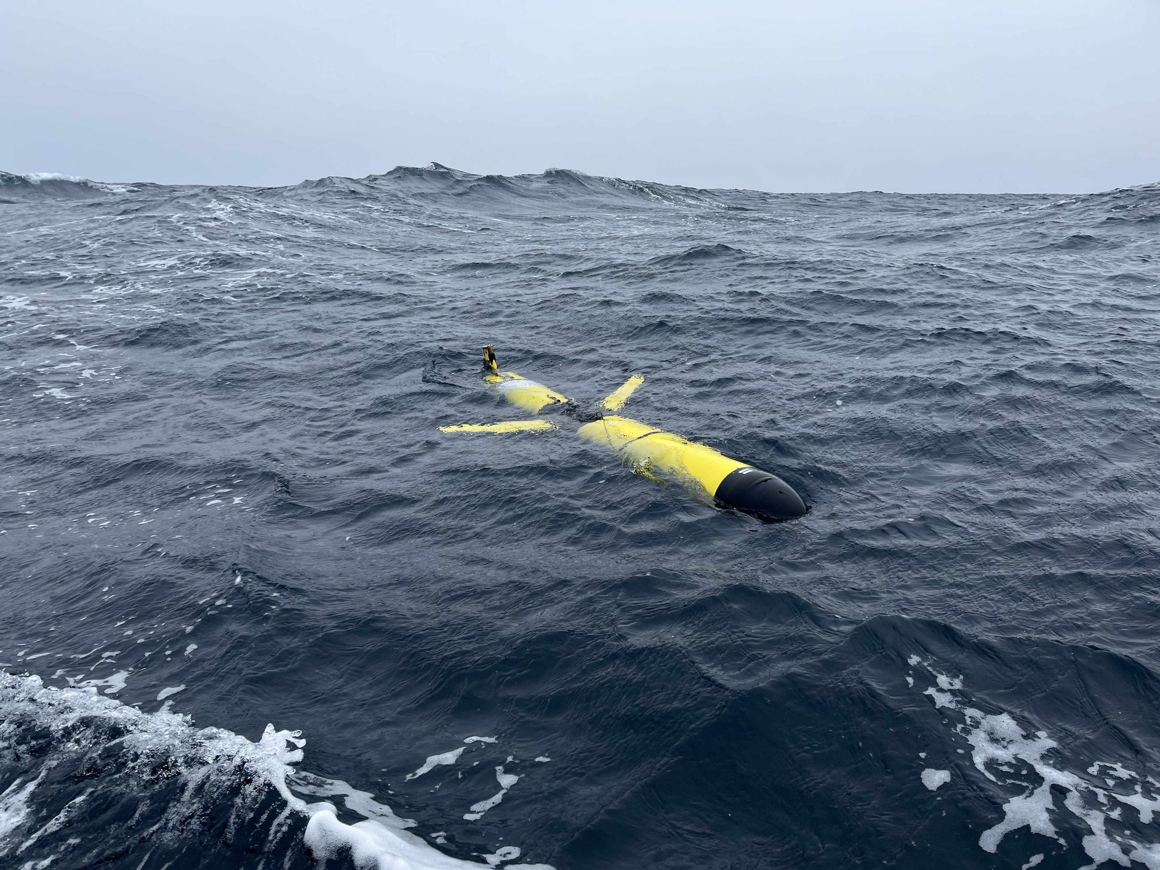


Palmer LTER
Data and Information Management
Palmer LTER
Mid-Term Review 2024

Slide 2

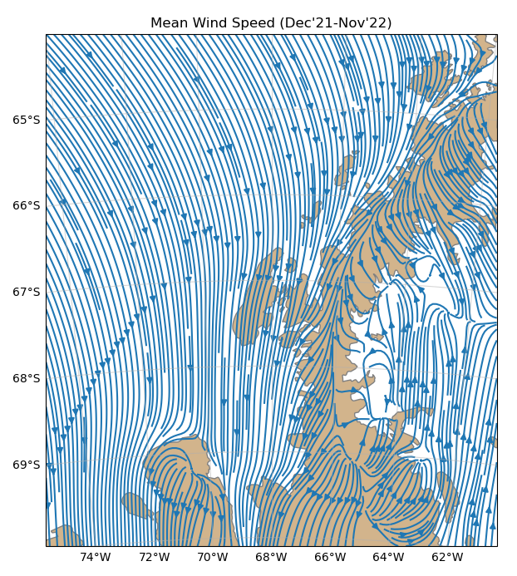
Information Management (IM)
Key Responsibilities
Data Archiving
Website & Communications
Team Database
Journal Database
Data Processing Assistance (when possible)
The PAL IM has 4+1 Key Responsibilities, which includes being a data and metadata evangelist for the PAL Site.

Slide 3
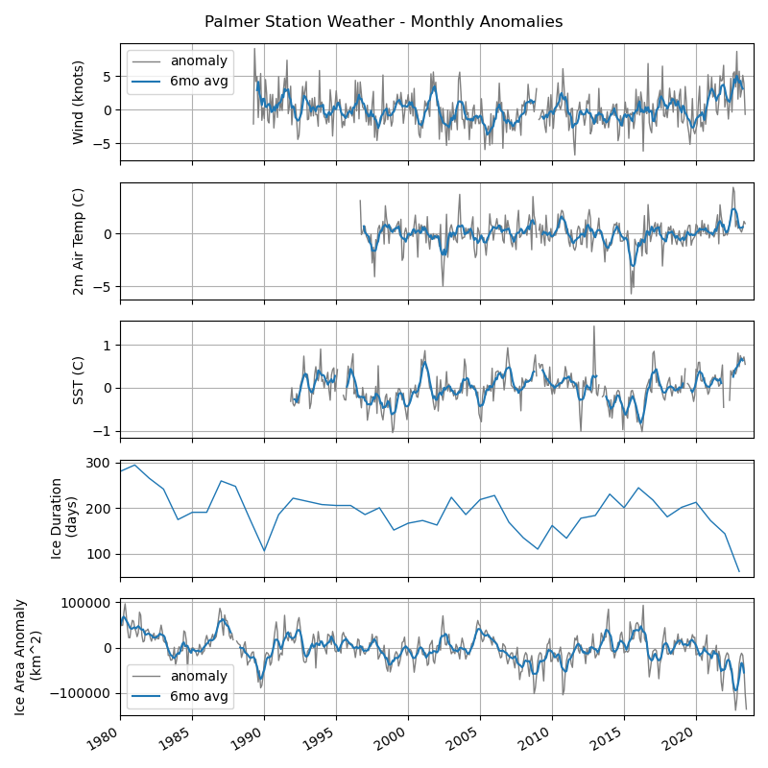
IM Recent Challenges and Goals
Recent Goals
Rebuild the Pipeline
  Take advantage of new tools & formats to improve datasets, metadata, provenance, and team training
  Review and improve data processing workflows and archive formats
Emphasize Data and Metadata QC
  Continually improve metadata
Engage the Team
  New documentation
  1-on-1 Trainings
  Consider new datasets & products
  Promote dataset citations
Recent Challenges
Transition IM to Rutgers
PI Changes
Pandemic Disruptions
  Ship/station availability
  Team workload
PAL IM Vision
To improve the FAIR-ness and timeliness of PAL data by engaging the team more fully in the data management lifecycle.

Slide 4
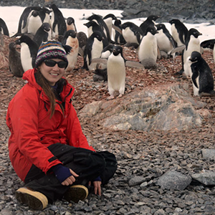
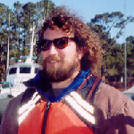

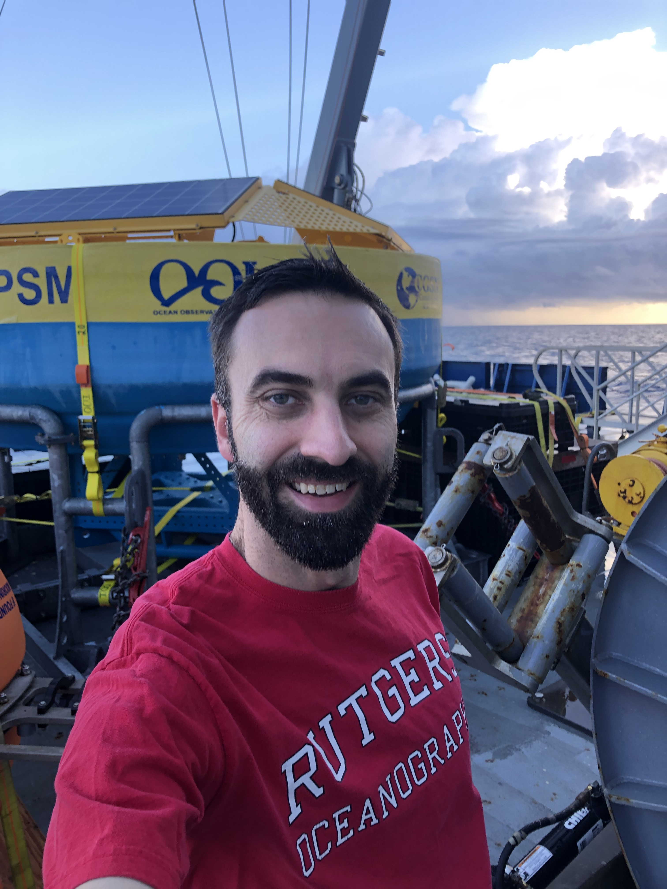
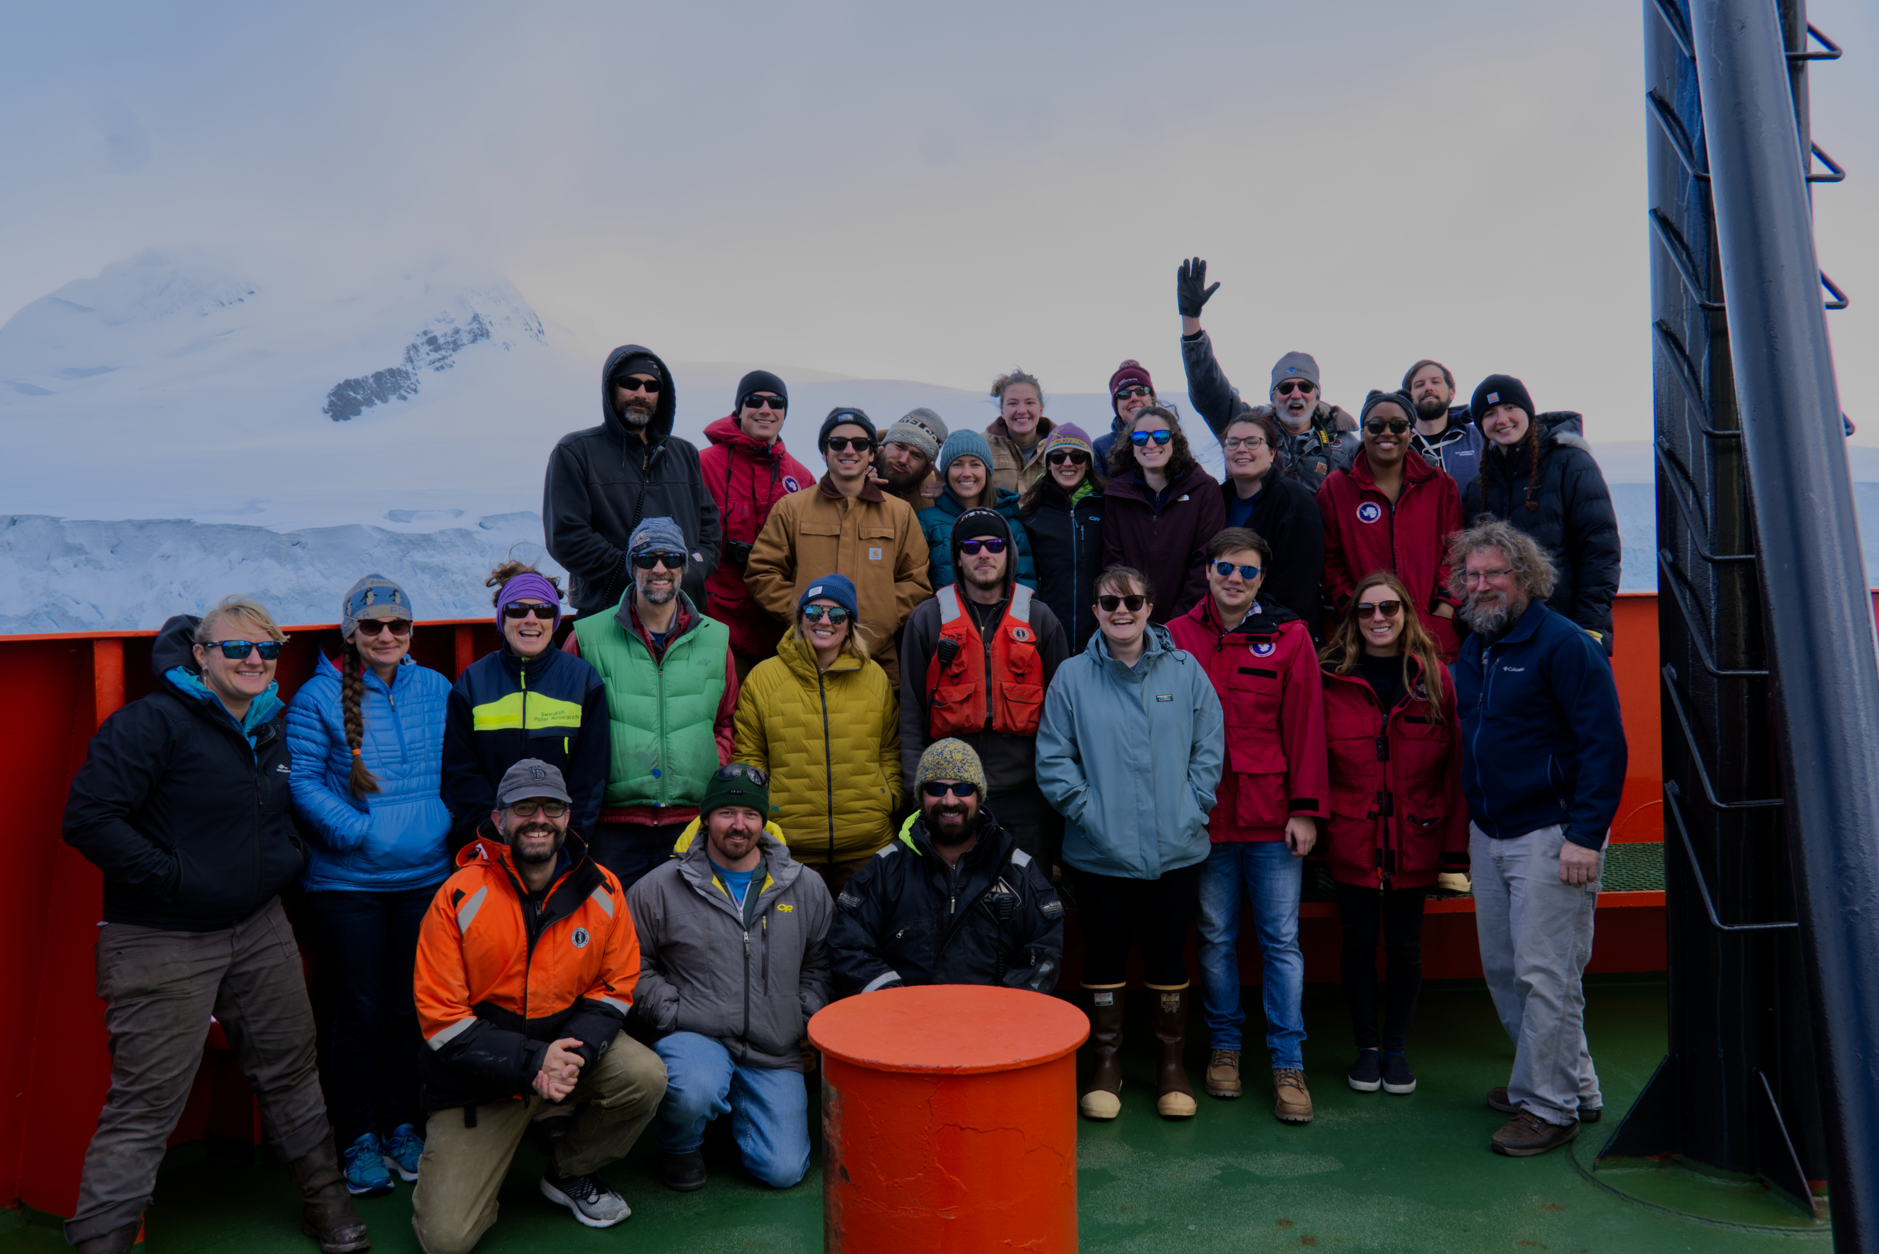
The IM Team
Lead IM
Research Technicians (with DM responsibilities)
Sage Lichtenwalner
Rutgers University
New to the project (and ecology) in 2021
~30% FTE
Background in UX and DM
Nicole Waite
Rutgers University
Phytoplankton
Joe Cope
VIMS
Zooplankton
Ross Nichols
UC Santa Cruz
Cetaceans
+ All other PAL Scientists and Students
Working to promote the value that everyone is responsible for effective data management.
Notes:
I joined the project in late 2021, but really took over in early 2022.
I am currently funded about 1/3 FTE but had some additional institutional support in the first years to help the project transition.
While I’m new to LTER (and ecology) I have been supporting DM and education on several other projects for over 15 years.
But even with all that experience, there are always new people, processes and tools to learn, which has been an exciting part about joining the project.

Slide 5
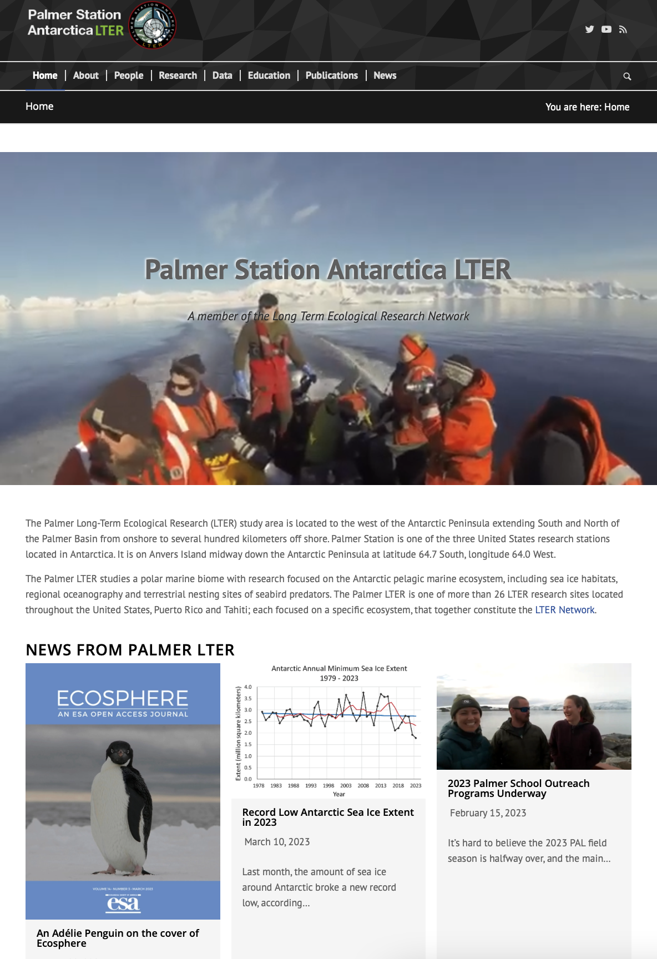
Website & Communications
Key Features and Accomplishments
Rebuilt in WordPress w/ updated theme
  Engaged team in content updates (ongoing)
New Dataset catalog
  Pulls directly from EDI
  Cruise List links to Rolling Deck to Repository (R2R)
  Building list of related/partner datasets
New Publications catalog
  Pulls directly from Zotero
Rebuilt People directories
Occasional news / blog updates
New IM Guides

Slide 6
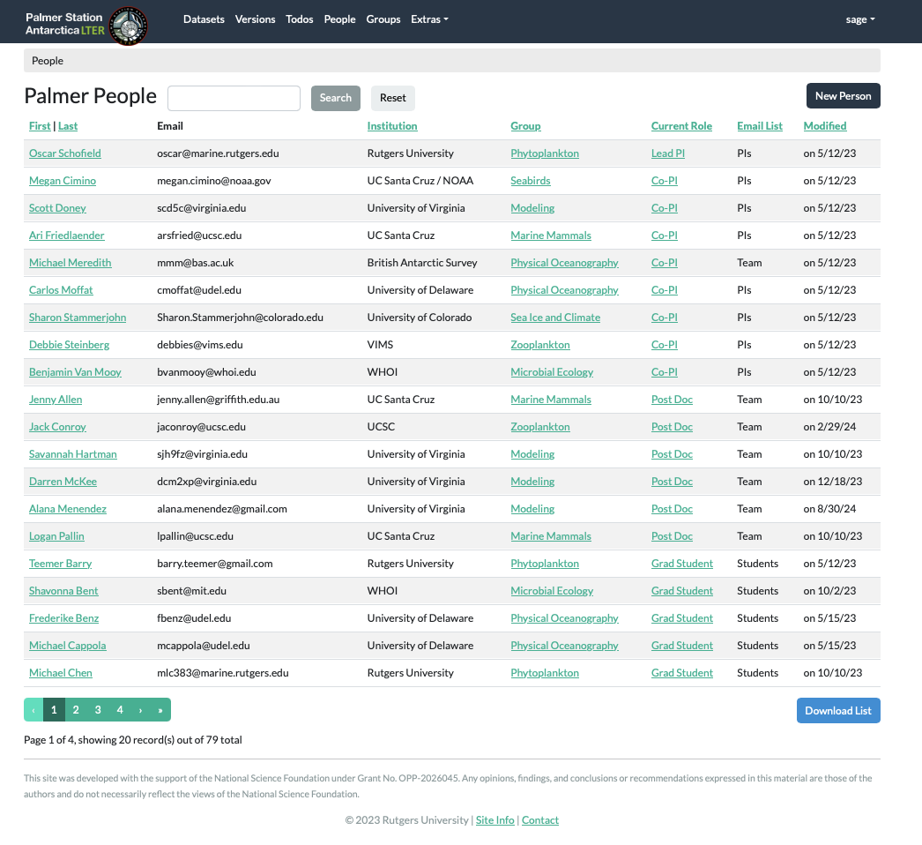
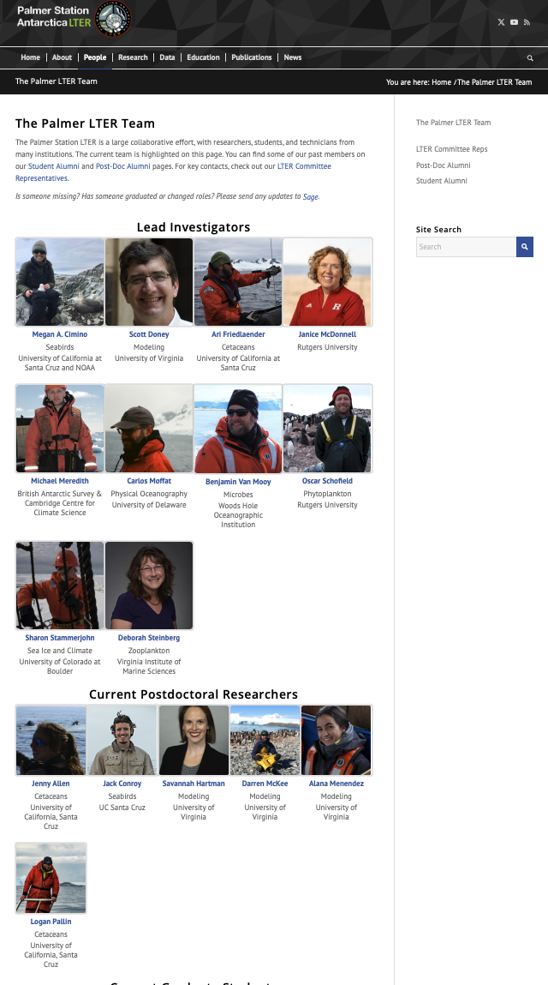
Team Database
Key Features and Accomplishments
Developed a new database to maintain team history
  Recompiled our team list from several outdated databases
  Synchronized with LNO
Rebuilt team and alumni pages on website
Setup a team Slack channel
Setup 4 new Mailman mailing lists
  PIs, Students, Team, Friends
  Custom database export makes updates easy
Team Database
Website
Mailman
Slack

Slide 7
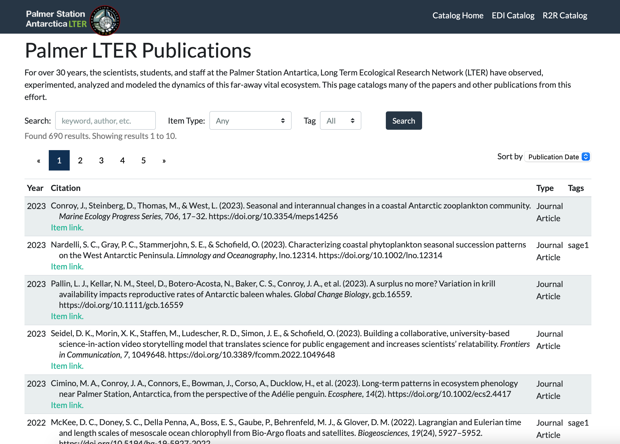
Publications Database
Key Features and Accomplishments
Migrated all pubs to Zotero
  Currently 742 total
New website catalog
  Pulls directly from Zotero
  Adapted from BLE Zotero-JavaScript-Search-Client tool
  Recent publications are tagged by research group for easy filtering
Backfilled online archive of cruise reports, station reports, and proposals

Slide 8
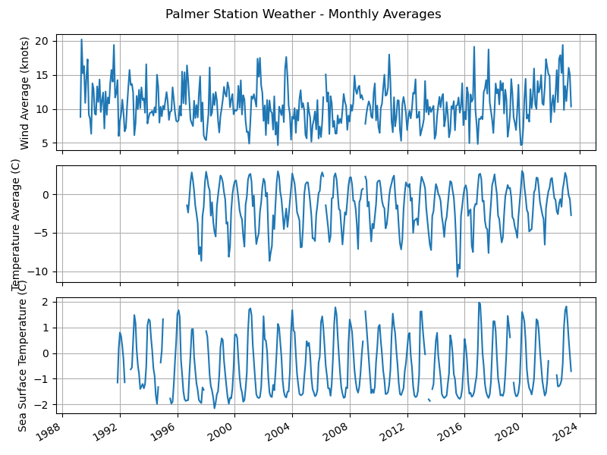
Data Archiving & Analysis
Key Features and Accomplishments
IM Transition
Data Lifecycle / New Pipeline
New processing, data formats, & QC workflows
Extensive QC effort on Palmer Station datasets, and others
Team Training & ezEML Usage
Status / Backlog Improvement

Slide 9



Data Management Transition
Zoo Pluses / Minuses
Zoo included data & metadata (+)
Limited data review support (-)
Older tech stack (-)
New Workflow Pluses / Minuses
Forces dataset review (+)
Mostly manual update process (-)
Harder to share md across datasets (?)
Still no hand-spun XML!* (+++)
* Except for special cases like provenance and citations
Cruise & Station Instrument Data
Data Zoo
(data + metadata)
EDI
Old
Workflow
Mostly IM Required
Cruise & Station Instrument Data
Compiled Data files
(data)
ezEML
(metadata)
EDI
Current
Workflow
Students & Techs can now play a bigger role in creating and updating datasets!

Slide 10
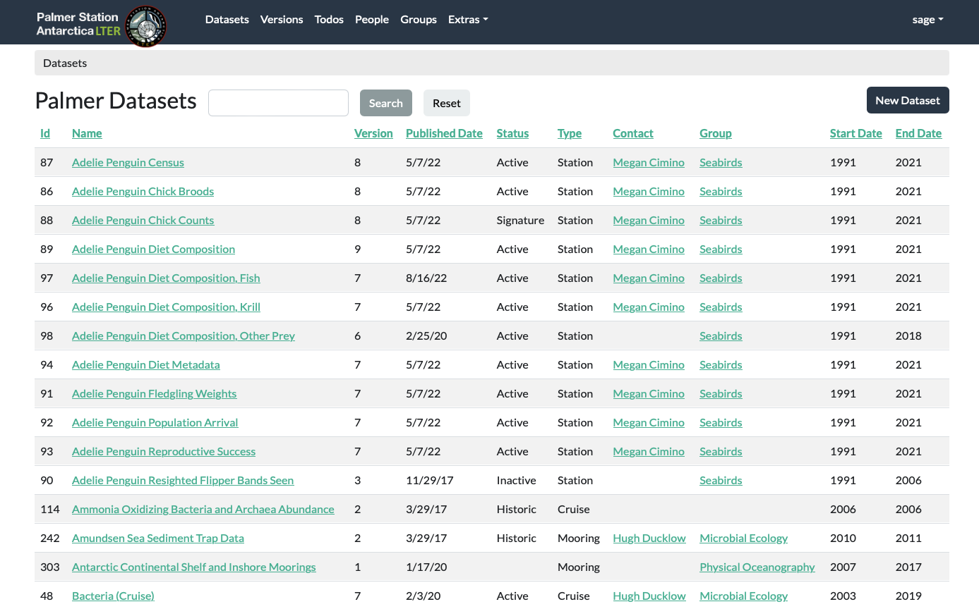
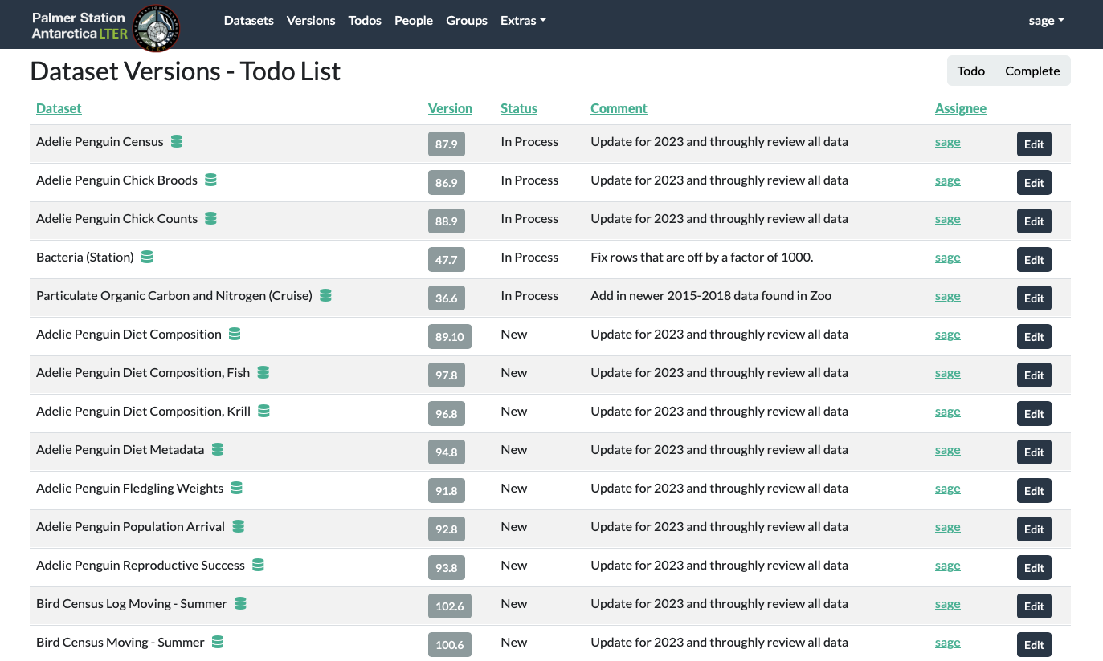
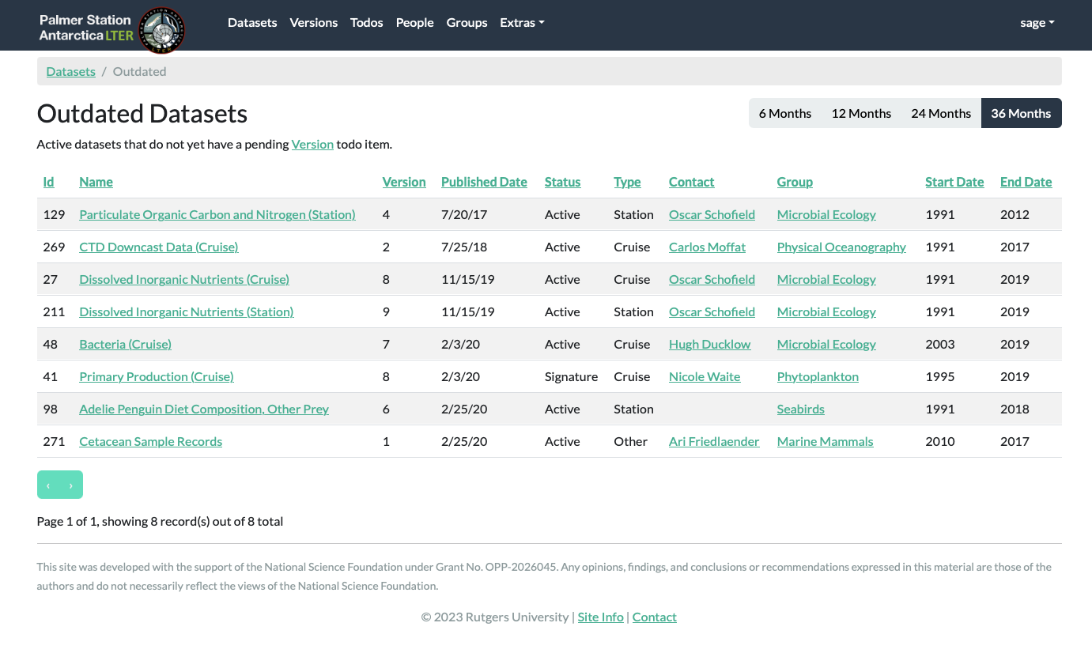
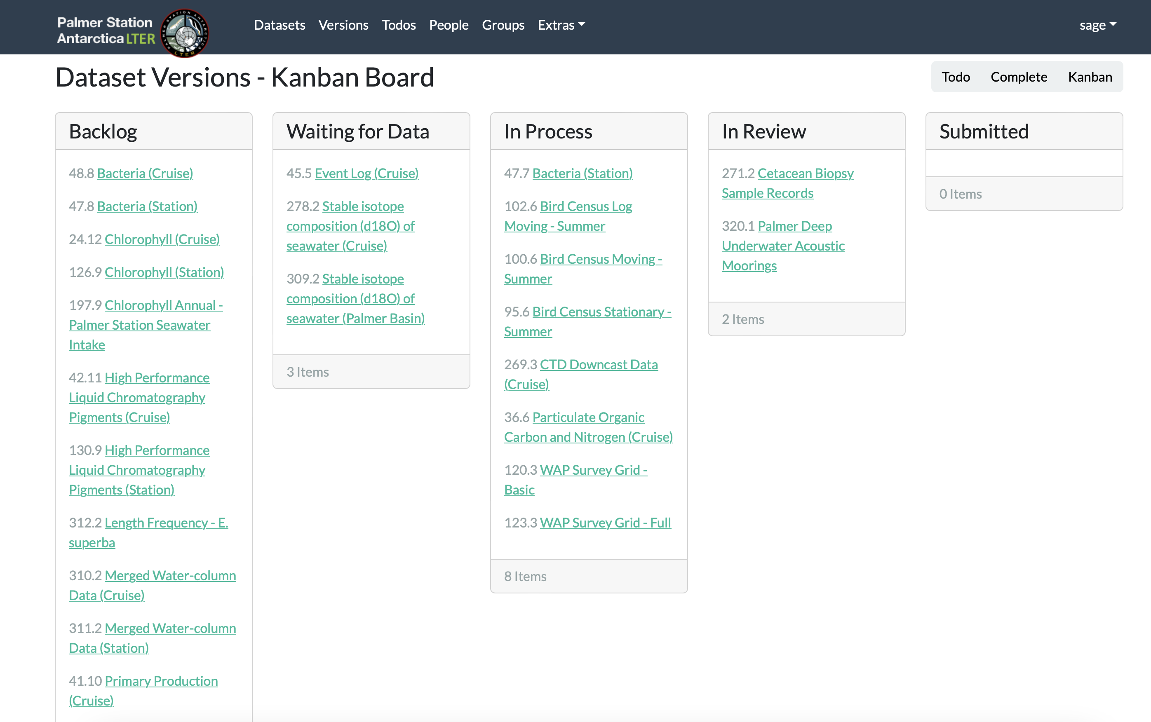
Tracking Datasets & Personnel (IM Database)
Dataset Update Tracking
Tracking workflow/versions
Dataset Aggregation & QC
Metadata Compilation
Publishing

Slide 11
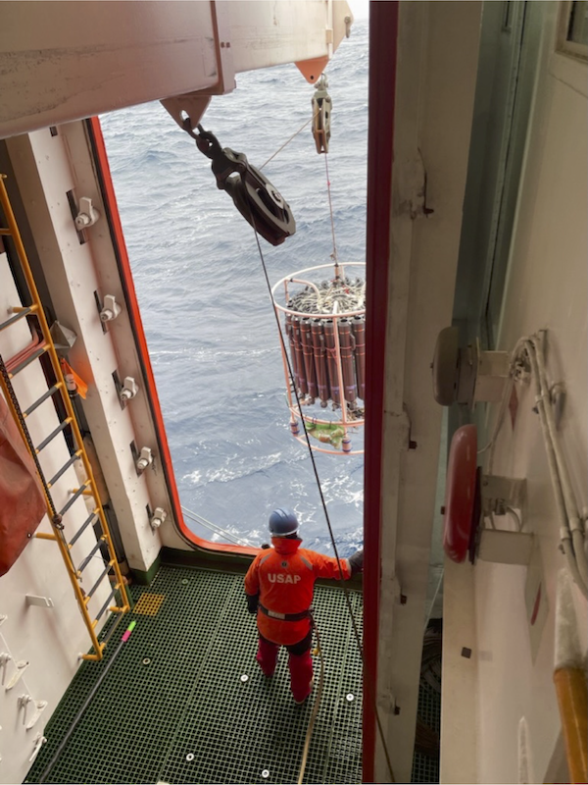
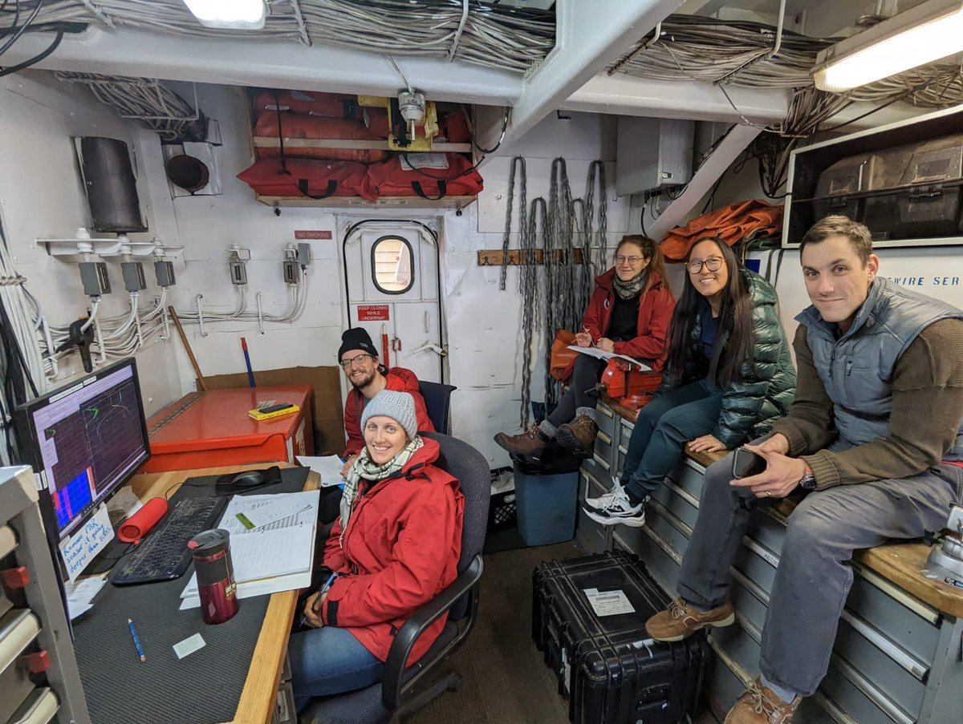
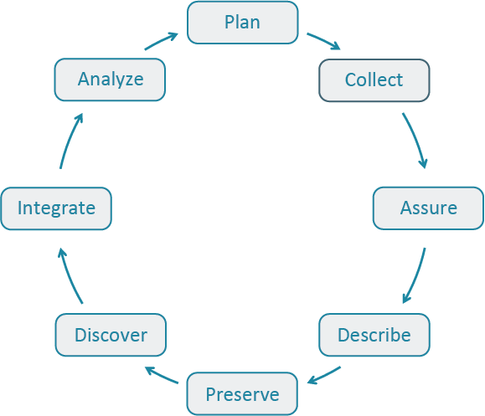

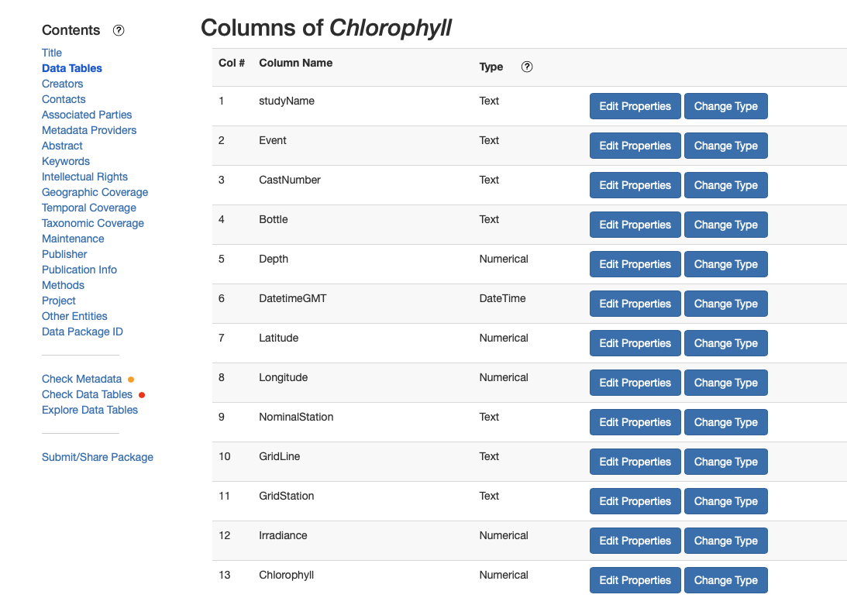

Data Lifecycle
Data One’s
Data Management
Lifecycle

Slide 12
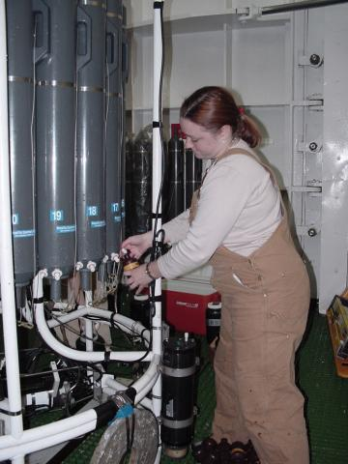
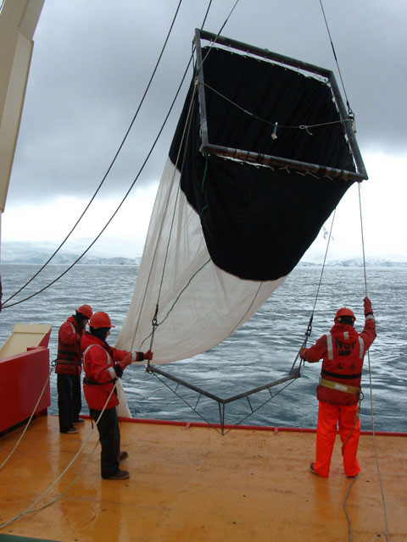
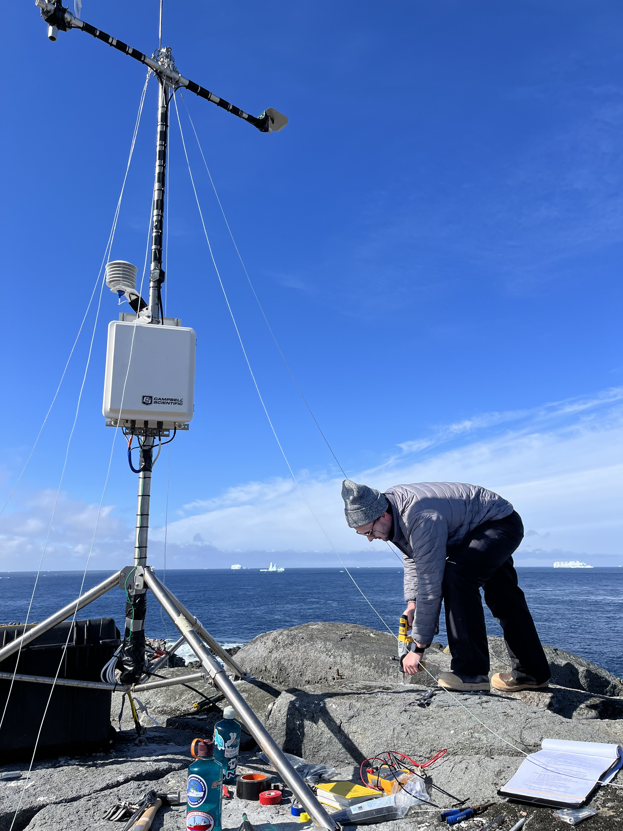

1. Collect: Data & Sample Collection
Field Data
PAL Cruise Data
PAL Station Data (field season)
Ship Data (R2R)
Station Data (contractors)
Instruments
Bottle samples
for 1-time
processing
Preserved
Samples
Raw data and sample collection, storage, and QC is generally the responsibility of individual labs or contractors.
In addition, Rutgers stores a copy of the communal ship/station directory in our well-backed-up local IT infrastructure and is moving some archives to Box.
A central long-term raw data storage is being considered.

Slide 13
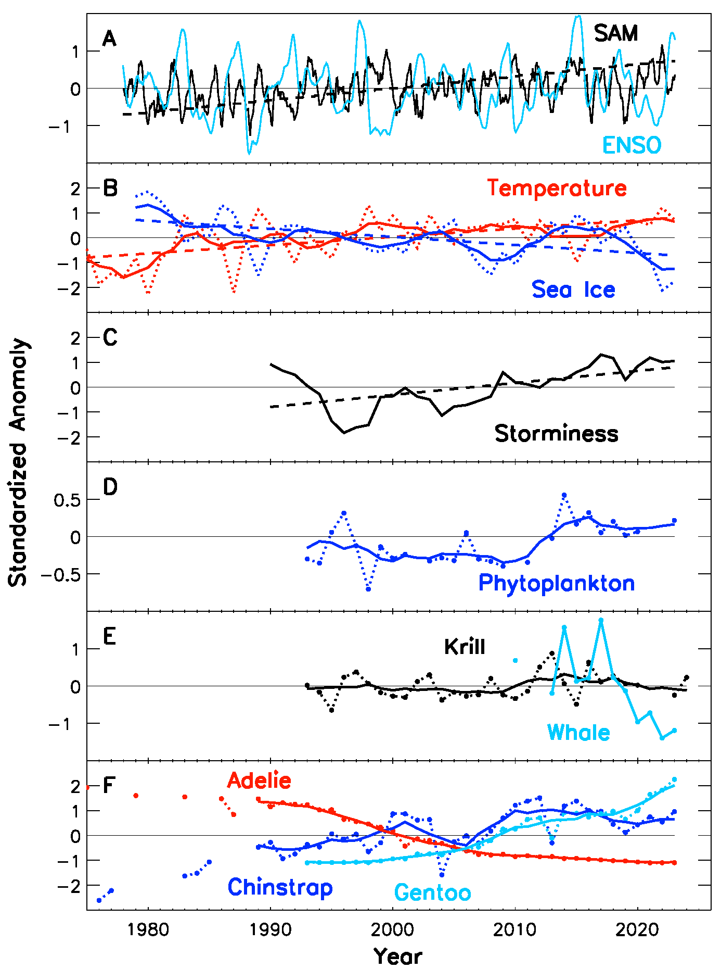
Core Datasets
ID | DATASET | VERSION | PUB. DATE | TYPE | GROUP | DATE RANGE
88 | Adelie Penguin Chick Counts | 9 | 10/3/24 | Station | Seabirds | 1991-2024
24 | Chlorophyll (Cruise) | 11 | 2/8/22 | Cruise | Phytoplankton | 1991-2020
28 | Palmer Station Weather – Daily Averages | 10 | 6/27/24 | Station | Physical Oceanography | 1989-2024
41 | Primary Production (Cruise) | 9 | 4/25/24 | Cruise | Phytoplankton | 1995-2023
49 | Sea Ice – Annual Averages | 8 | 8/16/24 | Other | Sea Ice and Climate | 1979-2023
34 | Sea Ice – Monthly Averages | 9 | 8/16/24 | Other | Sea Ice and Climate | 1978-2024
199 | Zooplankton Density – Current | 10 | 10/22/24 | Cruise | Zooplankton | 2009-2023
“Signature” datasets are those the program has committed to maintaining long-term.
Most “active” datasets are key to current research and are core to the program, with the hope of maintaining them as longs as possible.
Short-term and experimental projects are also archived, but not matinatined.

Slide 14









Palmer LTER Data Processing Workflow
Research Data
Raw Archives
Cruise Data (team)
Local Logs & Instrument Files
EDI Data Archive
Create or Update Metadata (ezEML)
List retrieved by API. Users pointed to EDI DOI for download.
Station Data (team)
Local Logs & Instrument Files
Reviewed
and Published
by IM
Data Users
(Research & Education)
Responsibility of Research Groups
Processed Datasets (CSV, NetCDF*)
PAL Website Catalog
Officially archived datasets, e.g. for publication
Ship Data (contractor)
R2R
Research teams and IM collaborate on data and metadata via email, GitHub, and ezEML
Station Data (contractor)
AMRDC
Documented scripts are used to reformat, merge, and clean raw data to standard formats
Scripts will pull new versions from EDI to Erddap (future)
Local ERDDAP Server
Custom dataset downloads and graphing
Responsibility of USAP Contractors
*NetCDF provides support for larger, multi-dimensional, and integrated datasets

Slide 15
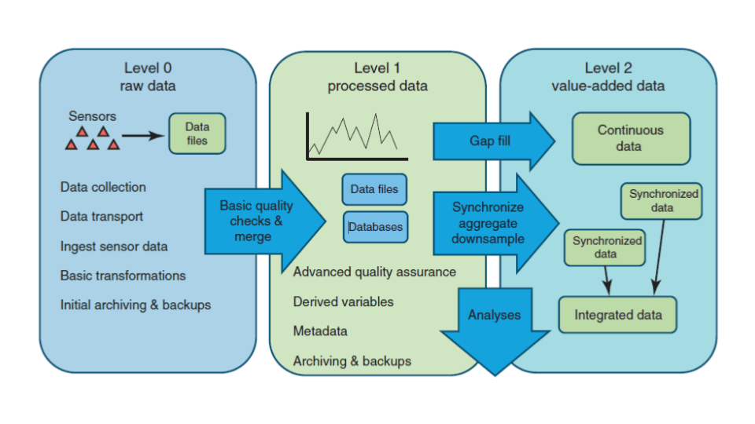
Data Processing Case Studies
Group | Raw Data | Processed | Metadata | Archive
Weather & Ship | Station (AMRDC) & Ship (R2R) | GitHub (IM) | ezEML (IM) | EDI (IM)
Sea Ice | Satellite (external) | Recently change to flat CSV (PI created) | ezEML (IM/PI) | EDI (IM)
Phyto / Zoo / Microbes | Samples & Files (team) | Complete CSV (team provided) | ezEML (team) | EDI (IM)
Seabirds | Log records (team) | GitHub (IM) | ezEML (IM) | EDI (IM)
Marine Mammals | Database & Media files | DB export to CSV (team provided) | ezEML (team) | EDI (IM)
Modeling | Code, Docs, Input data | Output data | Zenodo (team) | Zenodo (team)
Physical Oceanography | Instrument / Matlab Files | Previously CSV, moving to NetCDF | ezEML (team/IM) | EDI (soon)
From EDI

Slide 16
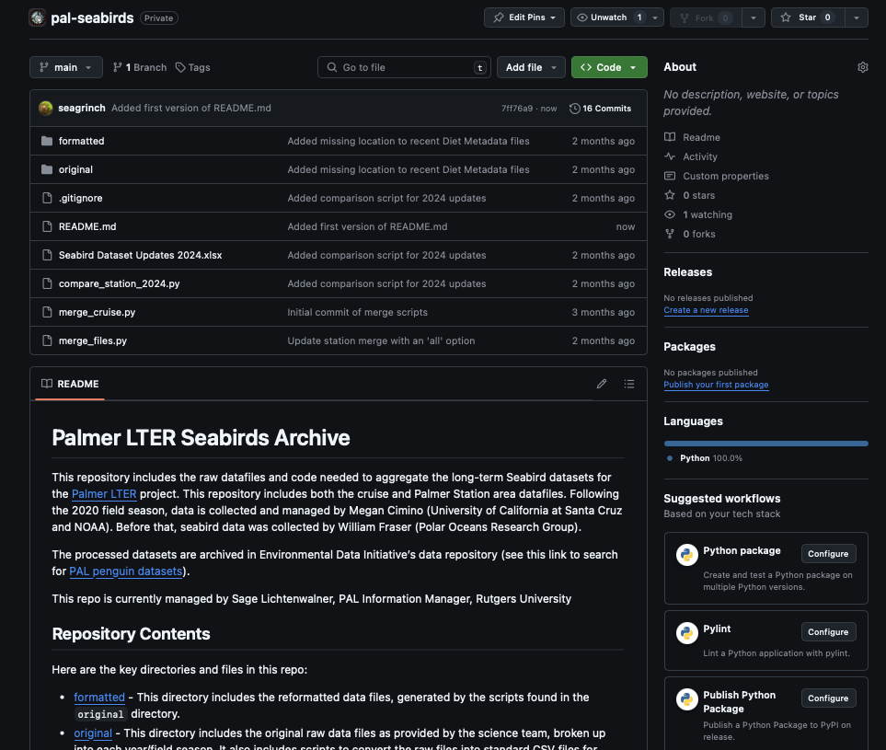
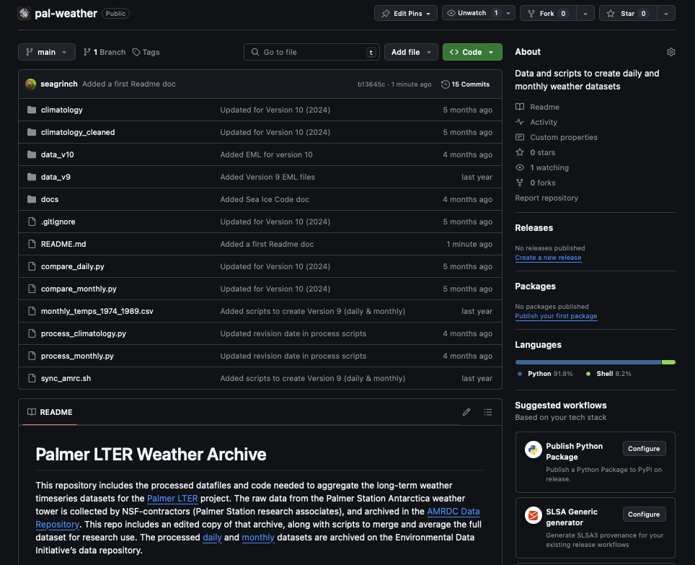
GitHub repos for Intermediate Processing
Great for smaller datasets
Version control of original, processed/cleaned, and merged files.
Also version control of scripts needed to clean, process, and aggregate datasets.
Documentation is stored alongside files, along with who did what.

Slide 17
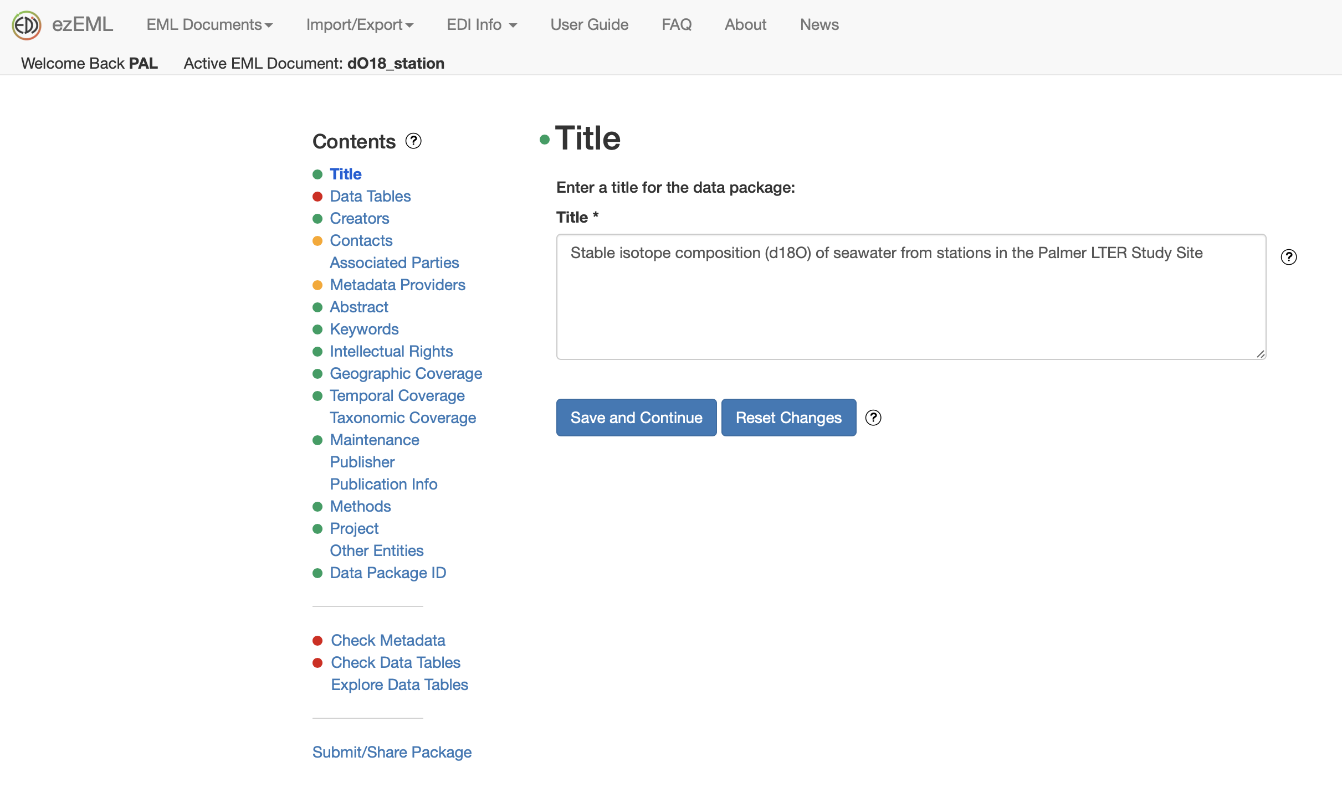
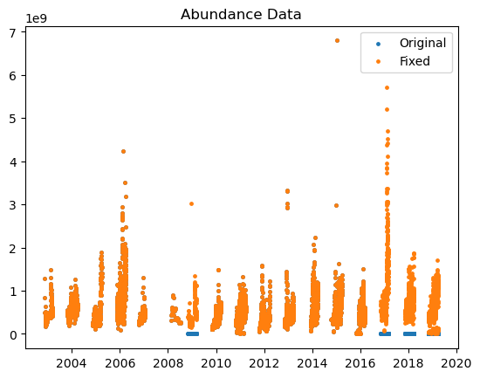
2. Assure: Metadata & Data QC
Major focus of last year
ezEML has been invaluable
  Status icons show issues
  Check Metadata (finds errors)
  Check Data Tables (applies QC)
  Data Explorer (for quick previews)
Assisted with major review of station datasets
  weather, water wall, & snow stakes
Dataset QC fixes as needed

Slide 18
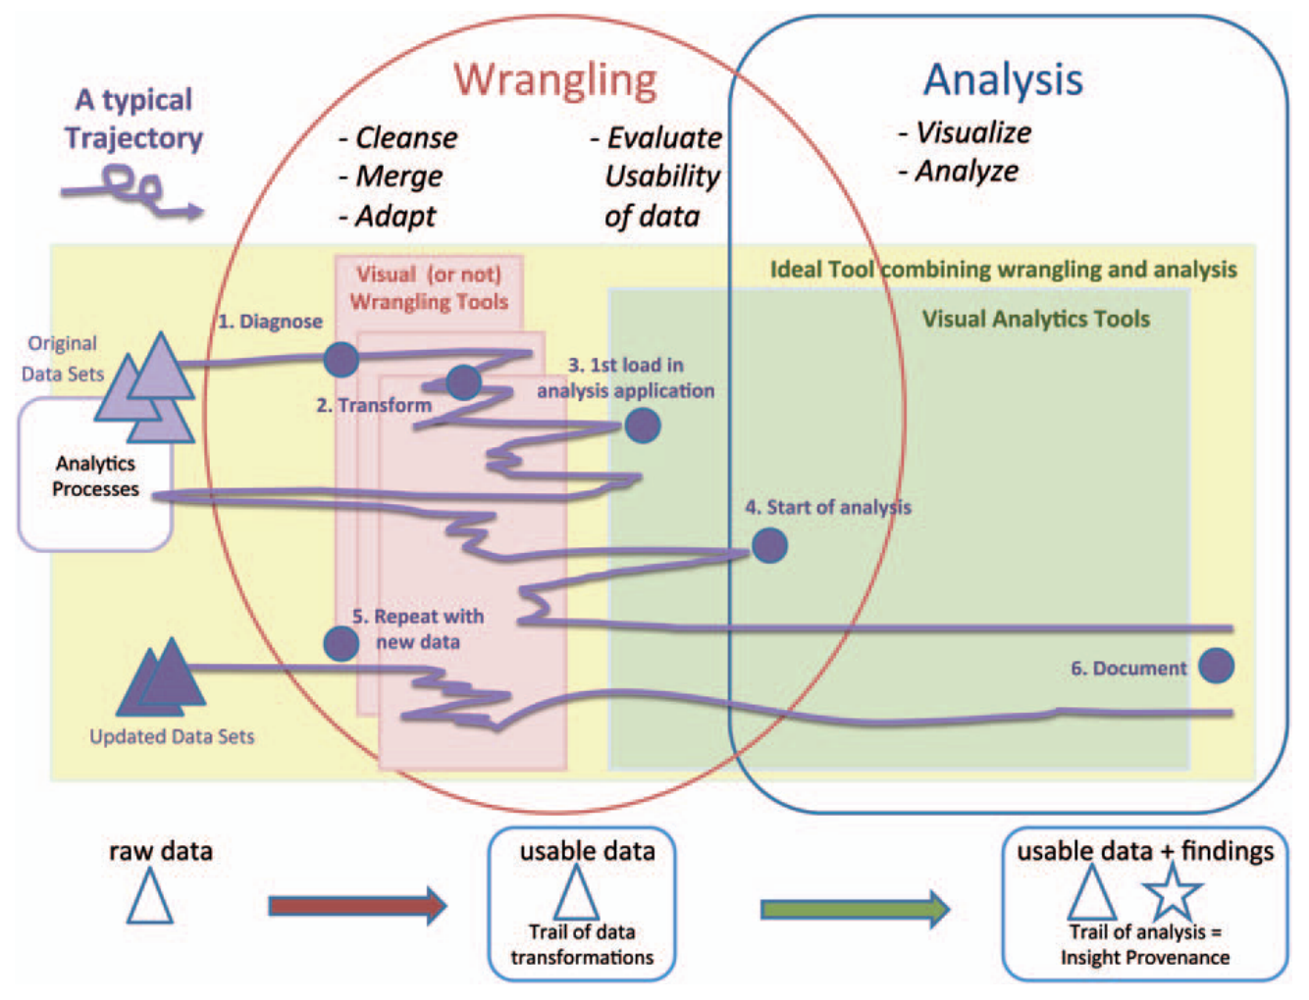
Cleaning Data
A ”linear” process?
Kandel, S., et al (2011), Research directions in data wrangling: Visualizations and transformations for usable and credible data, Inf. Vis., 10(4), 271–288.

Slide 19
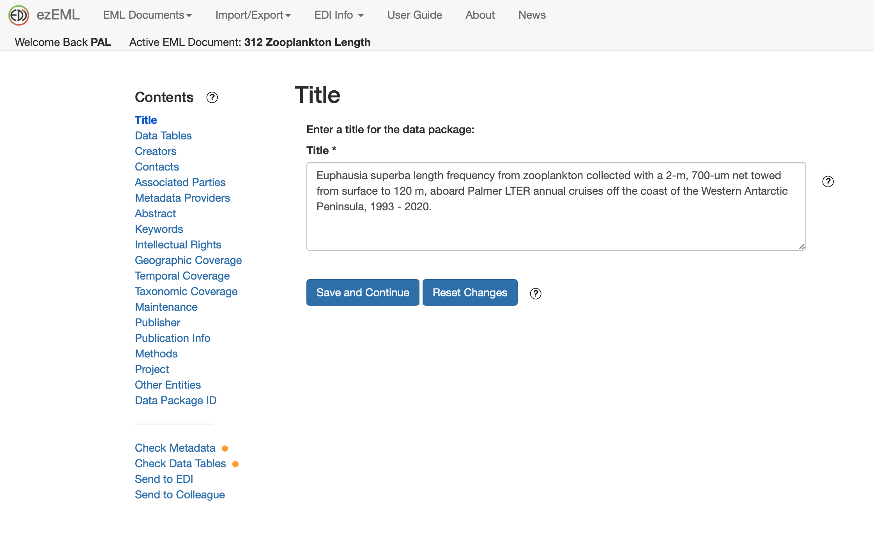
3. Describe: Data and Metadata Formats
Metadata
Moved to ezEML for almost all metadata management of active datasets
Created an EML Template to facilitate team creation.
Data Formats
Most datasets are still in CSV
New standard formats are under consideration
  Darwin Core (biological diversity)
  CF Metadata Conventions (netCDF)
  NCEI Templates (netCDF)

Slide 20
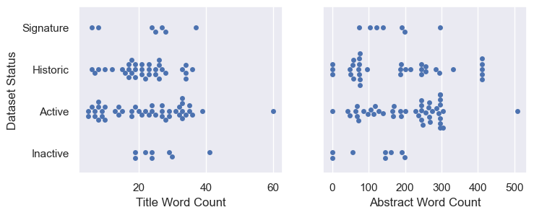
EML Metadata Improvements
When updating or creating a dataset, pay special attention to:
Title: Update with new date range
Abstract: Update as appropriate
Methods: Most datasets need improvement
  Additional Docs/Pdfs or citations can be included in a dataset package
  Reference citations should be added too
Datasets: Doublecheck data file column names, descriptions, and units
  Categorical columns should have categories defined
  Date/Time columns must follow a consistent format (e.g. yyyy-mm-dd or hh:mm)
  Doublecheck Lat/Lon and Grid/Line columns for format or range errors
Newer metadata fields we have focused on adding:
Provenance: Used for a few derived datasets
Taxonomy: New field!
Geographic Coverage: Default Cruise/Station areas
Maintenance: Started using this to include version changes
People: Added ORCIDs
Project: Added standardized project and funding info

Slide 21
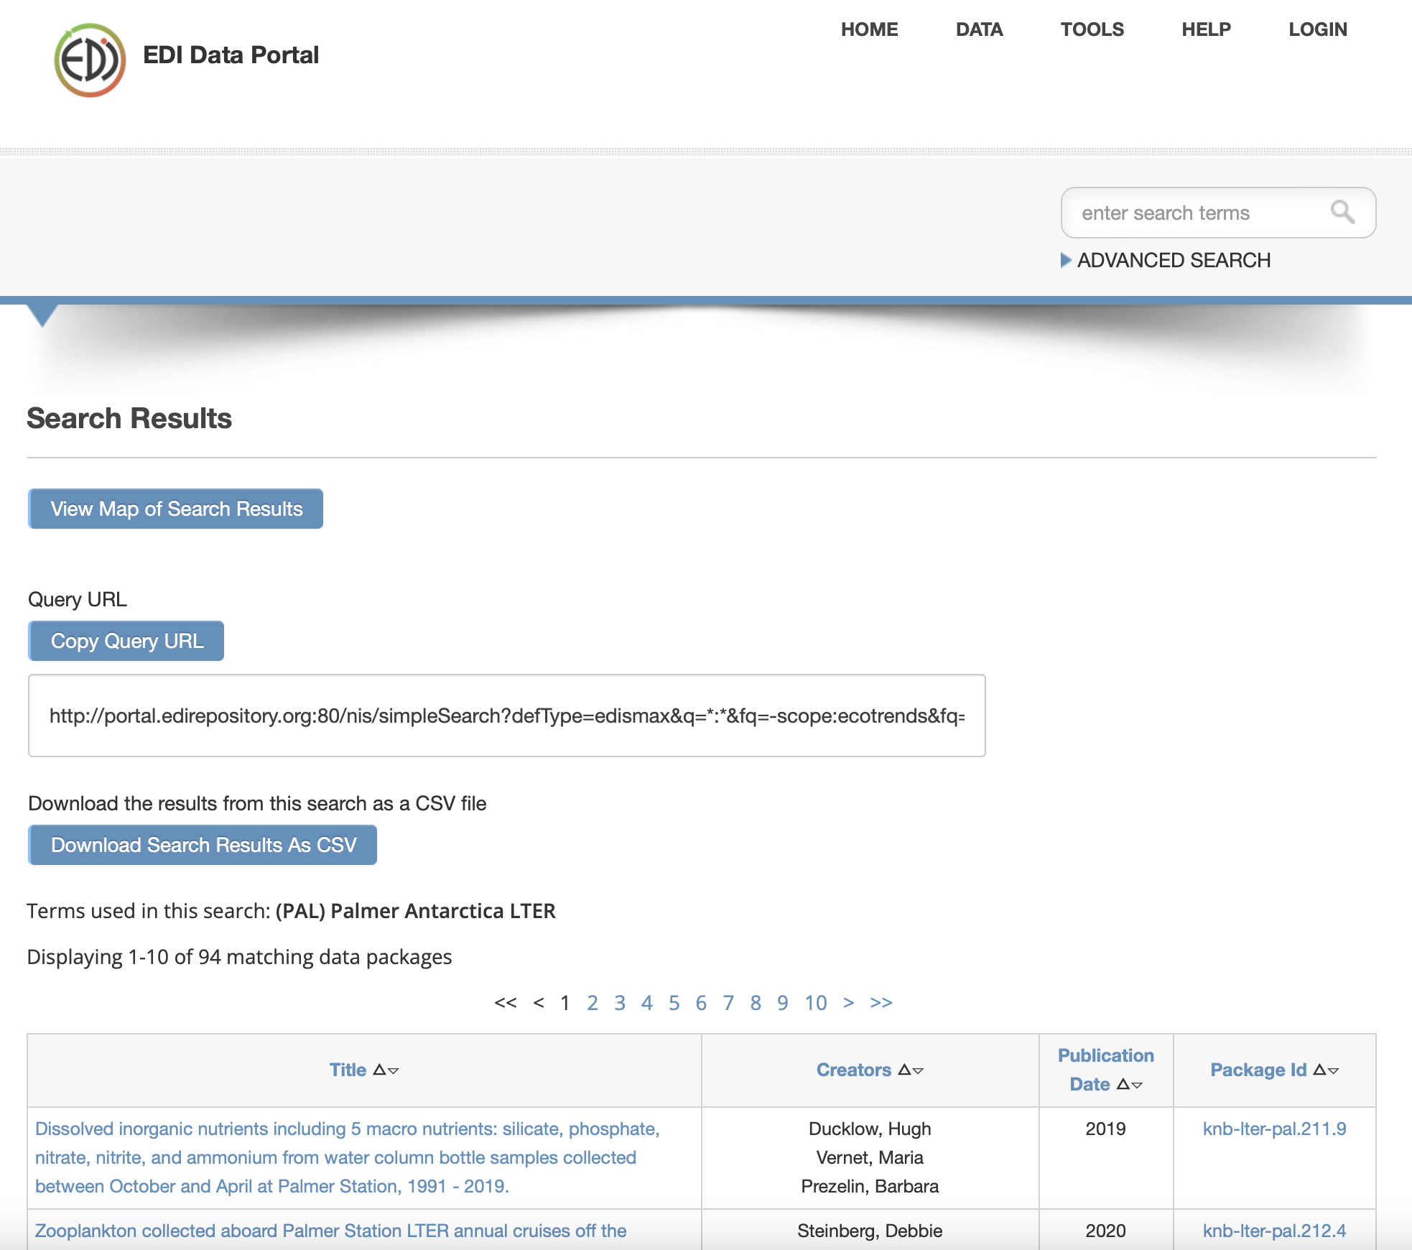
4. Preserve: Where can my data be archived?
Most datasets can be archived with EDI, using EML.
  CSV files with 100K+ rows or over 100MB are not ideal. We should either break them up or use another format like NetCDF.
  Other file formats (e.g. netcdf, zip of images, pdfs, code notebooks etc.) are also possible.
Specialty datasets (e.g. gliders, genomic) will likely have other homes.
Large datasets (e.g. models, imagery) are TBD.
  EDI can host files up to 500MB, but there may be more appropriate places.

Slide 22
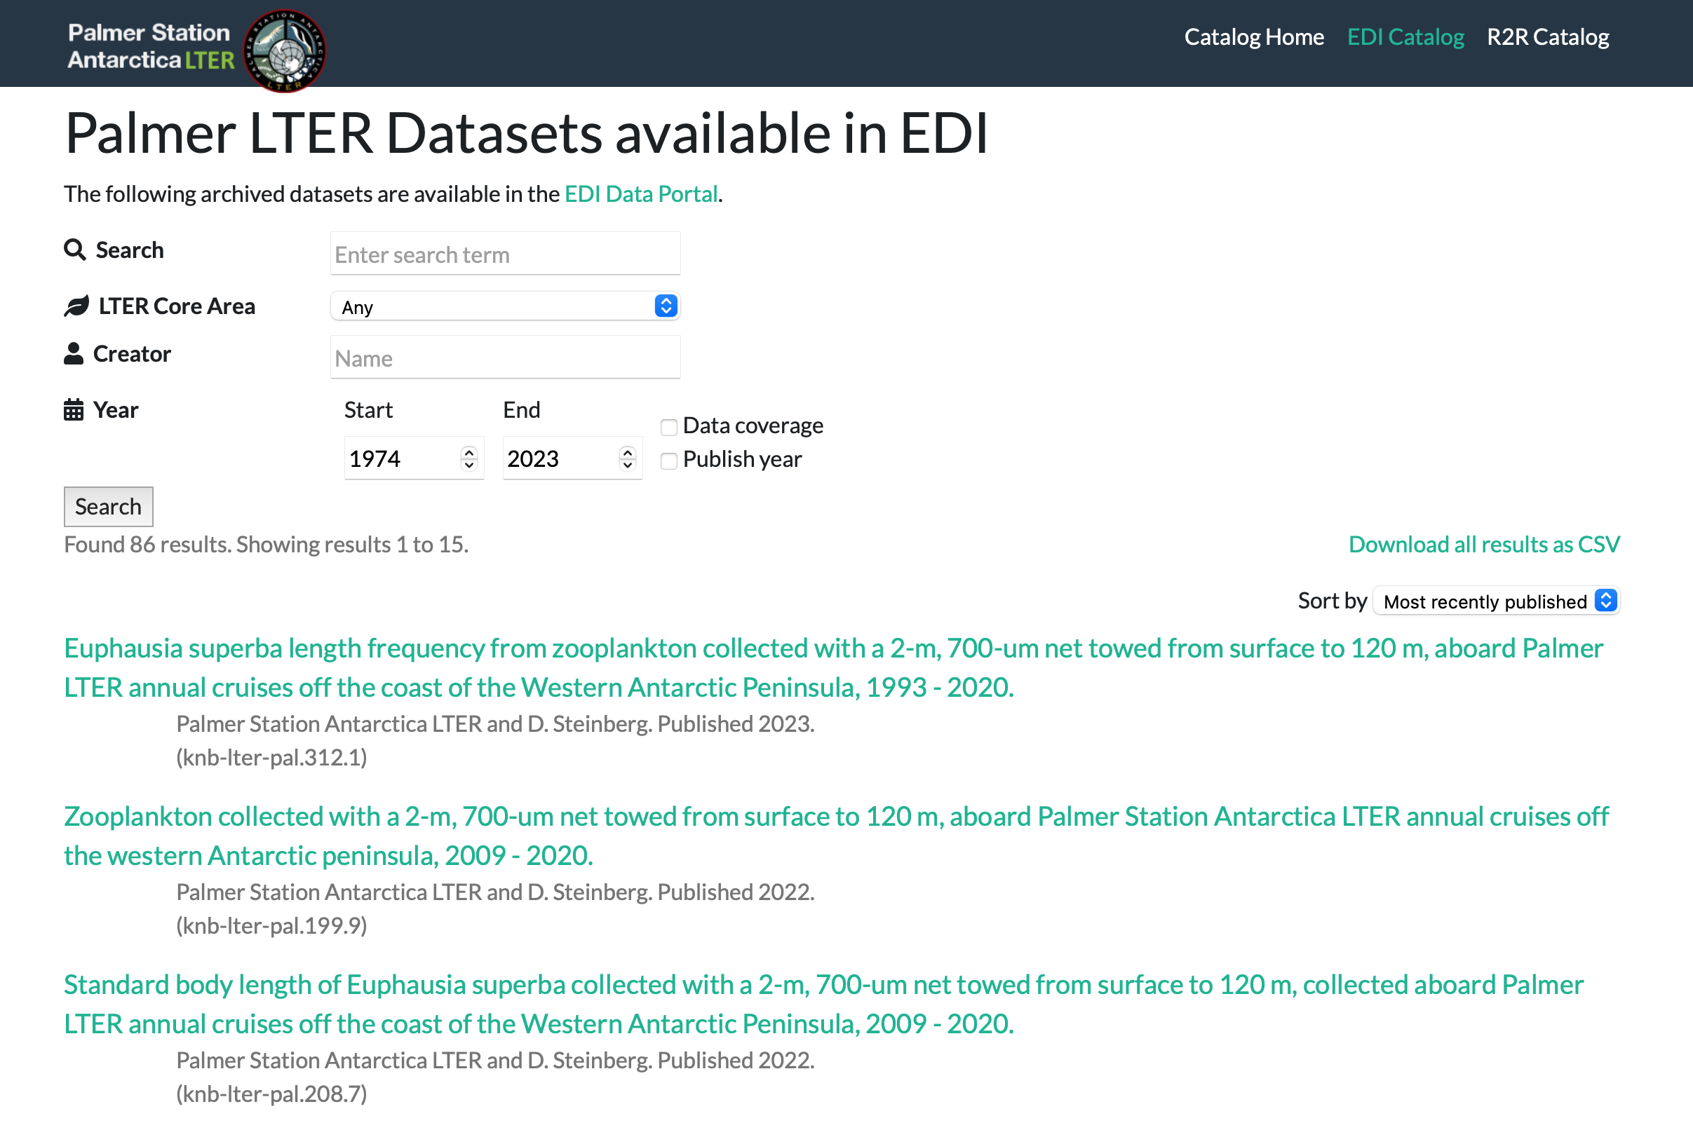
5. Discover
New Webpage Catalog
  Based on BLE Pasta-JavaScript-Search-Client tool
Updated Usage Policy
  Moving datasets to CC-By as they are updated

Slide 23
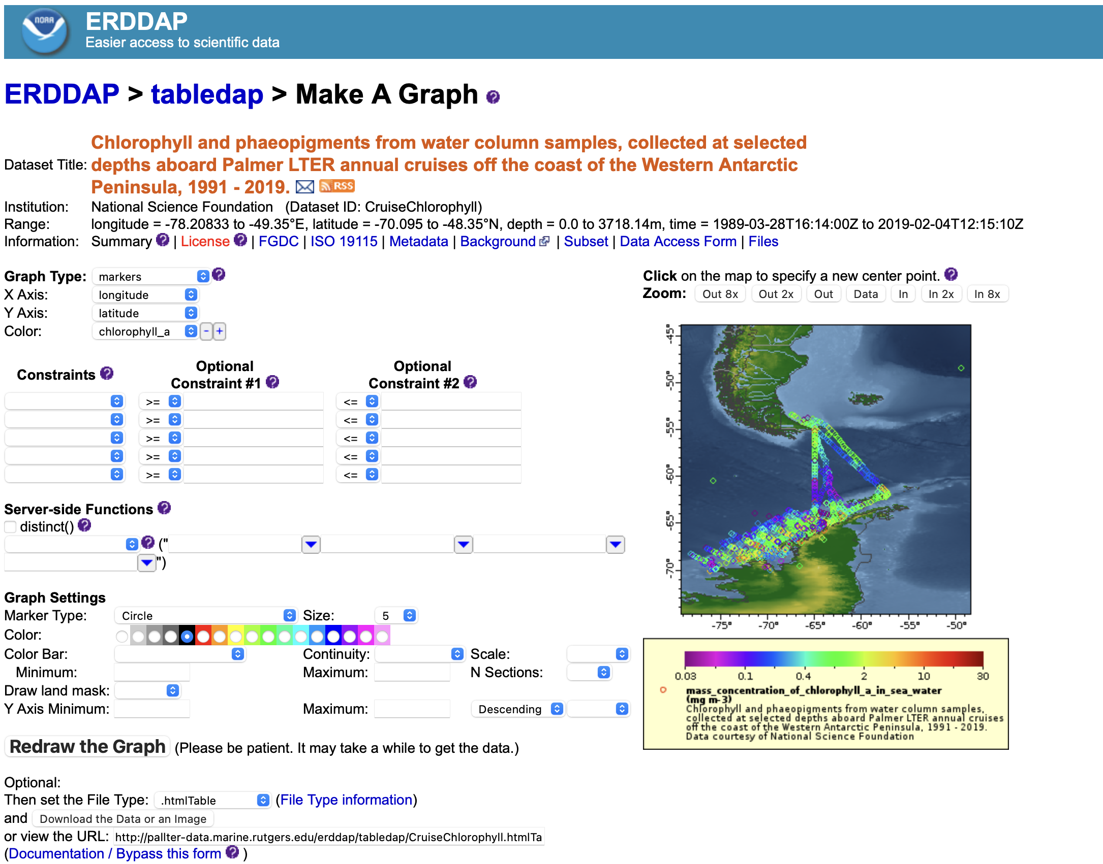
PAL Erddap Data Server (in development)
Provides a way to interactively select and plot datasets to support user exploration.
  Not currently available with EDI’s data portal.
Commonly used and known in oceanography
  Great for archiving and serving data, esp. real-time
  But not immutable
Can be used to aggregate data for official publishing, or to reshare EML from EDI
  +/- for both workflows
  Can specifying standard names and other metadata to be “CF compliant” which is not typical in EML
Previous IM setup a prototype in 2021. But recent focus has been on updating EDI datasets first.
Plan to repopulated with selected datasets from EDI archive.
https://pallter.marine.rutgers.edu/catalog/erddap/index.php

Slide 24
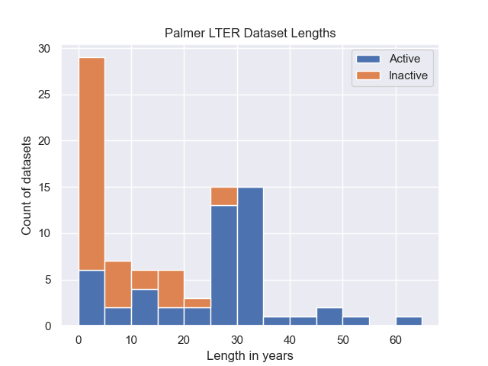
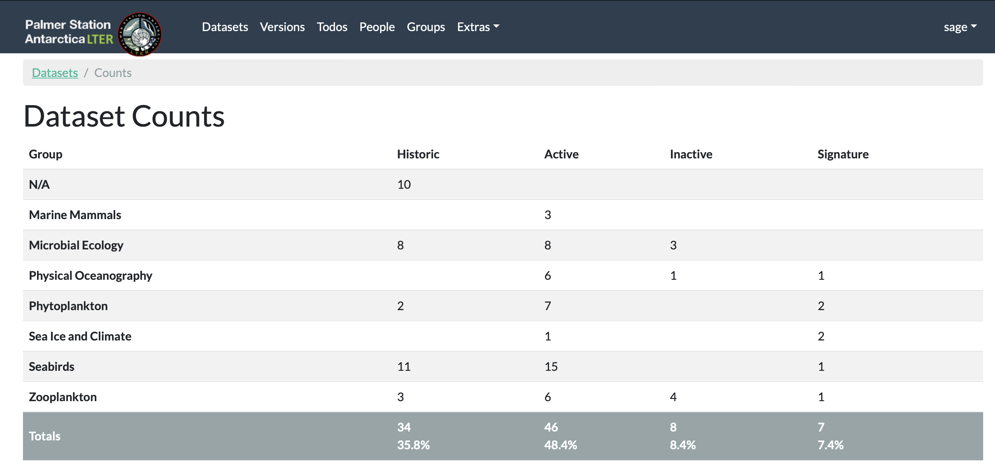
Data Availability

Slide 25
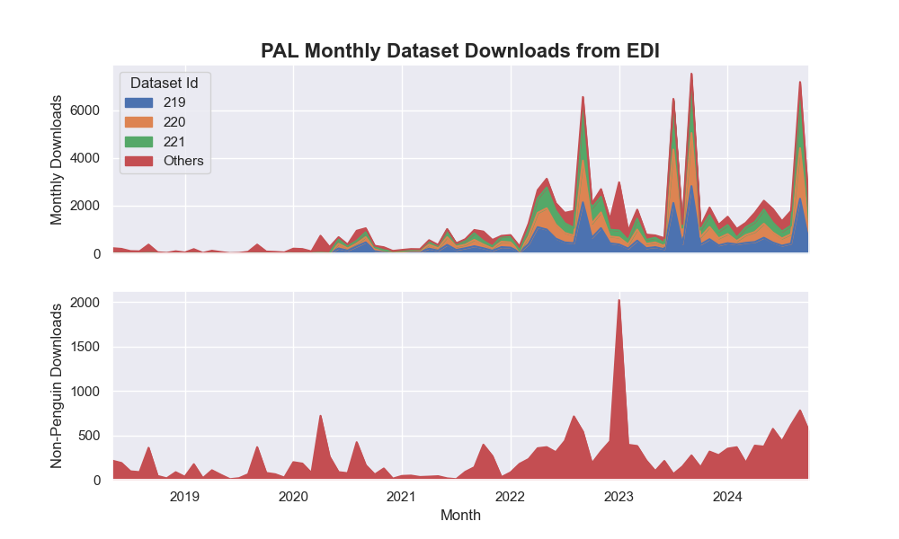

Dataset Stats
Most downloads are for palmerpenguins
https://allisonhorst.github.io/palmerpenguins/
But there is also a recent increase in downloads of other datasets.

Slide 26
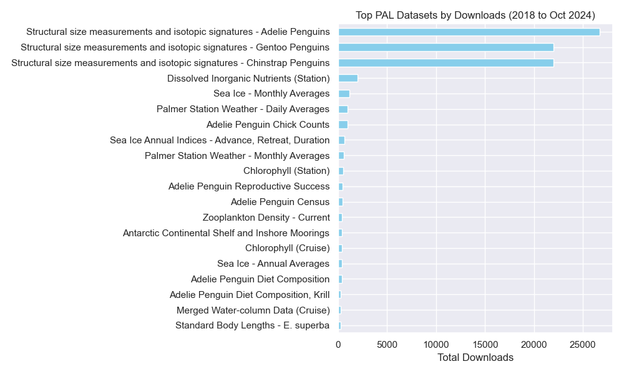
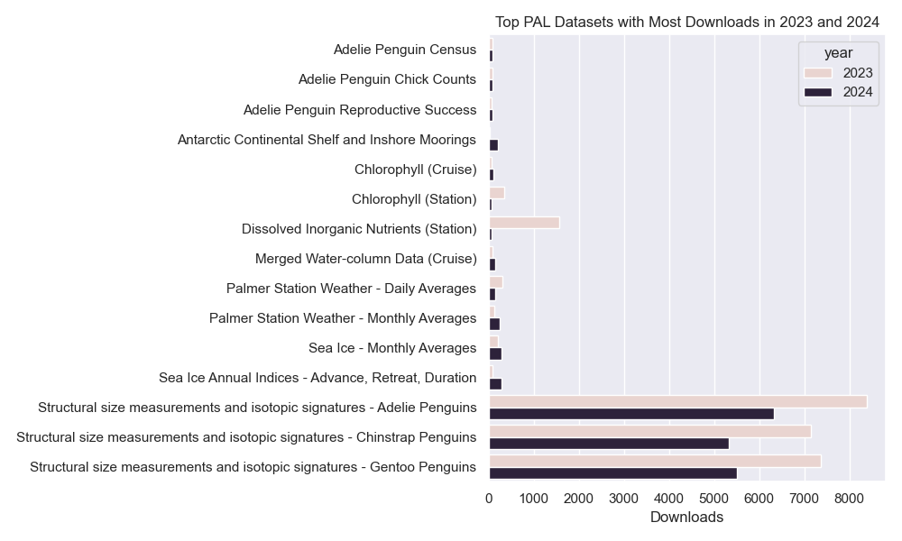
Popular Datasets
*
*
*
*
*
*

Slide 27
Team Training
New website guides to facilitate data package creation
  Metadata guide
  ezEML guide
  Grid converter
1-on-1 calls
  Data structure/format recommendations
  Data archiving training
Future outreach plans include trainings and office hours for students and postdocs

Slide 28
Future Challenges and Opportunities
Finish work on dataset backlog
  Expand use of GitHub based workflows and/or GitHub stored scripts
  To speed processing, consider publishing separate data fles each year for some instruments, instead of waiting to aggregate them, which takes a lot of time
Consider moving some datasets to Darwin Core
  e.g. marine mammals, seabirds, & zooplankton
Improve EML with Citations and QUDT
Rebuild Erddap using EDI versions as “gold standard” (or vice versa)
  Add standardized names to make them CF Compliant
Develop example notebooks to showcase “hallmark” datasets and maps
Prioritize Potential New Datasets
  Figure out how to handle large format and special datasets (e.g. drone video, tracking tags, and bioacoustics)
  Move PhyOce datasets to NetCDF format, using NCEI templates as standard
  Reassess which active datasets can be updated regularly

Slide 29
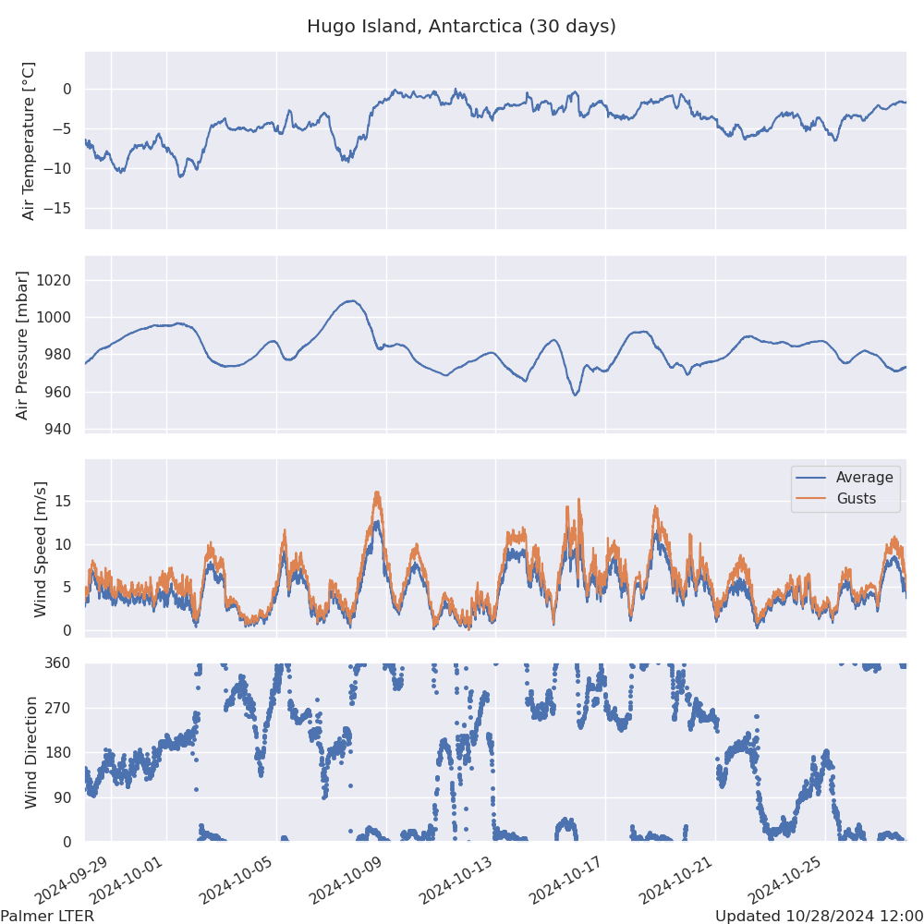
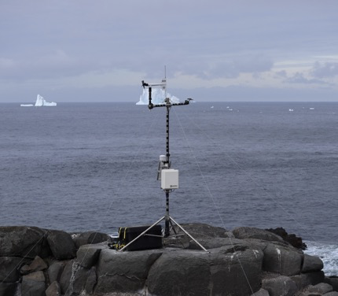
Potential New Datasets In the Works?
New Datasets
Hugo Island Weather (new site this year)
IFCB (cruise and station)
  Particle counts/sizes
  Classification (eventually?)
New Moorings
Compiled Datasets
Compiled Bottle Casts (cruise/station)
Compiled Raw CTD Casts (cruise/station)
Station Snow Stakes
Station Water Wall? (quality issues)
Station LTER Event Log? (usefulness?)
Glider deployment index? (archived at NCEI)
Derived Products
Processed CTD (new format)
Depth integrated HPLC & Chl
Hourly Weather from raw 1-min data
Mixed Layer Depths
“Big Fig” timeseries

Slide 30
Summary
Rebuilt the data management workflow and individual datasets (a work in progress)
Engaging the PAL team directly in dataset compilation and metadata management
  Substantial focus on QC
  Emphasis on archiving in EDI for citation
Relying on LTER network tools and learning from other IMs
  ezEML – For collaborative editing and QC of metadata and data
  Journal / Datasets web scripts from BLE
  IFCB processing example from NES
  Lots of IM discussions on citations, units, dataset formats, best practices, etc.
A lot of work remains, especially for new datasets

Slide 31
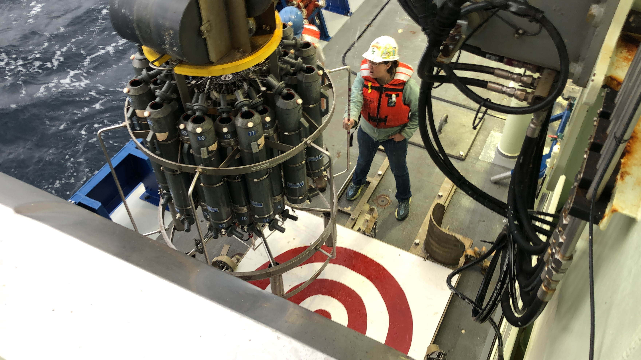
Questions?

