Slide 1
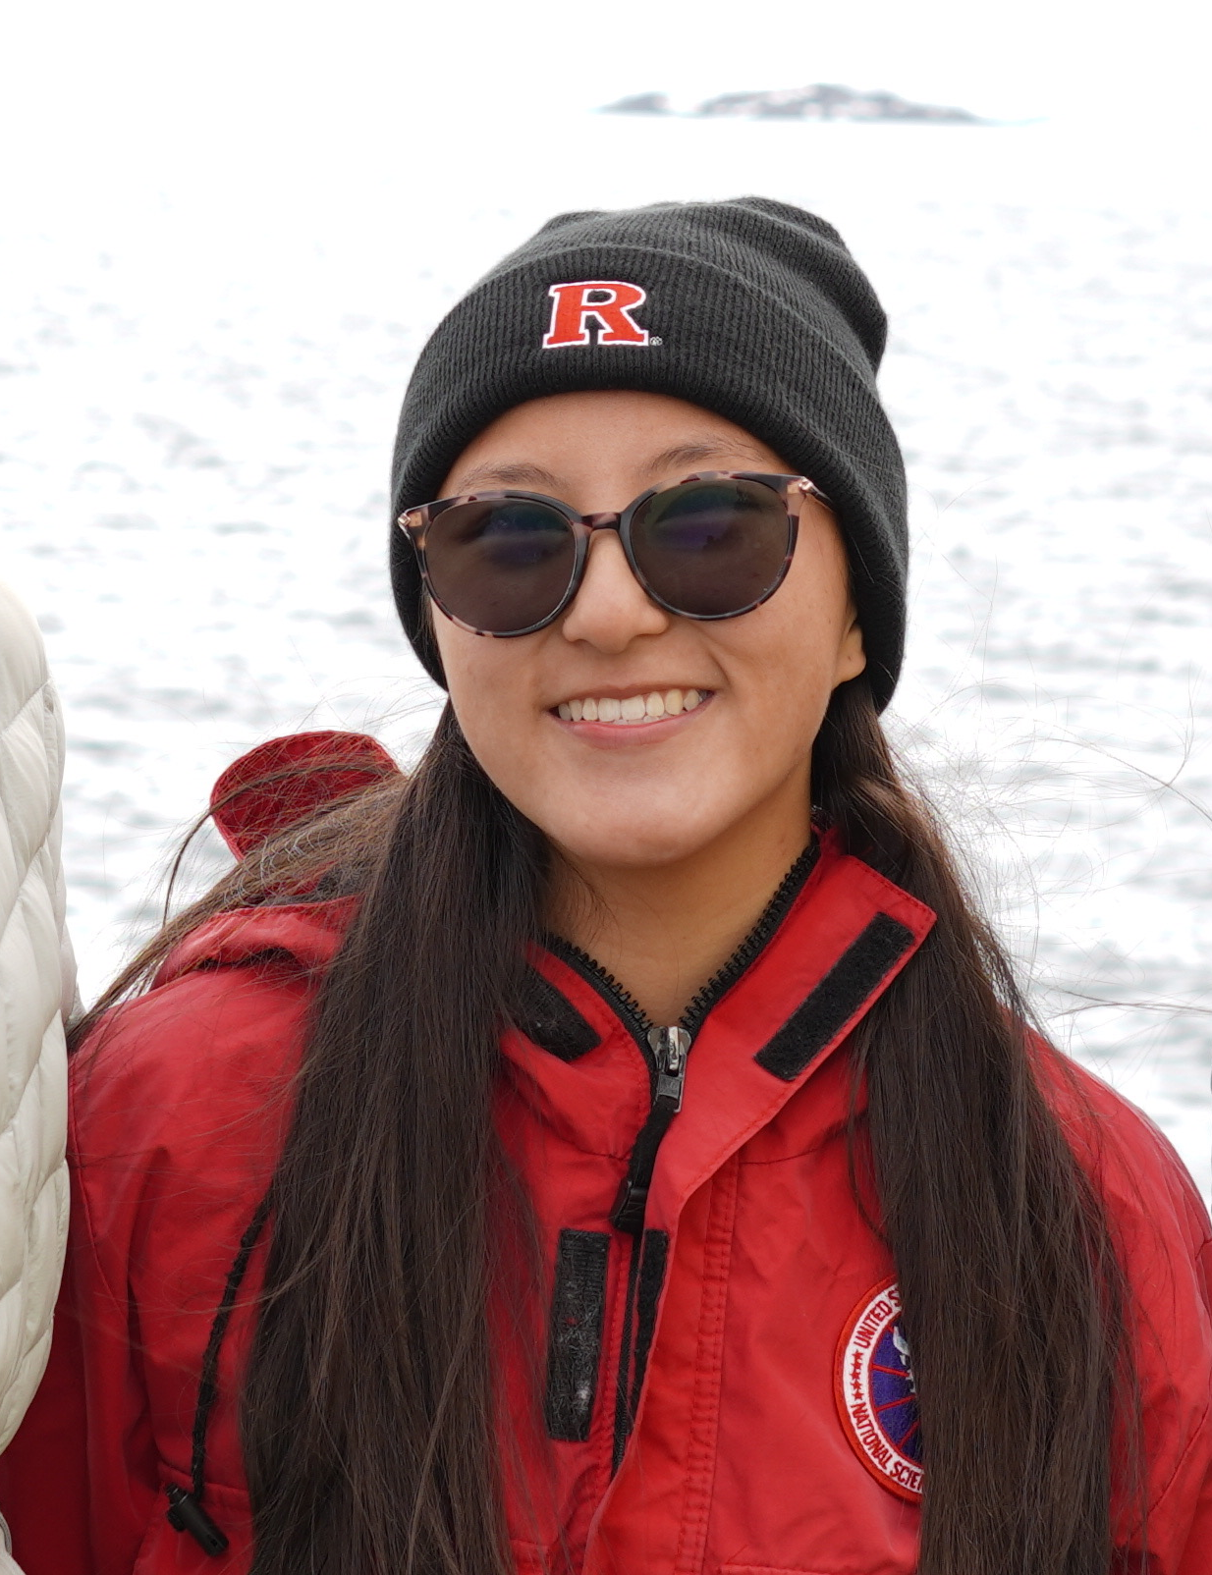
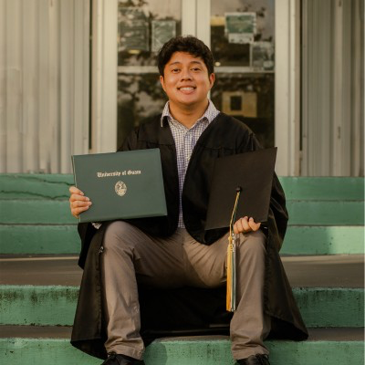
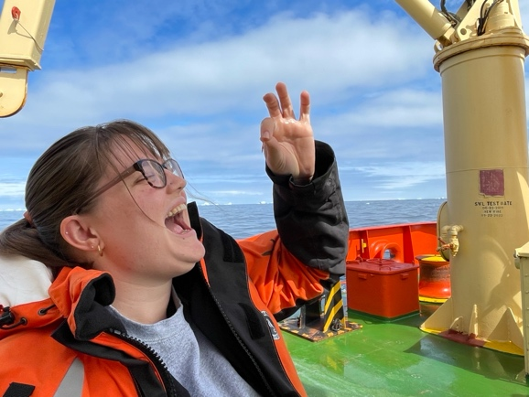
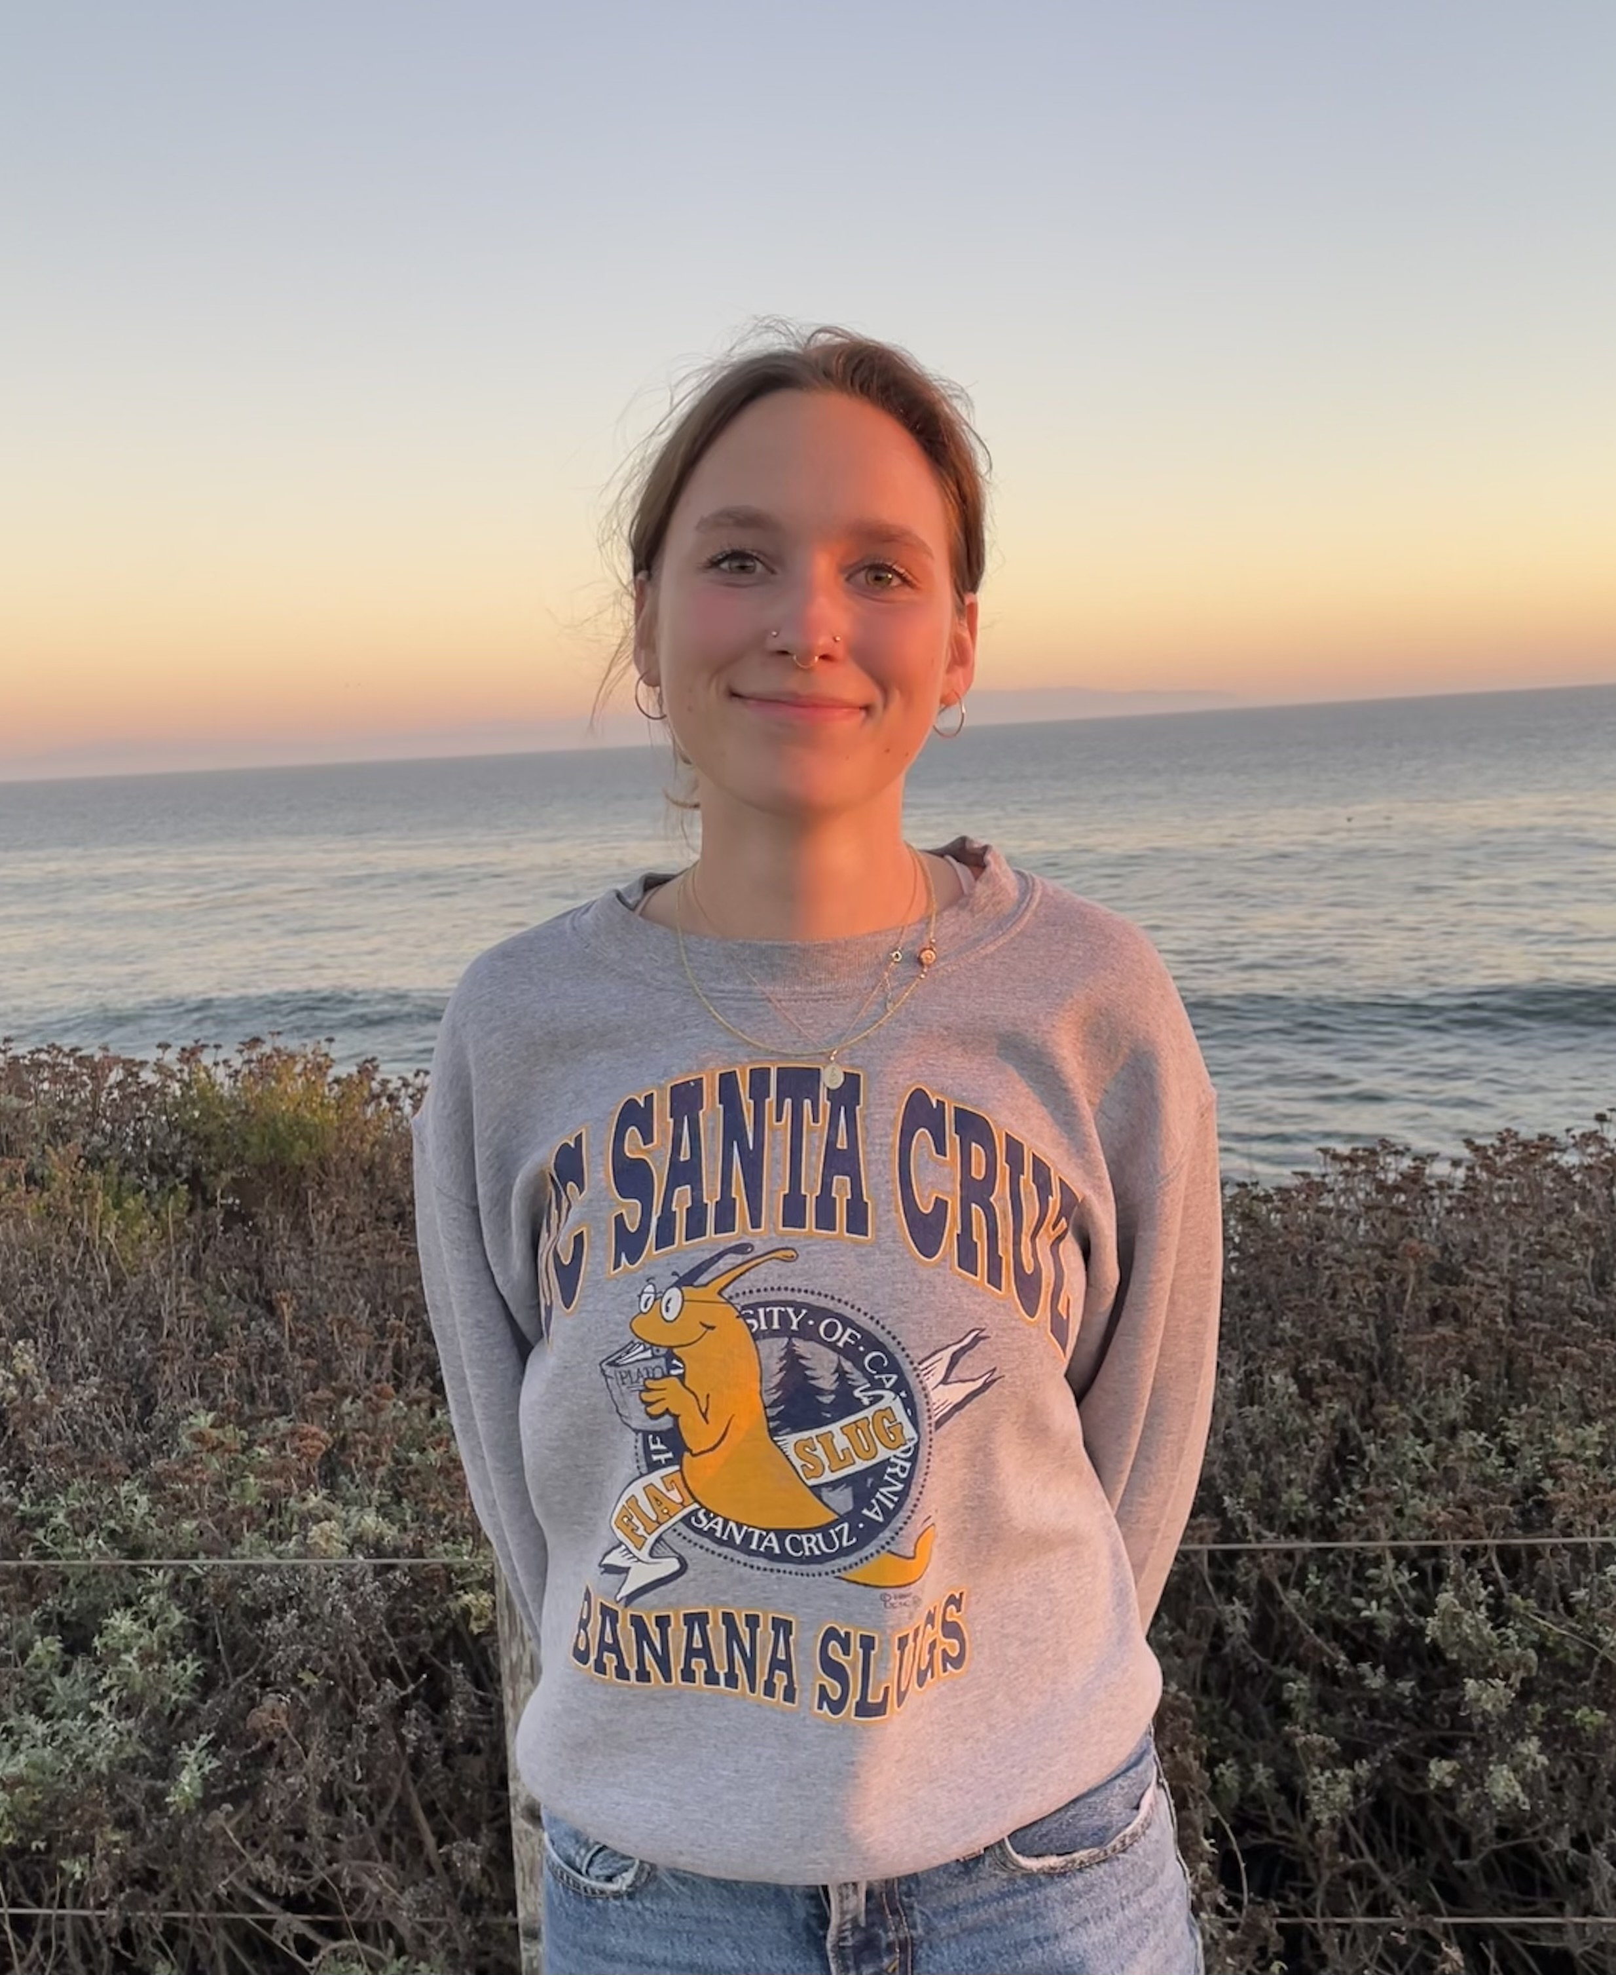
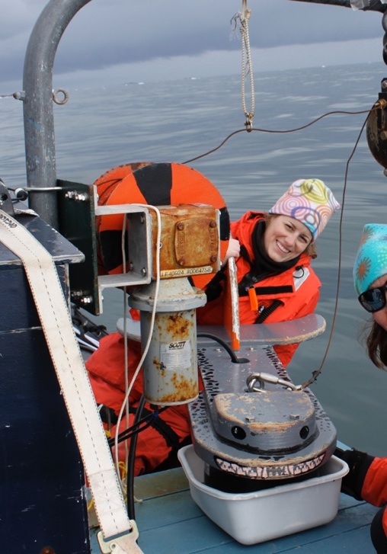
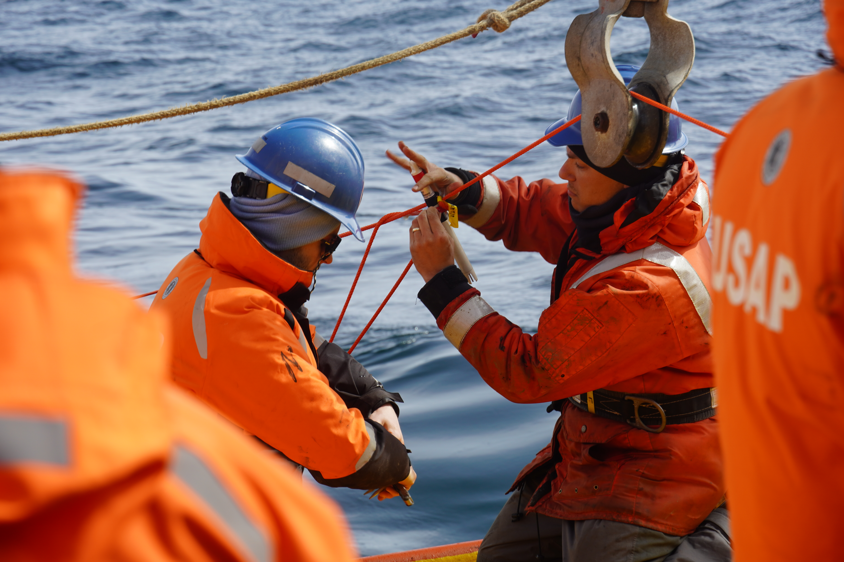

PAL-LTER: Undergraduate Students

Slide 2
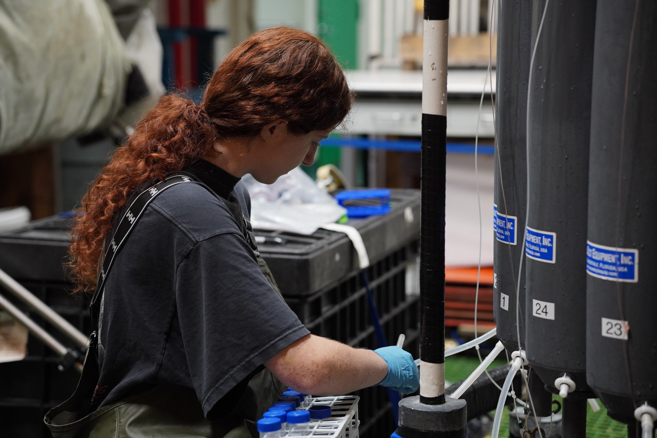
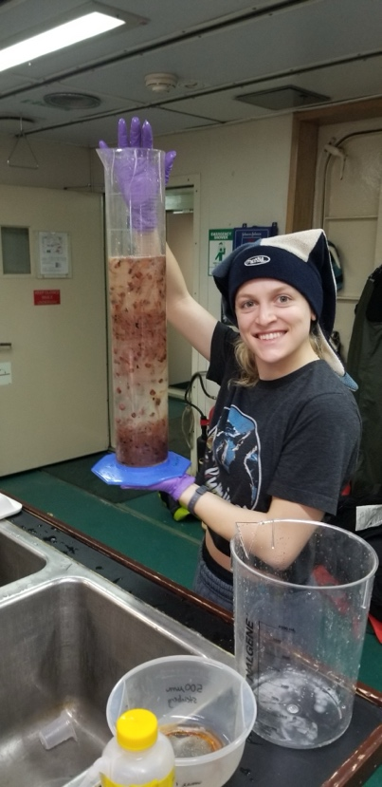
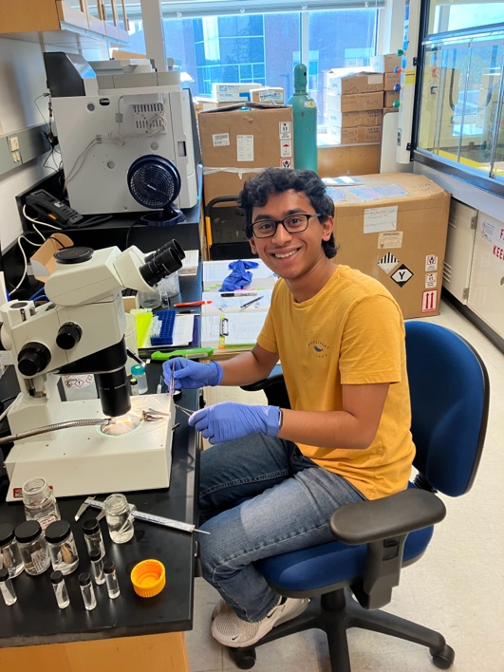
Undergraduate Opportunities with PAL-LTER
PAL provides opportunities for undergraduate students in key areas:
  Polar fieldwork
  Research
  Mentoring
  Professional Networking
We aim to involve a diverse group of students in LTER & Polar Science.
Undergraduate involvement also provides mentoring opportunities for PAL graduate students and post-docs.
We use a range of opportunities to recruit and support students:
  Undergraduate Marine Sciences programs at several PAL institutions.
  Three PAL institutions have NSF-funded Research Experiences for Undergraduate (REU) programs: VIMS, Rutgers, UDel
  Institution-specific programs aimed at supporting undergraduate research and/or broadening participation in science (e.g. ACCESS program at UCSD, Climate Scholars at UDel, George H. Cook Scholars Program at Rutgers)

Slide 3
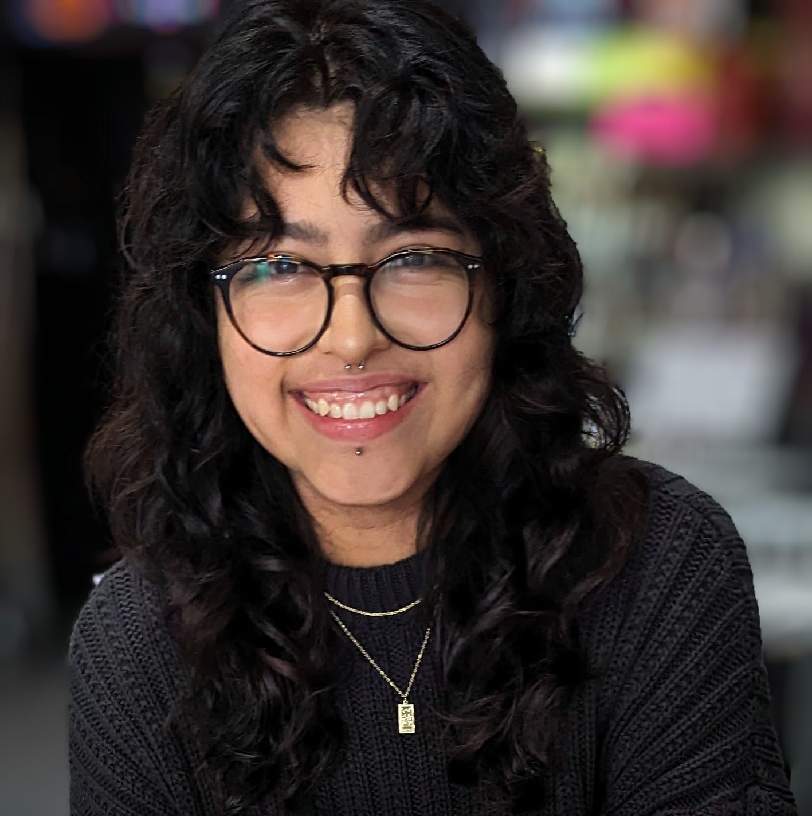
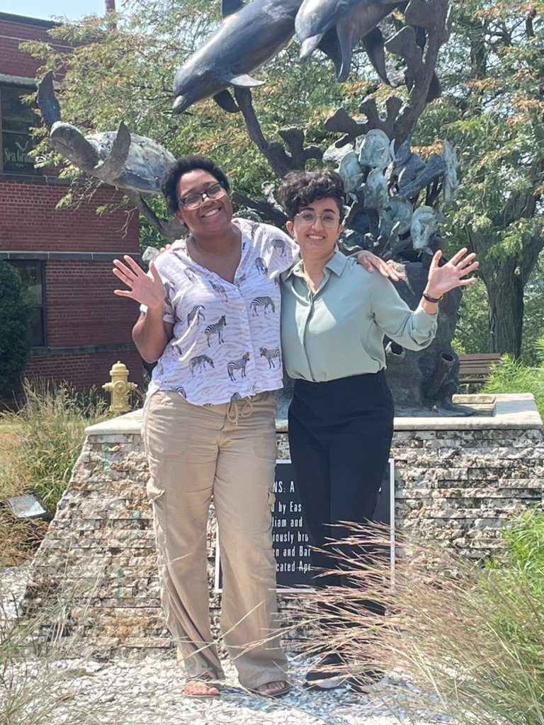
PAL Training and Mentorship
More than 20 undergraduate students involved in PAL in recent years.
Several have participated in fieldwork even with recent staffing challenges.
Students learn invaluable research skills using real, messy data.
Students participate in PIs group meetings and receive individual guidance and mentorship.
PAL monthly meetings, fieldwork, and LTER-wide activities provide opportunities to broaden scientific horizons and networking.

Slide 4
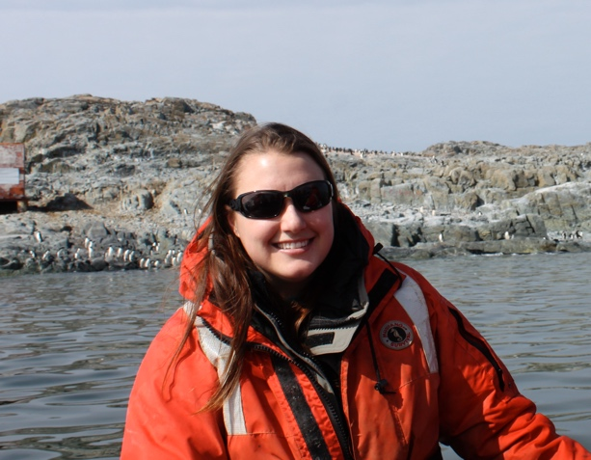
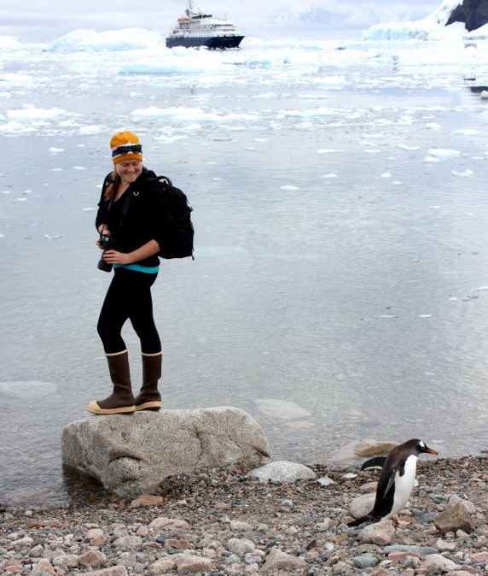
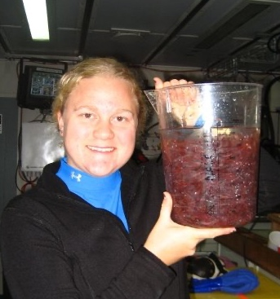
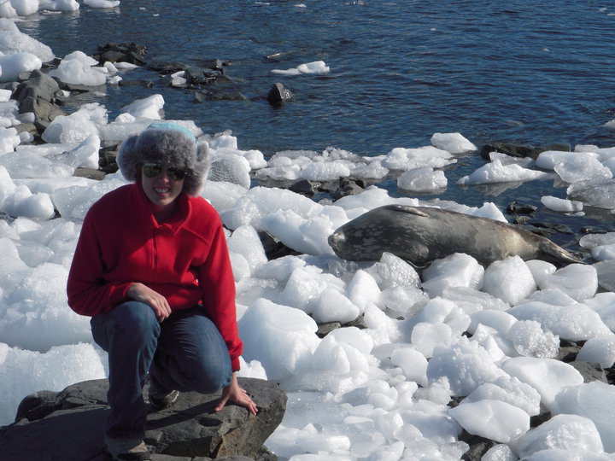
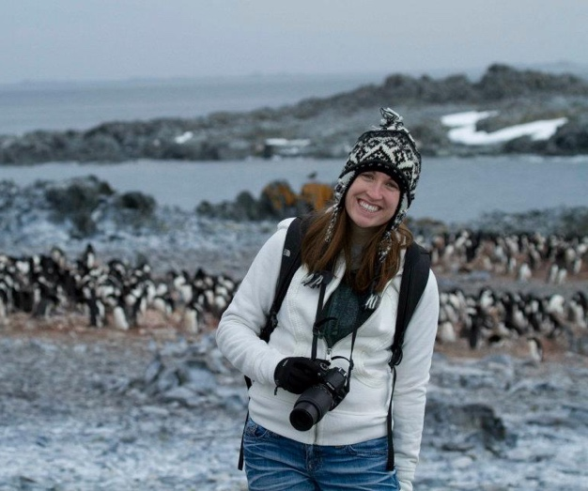
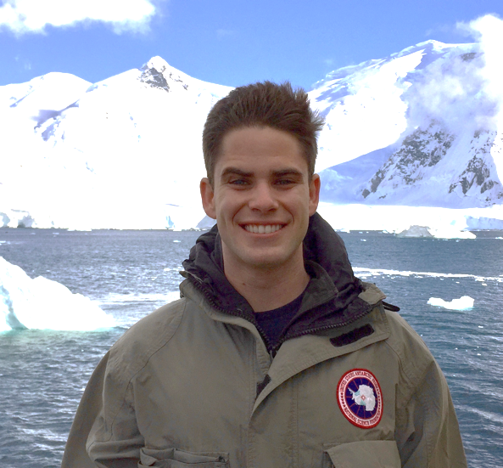
Steinberg Group (William & Mary): Undergrads in Antarctica
Caitlin Smoot ‘11
Miram Gleiber ‘09
Domi Paxton ‘12 &’13
Courtney Lorey ‘20
Sarah Giltz ‘10
Frances Armstrong ‘12
Josh Sacks ‘18
Meredith Nolan ‘23
Notes:
VIMS has received private donor funding to support 1-2 students (undergrad or graduate) annually participating in PAL LTER fieldwork. Most of these undergraduate students have gone on to graduate school, including in my lab. To date 5 undergraduates that came with us on the PAL cruise or to Palmer Station as undergrads ended up going to graduate school with me at VIMS (one, Jack Conroy, is here at meeting!).
(year indicated is year on the cruise or at Palmer Station, not year graduated)

Slide 5
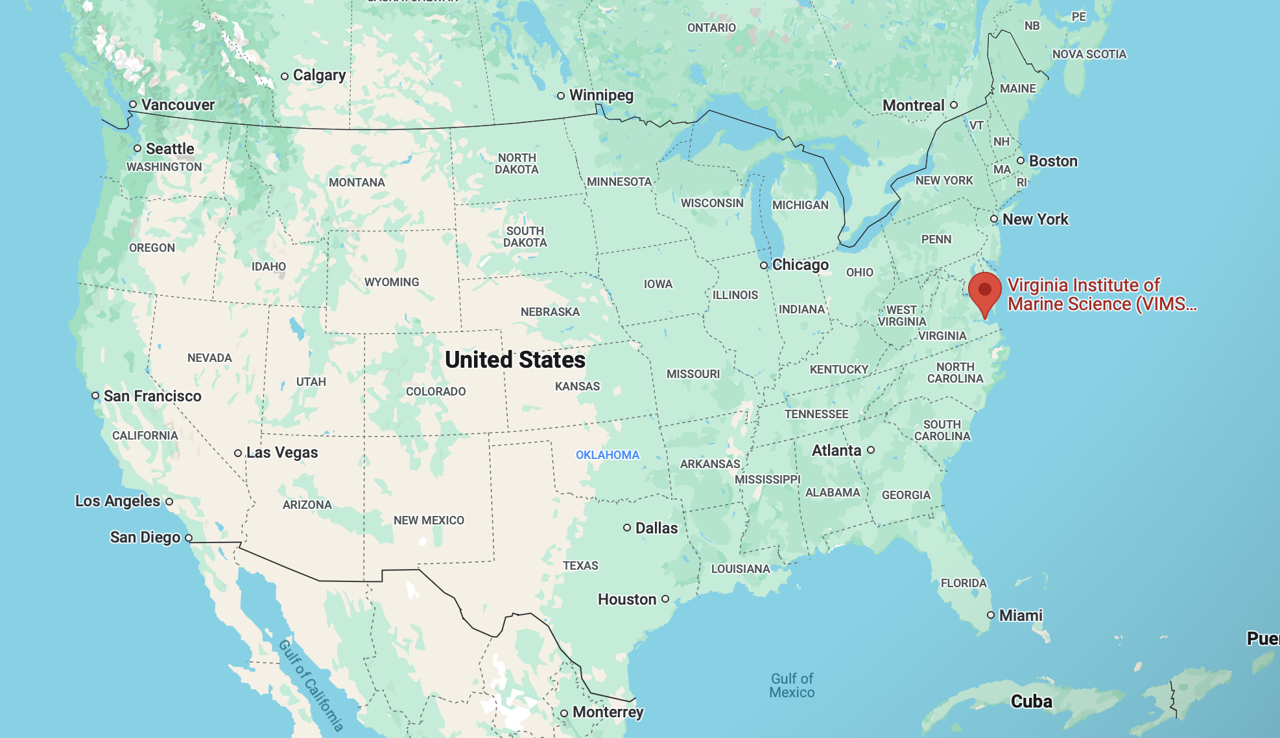
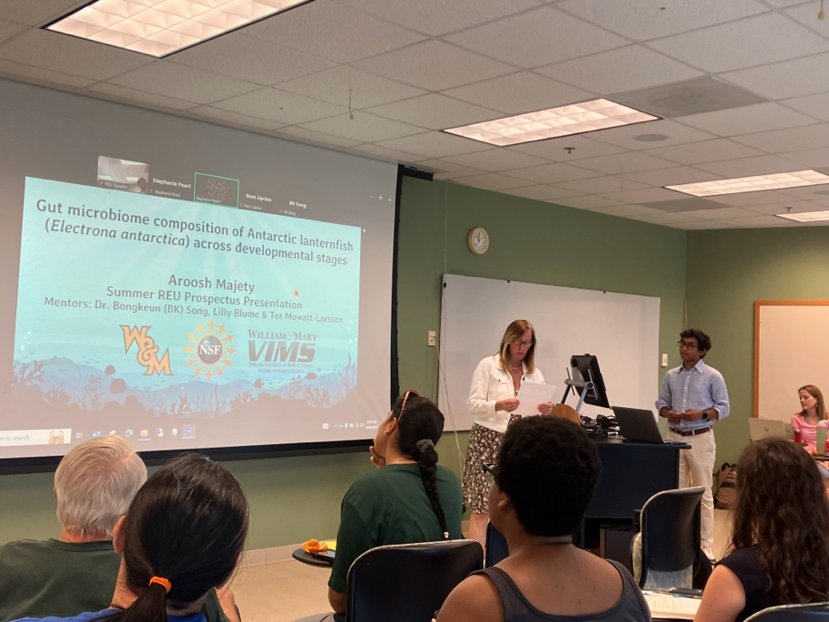
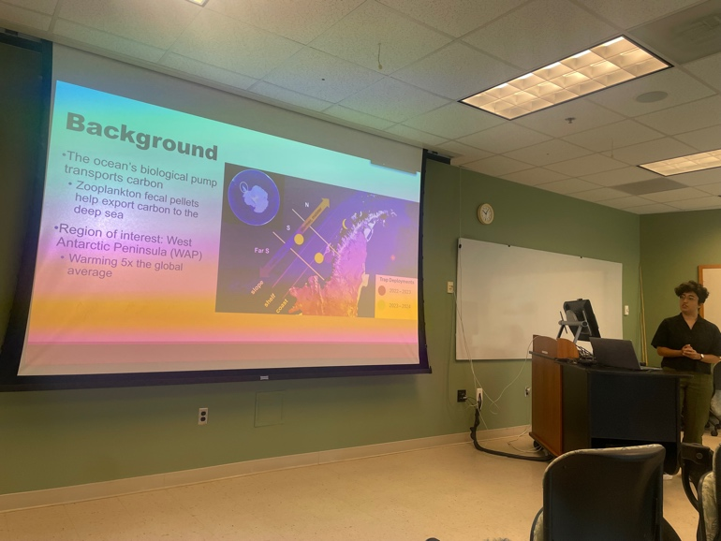
Research Experience for Undergraduates (REU) at VIMS (Steinberg Group)
Three of our PI’s institutions have REU site programs
(VIMS, U. Del, Rutgers)
PAL PhD student Maya Thomas and REU Sachi Anand, summer 2024
Sachi selected by the ASLO Multicultural Program to present her research at ASLO Meeting 2025
REU student Aroosh Majety, summer 2024
(mentored by Tor Mowatt-Larssen)
Notes:
These are VIMS summer REU site program participants. Maya mentored Sachi whose project was about zooplankton fecal pellet flux in the Wap
Tor Mowatt-Larsen mentored Aroosh, shown here dissecting guts of the Antarctic lanternfish for a microbiome study
VIMS site REU program is focused on underrepresented minorities, and it has been a good feed to our grad program

Slide 6
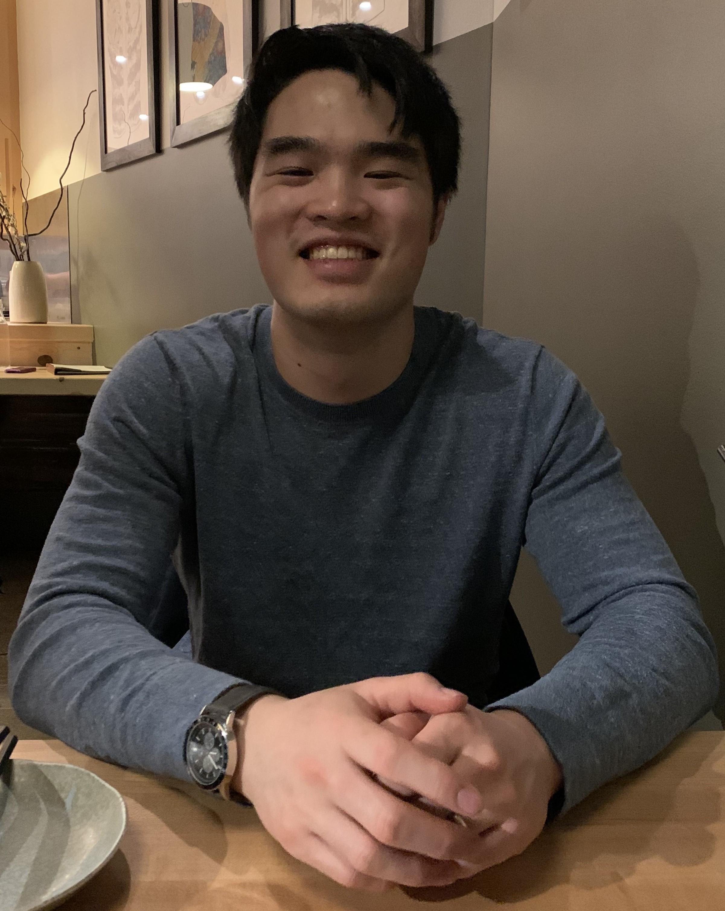
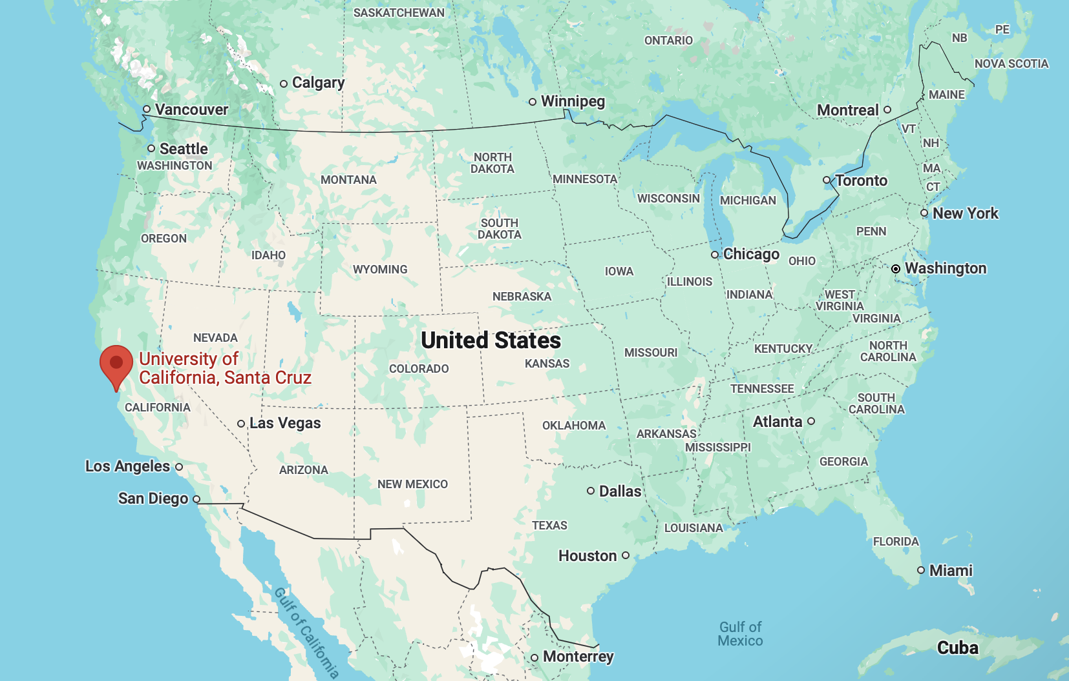
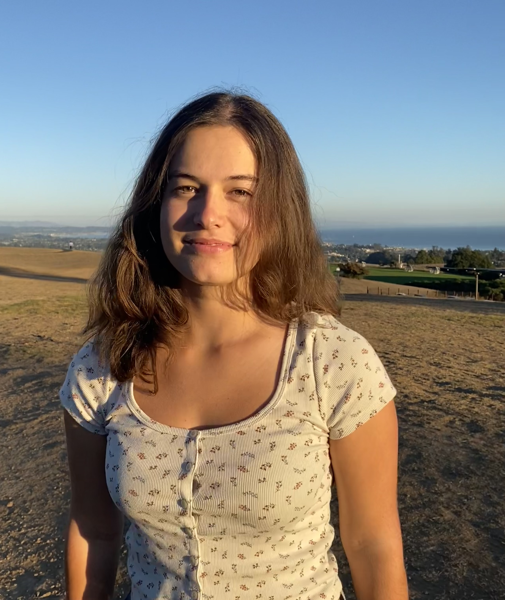
Cimino Group (UCSC) - 2024-25
Pierce Kim (ASU, research credits):
Glacier retreat in relation to gentoo penguin colonization
Tatiana Hernandez (UCSC, research credits & senior thesis): Net and penguin selectivity of the krill cohort
  Post-doc mentor: Jack Conroy
Margaret Moran & Annessa Thompson (UCSC) – Annotating penguin dive videos to understand predator-prey dynamics
  Grad student mentor: Victoria Hermanson

Slide 7
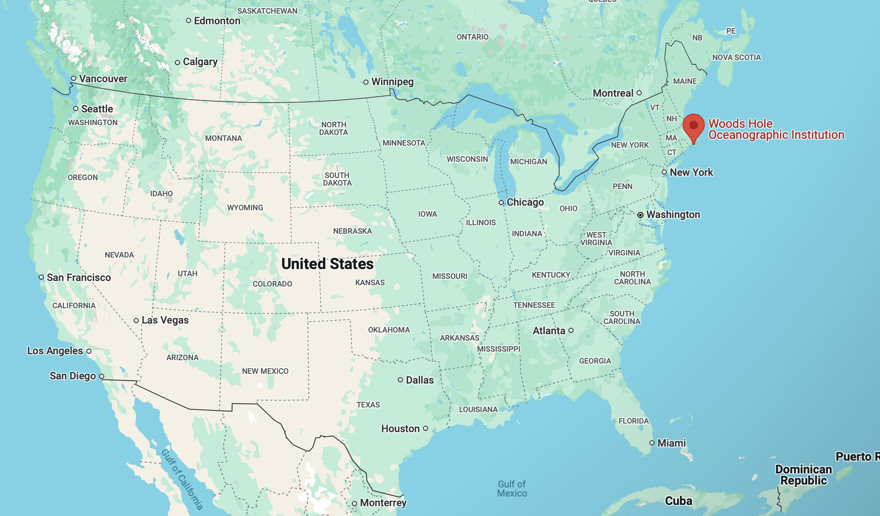
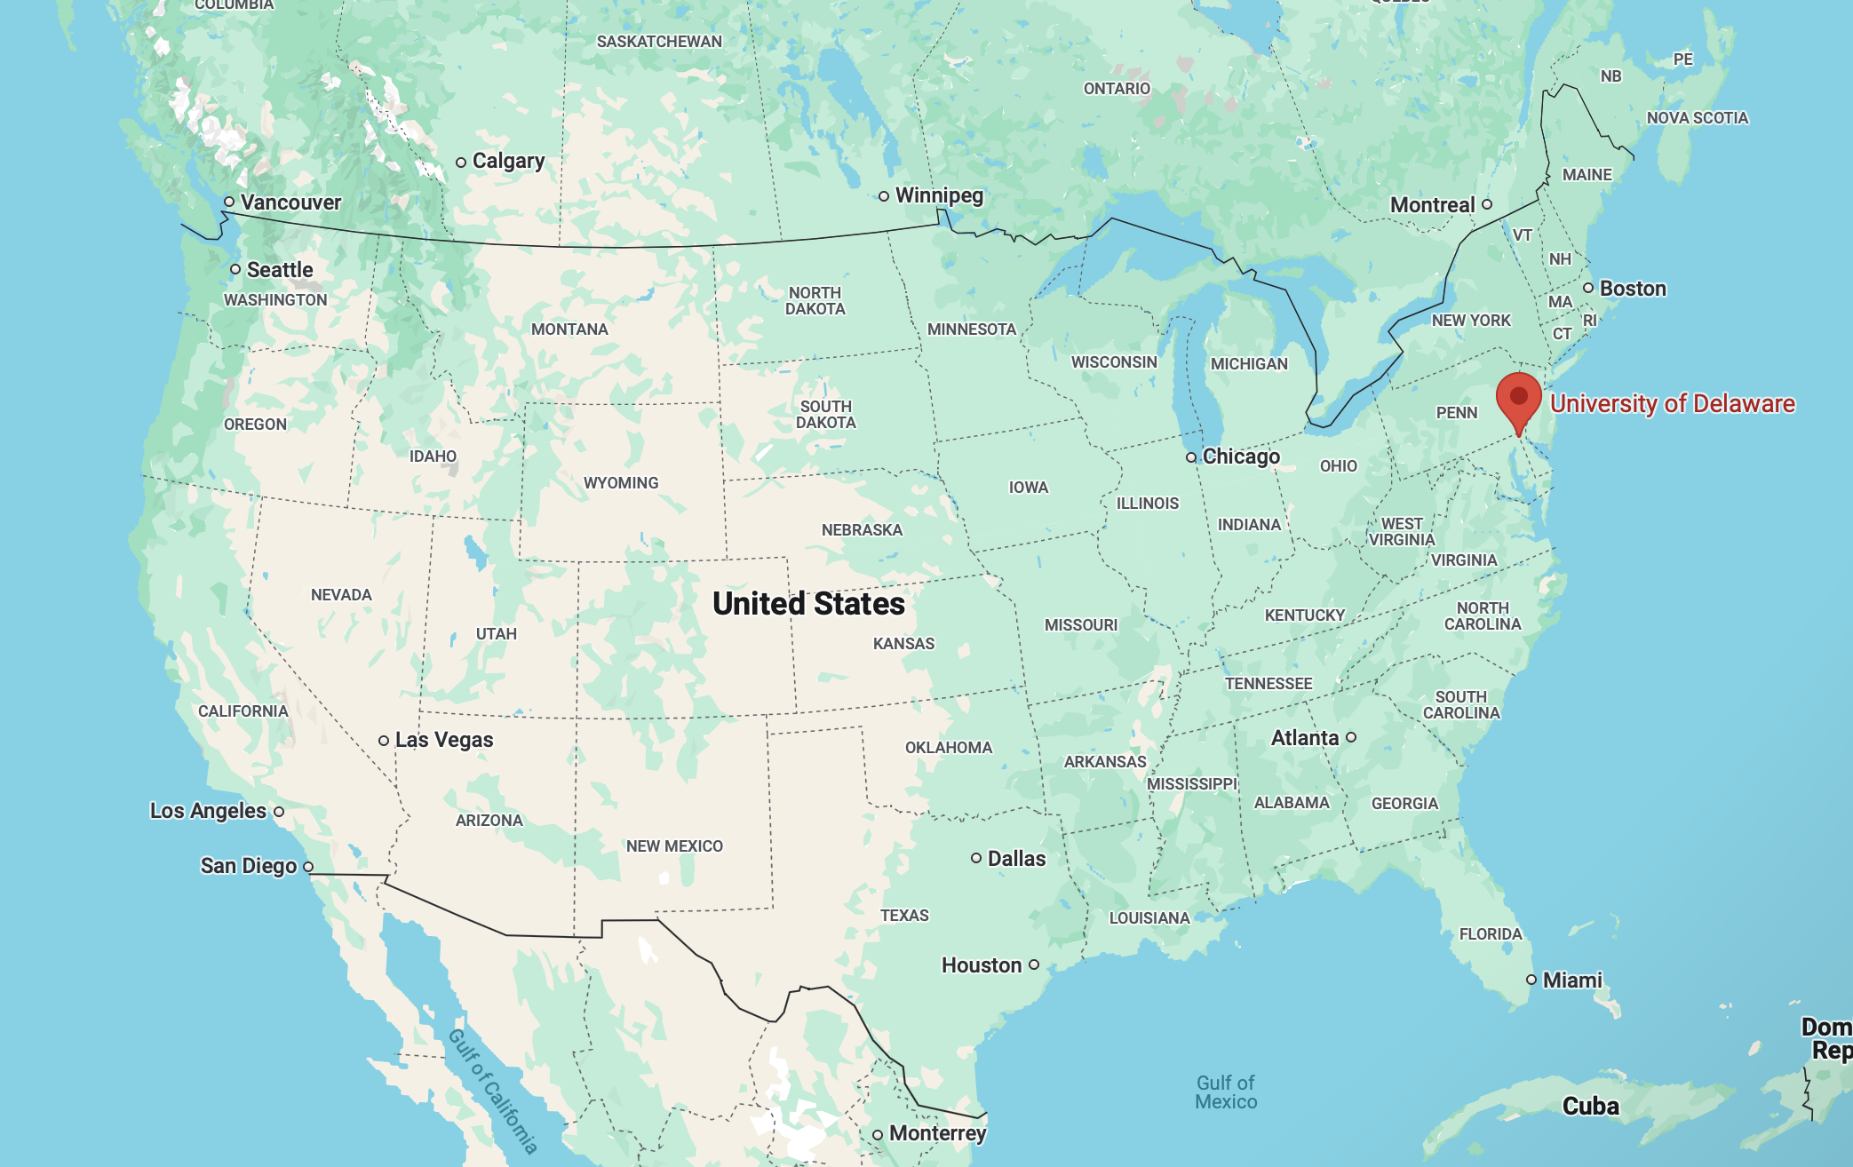
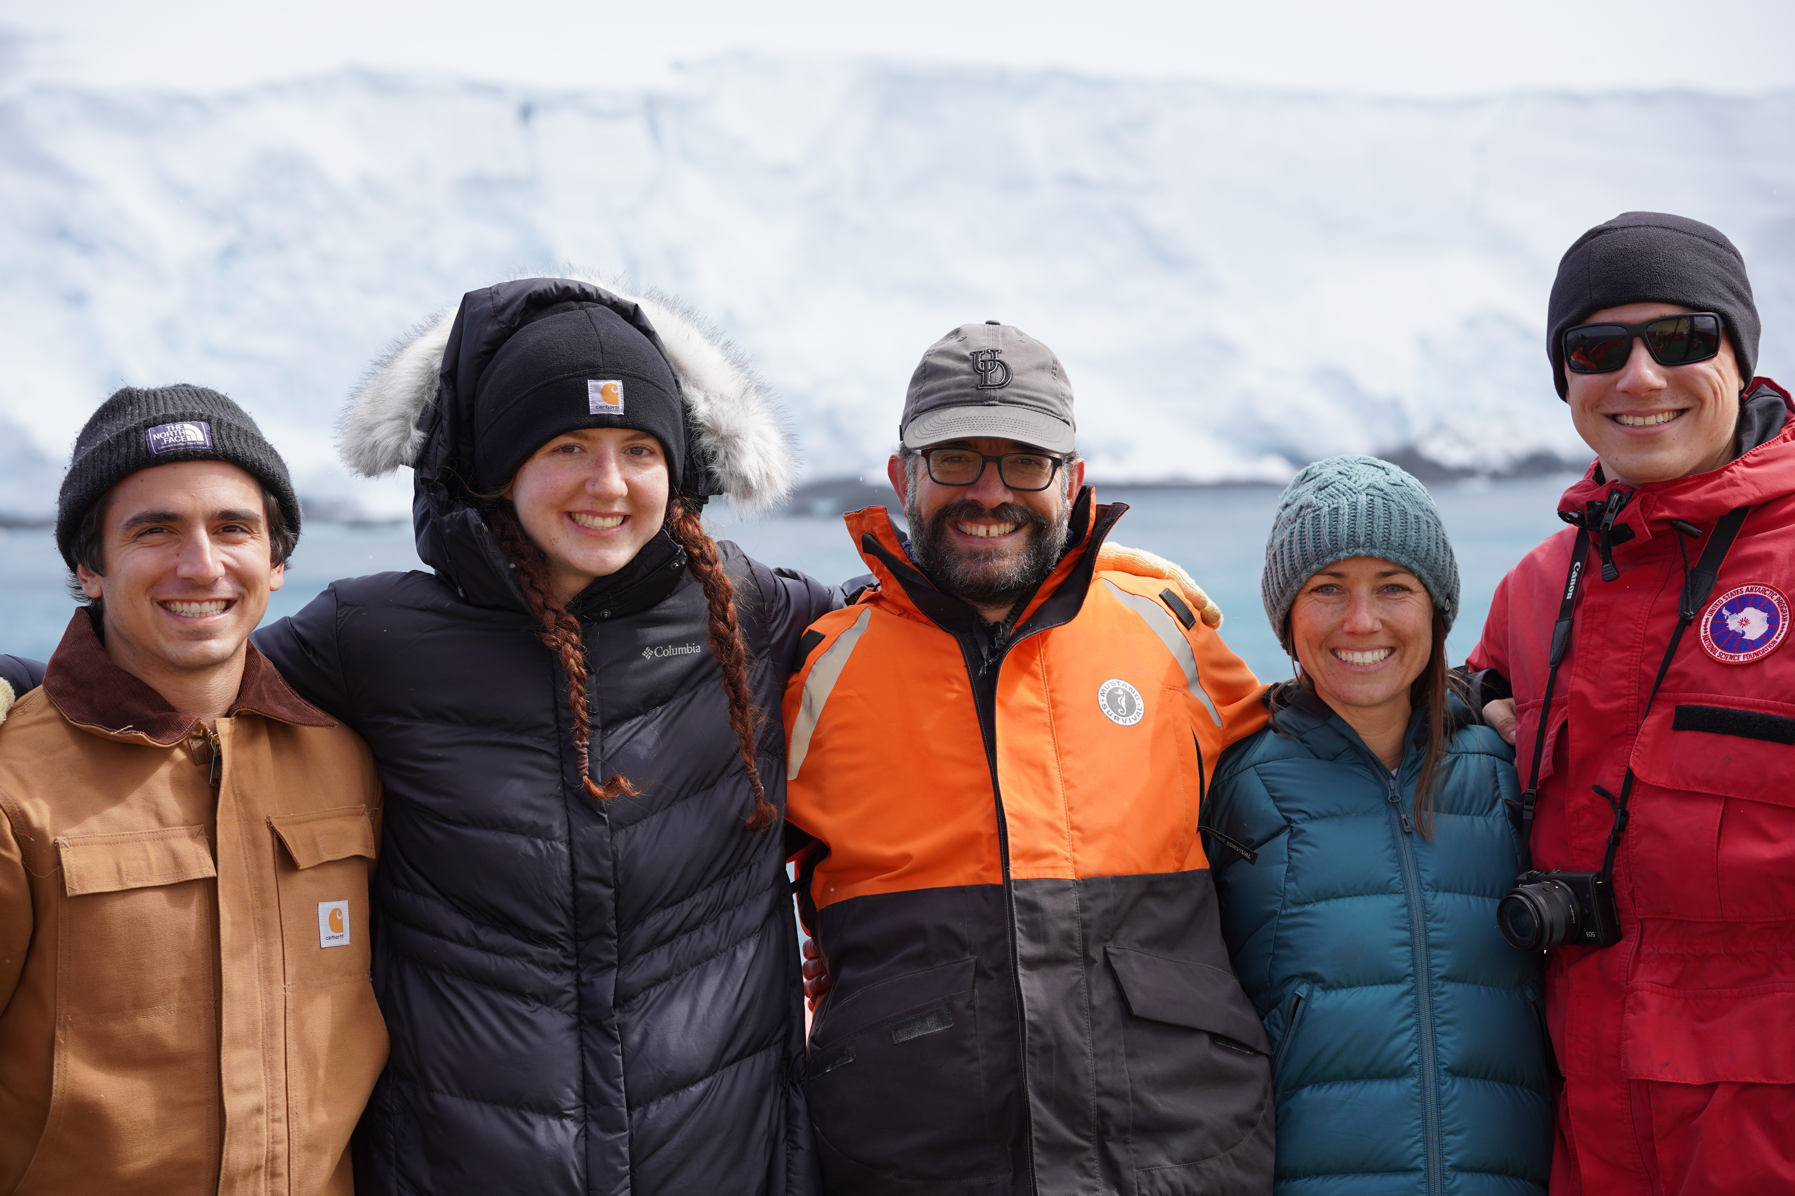
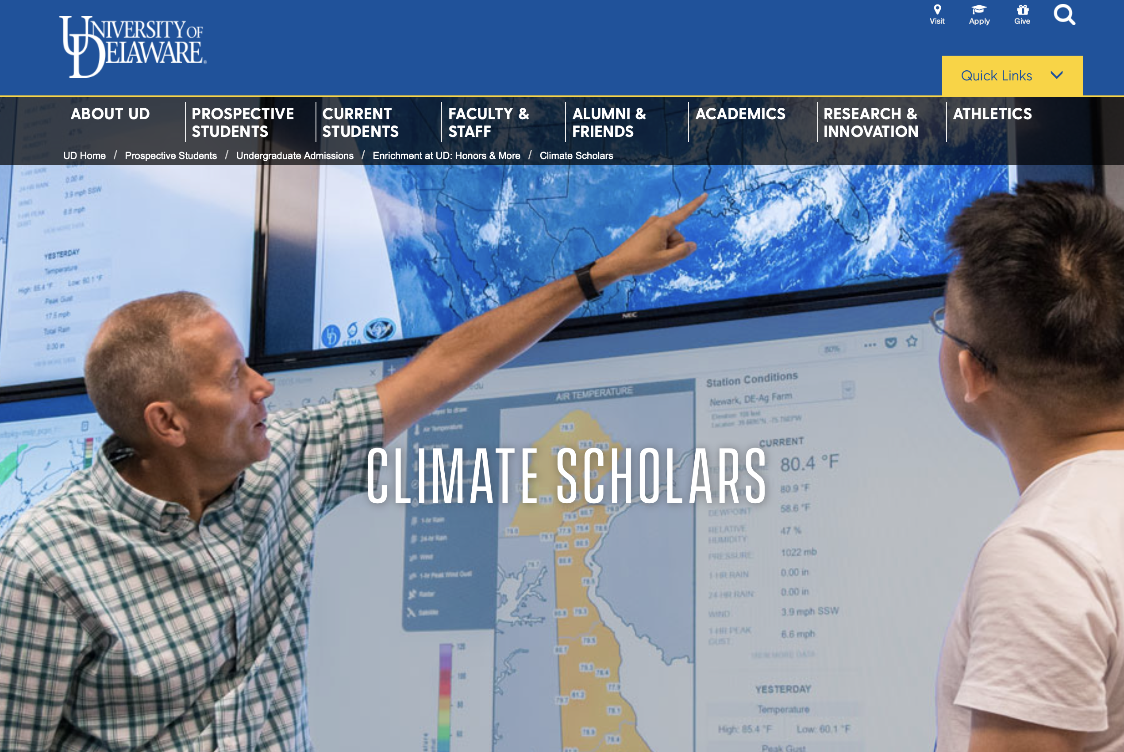
Moffat Group (U. of Delaware) & Van Mooy Group (WHOI)
Rachel Davitt (UDel. undergrad, sailed with Van Mooy Group, now Ph.D. student at Rutgers). NOAA Hollings Scholar.
Michael Cappola (UDel undergrad, now Ph.D. with Moffat Group). UDel Climate Scholars 2022.

Slide 8
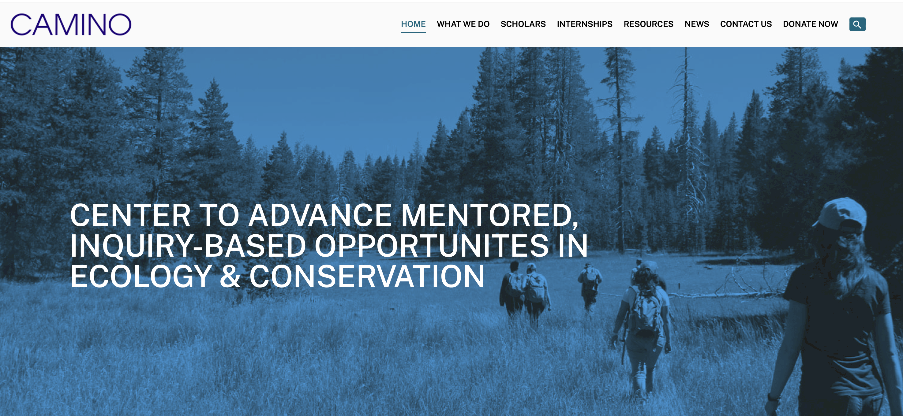
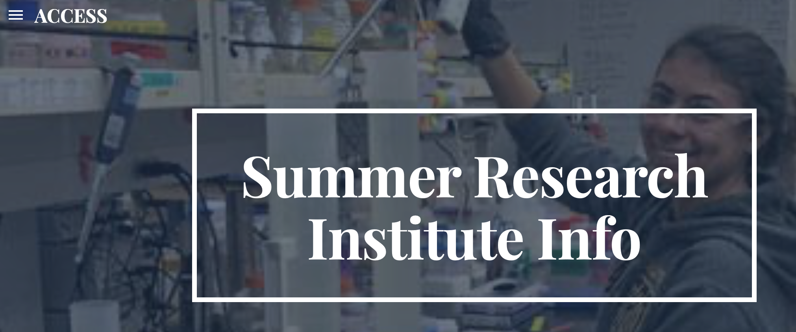
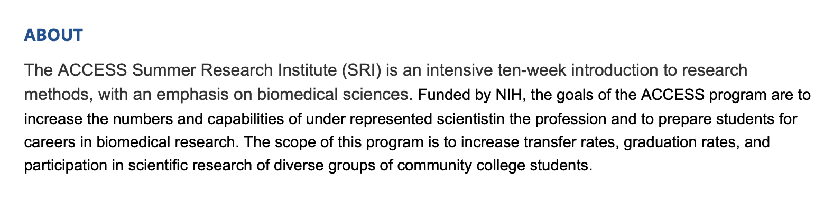
Friedlaender Group (UCSC)
Plus:
Martin Gonzales
Mimi Cole
Iris lam
Astarte brown
Linda Lai (2024 USCS CAMINO Scholar)
Aniyah chambers (2024 ACCESS Summer Research Institute)

Slide 9
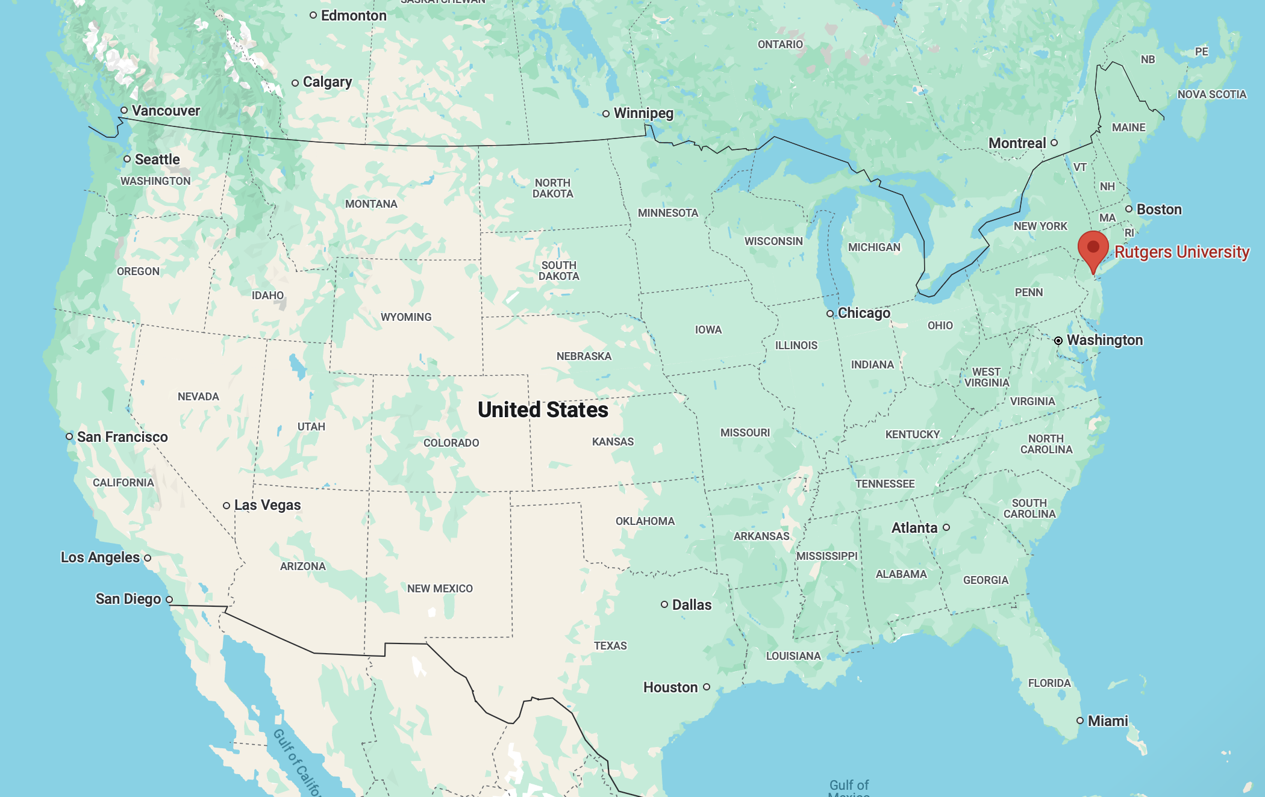
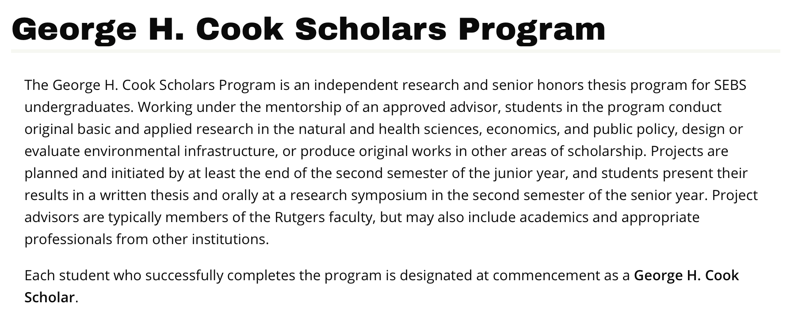
Schofield Group (Rutgers)
Miah Manning (2023): Sailed on 2023 PAL Cruise.
Nikko Galanto (2020): Whale foraging behavior. NSF-REU student.
Participated remotely, from Guam, during the pandemic.
Plus:
2021-2023 Miah Mullins “Phytoplankton decadal trends” Rutgers Honors College
Tyler Jordan (2022): NSF-REU student.
Noah Motz (2021-2022) - Dynamics in nearshore penguin zones. George H. Cook Scholars Program at Rutgers. Now Ph.D. student at UDel.

Slide 10
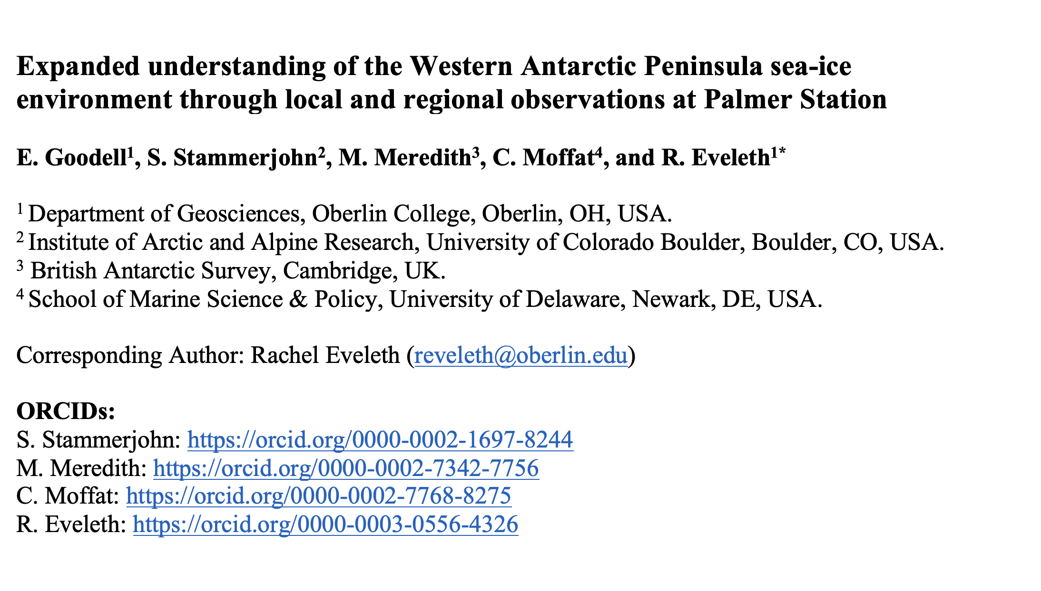
External Collaborators
Dr. Rachel Eveleth, Assistant Professor, Oberlin College
Ph.D. from Duke (Sailed with LTER), Post-doc with S. Doney at U. Va.
Eliza Goodell (Undergrad at Oberlin, seeking Ph.D. opportunities in Polar Sciences for Fall ’25)
(Paper accepted in JGR-Oceans on October 19)

