Slide 1
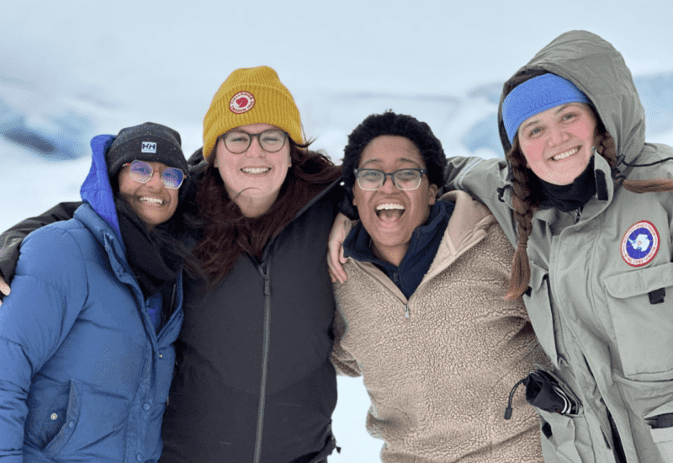
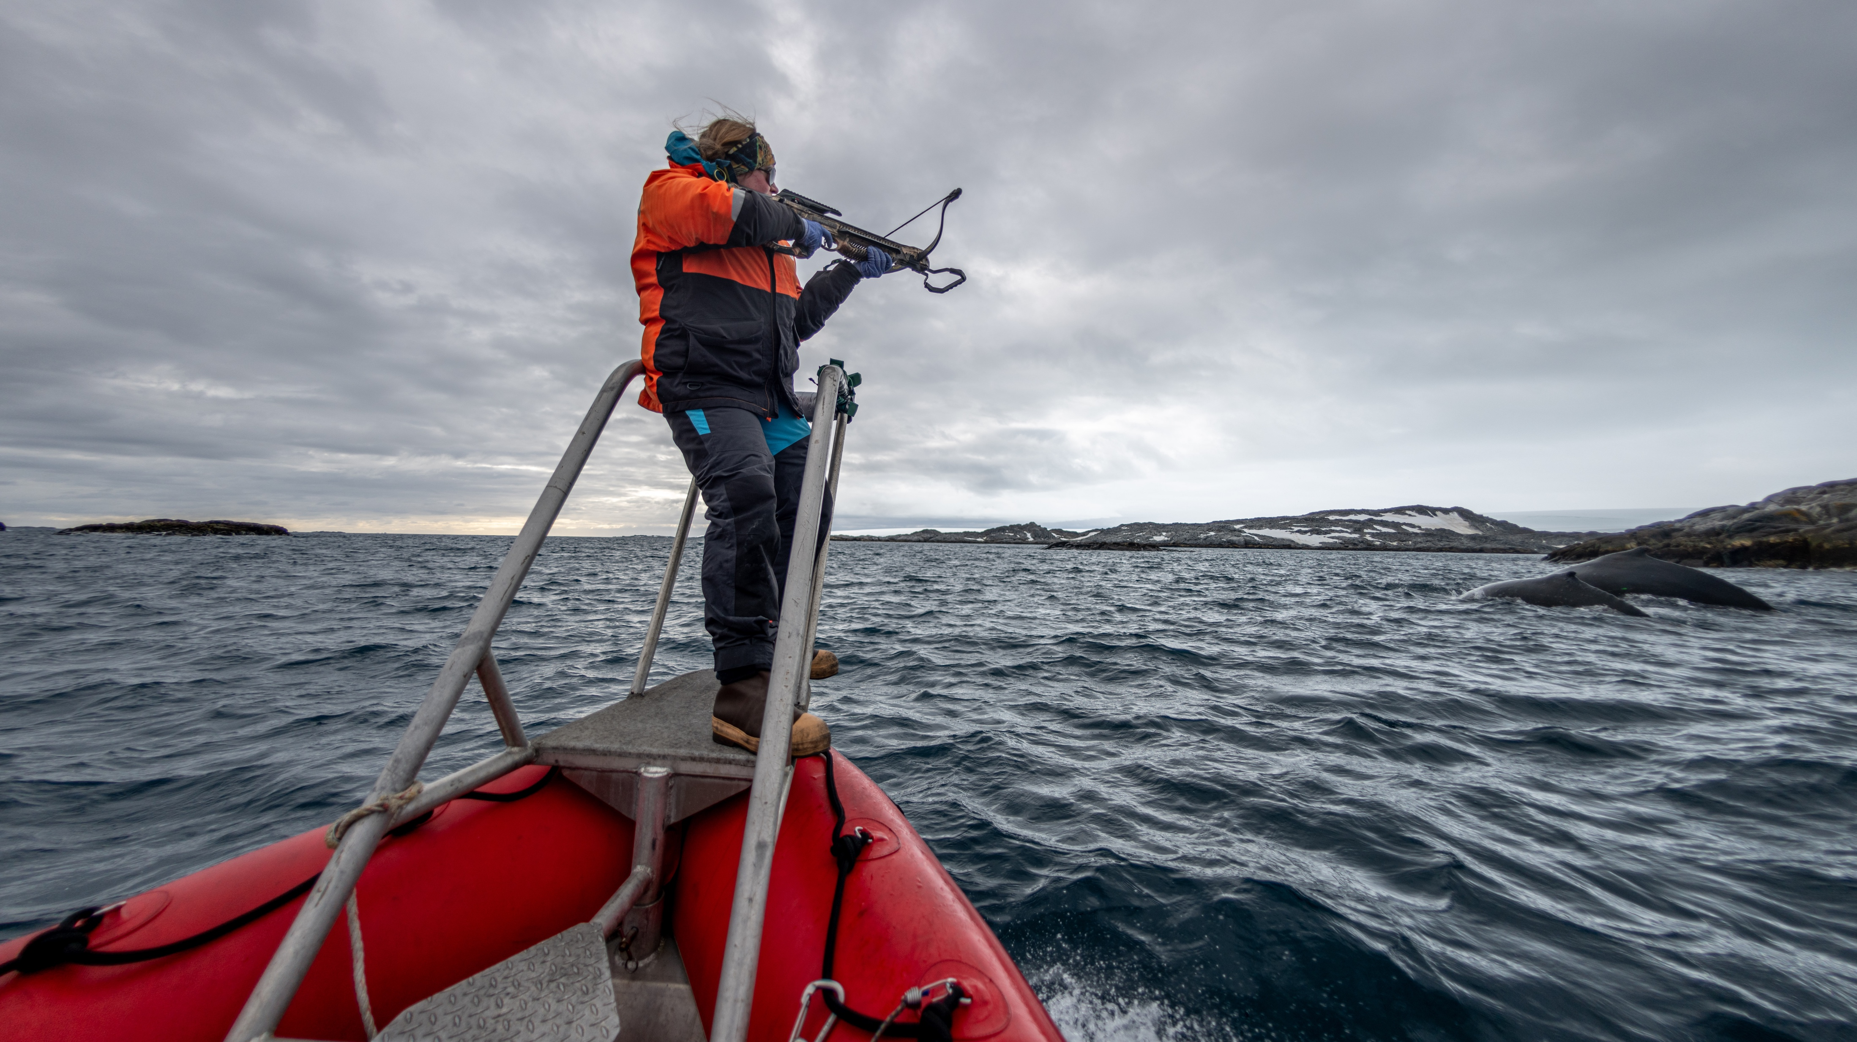
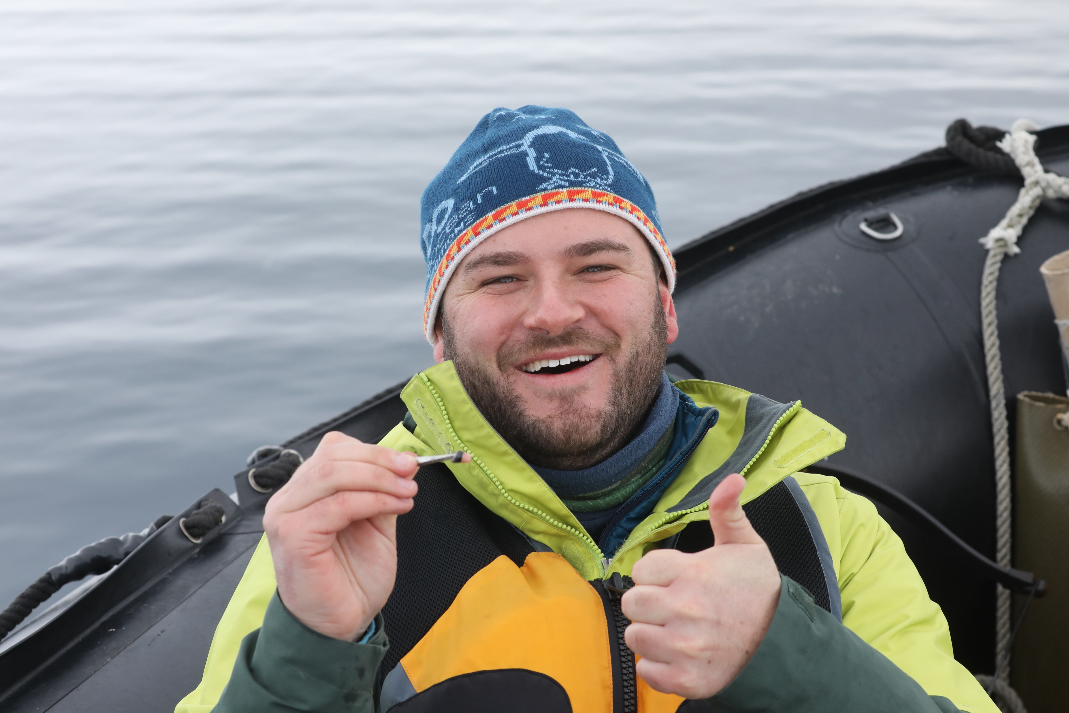
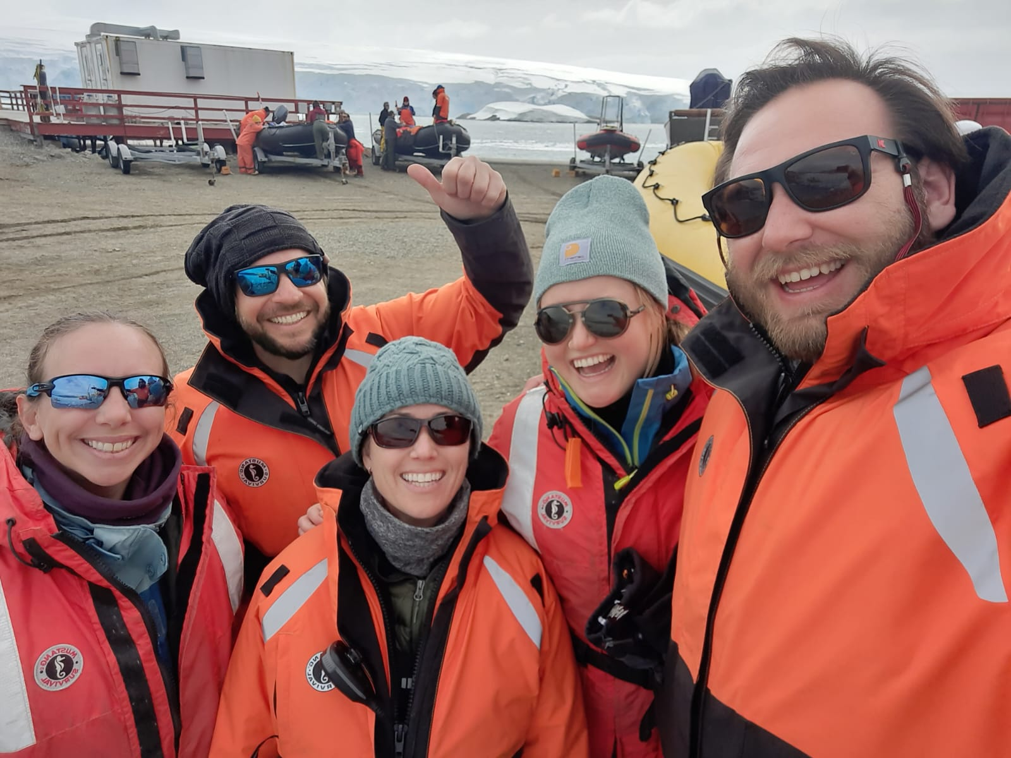
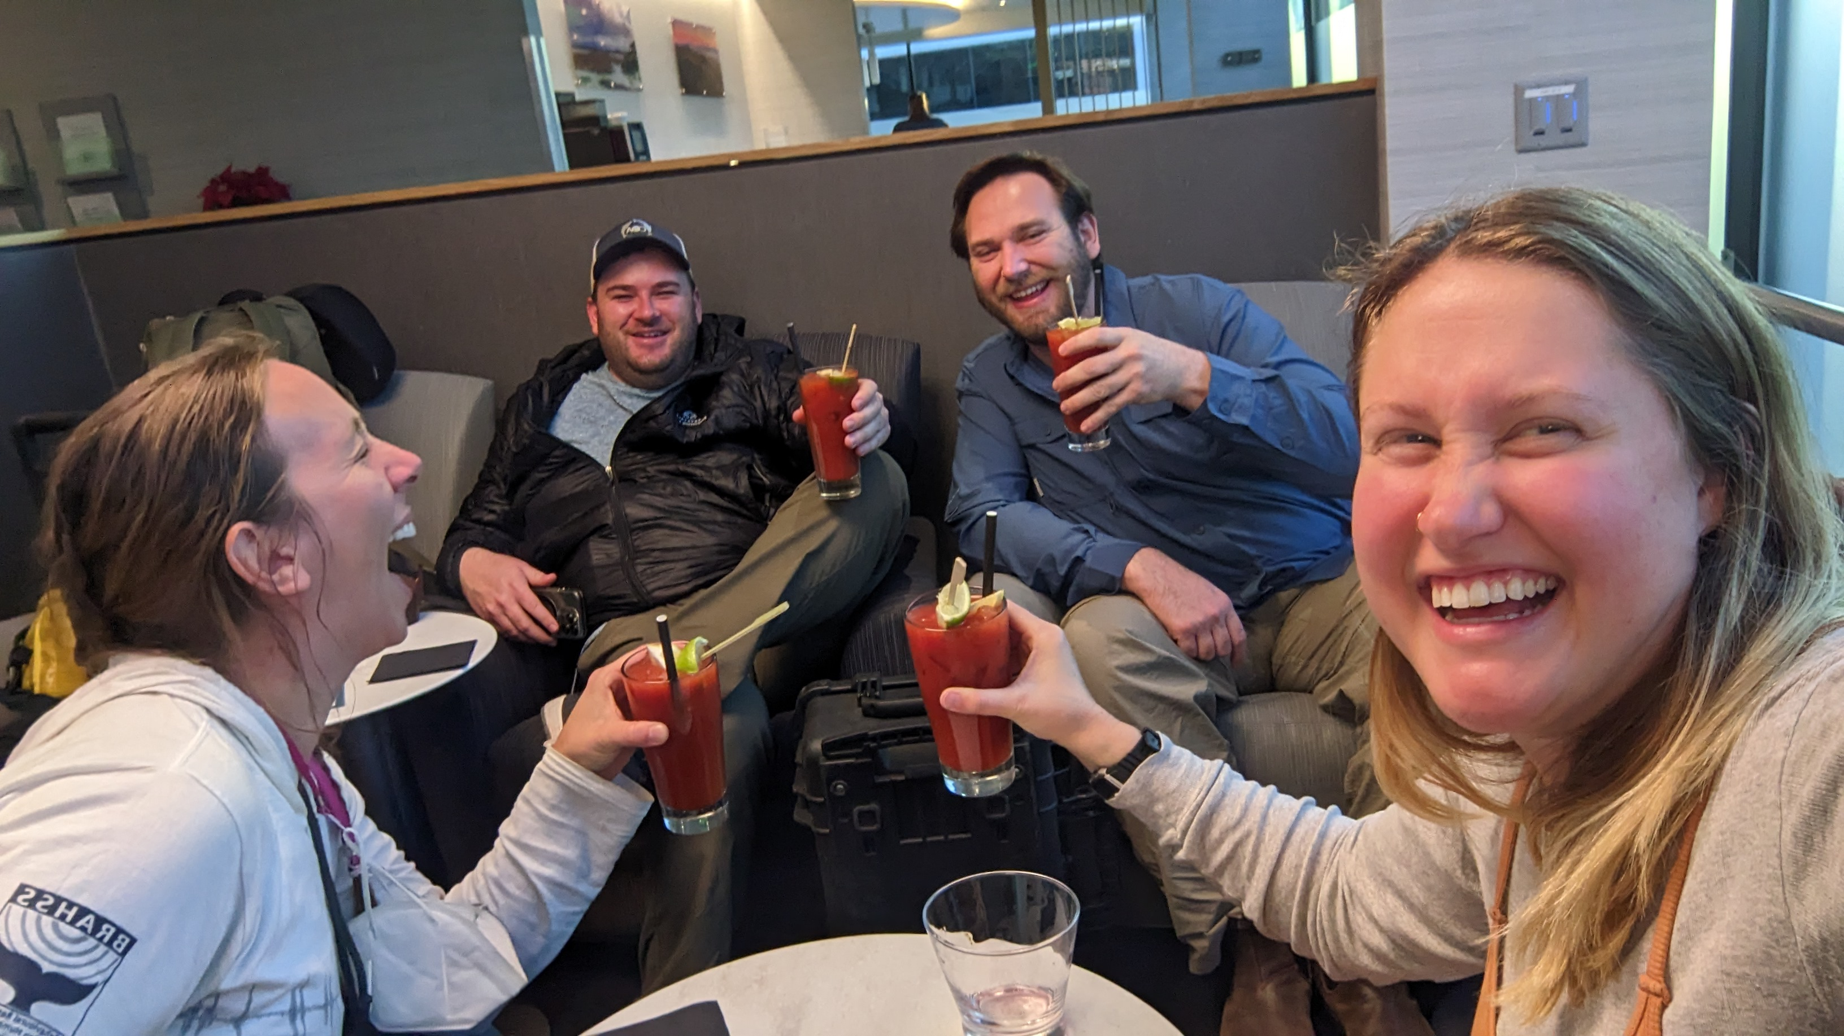

PAL-LTER: Graduate Students & Postdocs

Slide 2
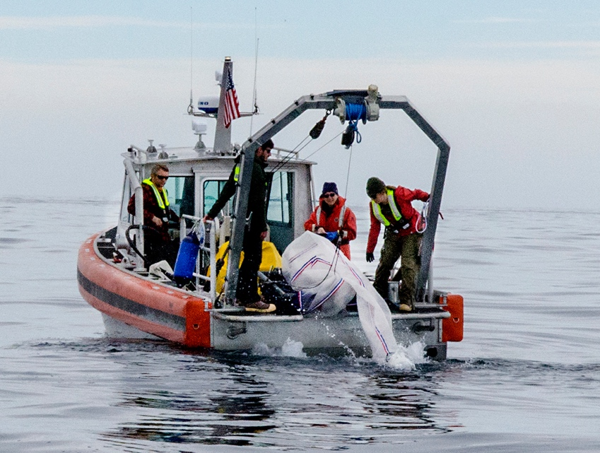
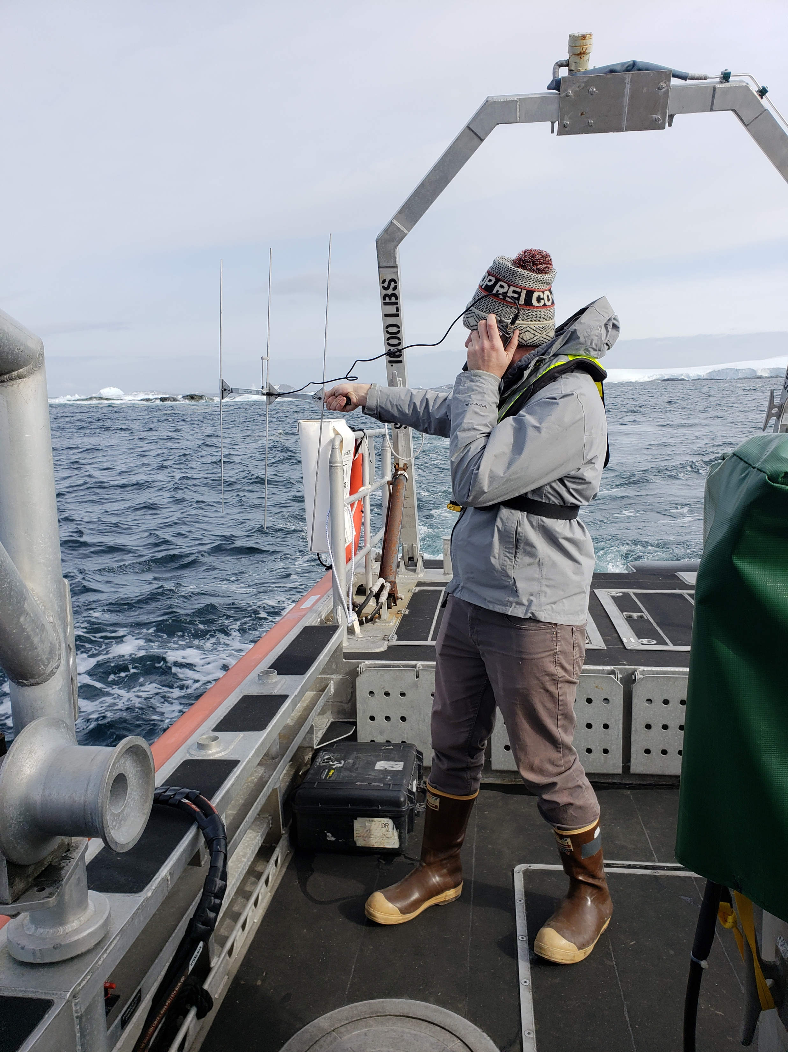
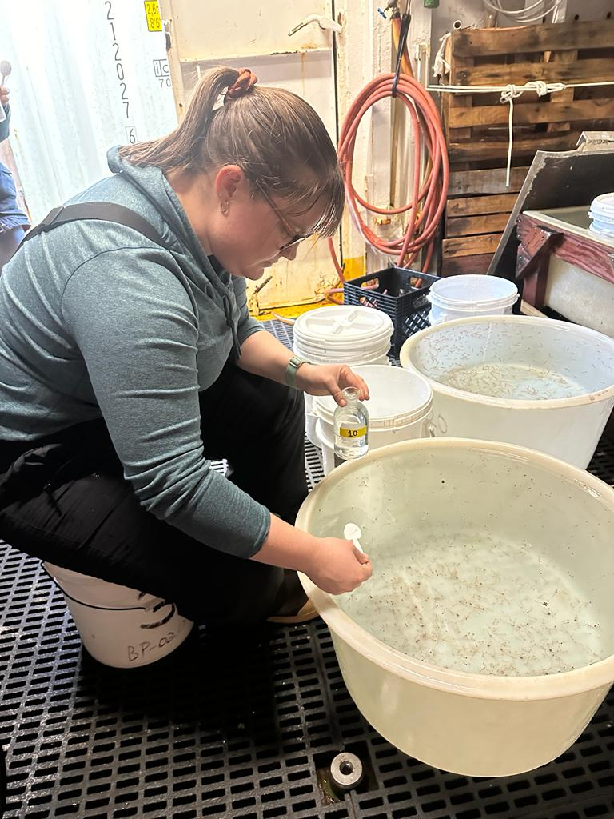
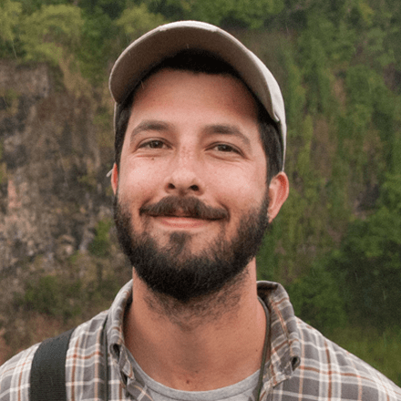
Graduate/Post-Doc Opportunities with PAL-LTER
PAL provides opportunities for graduate students and postdocs in:
  Polar fieldwork, Research, Mentoring, Teaching, Professional Development
We aim to involve a diverse group
Tiered mentoring platform
Cohort of colleagues, friends, family
Multiple opportunities to recruit and support students:
  NSF OPP Postdoctoral Fellowship
  NSF GRFP
  Institution-specific endowments aimed at supporting graduate students
  Foundation for pursuing careers in a range of sectors
    Academic, government, NGO, private, etc

Slide 3
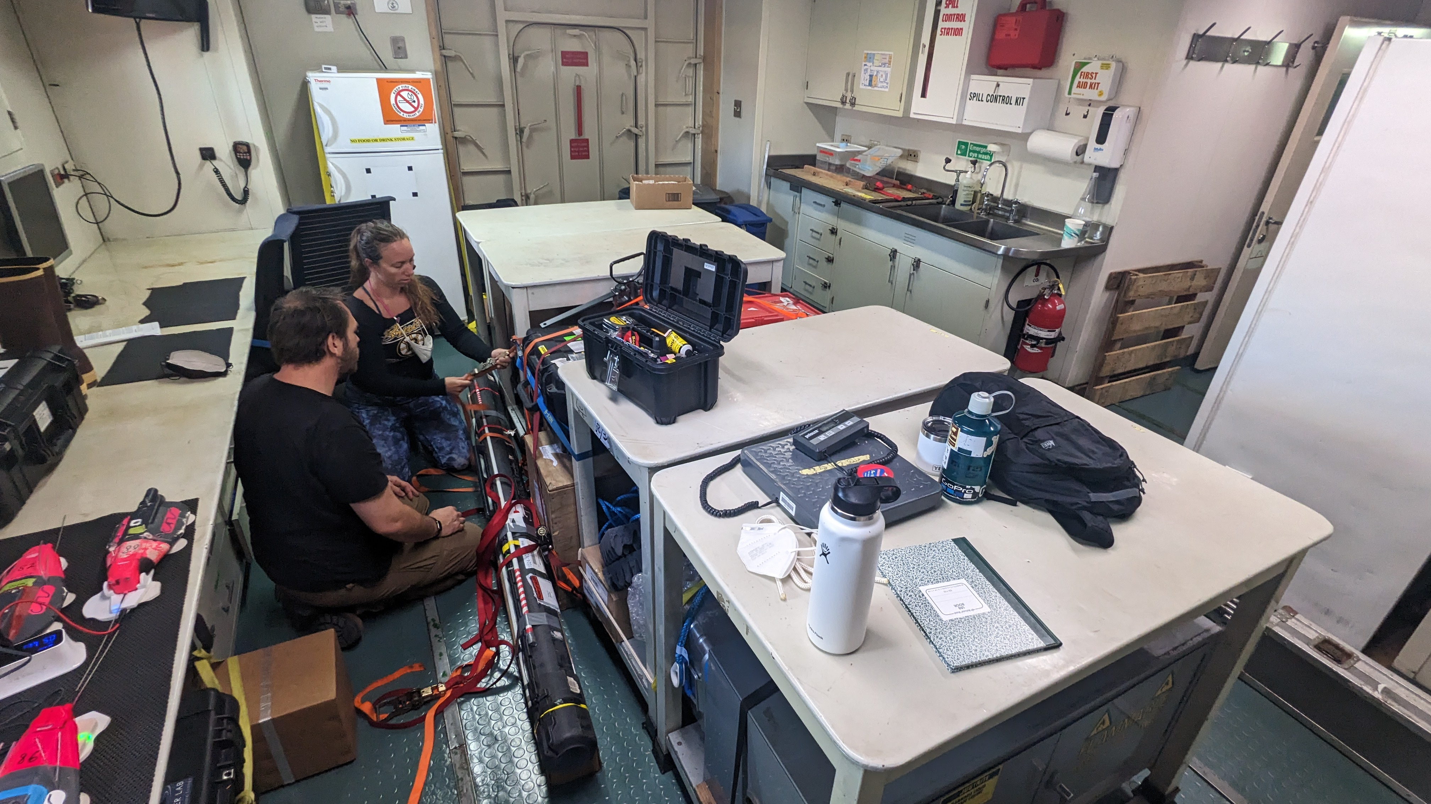
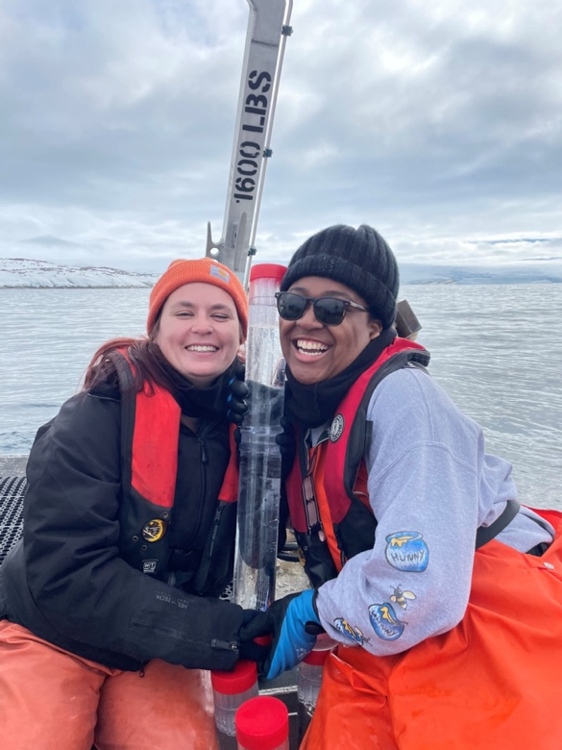
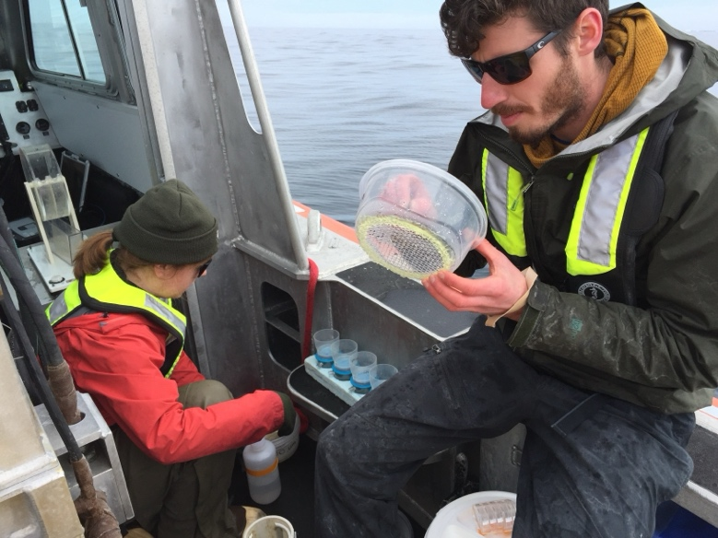
PAL Training and Mentorship
>50 graduate students and post-docs involved in PAL in recent years.
nearly all participated in field work.
Students develop independent projects and lead aspects of PAL themes.
Students participate in PIs group meetings and receive individual guidance and mentorship.
PAL monthly meetings, fieldwork, and LTER-wide activities provide opportunities to broaden scientific horizons and networking.
Professional development through engagement in professional societies

Slide 4
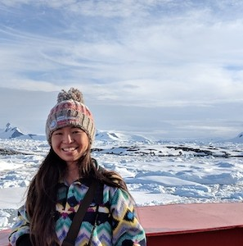
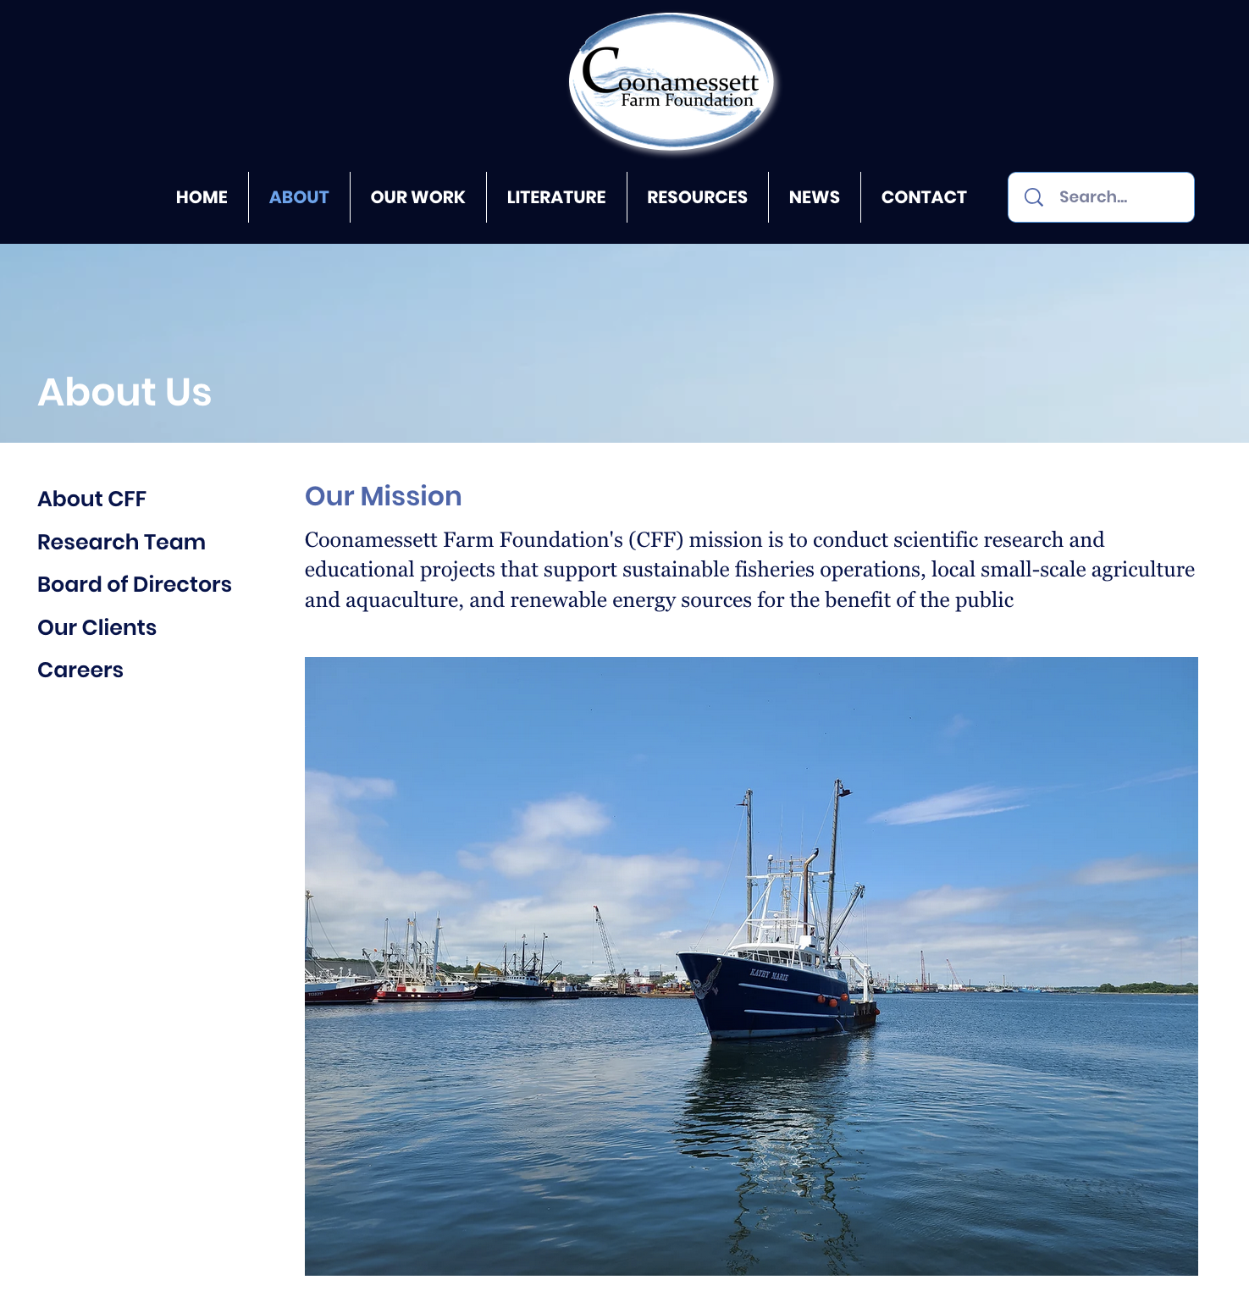
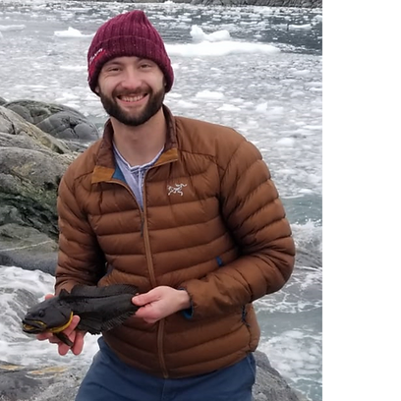
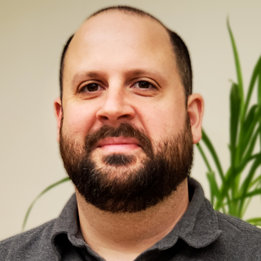
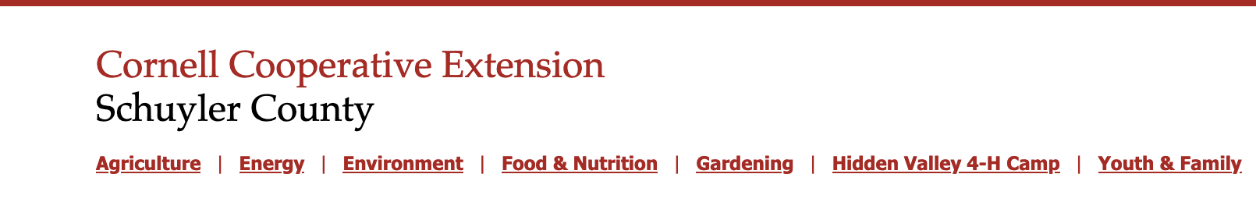

Slide 5

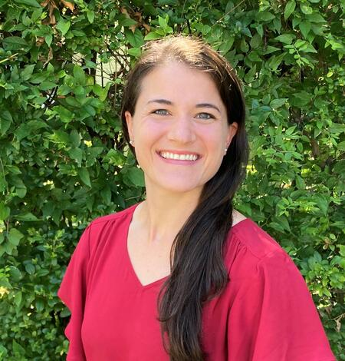
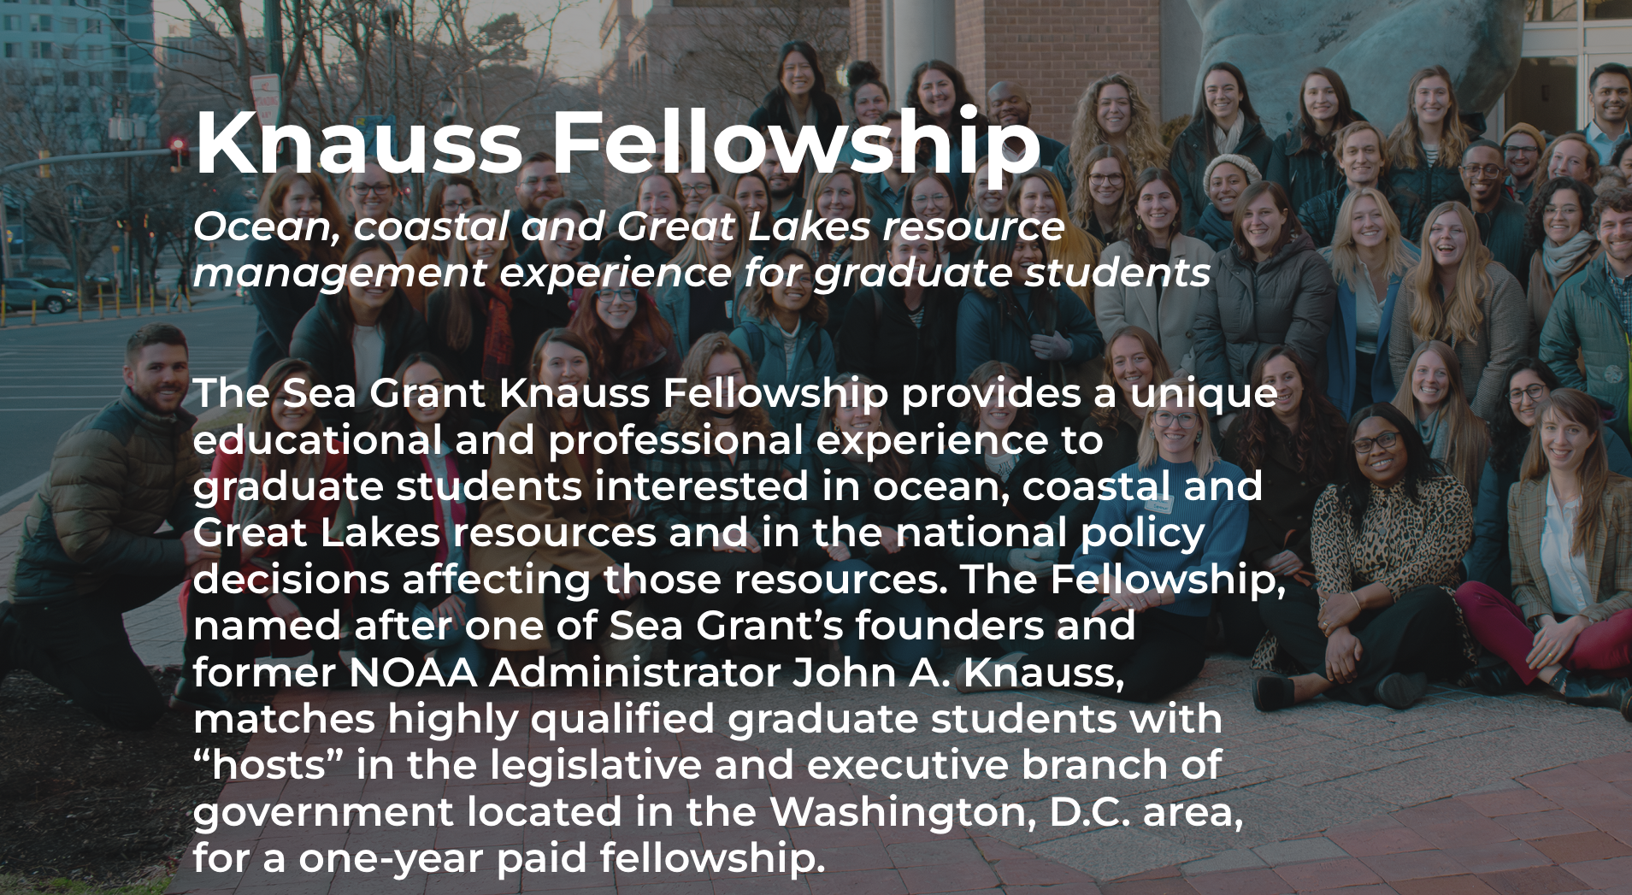

Postdoctoral Biologist in the Biogeochemistry Group at the California Water Science Center

Slide 6
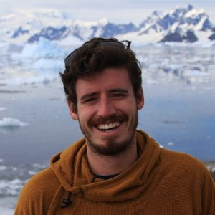


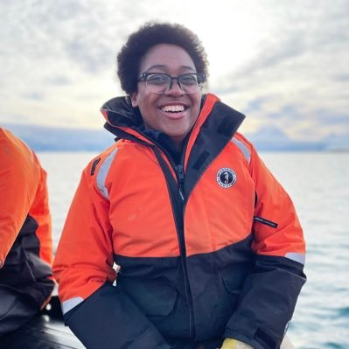
SCAR Krill Expert Group
Expert group on Birds and Marine Mammals, SCAR
Co-chaired international session at 2022 Ocean Sciences Meeting
Co-authoring resource guide and perspective paper on inclusive leadership in polar science resulting from 2023 NSF-funded Polar Postdoc Leadership Workshop
LTER pelagic cross-site synthesis group
Co-organized 2024 Monterey Bay Marine Science Volleyball Tournament

Slide 7
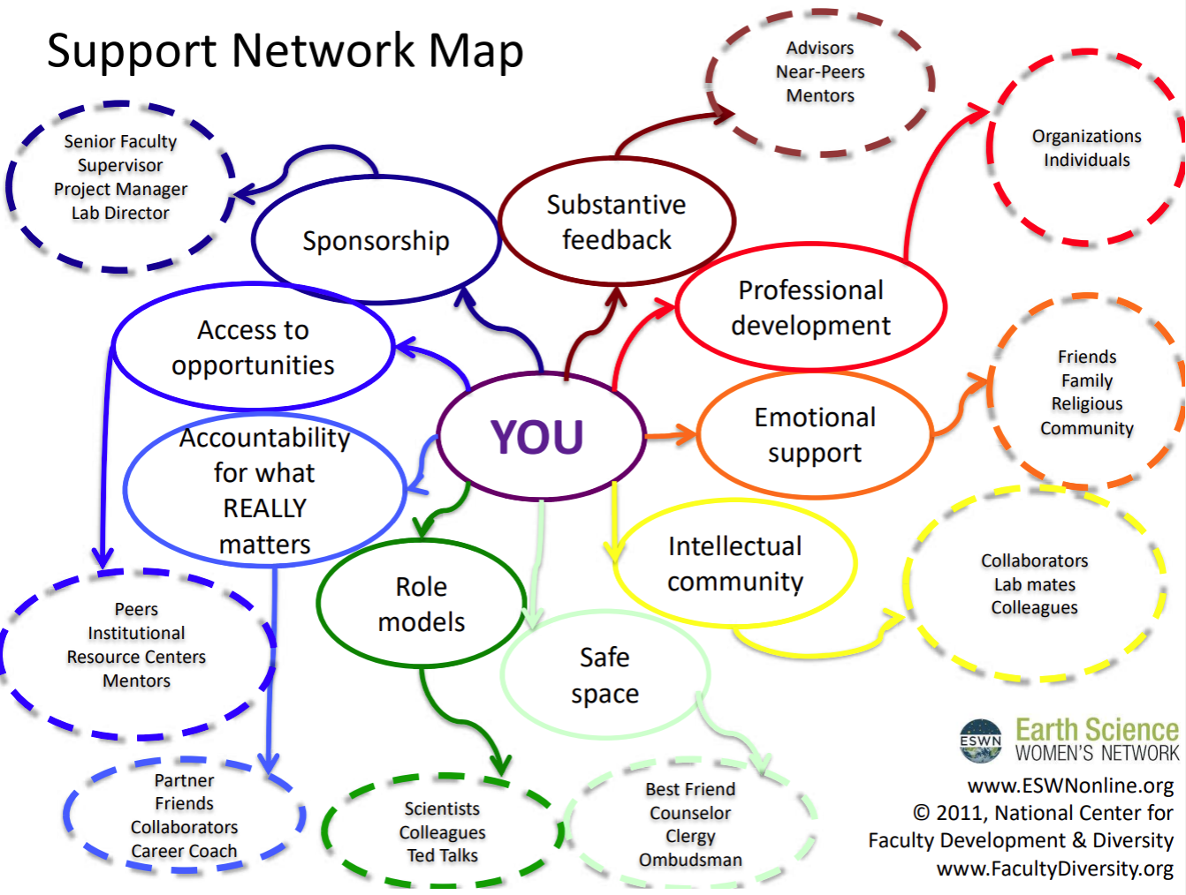
PSECCO Resources
Polar Education Materials
Polar Careers Outside of Academia
Early Career Researcher Resources
Polar Postdocs Leadership Resource Guide

Slide 8
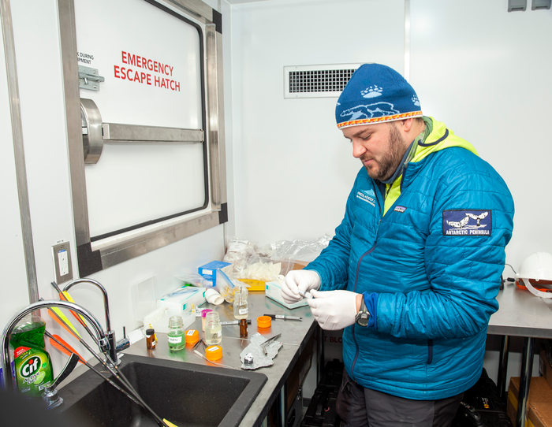
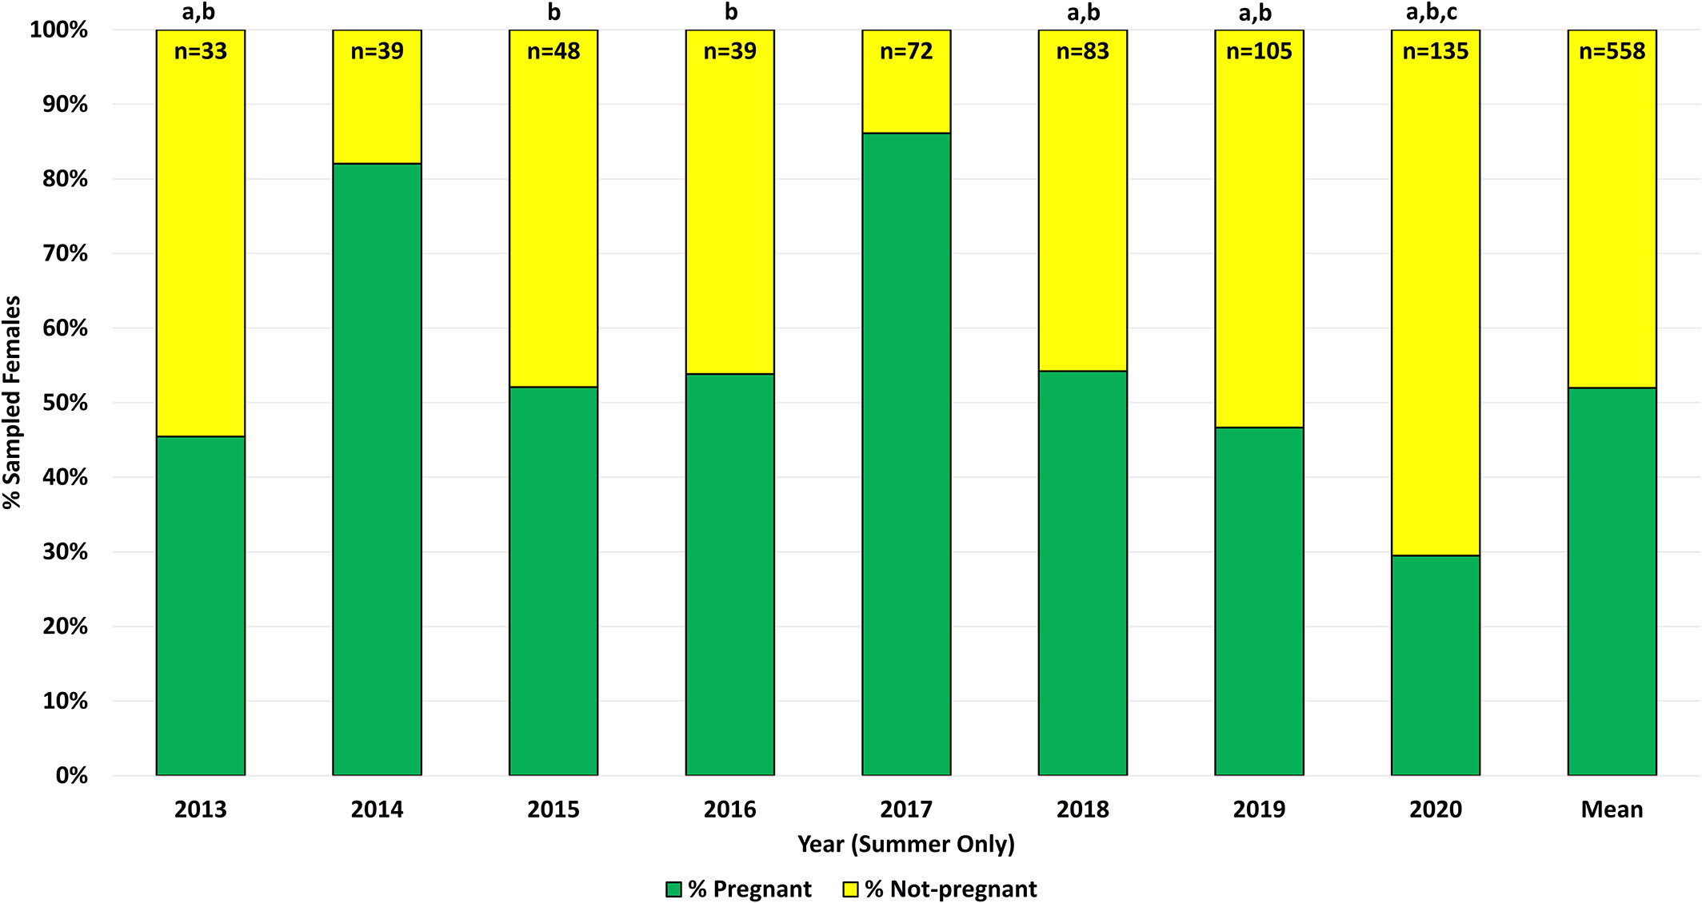
Developed a novel method
Built a time-series
Teaching students and researchers
Applying it to international conservation efforts

