Slide 1
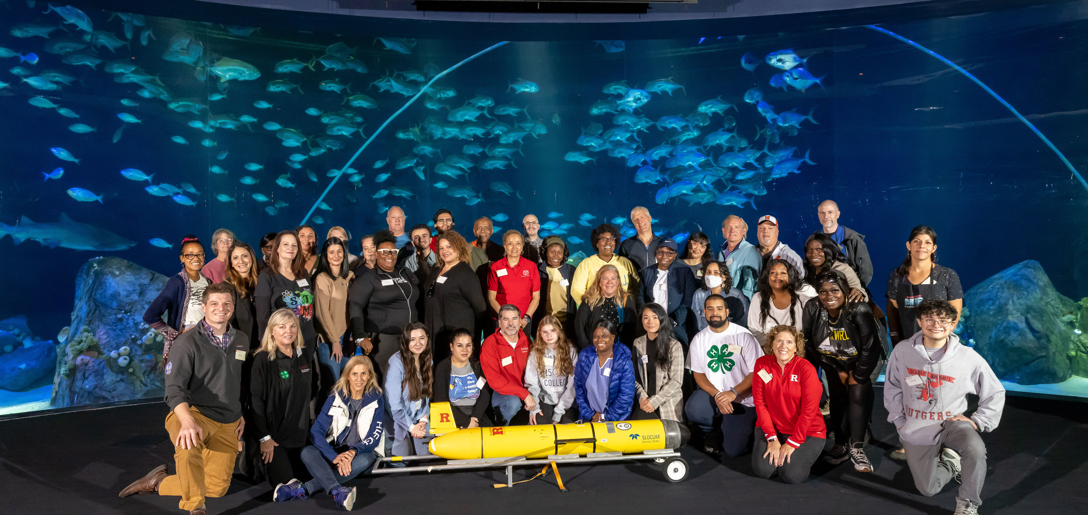


Education and Outreach at PAL
Janice McDonnell
Palmer LTER , Mid-Term Review 2024

Slide 2
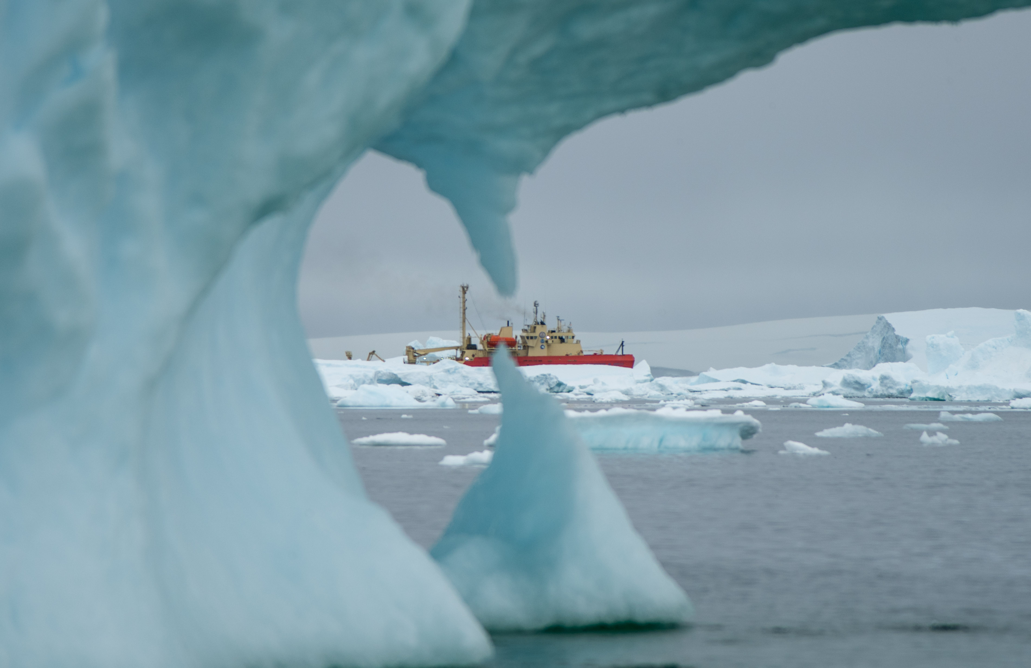
Background and Context
Challenges
Distant and remote
Connecting local to global relevance in climate change concepts
Cannot bring (most) people directly to the Antarctic habitats to build connection and sense of place
Opportunities
Engenders a sense of exploration and adventure
Charismatic organisms
Fun and excitement to learn about a far-away place
Notes:
2017- present serving as education coordinator

Slide 3
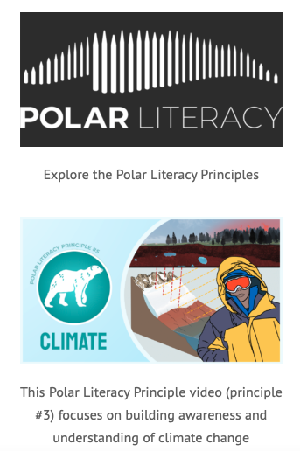
Mission
We strive to:
Promote understanding of the polar ocean environment though our Polar Literacy Initiative
Support the next generation of young scientists through innovative field and classroom experiences for K-12 students; and
Provide opportunities to pursue lifelong learning through public outreach initiatives, events, and meetings.
Support the PAL team in building BI capacity
Notes:
Since its inception in 1990, the PAL LTER education and outreach program focuses on increasing the publics’ knowledge and excitement for science conducted along the western Antarctic peninsula (WAP) through partnerships with a wide variety of informal science centers, universities, science museums, aquariums, nonprofit organizations, corporations, broadcast media, community and govenment leaders.

Slide 4
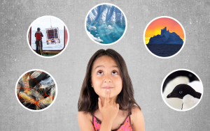
Research & Evaluation Questions
How does engagement with polar data and polar scientists influence informal/formal learners’ understanding and appreciation of polar systems?
Notes:
What role do polar scientists play in an informal learners' appreciation and understanding of polar systems? How best can polar data be incorporated in informal learning environments? What is the impact of the delivery mode on an learners’ understanding and appreciation for polar systems?

Slide 5
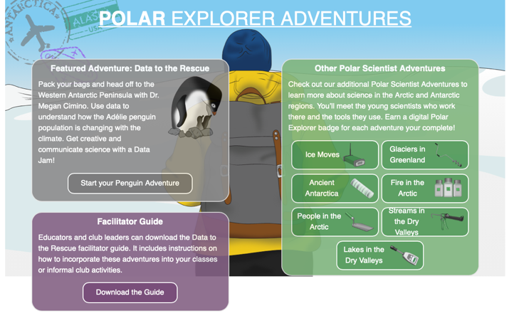
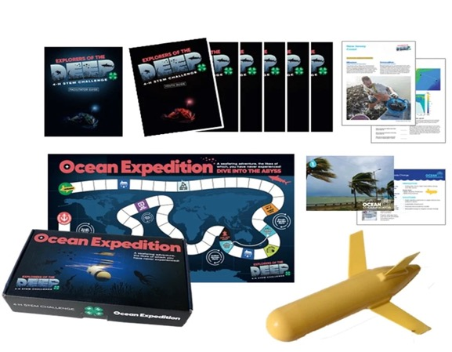
Program overview:
Schoolyard LTER program
4-H Explorers of the Deep
Data to the Rescue: Penguins Need Our Help!
  Program Implementation
  What the evaluation data tells us
  Questions and next steps
Notes:
My plan for today was to introduce you to our research questions and logic model of how we set up our project. Walk you through our pilot implementations and what the data is telling us so far. Lori will give you some insight in how her district took this program on and what STEM teaching has been like through the pandemic (opportunities and challenges). We will have time for questions and of course share our next steps.

Slide 6
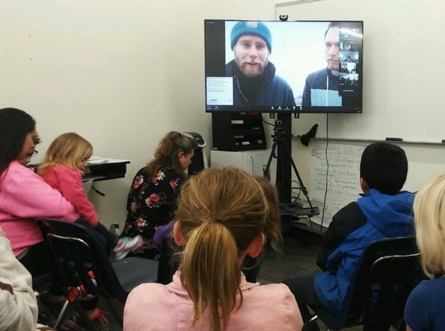
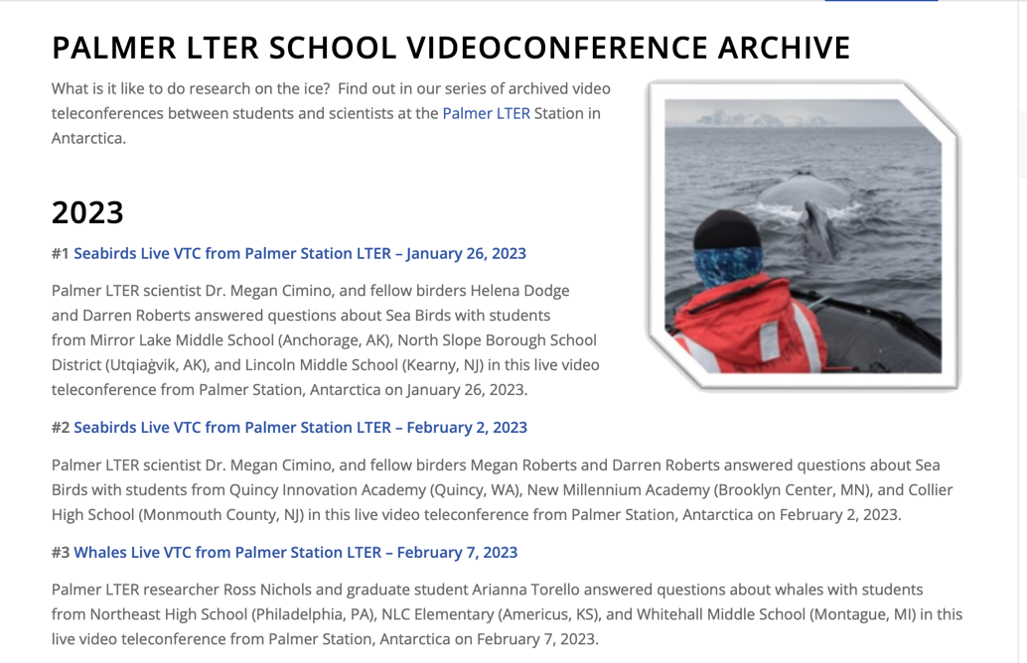
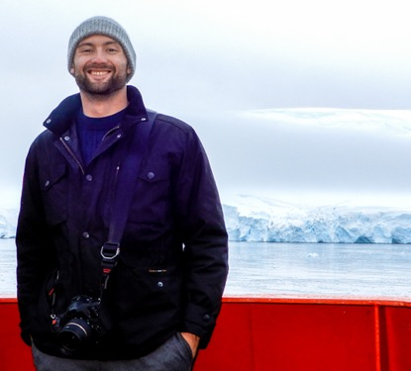
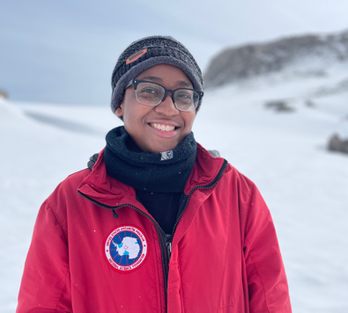
Schoolyard Program: Video Teleconferences (VTCs)
2017-present

Slide 7
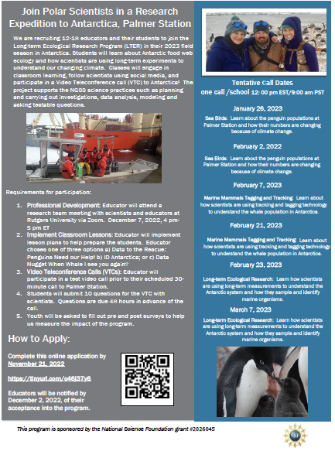
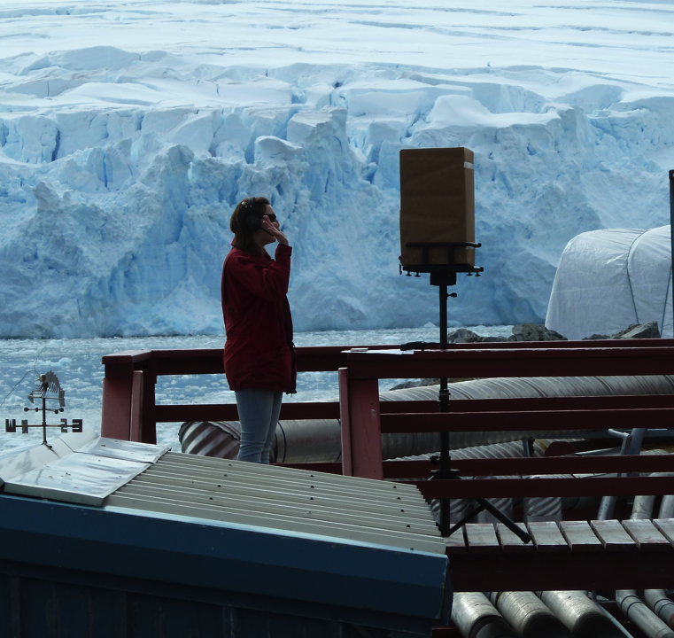
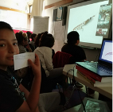
VTC Process & Timeline
November 2022
Announcement to schools
December 2022
Professional Development for Teachers
Curriculum is available
January – March 2023
Curriculum is implemented
Student questions are collected and vetted -- VTCs take place

Slide 8
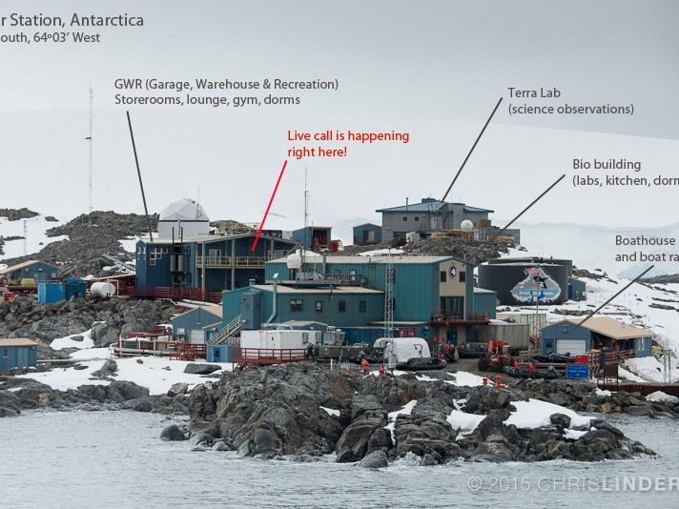

Slide 9
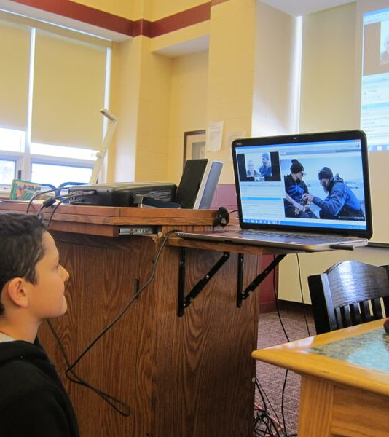
Program Lessons Learned
Ability to practice asking scientific questions: Educators noted the importance of getting students to develop and ask scientific questions. Students were generally interested in questions posed by their peers from their schools and from other schools.
“As a class, we spent time examining types of questions and quality of questions. We read previously submitted questions and evaluated where on Blooms Taxonomy did that question fall- comprehension to an analysis. This seemed to be the first encounter my students had with the idea of question types. They were engaged and extremely thoughtful about the quality of their questions”.

Slide 10
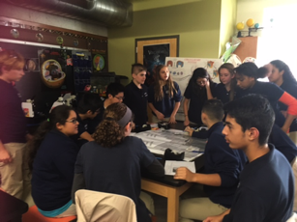
Lessons Learned
Increase understanding and awareness of Polar Regions: Educators noted that students were interested to learn more about Antarctica. Students were able to learn more about the Antarctic food web from the smallest microbes to the largest whales.
    “We are currently investigating microbes in class and our curriculum standards tend to focus more on the "bad" microbes than all of the "good" microbes in our world. The broadcast allowed my students to learn more about how microbes are studied and about some of the related careers available”.

Slide 11
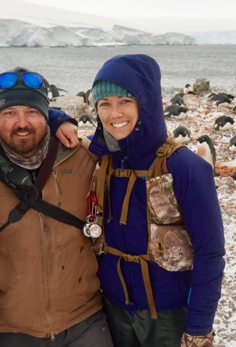
Lessons Learned
Ability to meet a practicing scientist: Many educators noted that it was important for students to have the opportunity to meet and talk to a real scientist.
    “Students had a chance to meet a real scientist and hear about their work and everyday life. They left very excited. I heard sentences start with "I wonder if...." "What would you study..." and just a general sense of excitement”.
    “It was helpful to see a female scientist and allow female students to see themselves with her and both scientists were engaging but it was also hard to actually see them to allow students to see themselves in the scientists”.

Slide 12
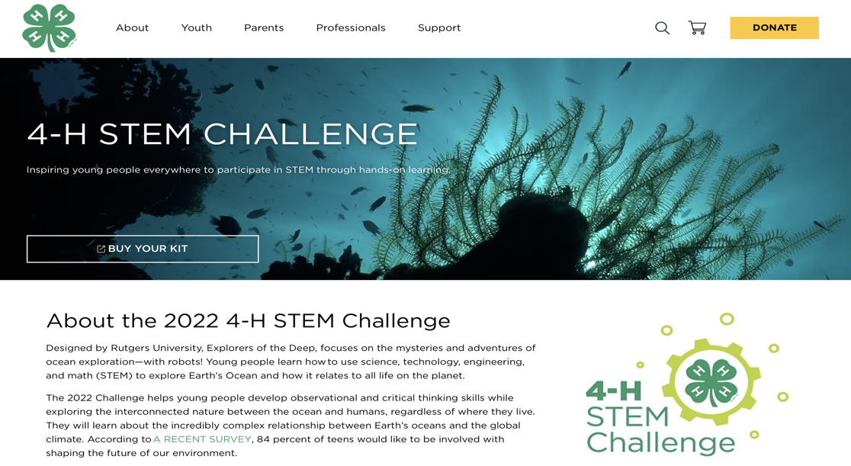
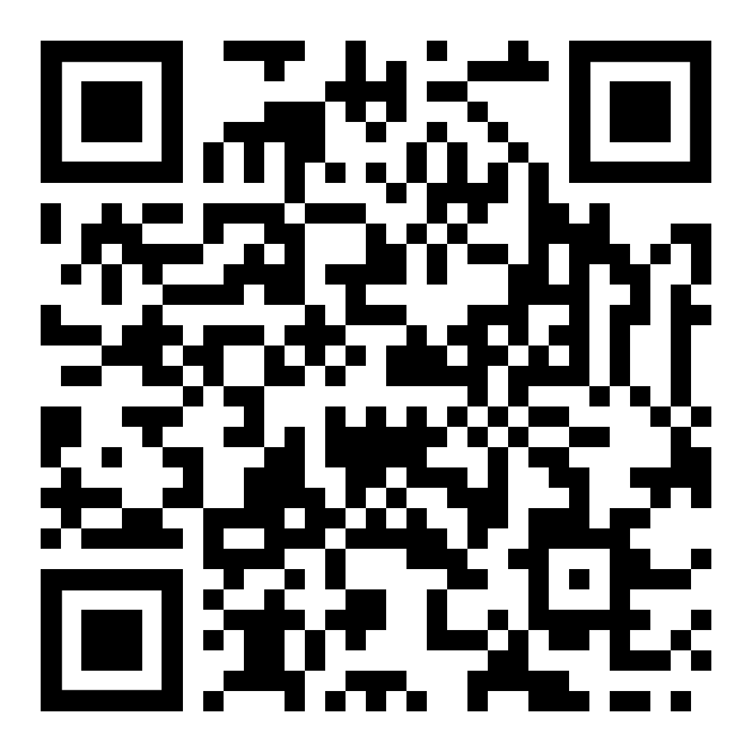
4-H STEM Challenge
(2022-present)
Awarded 50K grant to develop the 4-H STEM Challenge
Opportunity to promote LTER-PAL on a national stage
4-H is a youth development program in 50 states/every county in the U.S. reaching more than 4 million youth.

Slide 13
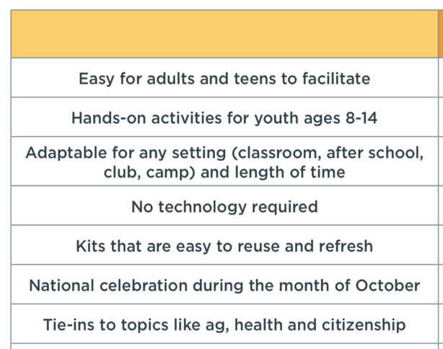
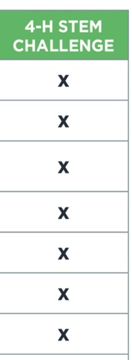
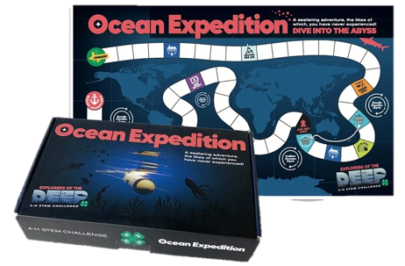
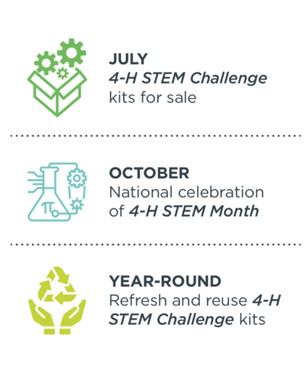
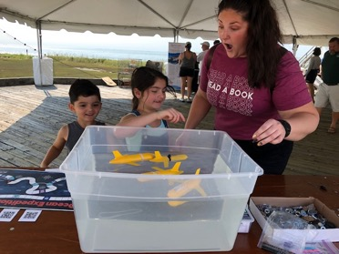
Design Criteria

Slide 14
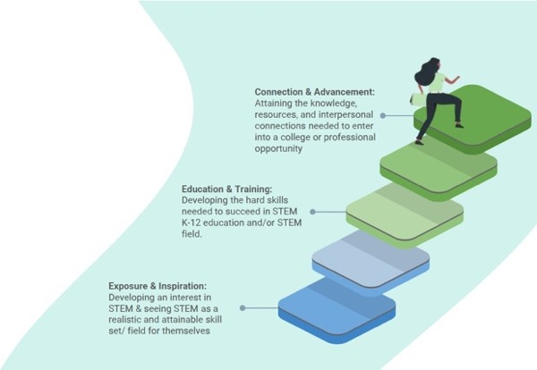
Our Own Design Criteria
Based on VTC experience
Building STEM Identity in Youth
STEM Interest:
I like to do this
STEM Skill Building:
I can do this
STEM Pathways:
This is important to me
Outcomes for Informal Science Education Programs: (Afterschool Alliance, 2013)

Slide 15
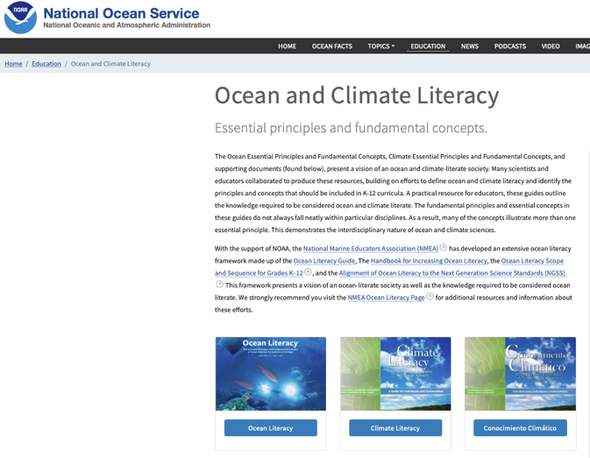
Our Design Criteria
Focus on Ocean and Climate Literacy Principles.
Get young people to talk about climate solutions, adaptations and resilience.
Data literacy.

Slide 16
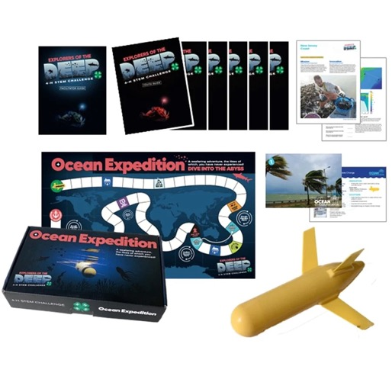
Kit materials distributed through national 4-H

Slide 17
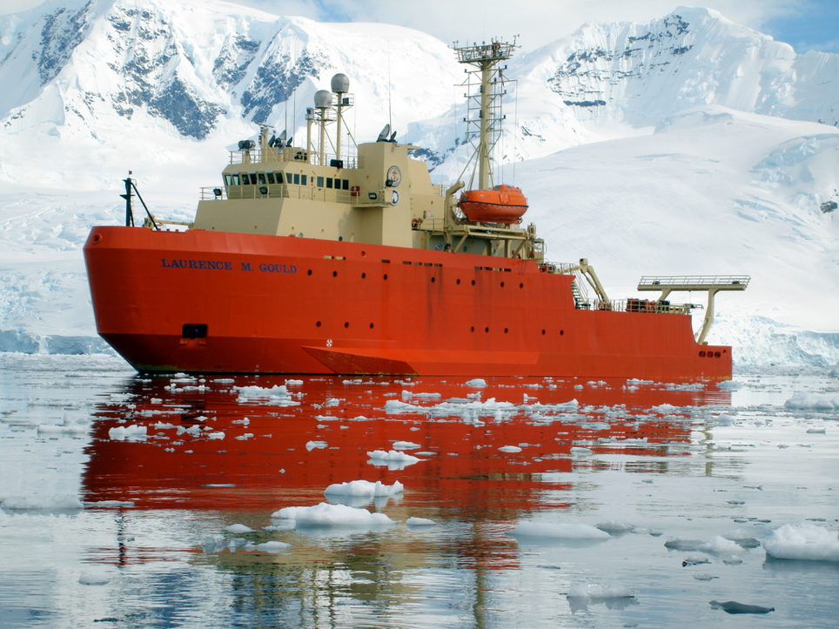
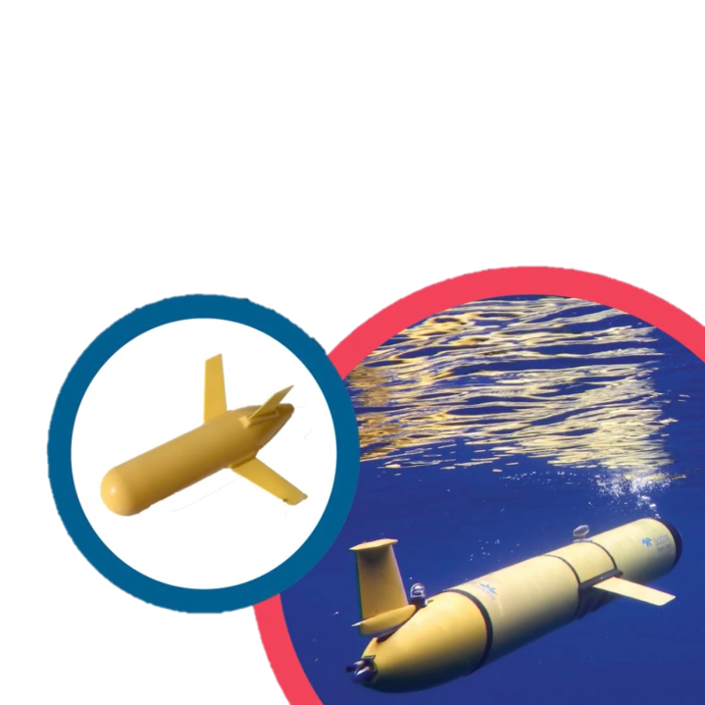
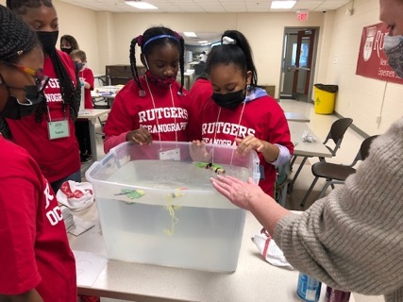
ACTIVITY 1:
OCEAN ROBOT TEST TANK
Notes:
Youth prepare their ocean robot for a research mission. Participants “ballast” their ocean robot by adding weights to create the sinking and floating behavior of a real ocean robot. Finally, they investigate data collected by ocean robots and learn about the value of ocean exploration.

Slide 18
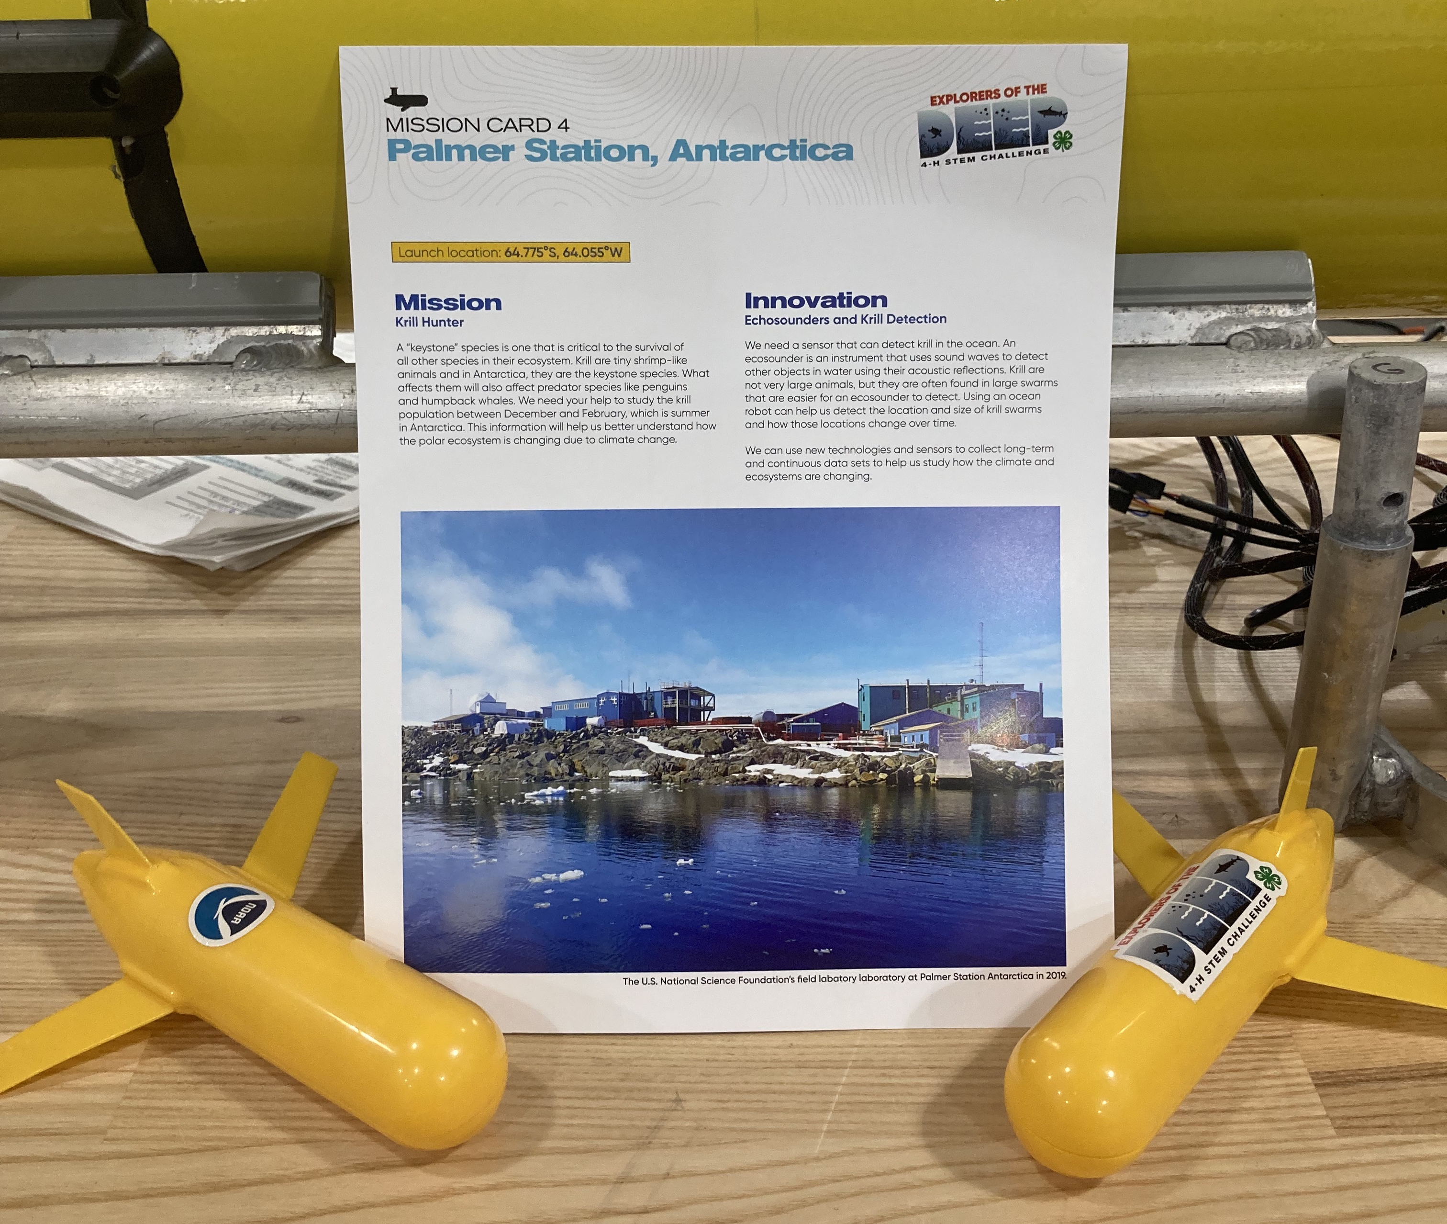
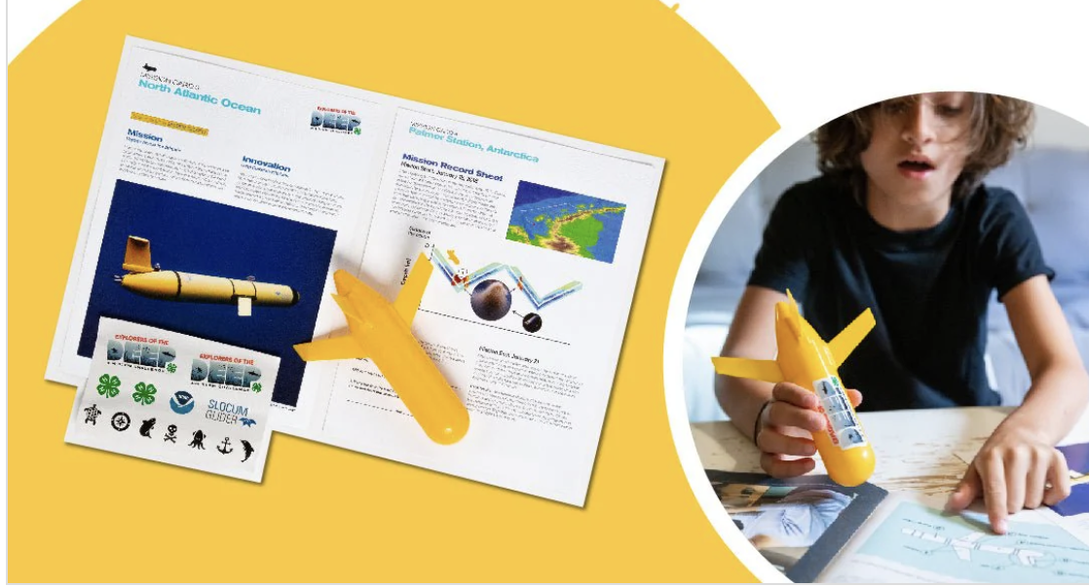
Part II. Diving into Data and Mission Journals
Have youth practice interpreting the data from their mission and answer questions on page 14.

Slide 19
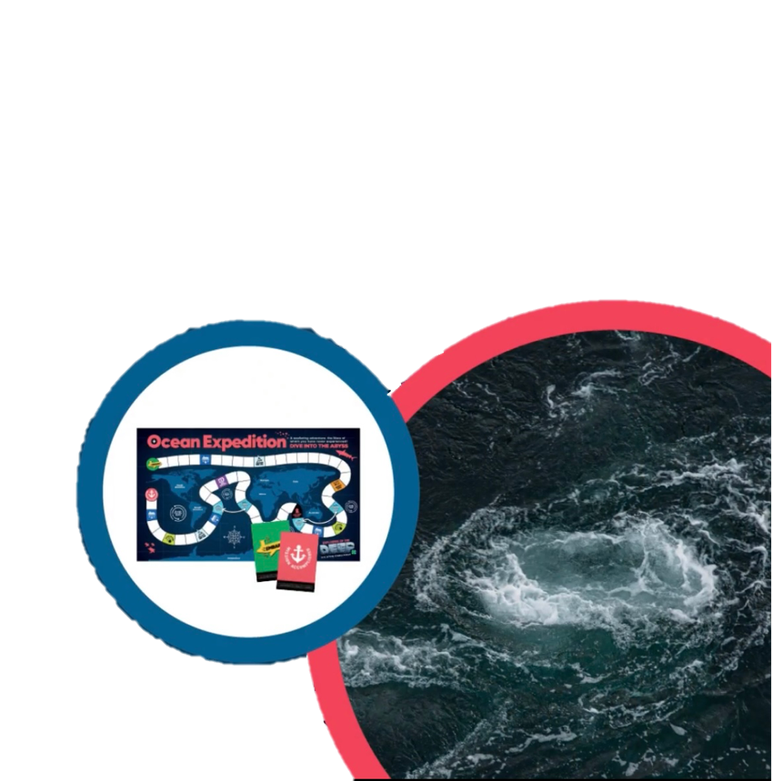
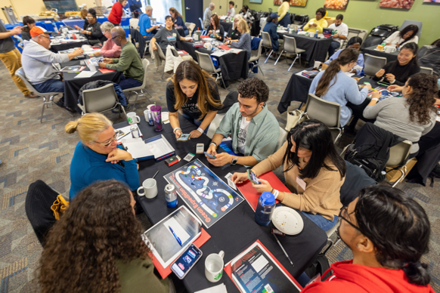
OCEAN EXPEDITION
ACTIVITY 2:
Notes:
Youth play a board game to navigate their ocean robot around the world while learning key ocean concepts. Topics include aquaculture, climate change, innovation, human impact and the ocean ecosystem.

Slide 20
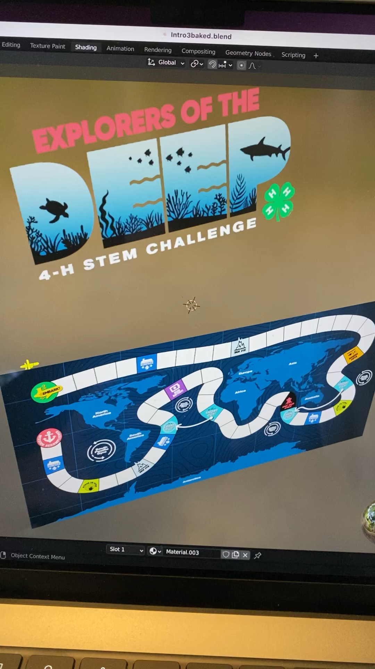
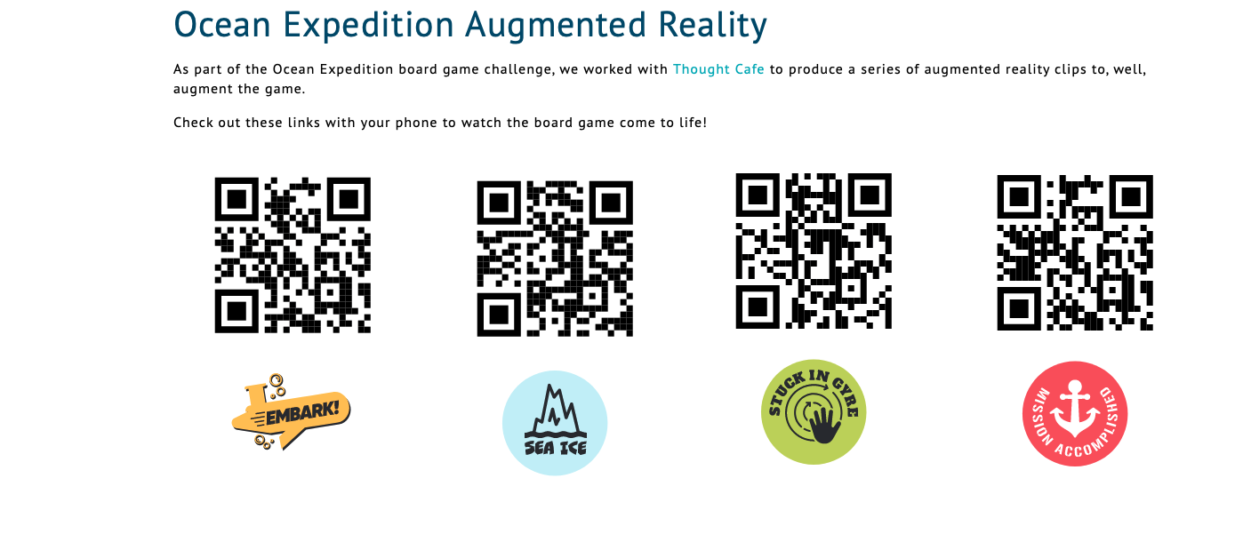

Slide 21
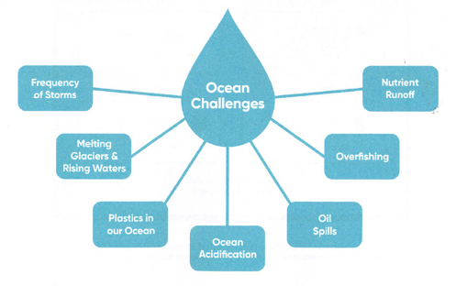
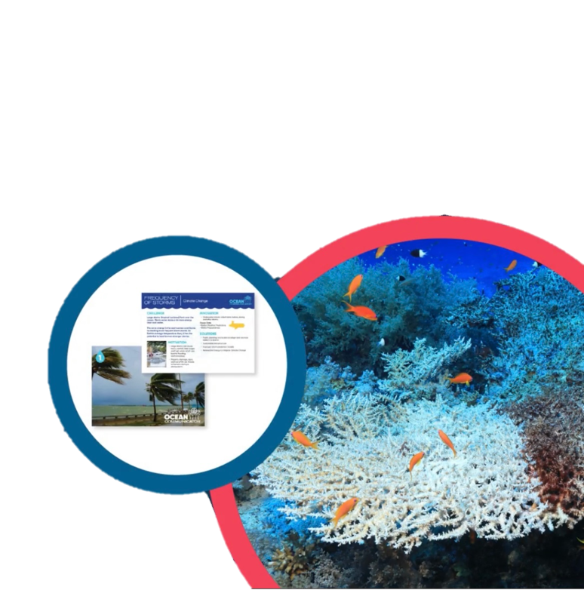
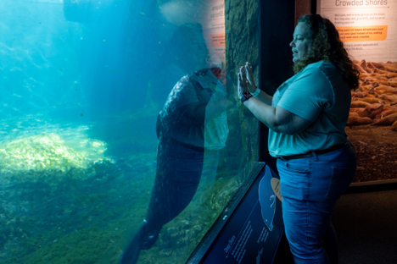
OCEAN COMMUNICATOR
ACTIVITY 3:
Notes:
Youth investigate challenges that ocean scientists, engineers and technologists are currently addressing. Each challenge requires innovations and technical solutions that inspire public action.

Slide 22
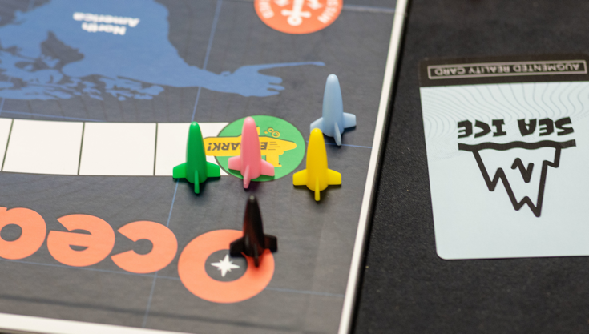
Did well in sales and continues to be sold through 4-H
“I did not know that the ocean could impact me living in landlocked Indiana”.
Teacher
4-H Volunteer Training in Georgia
October 6, 2022

Slide 23
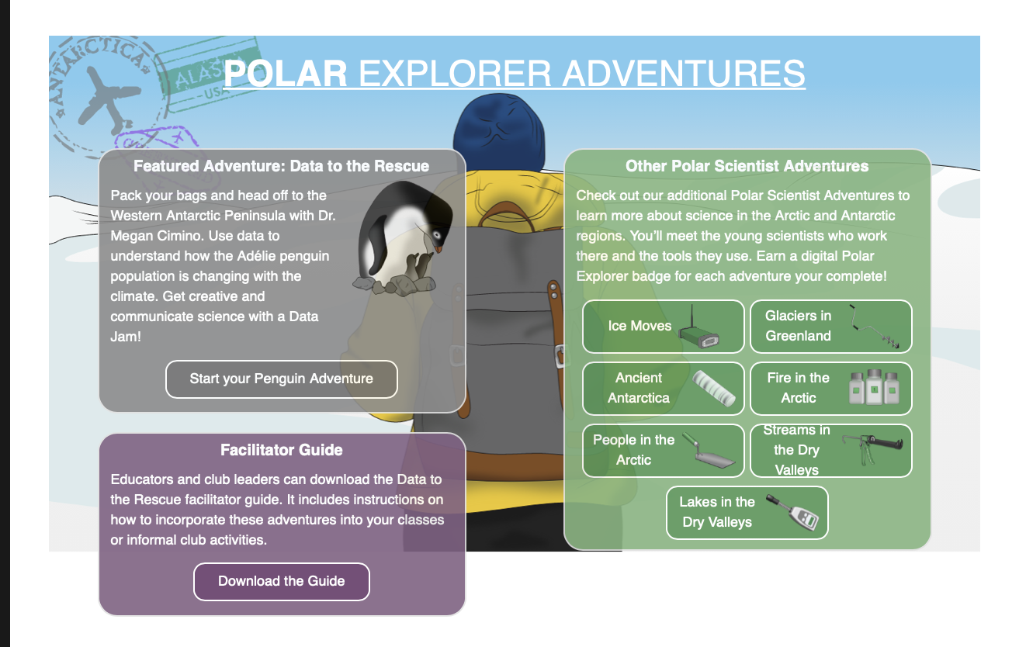
NSF AISL Project
Advancing Information Science Learning (AISL) at National Science Foundation (NSF)- awarded 2019
(1.2. million/ 3 years)
Seeks to advance new approaches to and evidence-based understanding of the design and development of STEM learning opportunities for the public in informal environments.
Notes:
If you are not familiar with AISL – it is a program within the National Science Foundation’s (NSF) that seeks to advance new approaches to and evidence-based understanding of the design and development of STEM learning opportunities for the public in informal environments; provide multiple pathways for broadening access to and engagement in STEM learning experiences; advance innovative research on and assessment of STEM learning in informal environments; and engage the public of all ages in learning STEM in informal environments. The Center for Advancement of Informal Science Education (CAISE) is an NSF-funded resource center which supports the AISL program. CAISE works in partnership with NSF Program Directors to plan resources that can help teams develop their proposals.

Slide 24
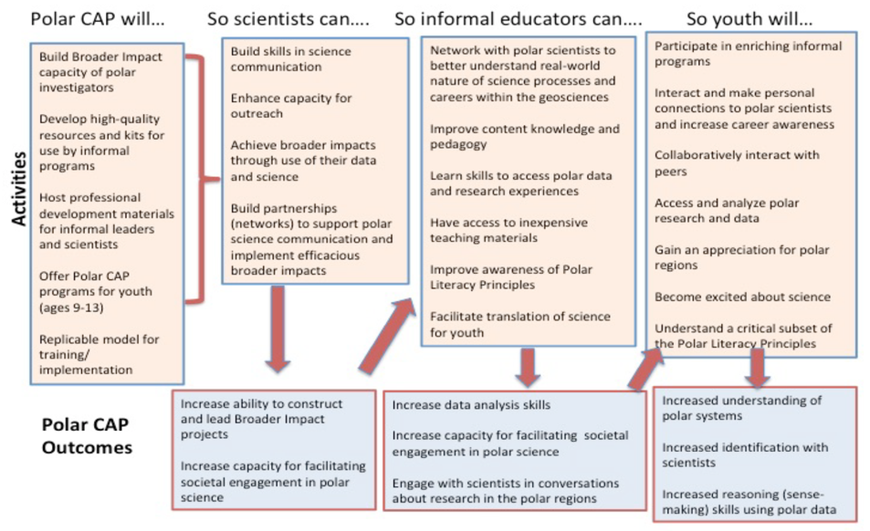
Logic
Model
Polar
Camps
Afterschool
Programs
Polar-CAP
Notes:
Our end goals are on the far right bottom with the youth being the focal audience
Informal and formal educators and our scientists collaborators were also important to the implementation
Our key tasks are (review list)

Slide 25
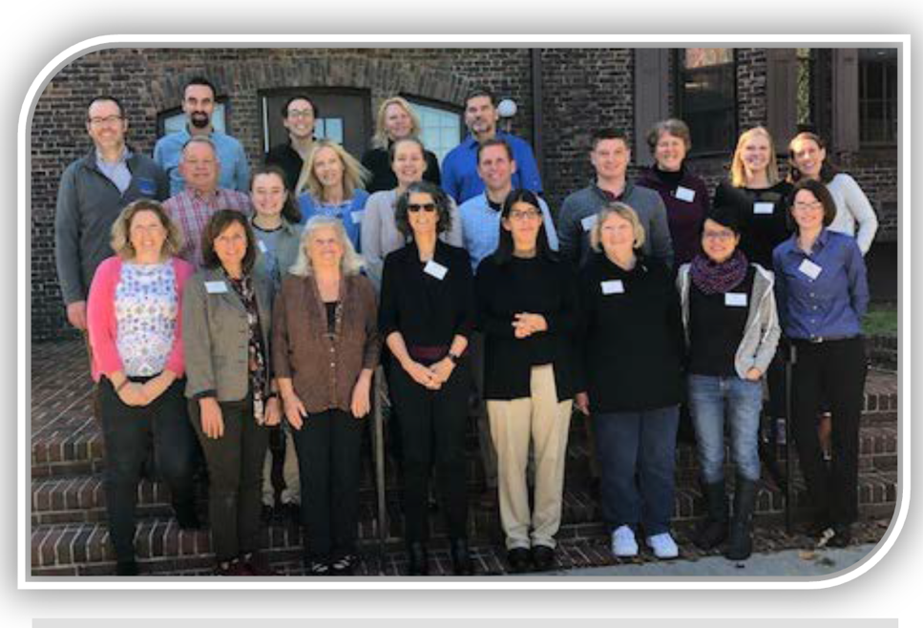
Advisory Board
Gail Scowcroft (University of Rhode Island)
Dr. Judy Diamond- University of Nebraska – Lincoln
Margie Turrin – Lamont Doherty Earth Observatory
Marilyn Sigman – Alaska Sea Grant
Dr. Rabbiah Mayas – Museum of Science and Industry
Dr. Sue Allen
Dr. Josh Kohut & Oscar Schofield – Rutgers University
Dr. Lynn Tran & Catherine Halversen – Lawrence Hall of Science – UC Berkeley

Slide 26
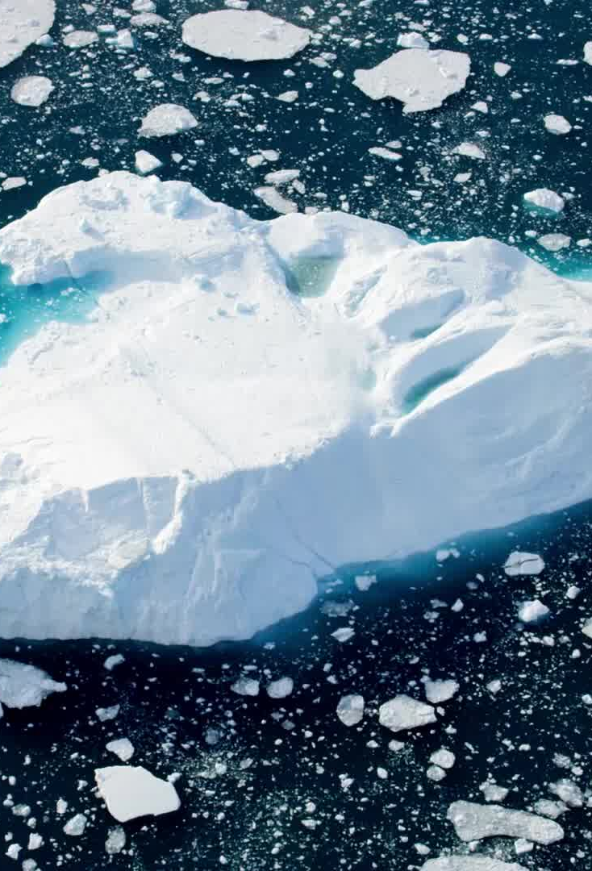
Student Learning Objectives
Students will KNOW (cognitive goals)
The Polar Regions are predominantly ice - yet the Arctic and the Antarctic have geographic differences.
Ice is important because organisms (plants, animals, humans) depend on it for habitat (food source, shelter, etc.)
Climate change is affecting the amount of ice at the poles. This has local and global impacts.
Scientists collect data over many years to study the changes in ice and how that is impacting local things like food webs and global things like sea level rise.
There are different tools that scientists use to collect data, and there are different ways to display this data (maps, graphs). Graphs can be used to display how one variable relates to another
Data can be analyzed by asking questions. Data “tells a story” (is interpreted).
Notes:
These are our key learning objectives

Slide 27
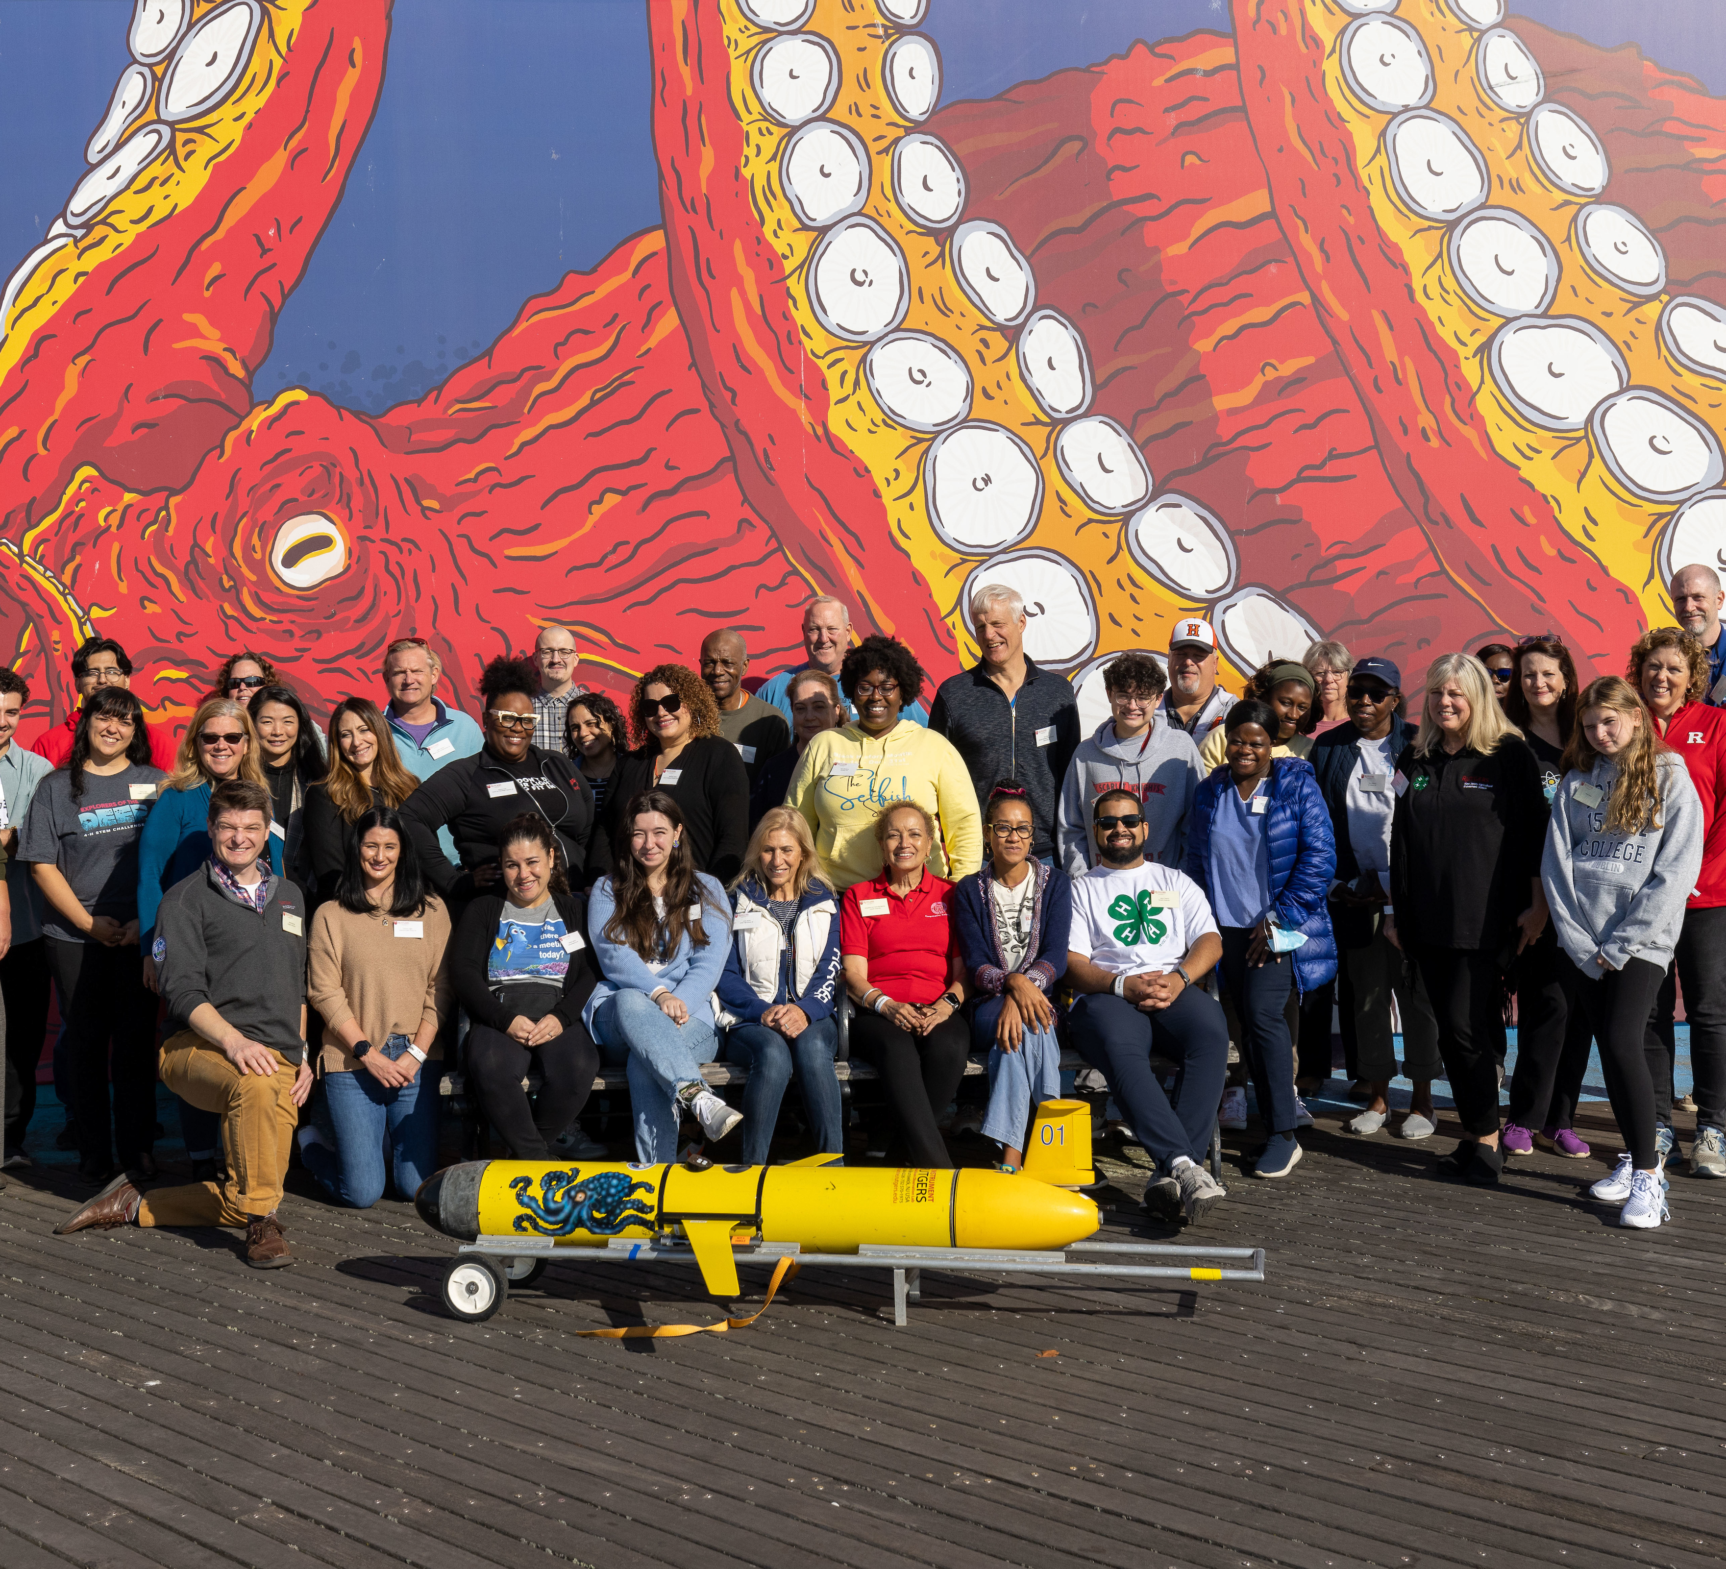
Student Learning Objectives
Students will FEEL (affective goals)
Excited about the process of discovery in science
A sense of what it feels like to actually be in these polar regions
A greater sense of self-efficacy regarding data
More connected to the polar regions
Students will DO (behavioral goals)
Notice the changes over time in their own local area
Participate in another science program--"I care more about the poles (through knowing a little more and through an emotional connection and through getting to work with real data and hear from scientists)”
Notes:
Feel and Do goals

Slide 28
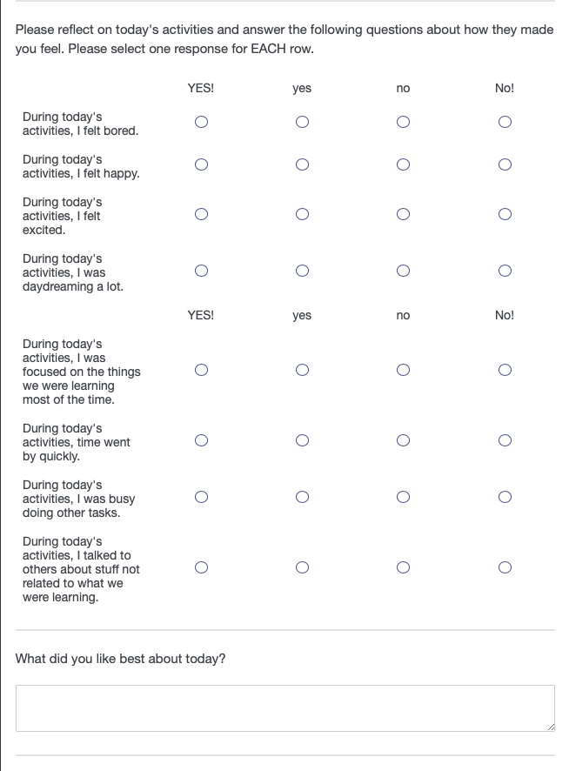
Metrics Overview
Engagement in Science
measured at three times points (end of Days 2, 3, and 4) for five-day programs and on additional days for programs that extended beyond five days using eight items from the Engagement in Science Learning Activities Survey.
http://activationlab.org/wpcontent/uploads/2018/03/Engagement-Report-3.2-20160803.pdf
Notes:
Four youth surveys at multiple time points. The surveys were designed to assess engagement and changes in science identity, fascination in science, and valuing of science.
Youth were asked to respond to each item (e.g., “During this activity, I felt excited”) on a four-point scale that ranged from 1 (e.g., “NO!”) to 4 (“YES!”). Prior
to averaging youths’ responses across the eight items, four items were reverse scored so that higher scores always
indicated higher engagement. The eight items formed a reliable scale with Cronbach’s alphas (as) ranging from .80
to .85 across all five-day programs. Programs lasting more than five days were not included in reliability analyses
because of small ns.

Slide 29
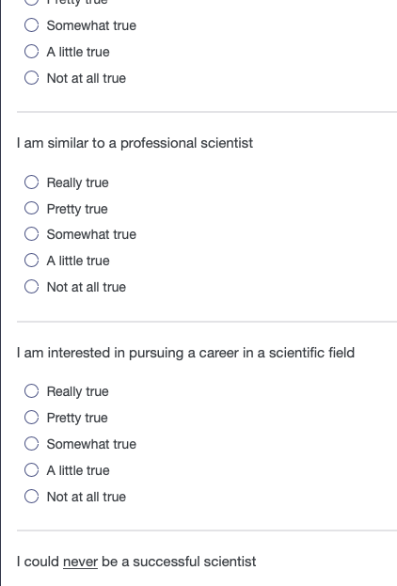
Science Identity
measured at two time points using four items modified from Cole (2012). The pre-survey was administered at the start of Day 1. The post-survey was administered at the end of the program.
Notes:
Youth were asked to respond to each item (e.g., “I am interested in pursuing a career in a scientific field”)
on a five-point scale that ranged from 1 (“not at all true”) to 5 (“really true”). Prior to averaging youths’ responses
across the four items, one item was reverse scored so that higher scores always indicated stronger science
identity. The four items formed a reliable scale with Cronbach’s alphas (as) ranging from .70 to .83 across the two
time points.

Slide 30
Fascination in Science from Activation Lab
1. I wonder about how nature works: 4=every day 3=once a week 2= once a month 1=never F02
2. In general, when I work on science I: 4=love it 3=like it 2=don't like it 1=hate it
3. In general, I find science: 4=very interesting 3=interesting 2=boring 1=very boring
4. After a really interesting science activity is over, I look for more information about it. 4=YES! 3=yes 2=no 1=NO!
5. I need to know how objects work. 4=YES! 3=yes 2=no 1=NO!
6. I want to read everything I can find about science. 4=YES! 3=yes 2=no 1=NO!
7. I want to know everything about science. 4=YES! 3=yes 2=no 1=NO! F08
8. I want to know how to do everything that scientists do. 4=YES! 3=yes 2=no 1=NO!
measured at two time points (i.e., at the start of Day 1 and the end of the program) using eight items from the Fascination in Science subscale of the Science Learning Activation Survey (2016).
Notes:
Youth were asked to respond to each item (e.g., “I want to read everything I can find about
science”) on a four-point scale that ranged from 1 (e.g., “NO!”) to 4 (“YES!”). Youths’ responses were averaged
across the eight items so that higher scores always indicated greater fascination in science. The eight items formed
a reliable scale with Cronbach’s alphas (as) ranging from .86 to .88 across the two time points.

Slide 31
Valuing of Science
measured at two time points (i.e., at the start of Day 1 and the end of the program) using eight items from the Valuing Science subscale of the Science Learning Activation Survey (2016).
1. Knowing science is important for: 4=all jobs 3=most jobs 2=a few jobs 1=no jobs
2. Knowing science helps me understand how the world works: 4=all the time 3=most of the time 2=sometimes 1=never
3. Thinking like a scientist will help me do well in: 4=all my classes 3=most of my classes 2=a few classes 1=none of my classes
4. I think scientists are the most important people in the world. 4=YES! 3=yes 2=no 1=NO!
5. I think science is more important than anything else. 4=YES! 3=yes 2=no 1=NO!
6. Science makes the world a better place to live. 4=YES! 3=yes 2=no 1=NO!
7. Knowing science is important for being a good citizen. 4=YES! 3=yes 2=no 1=NO!
8. I think science ideas are valuable. 4=YES! 3=yes 2=no 1=NO!
Notes:
Youth were asked to respond to each item (e.g., “Science makes the world a better place to live”) on a
four-point scale that ranged from 1 (e.g., “NO!”) to 4 (e.g., “YES!”). Youths’ responses were averaged across the
eight items so that higher scores always indicated greater valuing of science. The eight items formed marginally
reliable scale with Cronbach’s alphas (as) ranging from .78 to .84 across the two time points.

Slide 32
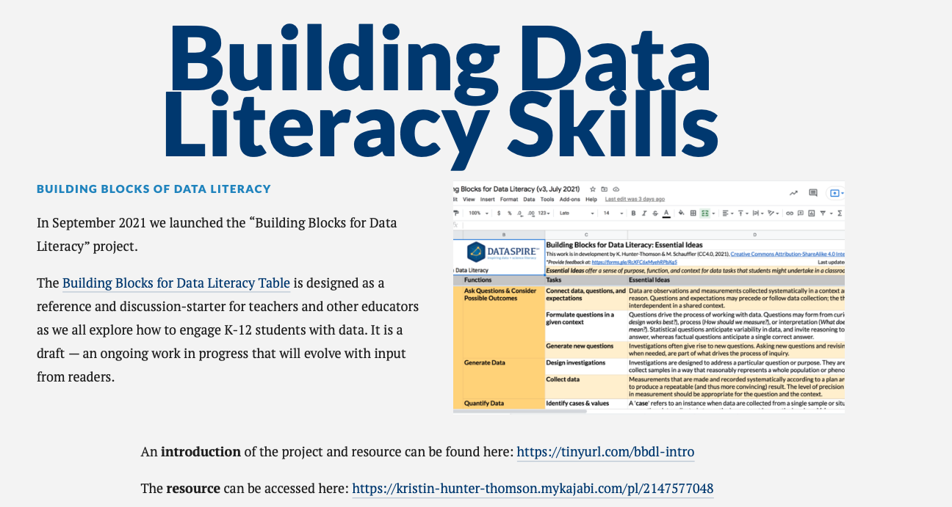
https://dataspire.org/building-blocks-for-data-literacy
Notes:
We worked with a Data Literacy consultant – Kristin Hunter Thomson of Dataspire to hone in on the data skills we really wanted to teach in this program. This is a subset of skills she has identified over the K-12 continuum

Slide 33
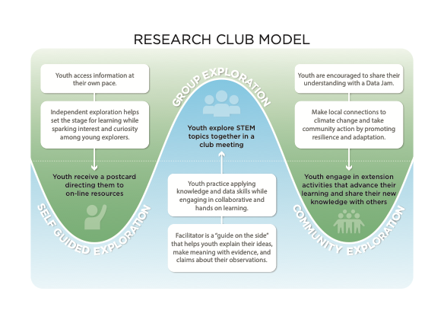

Slide 34
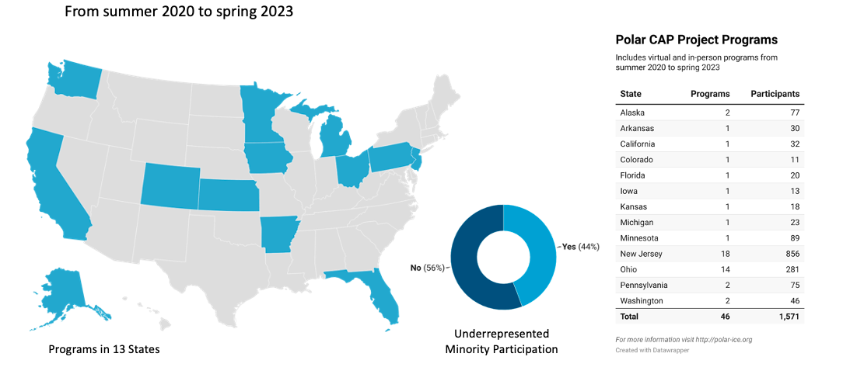

Slide 35



Notes:
Janice describes how youth are introduced to the curriculum at the first club meeting.

Slide 36


Club meeting 1 & 2
Let’s pack our bags & Join the Team
Notes:
I would like to quickly walk you through the club meetings sessions to give you a feel for the program.
Club meeting 1 and 2 are all about packing our bags and going on an adventure. Youth receive a research journal to keep track of their work and reflections. The first post card pictured here – invited young explorers to use a drag and drop online interactive to chose personal items, science research equipment and field gear needed to work at Palmer Station. They watch short engaging videos about the tools needed to do polar research and information about the location.

Slide 37






Club Meeting 3 - Digging into Data
Club Meeting 4- Penguins Need Us!
Notes:
In club meeting 3- youth dig into data. They explore data collection using a small bag of M&Ms, and the relationships between X and Y axis variables in an online game. In club meeting 4 – they learn how to identify the three species of penguins at Palmer Station – adelie, gentoo, and chinstrap. Youth also learn about the habitat and behaviors of the penguin species.

Slide 38


Slide 39

Notes:
Each club meeting has a community exploration and climate connection piece where club leaders can talk about the impacts of climate change locally and things we can do at the community level to help reduce our impact on the environment.

Slide 40




B
B
A
C
A
C
Which Adelie
are you today and why?
D
D
Notes:
A Credit
B Credit
C Credit
D Credit

Slide 41

Club Meeting 5 – Penguins of Palmer
Using CODAP- Common Online Data Analysis Platform
Notes:
In club meeting 5 – they learn how to analyze a time series data set of the penguin species collected by Dr. Cimino and other scientists. They use an online tool called CODAP to manipulate and make a graph of the time series data. CODAP is a free online tool developed by the Concord Consortium.

Slide 42



Club Meeting 6- Questionland
Notes:
IN session 6- youth engage in asking questions about the data. They hypothesize why the penguin populations are changing. We use the Question Formulation Technique or QFT to generate a list of questions about the penguin population dynamics. Finally, youth watch a call to action video from Dr. Cimino where they get their instructions on how to communicate their knowledge to others in their community about the penguins and climate change.
It is worth noting here that we have a strong partnership with the Click to Computer Science Program with a series of professional development videos that demonstrate the key objectives and implementation of the club meetings.

Slide 43




Club Meeting 7 – Ice as Habitat
Notes:
In club meeting 7 – youth learn about ice as a habitat and most importantly practice their skills at doing a Data Jam – a data jam is an expressive art project that communicates the data in a public friendly way – through art projects, culinary displays, music, dance and more! The most important aspect of the meeting is engaging the youth in sharing what they have learned with others in a creative way.

Slide 44




Club Meeting 8
Data Jam
Notes:
Club meeting 8 is about building and sharing the Data Jam – it can be a group project like this wall mural pictured here
What does your community need to know about what is happening to the penguins in Antarctica?

Slide 45





Data Jams
Notes:
Individual project that show the changes in the population dynamics of the penguins.

Slide 46




Data Jams Year 2

Slide 47


Data Jams and Community Connection Community Connection
Notes:
Finally– throughout the club meetings youth are introduced to local climate connections

Slide 48


Slide 49


Slide 50


Slide 51


Slide 52


Slide 53


Slide 54


Slide 55
Lessons Learned
Incorporating Data into Informal Learning
Data curation is a crucial and time-consuming task situated around a narrative/storyline/theme
Incorporation of arts educators and professionals improves engagement and quality of programming
CODAP is a promising tool for data manipulation in informal learning settings
Increase discussion of ratios (hands on activities)
Improving Understanding of Polar Literacy and Connection to Polar Science
Youth valued connection with polar researchers
Polar researchers found experience to be meaningful
Narrative frame allows youth to find relevance (examples of frames include help the penguins)
Impact of Delivery Mode
Integration with social-emotional learning
Technological challenges and opportunities influenced by the pandemic
Providing physical materials was helpful in all cases and essential in some cases
Narrowing the scope was necessary

Slide 56


THANK YOU
Contact me for more information:
Janice McDonnell
mcdonnel@marine.rutgers.edu
https://stemfinity.com/
Key word data
https://click2computerscience.org
Notes:
Thank you for listening – You can access the curriculum through STEMfinity – discount codes are available – reach out to me for more information. Also there is a series of professional development videos available through Click to Computer Science – to help you implement the sessions and get the most out of the program.

Slide 57
Greetings from Kansas, Ms. McDonnell!
My name is Dyane Smokorowski, and I am the Coordinator of Digital Literacy with the Wichita Public Schools in Kansas. This December, all of our district’s 4th-grade students will be engaging in an exciting unit on the Palmer Long Term Ecological Research (LTER) station in Antarctica.
In reviewing your wonderful outreach resources, I noted the latest update from early 2023, and I wondered if there might be an opportunity for a virtual teleconference (VTC) with our 4th graders this fall or winter. A live call would be an incredible chance for our students to connect directly with the discoveries and research at Palmer, allowing them to learn about life outside of our urban setting in a setting brimming with curiosity and exploration.
The majority of our students come from urban, economically disadvantaged backgrounds, and a live connection to your research would be such an inspiring look into life beyond their world. I know they’d love hearing about the discoveries your team is making and what it’s like to work in such an incredible environment.
If this is possible, we’d be more than happy to work with you on scheduling.
Thank you so much for considering this opportunity—it would mean a lot to our students, and I think it could spark some lasting curiosity!
Dyane Smokorowski (Mrs. Smoke)
Coordinator of Digital Literacy
Wichita Public Schools
2013 Kansas Teacher of the Year
2019 National Teacher Hall of Fame Inductee

