Slide 1



Summertime Shallowing of Upper MLD Fuels Long-Term
“Tanning” in WAP Phytoplankton
Quintin Diou-Cass¹,
Nicole Waite¹, Oscar Schofield¹
¹Department of Marine and Coastal Sciences, Rutgers University, New Brunswick NJ
Palmer LTER
Mid-Term Review
2024
Presented October 29th, 2024

Slide 2



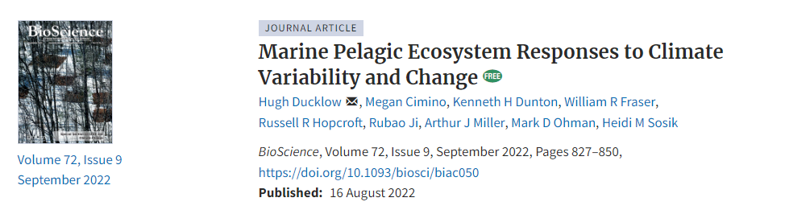

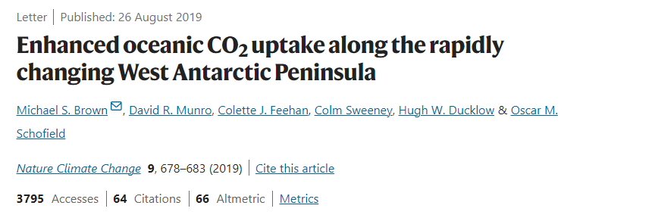
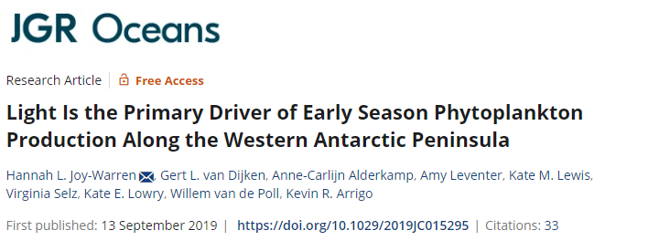
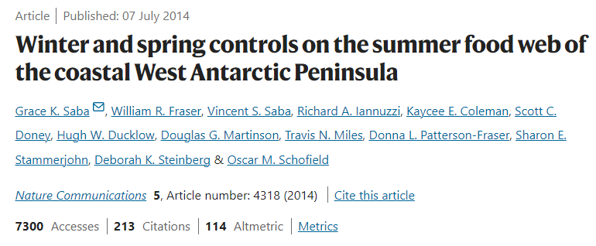


Biophysical Cascades
Climate/Sea Ice
Upper Ocean Mixing
Light Availability
Primary Production

Slide 3
Biophysical Cascades
Climate/Sea Ice
Upper Ocean Mixing
Production in the PAL region as a whole is primarily light-limited
Light Availability
Primary Production

Slide 4
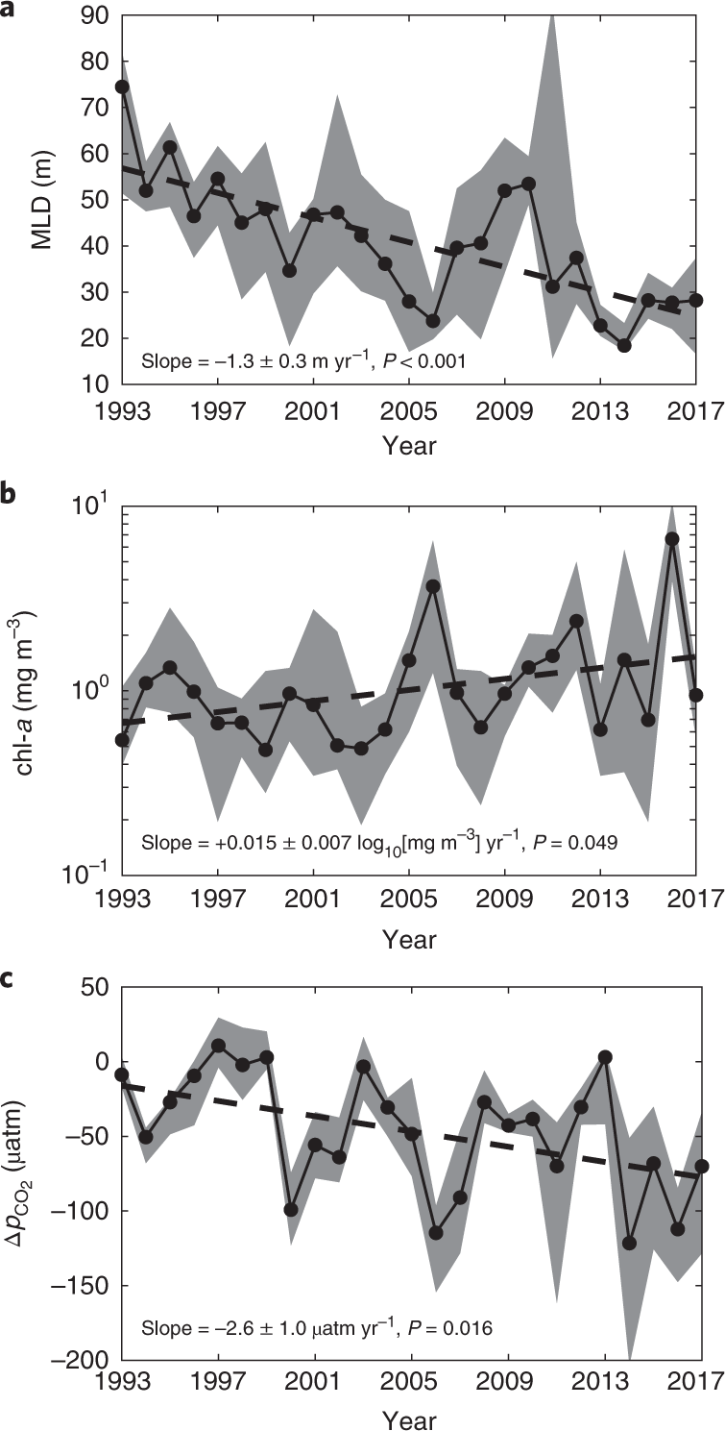


Rapid Interdecadal Change
MLD
Light-dependence
is critical...
Conditions continue to see record levels of change
System wavers on the edge of a drastic regime shift?
This core dynamic of light-limited ecology plays out on an interdecadal scale
Chl-a
∆P_{CO2}
Schofield et al. (2018); Brown et al. (2019)

Slide 5
Rapid Interdecadal Change
MLD
Light-dependence
is critical...
Conditions continue to see record levels of change
System wavers on the edge of a drastic regime shift?
This core dynamic of light-limited ecology plays out on an interdecadal scale
Chl-a
In the face of rapid change, it becomes critical to better understand the functionality of this
light-dependent dynamic
∆P_{CO2}
Schofield et al. (2018); Brown et al. (2019)

Slide 6

Underlying Physiological Change?
MLD
My Thesis
Better understanding the biophysical interactions underlying phytoplankton ecology in the WAP around light changes and photophysiology
This core dynamic of light-limited ecology plays out on an interdecadal scale
Chl-a
∆P_{CO2}
Can we see the signature of a light-driven cascade expressed in community photophysiology over the same, interdecadal timescales?
Schofield et al. (2018); Brown et al. (2019)

Slide 7

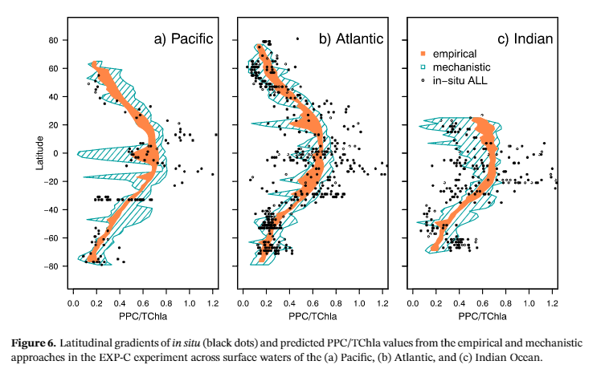
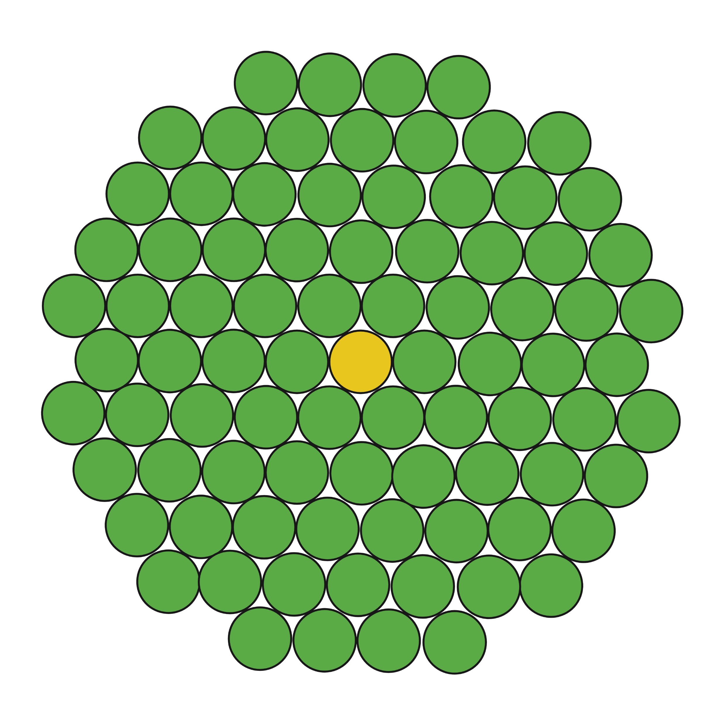
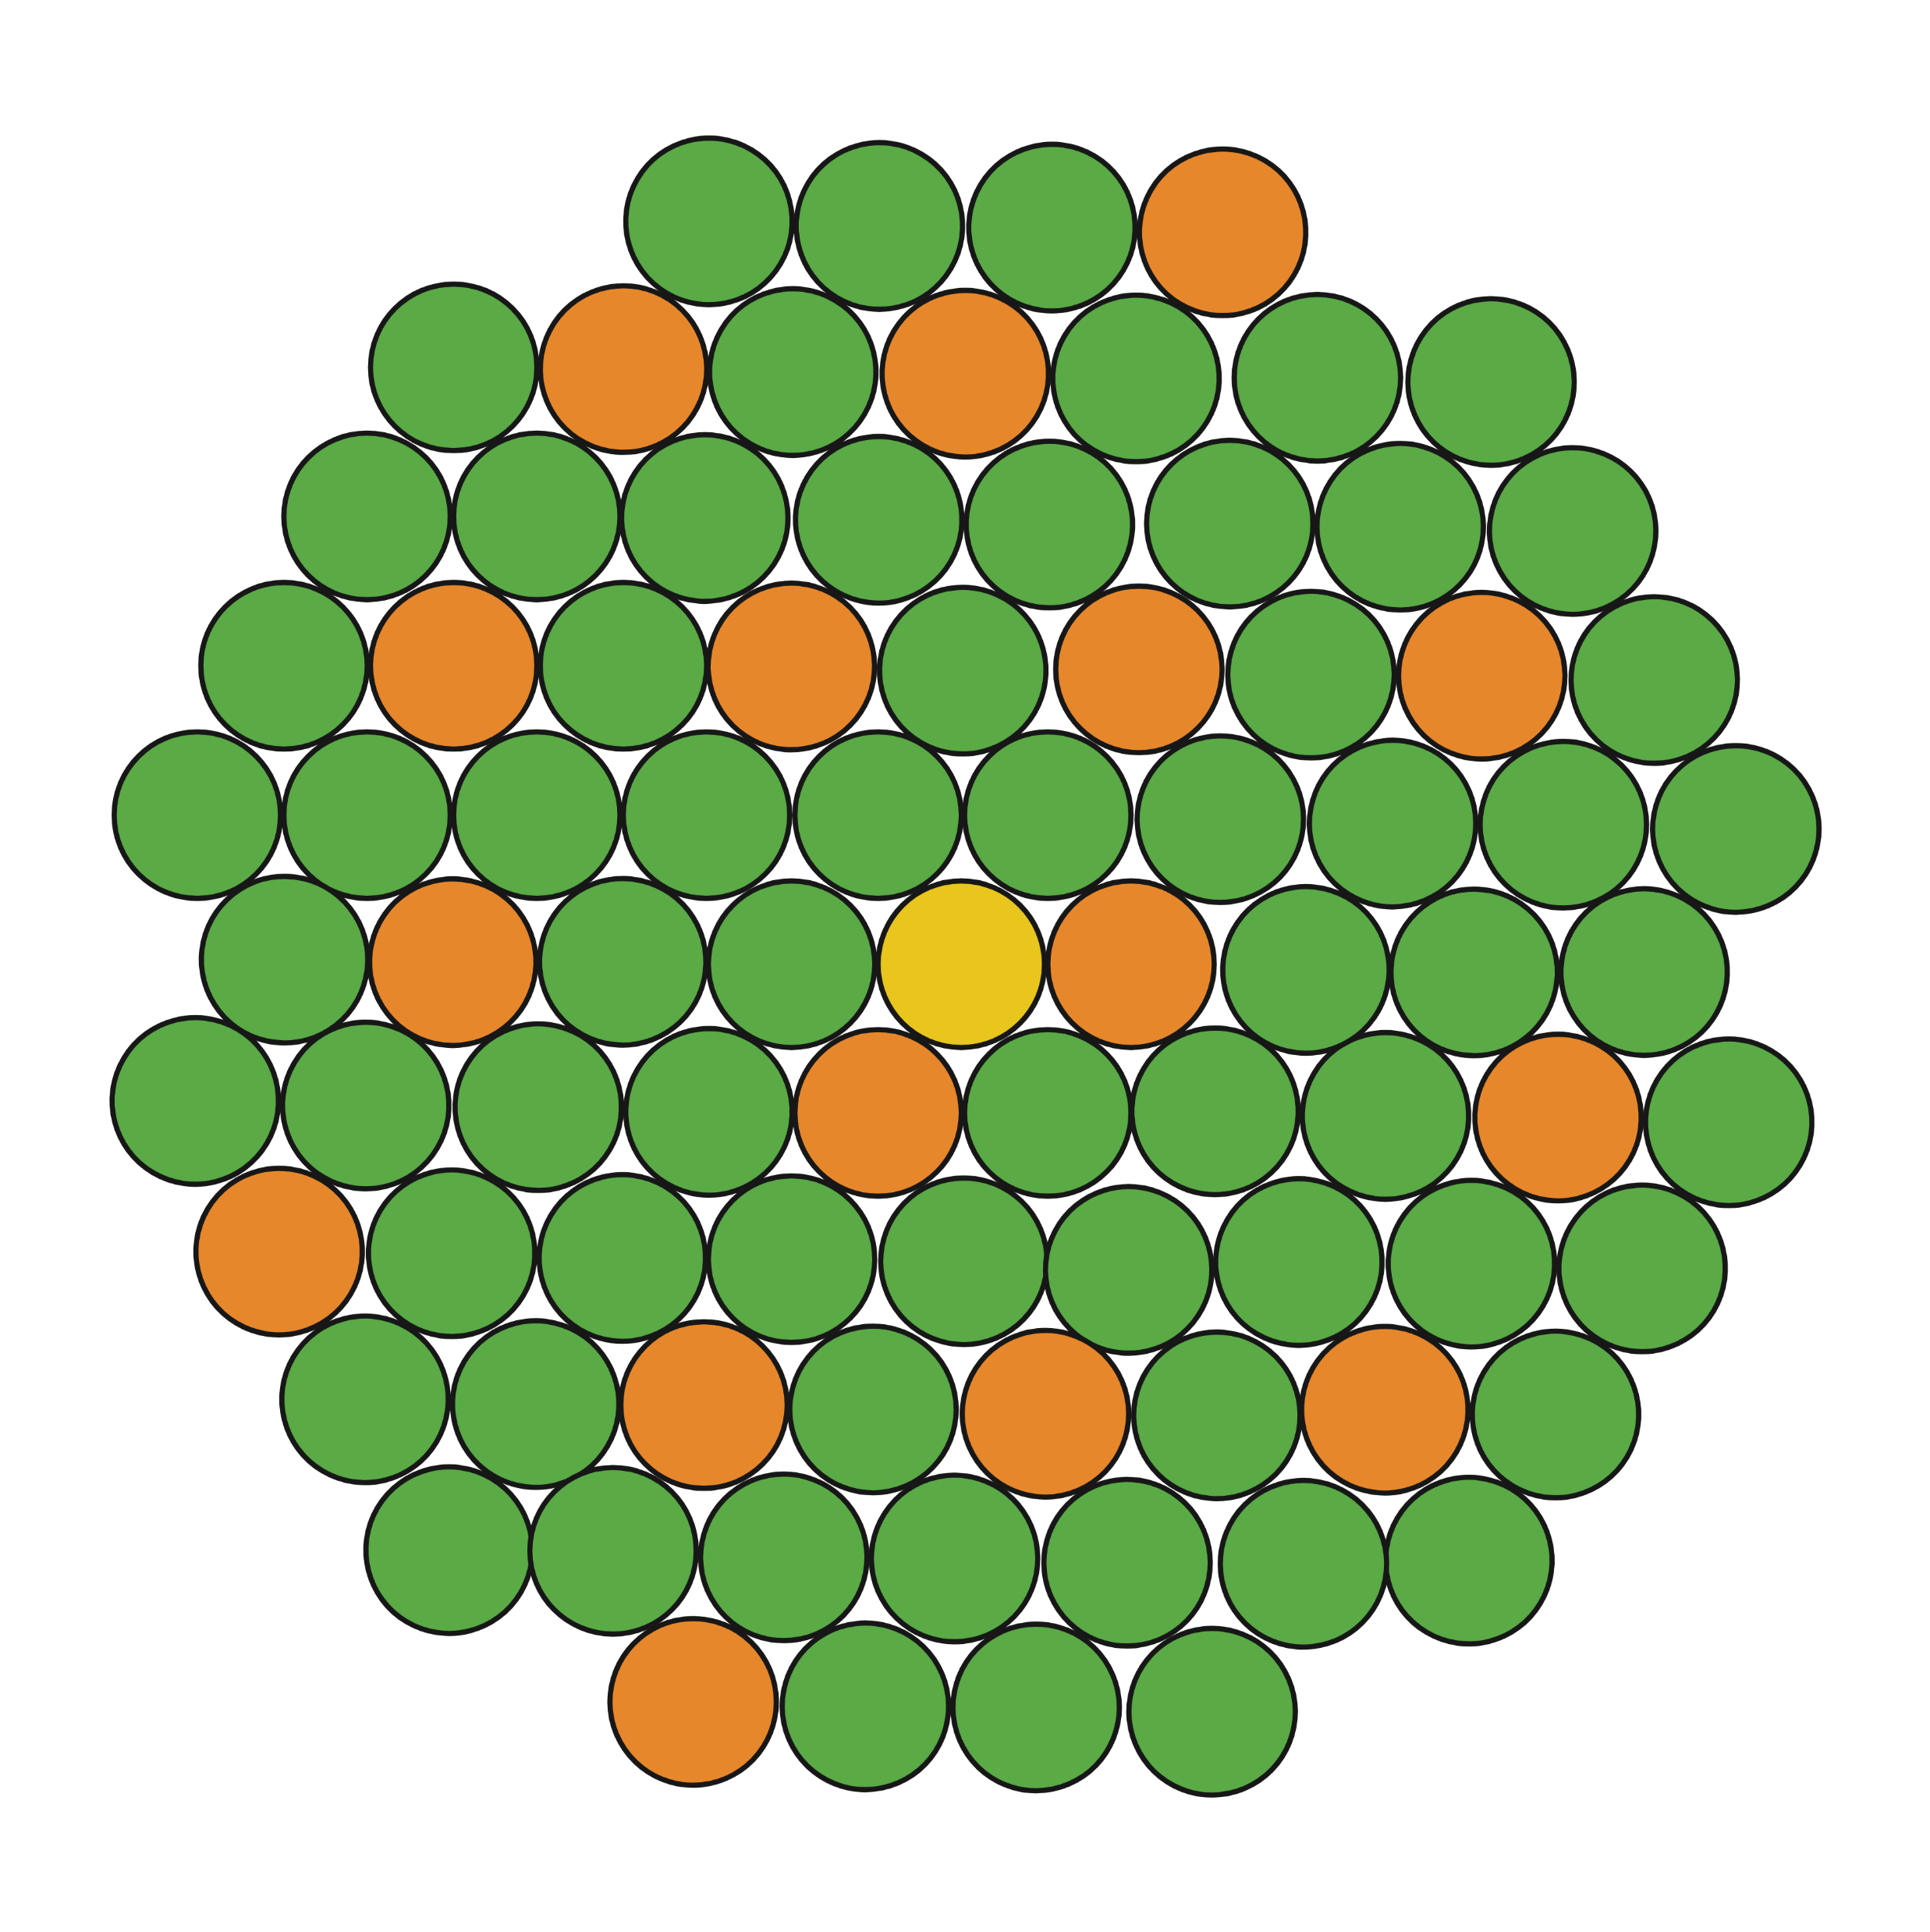
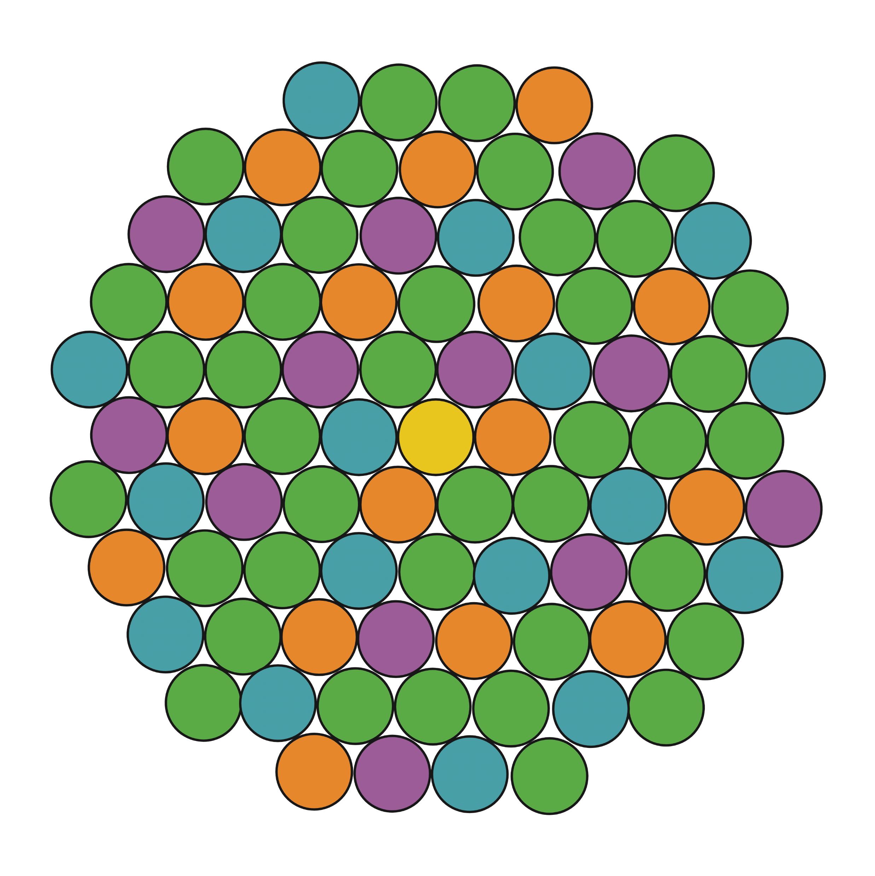
Pigment Ratios as Signatures
Change in Photophysiological Pigment State
Light-limited Communities
Change in Light Environment
Acclimation
Photoprotective Carotenoids
Light-Harvesting Pigments
Latitudinal Scales
E.g., Under high-light environments, phytoplankton increase investment in photoprotective pigments relative to chlorophyll-a
High in the “bright” tropics
Low in the “dark” polar regions
Alvarez et al. (2019)

Slide 8
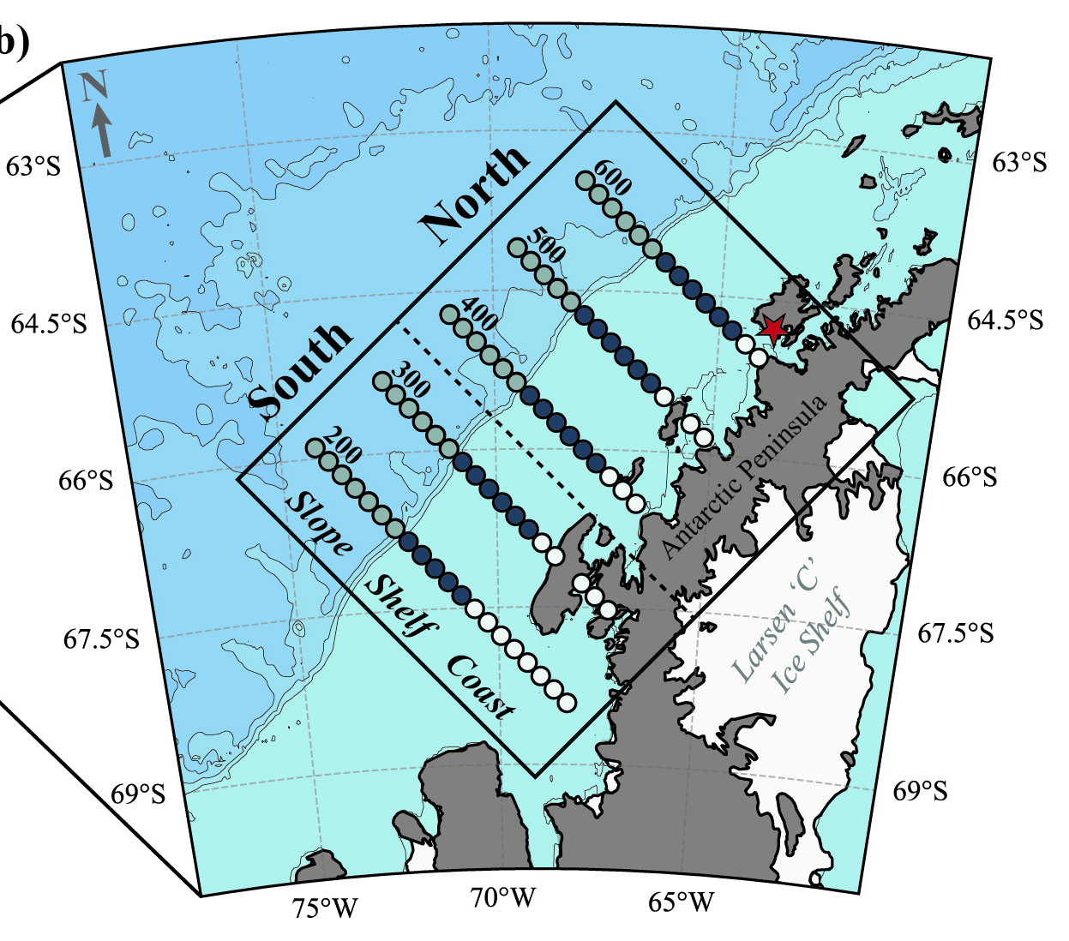
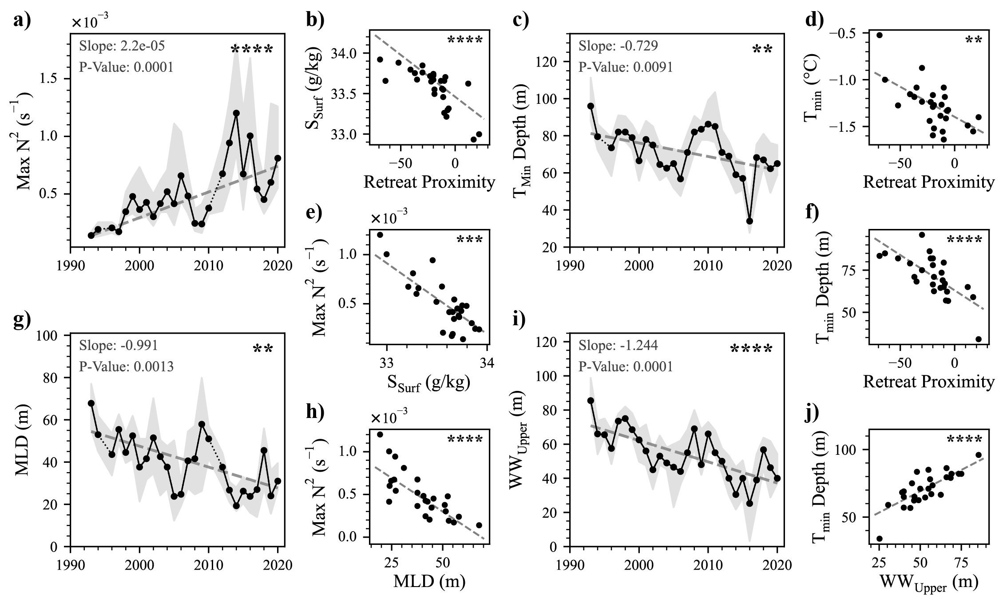
PAL Grid Pigment Indices
TCaro
PAL Standard Survey Grid (N+S)
PSC
PPC
Relative to Chlorophyll-a
PAL LTER Cruise Data
January (Peak Summer)
MLD
Winter Water
1993-2020
Underway & CTD
North + South Subregions
Surface Median (0-7m)

Slide 9
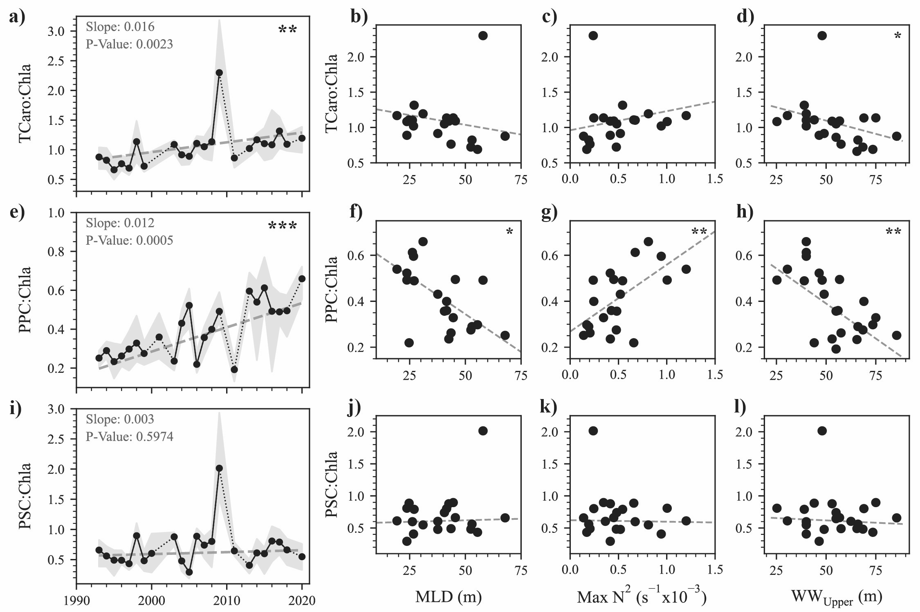

Photophysiological Shifts
TCaro
PSC
PPC
Interdecadal rise in median proportions of TCaro:Chla
Over time, the relative quantity of accessory carotenoids in the summer community has increased
PAL LTER Cruise Data
January (Peak Summer)
+16% decade⁻¹
1993-2020
Underway & CTD
TCaro:Chla > 1
TCaro quantity exceeding Chla
North + South Subregions
Surface Median (0-7m)

Slide 10
Photophysiological Shifts
TCaro
PSC
PPC
Photosynthetic fractions make up majority of total carotenoids:
PSC = ~67% of TCaro
Variability, but no discernable trend
PAL LTER Cruise Data
January (Peak Summer)
1993-2020
Underway & CTD
North + South Subregions
Surface Median (0-7m)

Slide 11
Photophysiological Shifts
TCaro
PSC
PPC
+12% decade⁻¹
PAL LTER Cruise Data
January (Peak Summer)
Median photoprotective fractions in surface community doubled:
1993-2020
Underway & CTD
PPC = ~25% mid-1990s
North + South Subregions
PPC = ~55% mid-2010s
Surface Median (0-7m)

Slide 12
Photophysiology & Physics
MLD
Max N²
Upper WW
Correlations between median photoprotection and water column structure
Enhanced photoprotective pigments associate with shallow, well-defined mixed layer structure in January
Akin to physical correlations with primary productivity

Slide 13
What About Community Composition?
Total Pigment State
Are the trends we see in photophysiological pigments a product of light response, or just a change in community composition?
Community Photoacclimation
Taxon-Specific Abundance

Slide 14
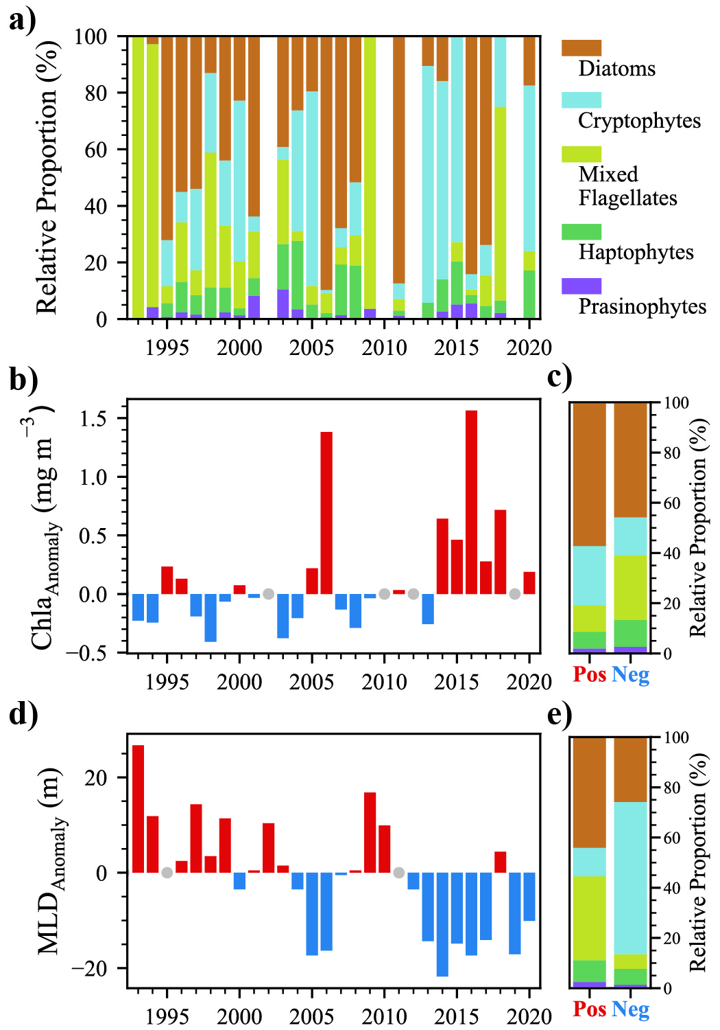
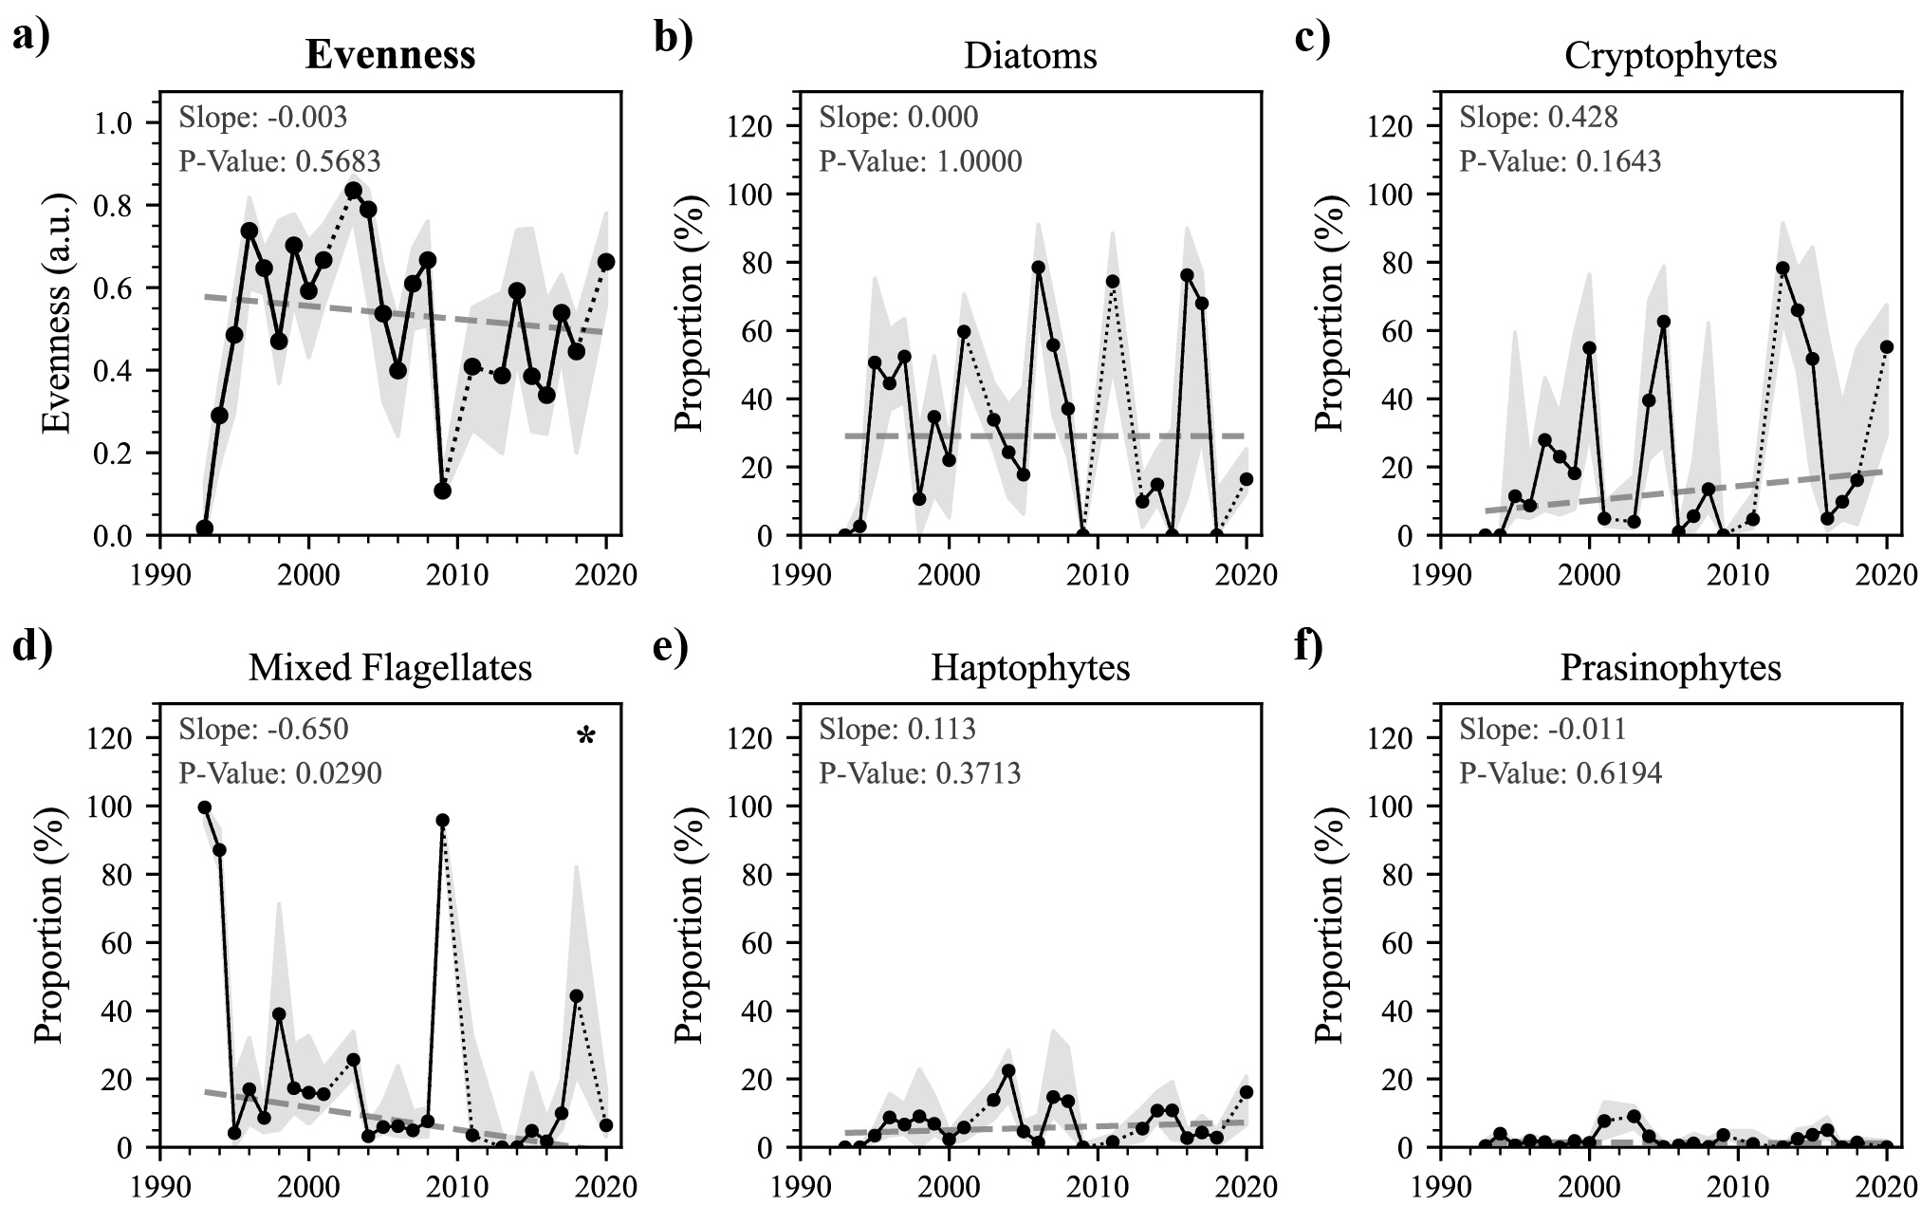
What About Community Composition?
Evenness
No clear trend in total community evenness or individual taxonomic group proportions is seen that can explain shift in pigment signature
This doesn't mean differences in composition across light environments aren't seen…

Slide 15
What About Community Composition?
Shallow
Years with shallower or deeper MLDs than the climatological median see significant differences in composition
Deep
Cryptophyte proportions are greater in
shallow MLD years
Deep
Mixed Flagellate proportions are greater in deep MLD years
Shallow

Slide 16
What About Community Composition?
Especially for extreme years of low sea ice, deep mixing, and low summer biomass,
Mixed Flagellates appear to persist over Diatoms and Cryptophytes
Community differences could become meaningful with continued instances of extreme low-ice years and/or long-term shoaling

Slide 17
Core Takeaways
Within the PAL Grid:
PPC:TChla
1) Long-term shift toward high-light environment is associated with an interdecadal increase in photoprotective pigments of the summer surface community
2) Compositional changes can’t account for the long-term trend in photophysiology, indicating a likely increased investment in photoprotection over time
3) Clear differences in average dominance between high and low light environments can be seen, with Mixed Flagellates persisting in deeply mixed, low-biomass years
4) While seemingly beneficial for now, shift in summer PPC on the grid as a whole is significant - on par changes along latitudinal gradients
1990s
2010s

Slide 18
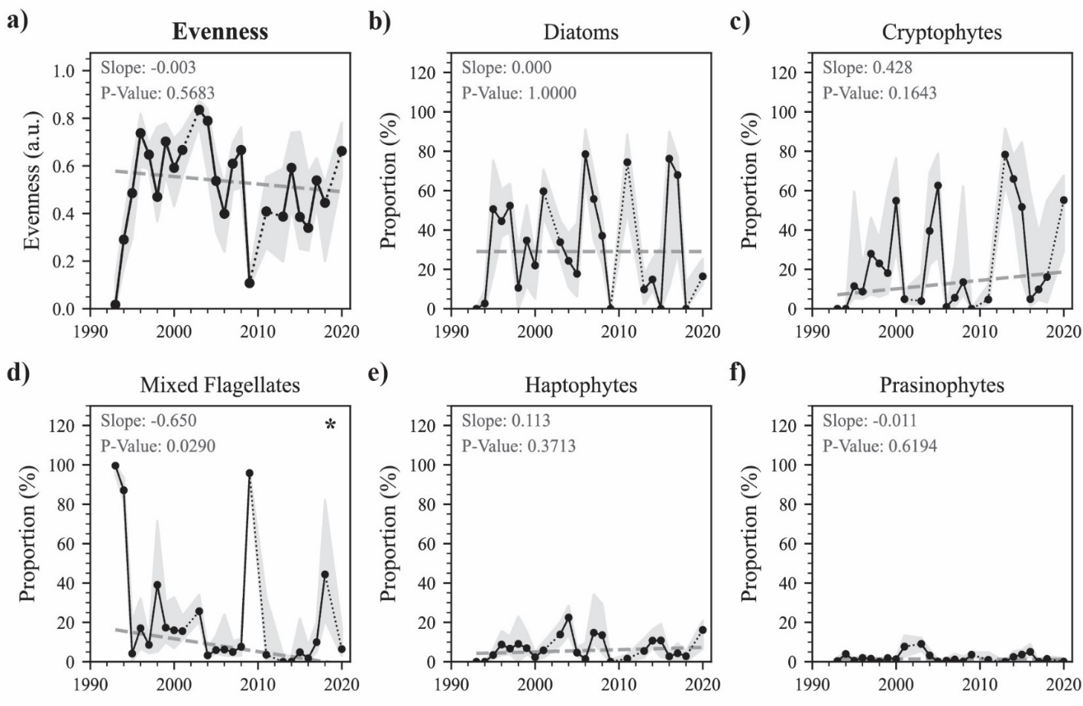
Supplemental: Community Composition

Slide 19
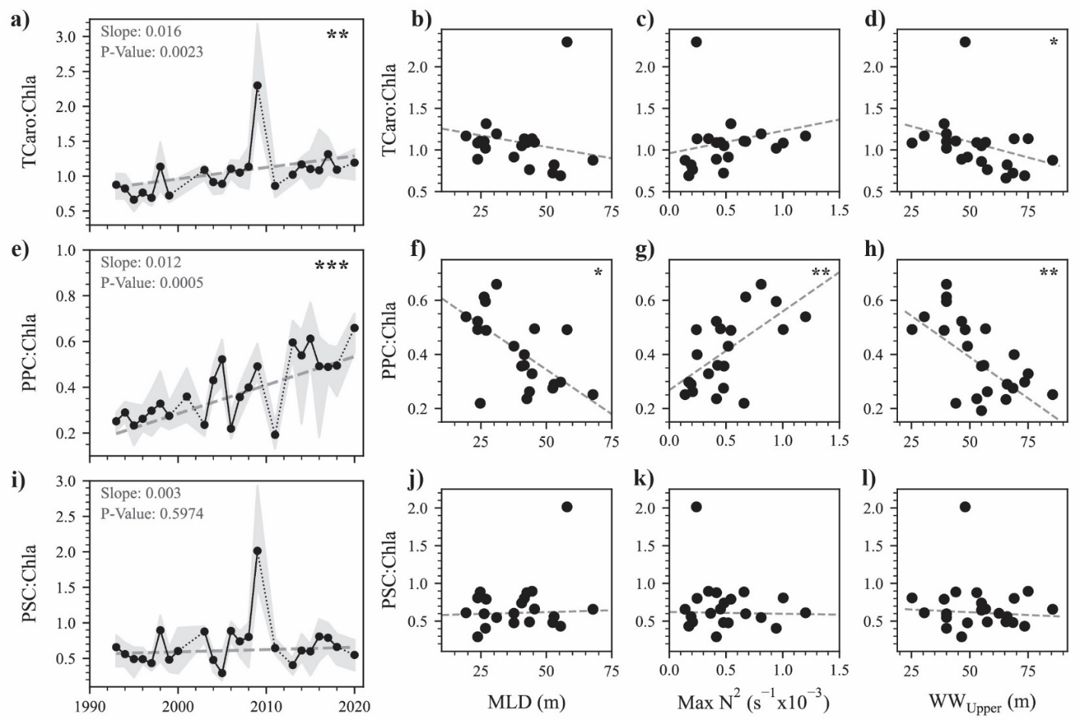
Supplemental: Pigment Shifts

Slide 20
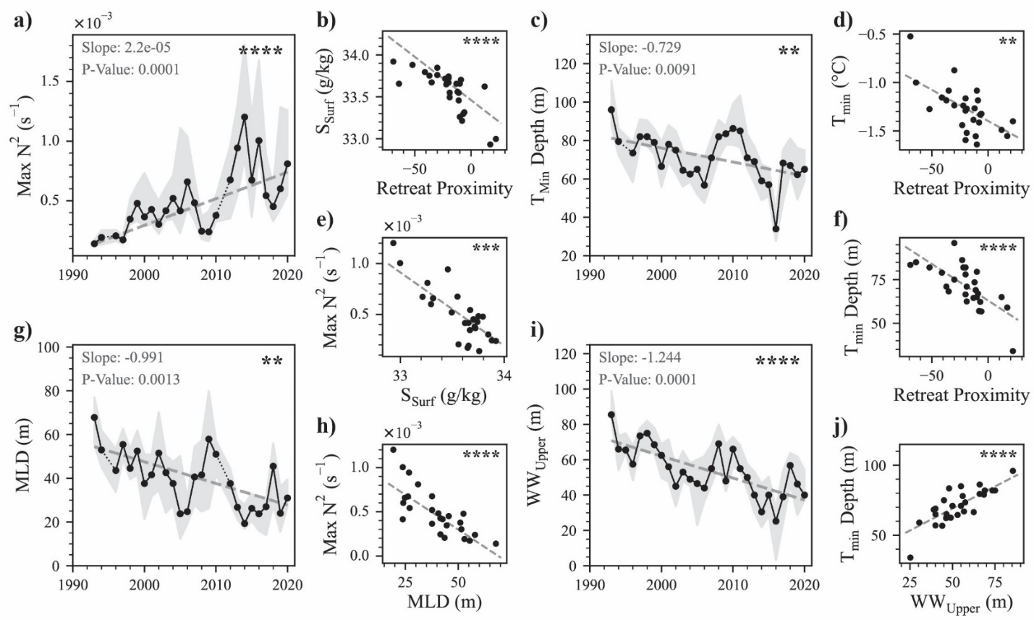
Supplemental: Water Column Trends

Slide 21
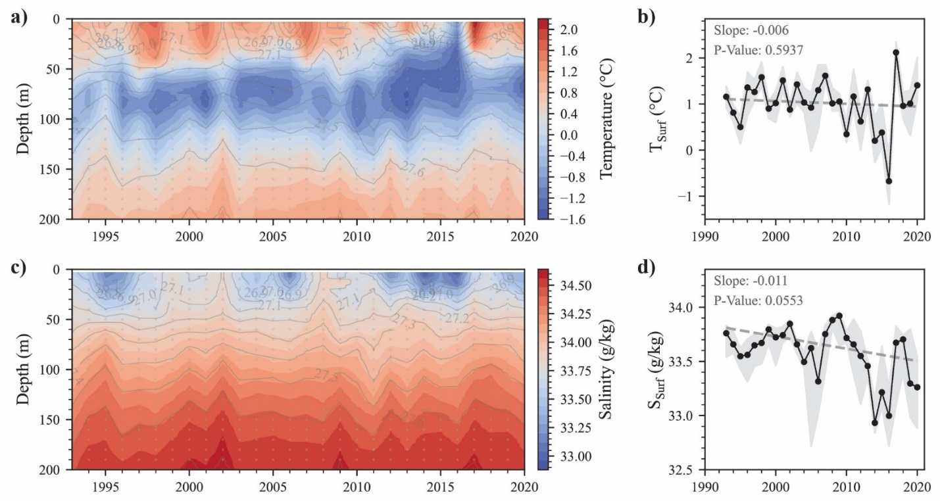
Supplemental: Long-term Hydrography

Slide 22
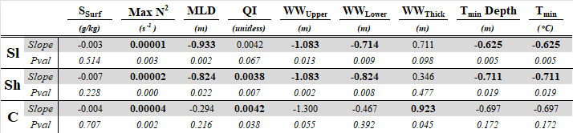
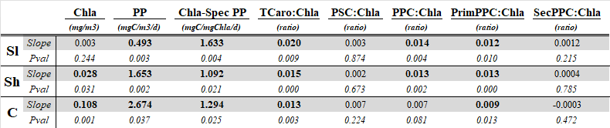
Supplemental: Regional Differences
Table 3a: MKT trend slopes and p-values for physical parameters across the Slope (Sl), Shelf (Sh), and Coast (C) subregions. Bold numbers indicate significant trends.
Table 3b: MKT trend slopes and p-values for biological parameters across the Slope (Sl), Shelf (Sh), and Coast (C) subregions. Bold numbers indicate significant trends.

Slide 23
Supplemental: Biophysical Correlations
Table 2: Kendall-Tau correlation coefficients of paired grid-level biological (columns ) and physical (rows) variables. Bold numbers indicate significant correlations (p-value < 0.05).

