Slide 1
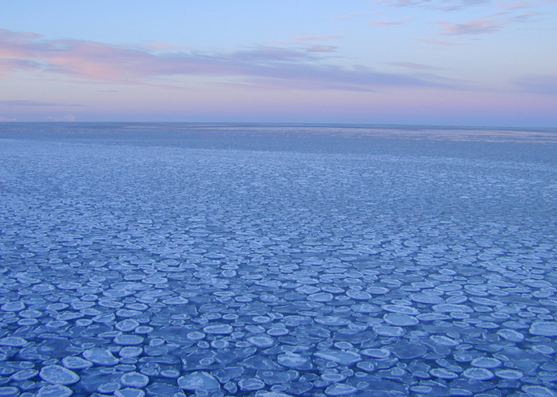
PAL Overarching Hypothesis
Sea ice plays a central role in structuring population dynamics and life history strategies across the entire food-web
Ongoing shifts in sea ice will drive systemwide ecological change

Slide 2
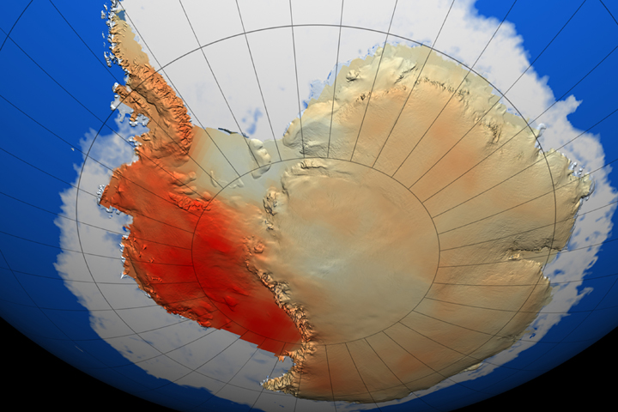
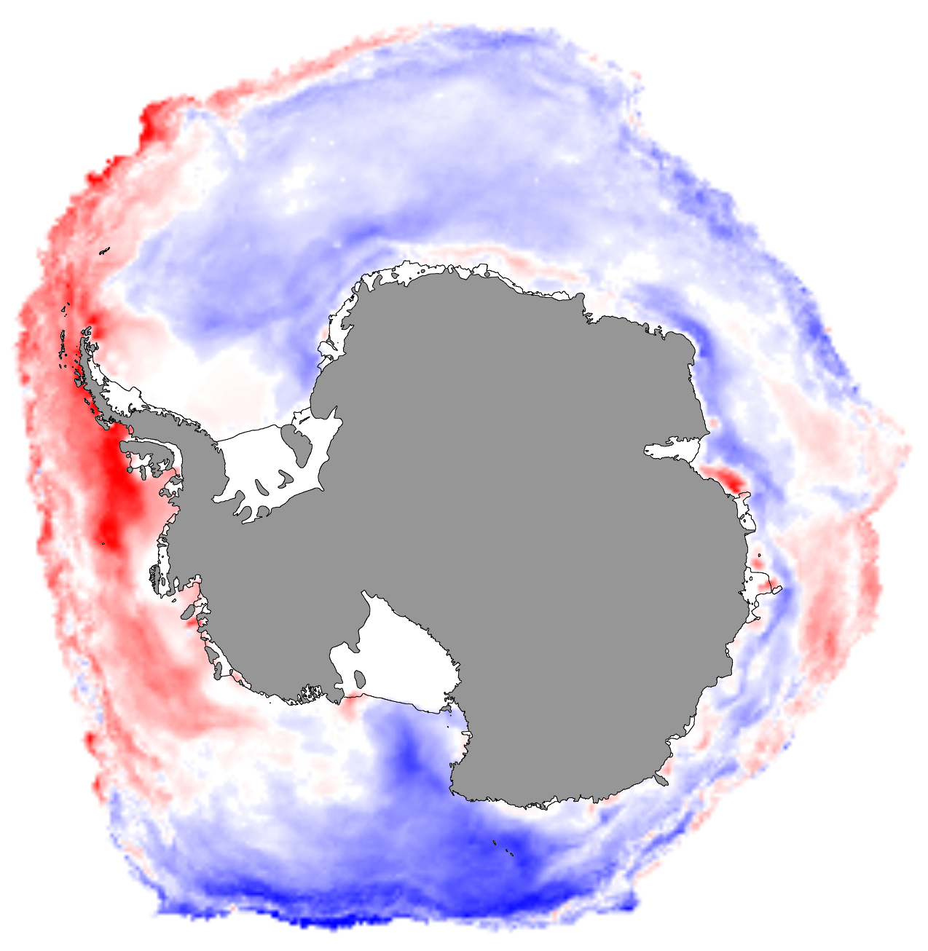

The Long-Term ”Press” of Climate Change
Spatial Patterns
BLUES: longer ice seasons by up to 3 months
60-Year Antarctic Temperature Trend (1957-2006)
30-Year Ice Season Duration Trend (1979-2008)
Stammerjohn and Maksym 2017 updated
Steig et al 2009
Notes:
From a circumpolar perspective, teleconnections have contributed to observed Antarctic and Southern Ocean changes (Li et al. 2021; Xin et al. 2023), including regions of rapid surface warming and sea-ice decline (e.g., the WAP and West Antarctic Ice Sheet) versus regions of moderate cooling and sea-ice expansion (e.g., the western Ross Sea) (Stammerjohn and Scambos, 2000; 2021), along with a sudden post-2016 circumpolar sea-ice reduction (Himmich et al., 2024). These dynamics play a major role in the transport of heat via ocean circulation onto continental shelves, especially along the WAP, with its proximity to the Antarctic Circumpolar Current (Moffat and Meredith 2018; See Theme B), with consequent impacts on sea-ice thickness and seasonality (Saenz et al. 2023).

Slide 3
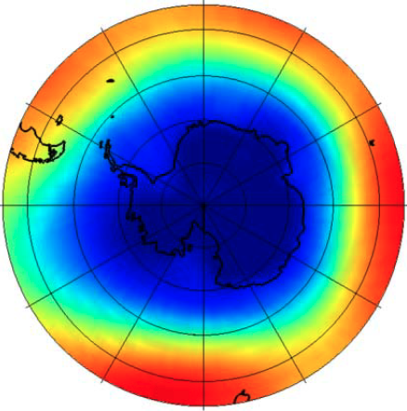
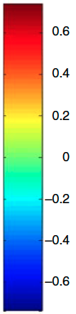
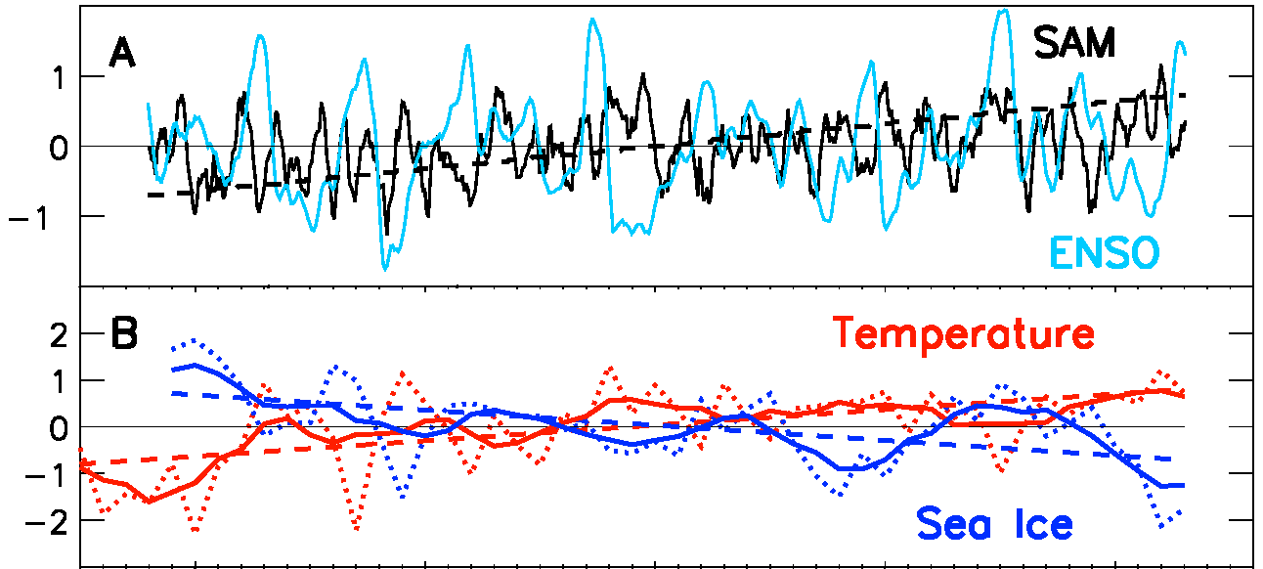
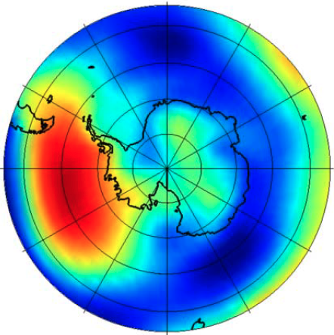
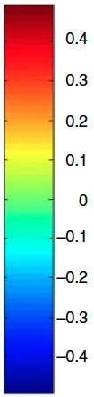
Large-Scale Drivers of Sea-Ice Change
(and why the WAP is the Canary of Antarctic Climate Change)
SAM vs SLP
ASL: Amundsen Sea Low
+SAM/La Nina: warm, windy, less sea ice
-SAM/El Nino: cool, quiescent, more sea ice
Correlation
SAM
ASL
ASL deepens in response to +SAM and La Nina
ENSO vs SLP
ENSO
WAP Winter Temperature
Correlation
ASL
WAP Winter Sea Ice
Year
(Meredith et al 2010; Stammerjohn and Maksym 2017; Li et al 2021)
Notes:
High levels of natural climate variability – both from local (ASL, local processes amplifying warming and wind-driven sea ice changes), and non-local (ENSO, SAM) drivers of variability. The WAP region is particularly sensitive to tropical teleconnections (ENSO, IPO, AMO) mostly through impacts on the Amundsen Sea Low (ASL) which in turn affects winds and heat advection along the WAP.
PAL explores both short- and long-term changes to investigate food web responses.

Slide 4
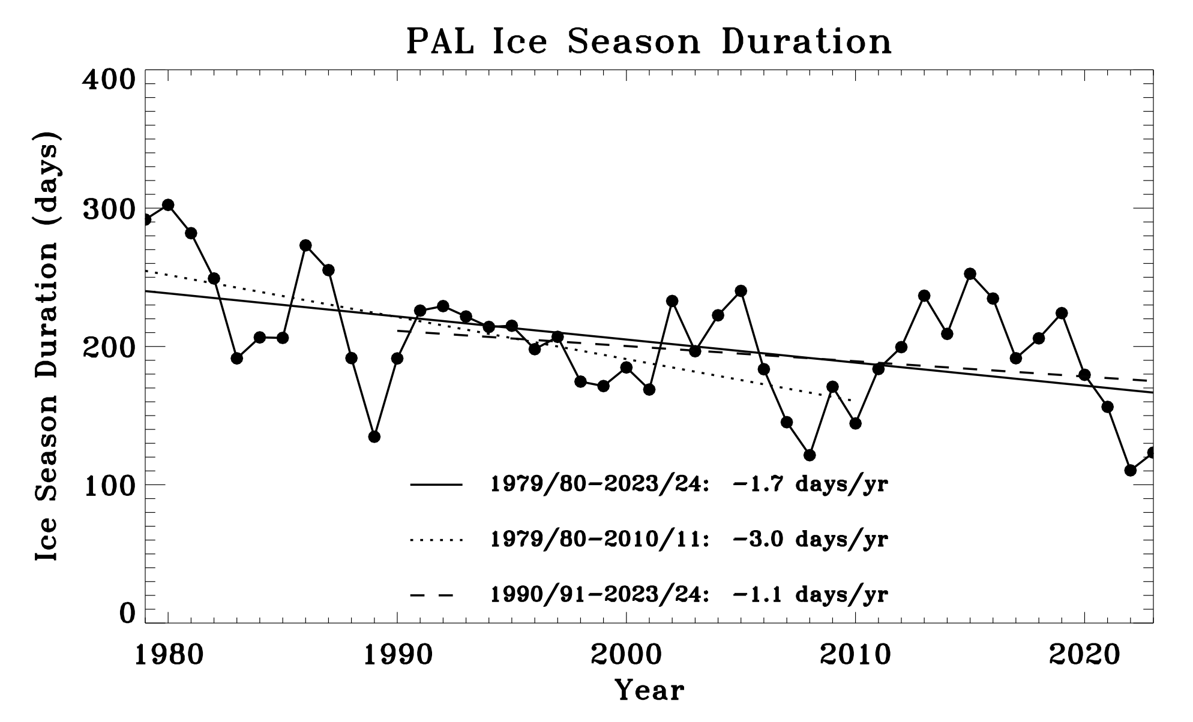
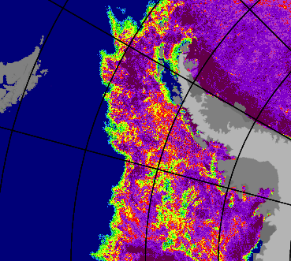
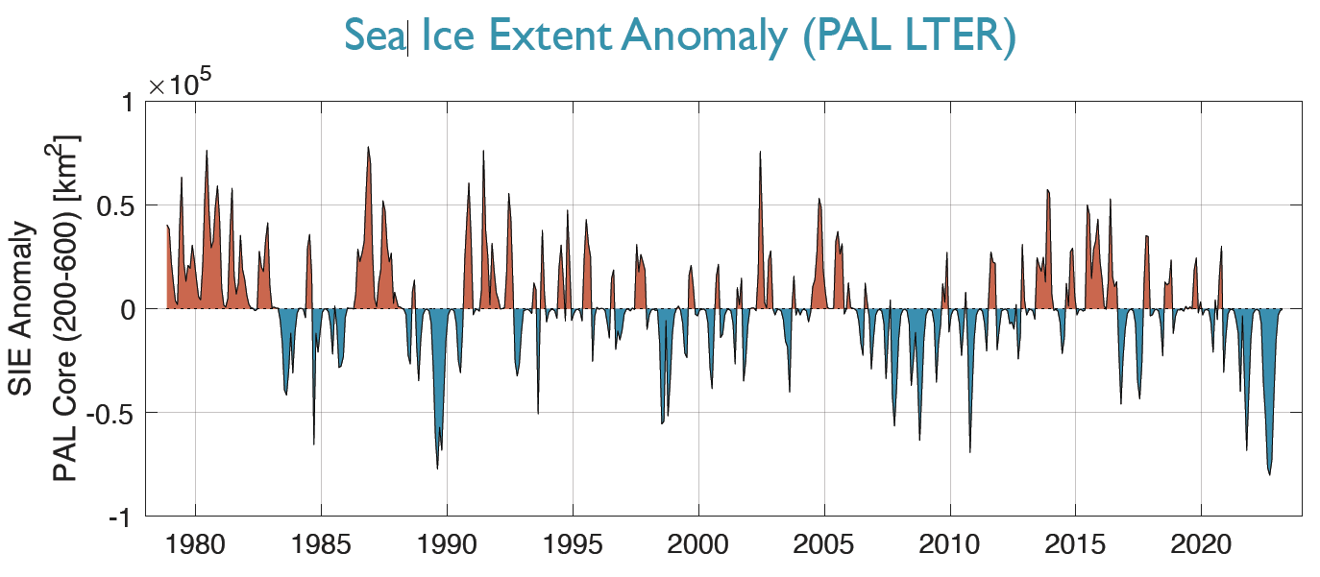
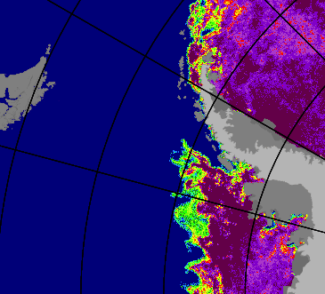
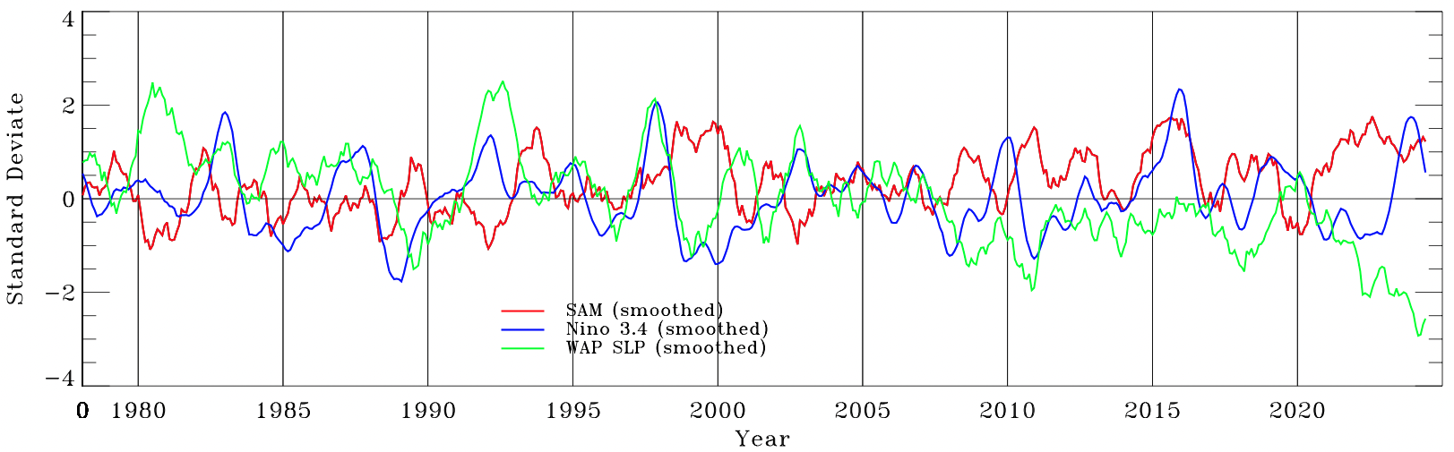
Response to Long-Term Press
Recent Extreme Shifts
WAP Ice Season Duration
Ice Season Duration (days)
WAP Sea-Ice Extent Anomalies
2015 max extent
PAL Sea-Ice Extent Anomaly
WAP Climate Anomalies
Standardized Climate Indices
2022 max extent
Year

Slide 5
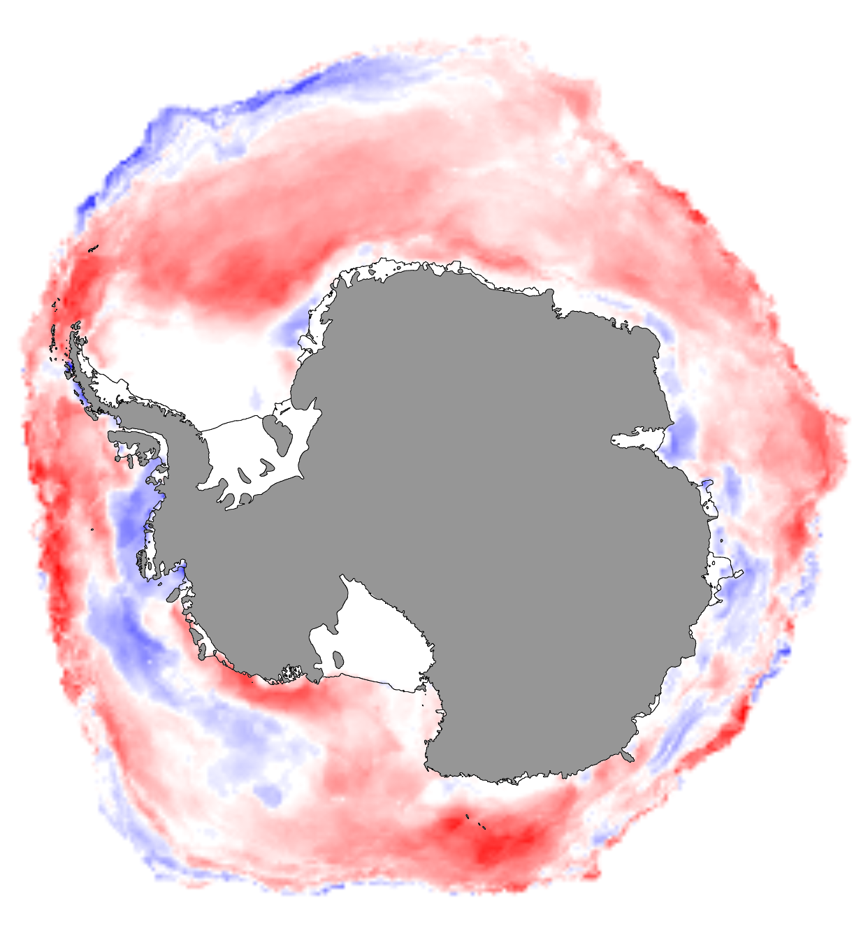
Recent Changes in Antarctic-wide Sea-Ice
Possibly indicating a Regime Shift
Fogt et al 2022; Hobbs et al 2024
BLUES: longer ice seasons by up to 3 months
REDS: shorter ice seasons by up to 3 months
Trend first 30 Years
(1979-2008)
Trend last 14 Years
(2009-2022)
What can the PAL LTER tell us about recent Antarctic-wide sea-ice changes?
Stammerjohn and Maksym 2017 updated
Notes:
In the last decade rapid decline in Antarctic-wide sea ice is potentially indicative of a fundamental state change. Simultaneously, regional atmospheric circulation patterns fail to fully explain the recent rapid sea ice declines, indicating that underlying ocean changes are driving the Antarctic-wide sea-ice variability pattern.
Given growing evidence that the dramatic and persistent Antarctic sea-ice decreases are due to a state change (or regime shift) in atmosphere-ocean-ice interactions, these related impacts will imprint differently on the distinct components of the ecosystem, given the intrinsic timescales on which they function.
Within this context, PAL offers the longest and most comprehensive study of an Antarctic marine ecosystem, with continuous detailed observations from the shelf break to the coast; there is no other program like it in Antarctica (although there a few long-standing coastal programs but they are primarily station-based).
PAL therefore has the opportunity to offer critical information and fundamental understanding on how marine systems in other Antarctic locations may be responding to recent rapid Antarctic-wide changes.

Slide 6
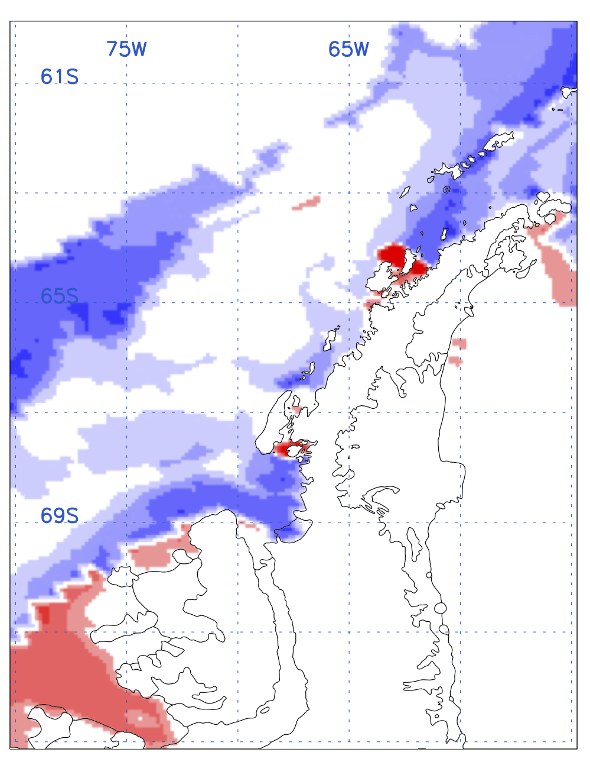
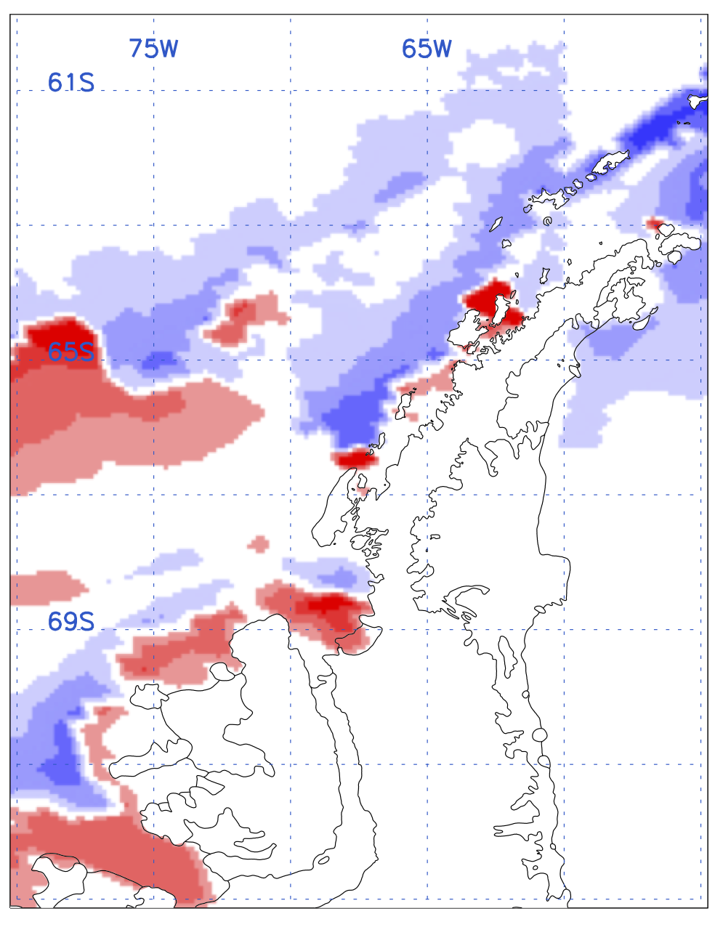
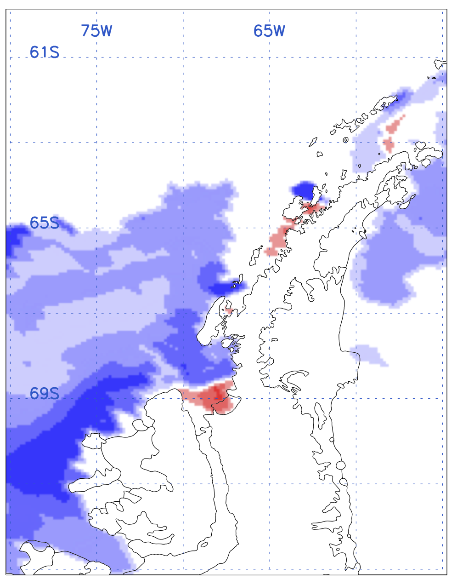
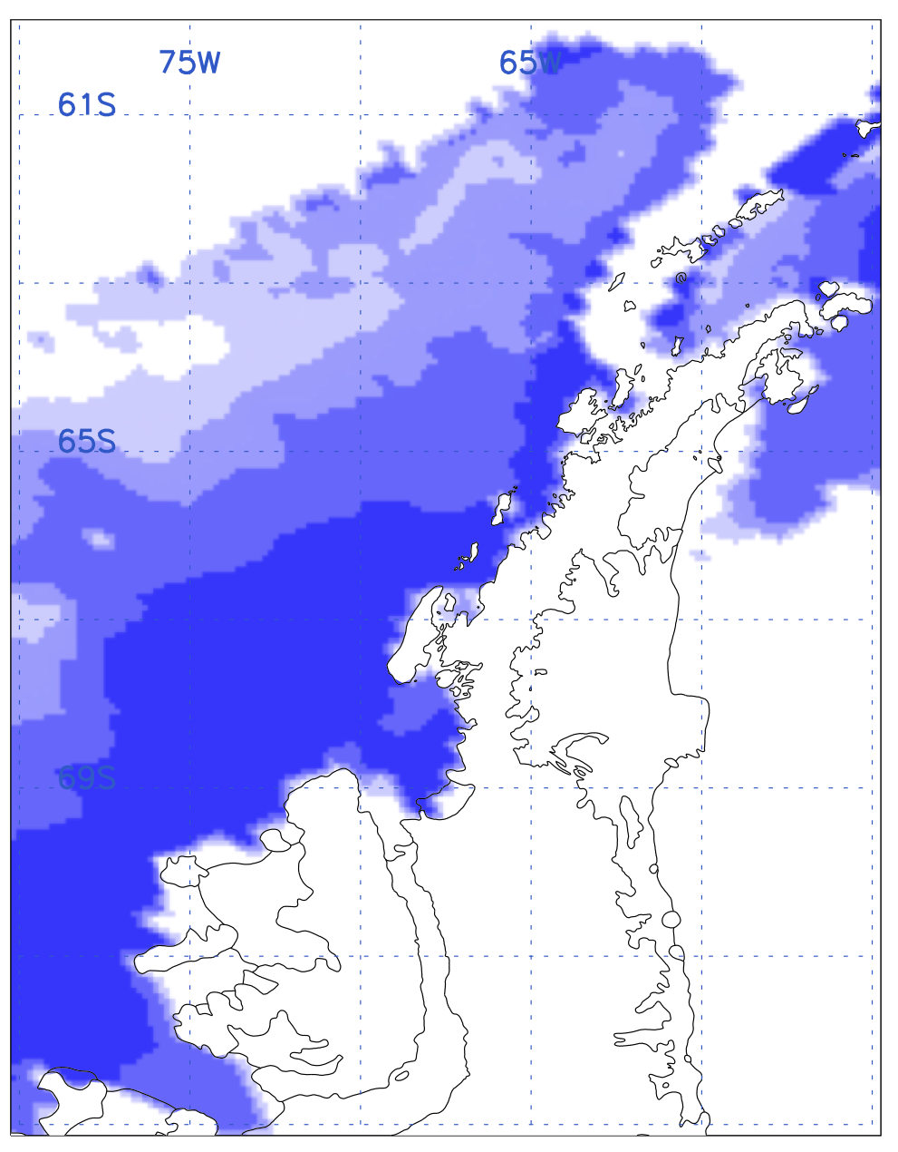
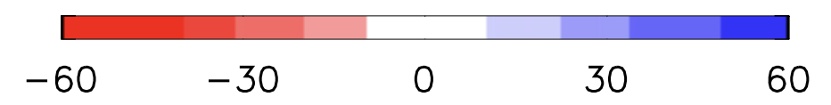
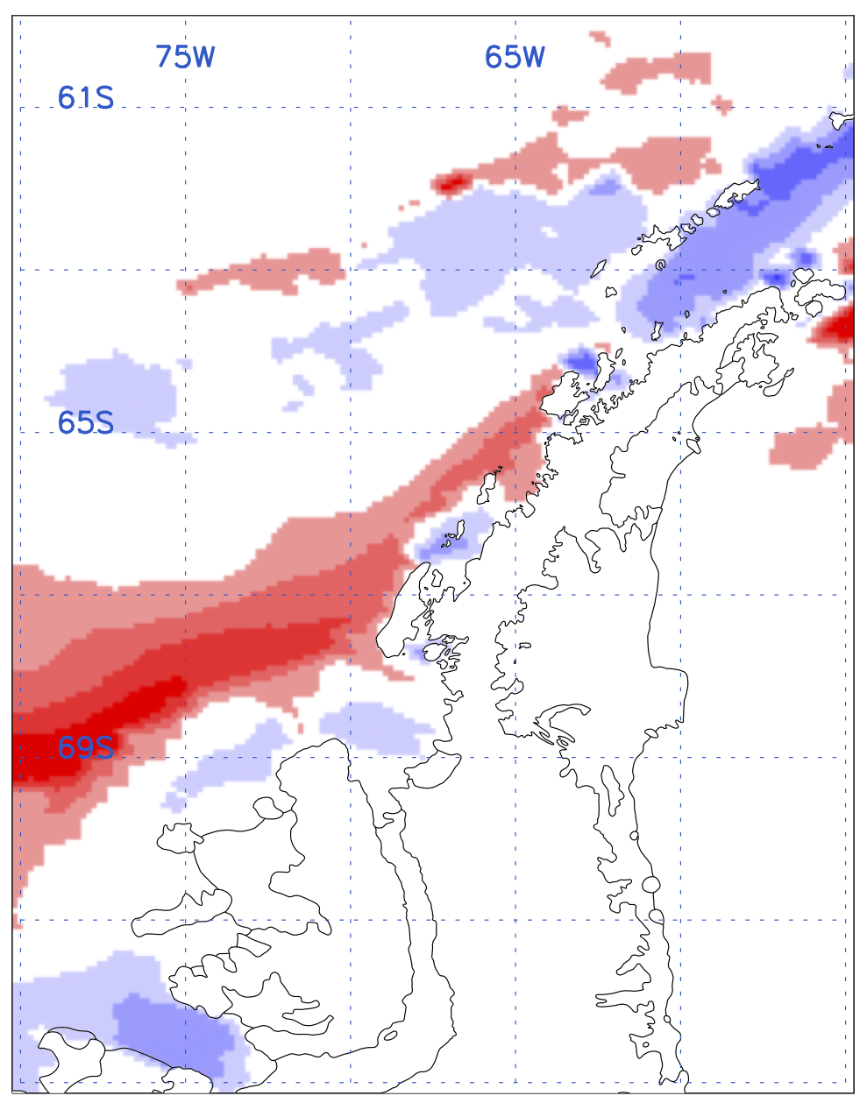
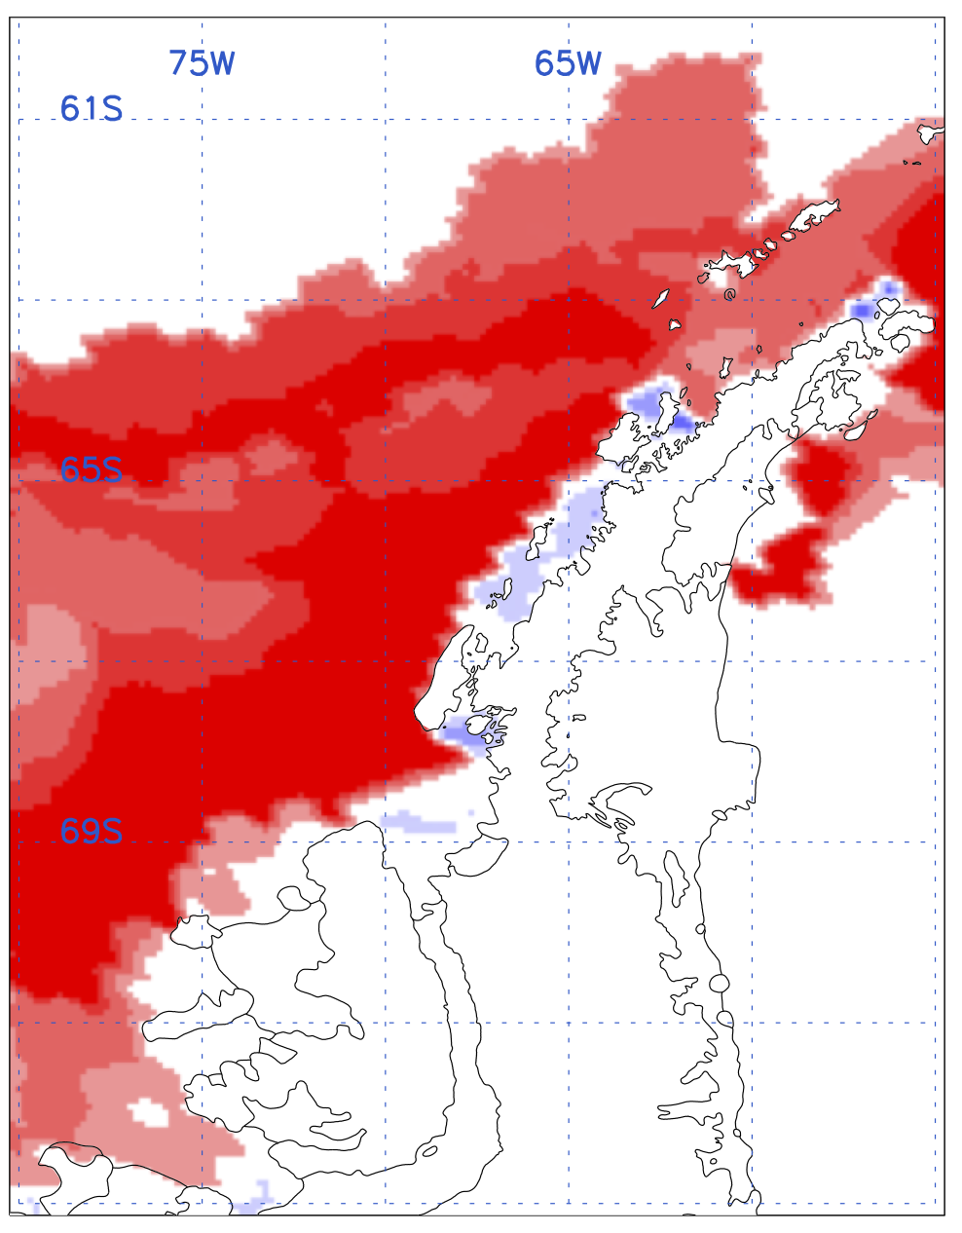
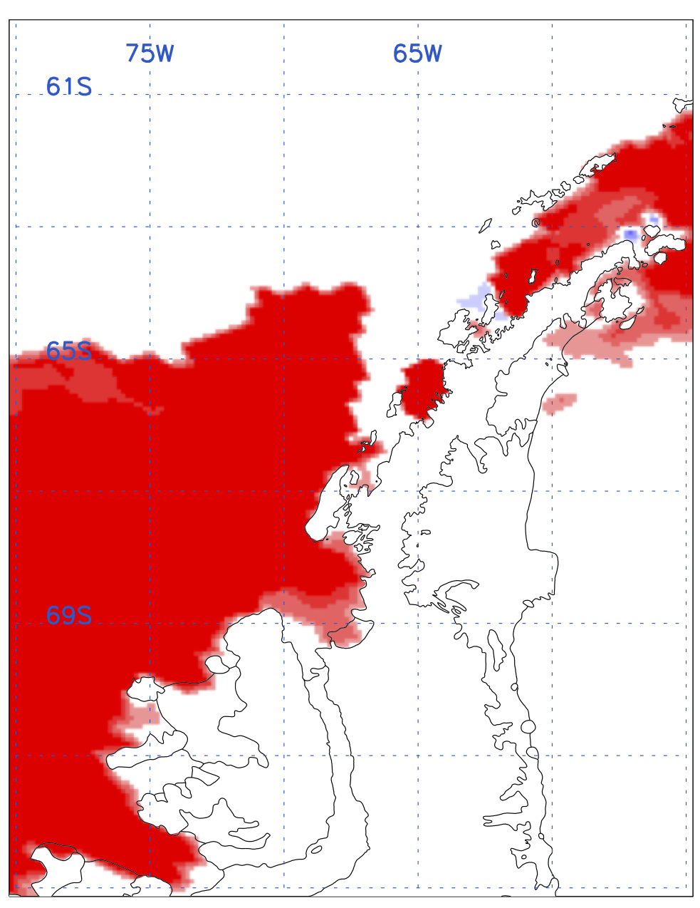
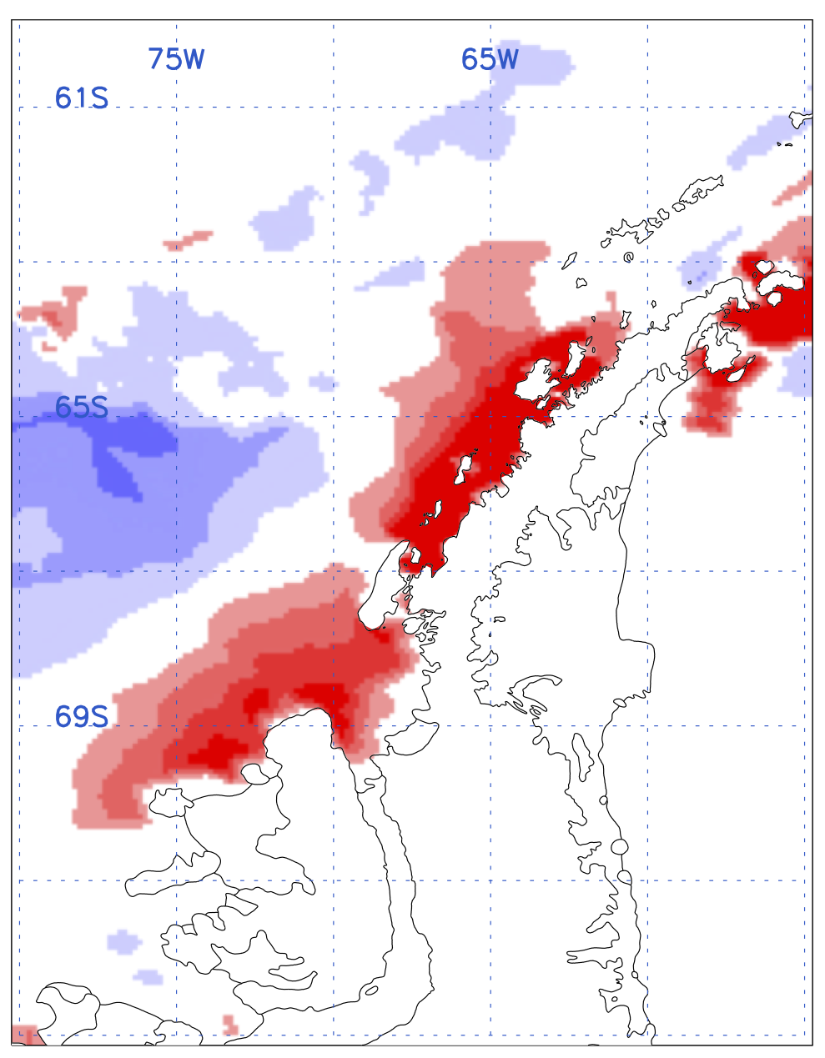
Extreme Changes in Sea-Ice Seasonality
2020
2021
2022
2023
Mostly later autumn advances (blues)
Autumn Advance
2020
2021
2022
2023
Mostly earlier spring retreats (reds)
Spring Retreat

Slide 7
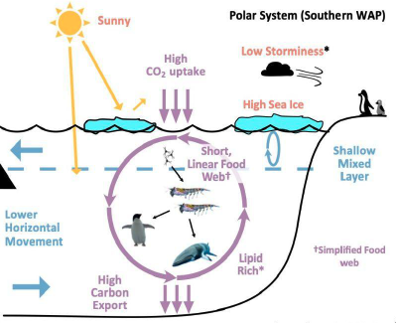
Seasonal Sea Ice – Ecosystem Interactions
(Ducklow et al 2018; Schofield et al 2024)
Seasonally alters ocean stratification, heat, nutrient, and gas exchanges
Provides a haul-out platform for penguins & seals, an under-ice refuge & feeding ground for juvenile krill & fish
Spring sea-ice melt seeds the spring-summer phytoplankton bloom
A dominant driver of biological processes across trophic levels
Notes:
The annual sea ice cycle (of growth/melt) seasonally alters upper ocean stratification, heat, nutrient, and gas exchanges (Martinson et al 2008), which in turn structure the seasonality and productivity of the marine ecosystem
In winter, sea ice and its snow cover provide a physical barrier between the underlying ocean and surface forcing (e.g., intense winds, low temperatures) (Saenz et al 2023)
In winter, the high algal concentration in sea ice provides food for larval Antarctic krill, which also use the under-ice habitat as a refuge from predators (Meyer et al 2017)
In winter, the diverse microbial sea-ice community will also become important in spring by seeding the spring phytoplankton bloom (Saenz & Arrigo 2014)
In spring, sea-ice meltwater not only seeds the water column but also helps to stratify the surface ocean, providing an ideal environment for spring/summer phytoplankton blooms, elevated new and net community production, and carbon export (Ducklow et al 2018)
Winter–spring preconditioning by sea ice is a dominant physical force governing biological processes across trophic levels (Saba et al 2014)

Slide 8
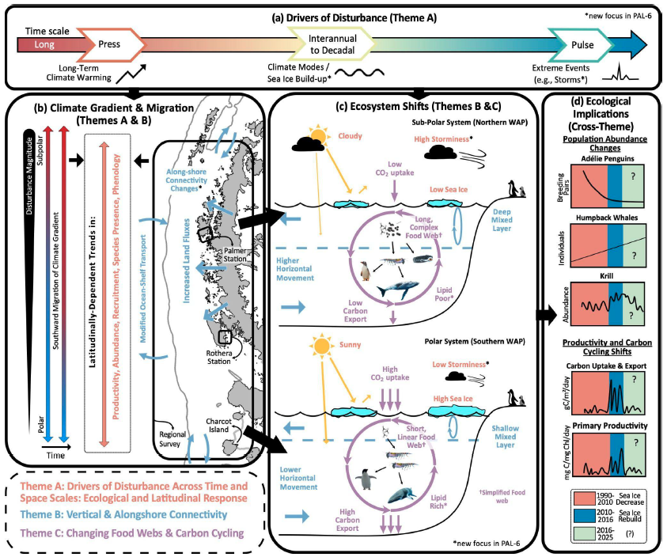
PAL Conceptual Model
Drivers of Disturbance
Climate Gradient & Migration
Ecosystem Shifts
Ecological Implications
Notes:
Ecosystem responses are filtered through relevant biological timescales for organisms that vary
from days–weeks for bacteria, phytoplankton and some microzooplankton, to years for krill, to
nearly decades for seabirds, seals, and whales. Thus, the impact of a given disturbance is
taxon- and life-history dependent; nevertheless, these food webs are among the marine systems
that are most vulnerable to climate change (Constables et al, 2022; IPCC).

Slide 9
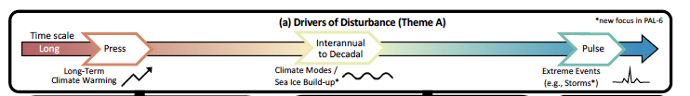
PAL Conceptual Model
Drivers of Disturbance
(Theme A)
How does long-term “press”, sub-decadal and shorter-term “pulse” drive changes in the WAP food web and ecosystem productivity
* New Focus in PAL 6: Sea Ice Build-up & Storminess
Notes:
The shifting sea-ice structured polar system is affected by a range of disturbances spanning climate press (long term warming), interannual to decadal variability (e.g., from ENSO, SAM), and pulses (storms) that affect both land and seascapes.
These drivers appear to be interdependent: SAM is influenced by human-driven climate change, and the pulse-like forcing of individual storms shows a longterm southward migration along the WAP. The strong north-south climate and sea-ice gradients provide a biogeographic trend along the WAP.

Slide 10
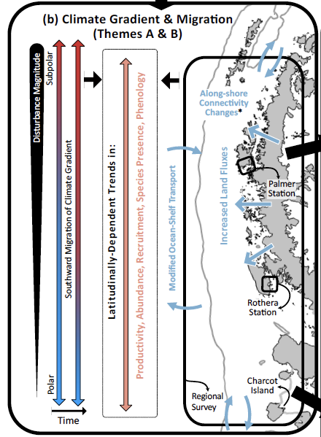
PAL Conceptual Model
Climate Gradient & Migration
(Themes A & B)
Climate Migration and Latitudinal Shifts in Ecosystem Productivity
Ecosystem Response to cross-shelf and along-shelf exchanges
* New Focus in PAL 6: Along-shore Connectivity Changes
Notes:
PAL spans a space and time climate-biogeographic gradient that has shifted due to local and atmospheric circulation changes affecting the ocean. A southern migration of the climate gradient and latitudinally varying disturbances is predicted to result in continued change in ecosystem properties, across all trophic levels, at regional scales which has implications for food web structure and the cycling of carbon.
1. We exploit the near-continuum of “press-to-pulse” temporal drivers which is differentially expressed along the WAP, providing a climate gradient over our study domain.
2. The northern regions are characterized by subpolar climate (shorter ice season, warmer moist atmosphere) and the southern regions by a polar climate (longer ice season, cooler dry atmosphere). The transition between the two appears to be shifting from north to south along the WAP and currently the “hinge point” of the transition is located at our long-term study site at Palmer Station. We predict this hinge point will continue to move southward, a process we term climate migration, reflecting the long-term press of planetary warming, providing us with an opportunity to study the ecosystem transition.
3. We use the variability associated with the relatively wide continental shelf (100-200 km) that has an on-to-offshore gradient– from the land influenced nearshore region driven in part by melting glaciers and an along-shore coastal current–to open ocean conditions on the continental slope more influenced by the Antarctic Circumpolar Current and deep-water upwelling. On local scales (10’s of km in the horizontal, 10-100s meters in the vertical), physical dynamics influence key ecosystem processes like rates of marine productivity and the breeding success of near-shore penguin colonies.

Slide 11
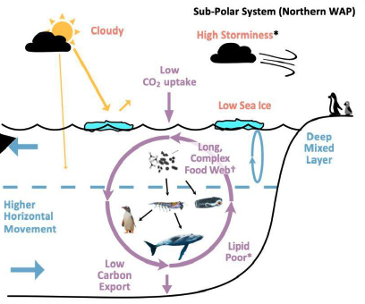
PAL Conceptual Model
Ecosystem Shifts (Themes B & C)
Polar to Sub-Polar Transitions and Altered food webs, trophic coupling, and carbon cycling & export
* New Focus in PAL 6: Lipids and Storminess
Notes:
(LEFT) Sub-polar ecosystems are typically characterized by longer, more complex food webs with higher regenerated productivity with sea-ice avoiding species.
(RIGHT) Polar ecosystems are typically characterized by relatively short, linear food webs, with diatoms, abundant krill and ice fish, and sea-ice obligate species such as Adélie penguins.
(RIGHT) On interannual timescales, years with high sea-ice extent are followed by higher primary productivity, krill recruitment, and penguin breeding success. (LEFT) Conversely, krill recruitment is poor following low sea-ice years with conditions favoring gelatinous salp blooms. The cumulative impacts of sea-ice decline and climate migration result in shifts in species composition, distributions, phenology, mismatches in trophic coupling, and carbon cycling and export.

Slide 12
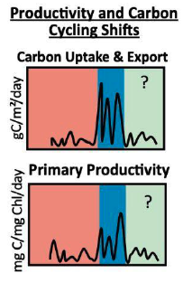
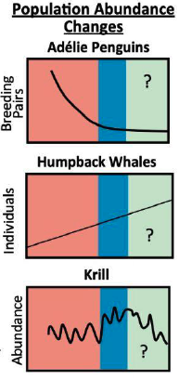
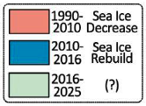
PAL Conceptual Model
Ecological Implications
(Cross-Theme)
The ecological response to multiple space/time disturbances are resulting in significant system-wide consequences for
population abundance
productivity
carbon cycling
Notes:
Together, our 3 Themes (A-C) are tasked to assess the ecological consequences towards improving predictions of ecological trajectories
Predicting ecological trajectories/change requires understanding ecological responses to, and variability resulting from, the interactions of multiple disturbances operating over a wide range of temporal and spatial scales
Combined, these responses result in significant system-wide ecological consequences for population abundance of key species, productivity and carbon cycling

Slide 13
Conclusions
The recent extreme changes underscore the importance of PAL research for informing how ecosystem productivity will change elsewhere in Antarctica
Notes:
This could be punchier!

