Slide 1
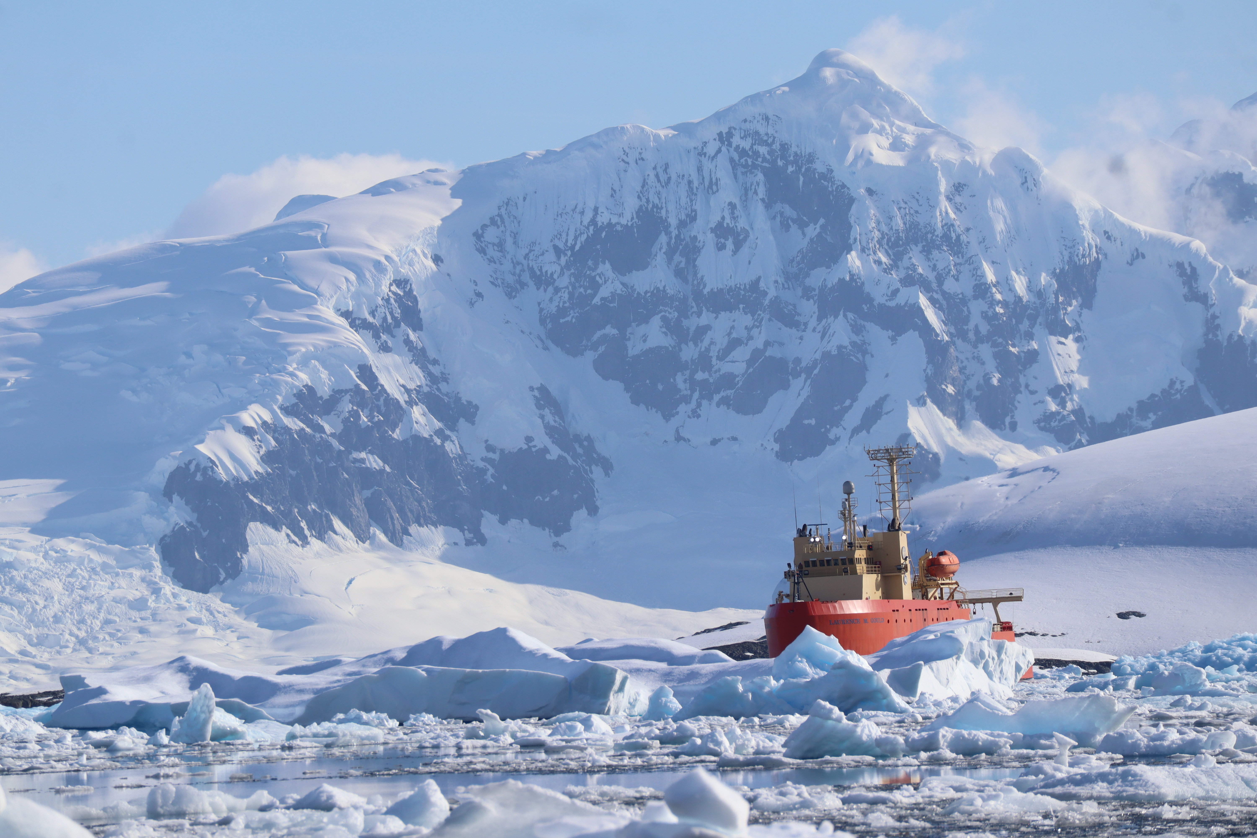



Long-term Trends in Upper Ocean Properties Along the West Antarctic Peninsula
(1993-2020)
Michael Cappola^{1*}, Carlos Moffat¹, Sharon Stammerjohn², Oscar Schofield³
University of Delaware¹, University of Colorado Boulder², Rutgers University³
(* Presenting Author mcappola@udel.edu)
October 28th, 2024

Slide 2
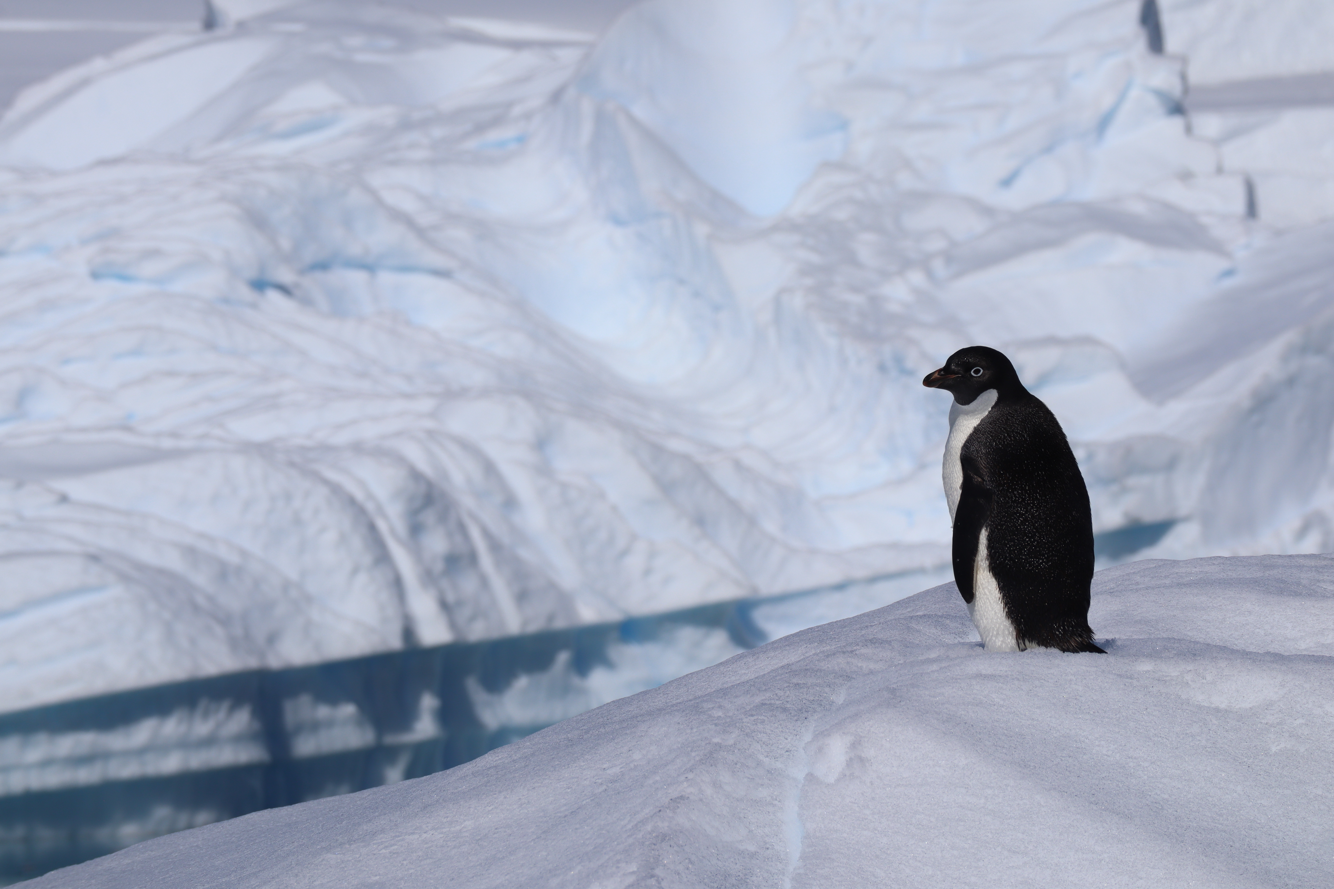
The West Antarctic Peninsula Shelf is a Sea-ice dependent polar marine ecosystem
Dramatic long-term change “Press”
  Significant Glacial Retreat
  Shortened sea-ice seasons
  Shifting precipitation modes
  Rising air temperatures
Large Interannual Variability “Pulse”
  Sea ice duration
  Climate modes oscillations
  Increased storminess

Slide 3
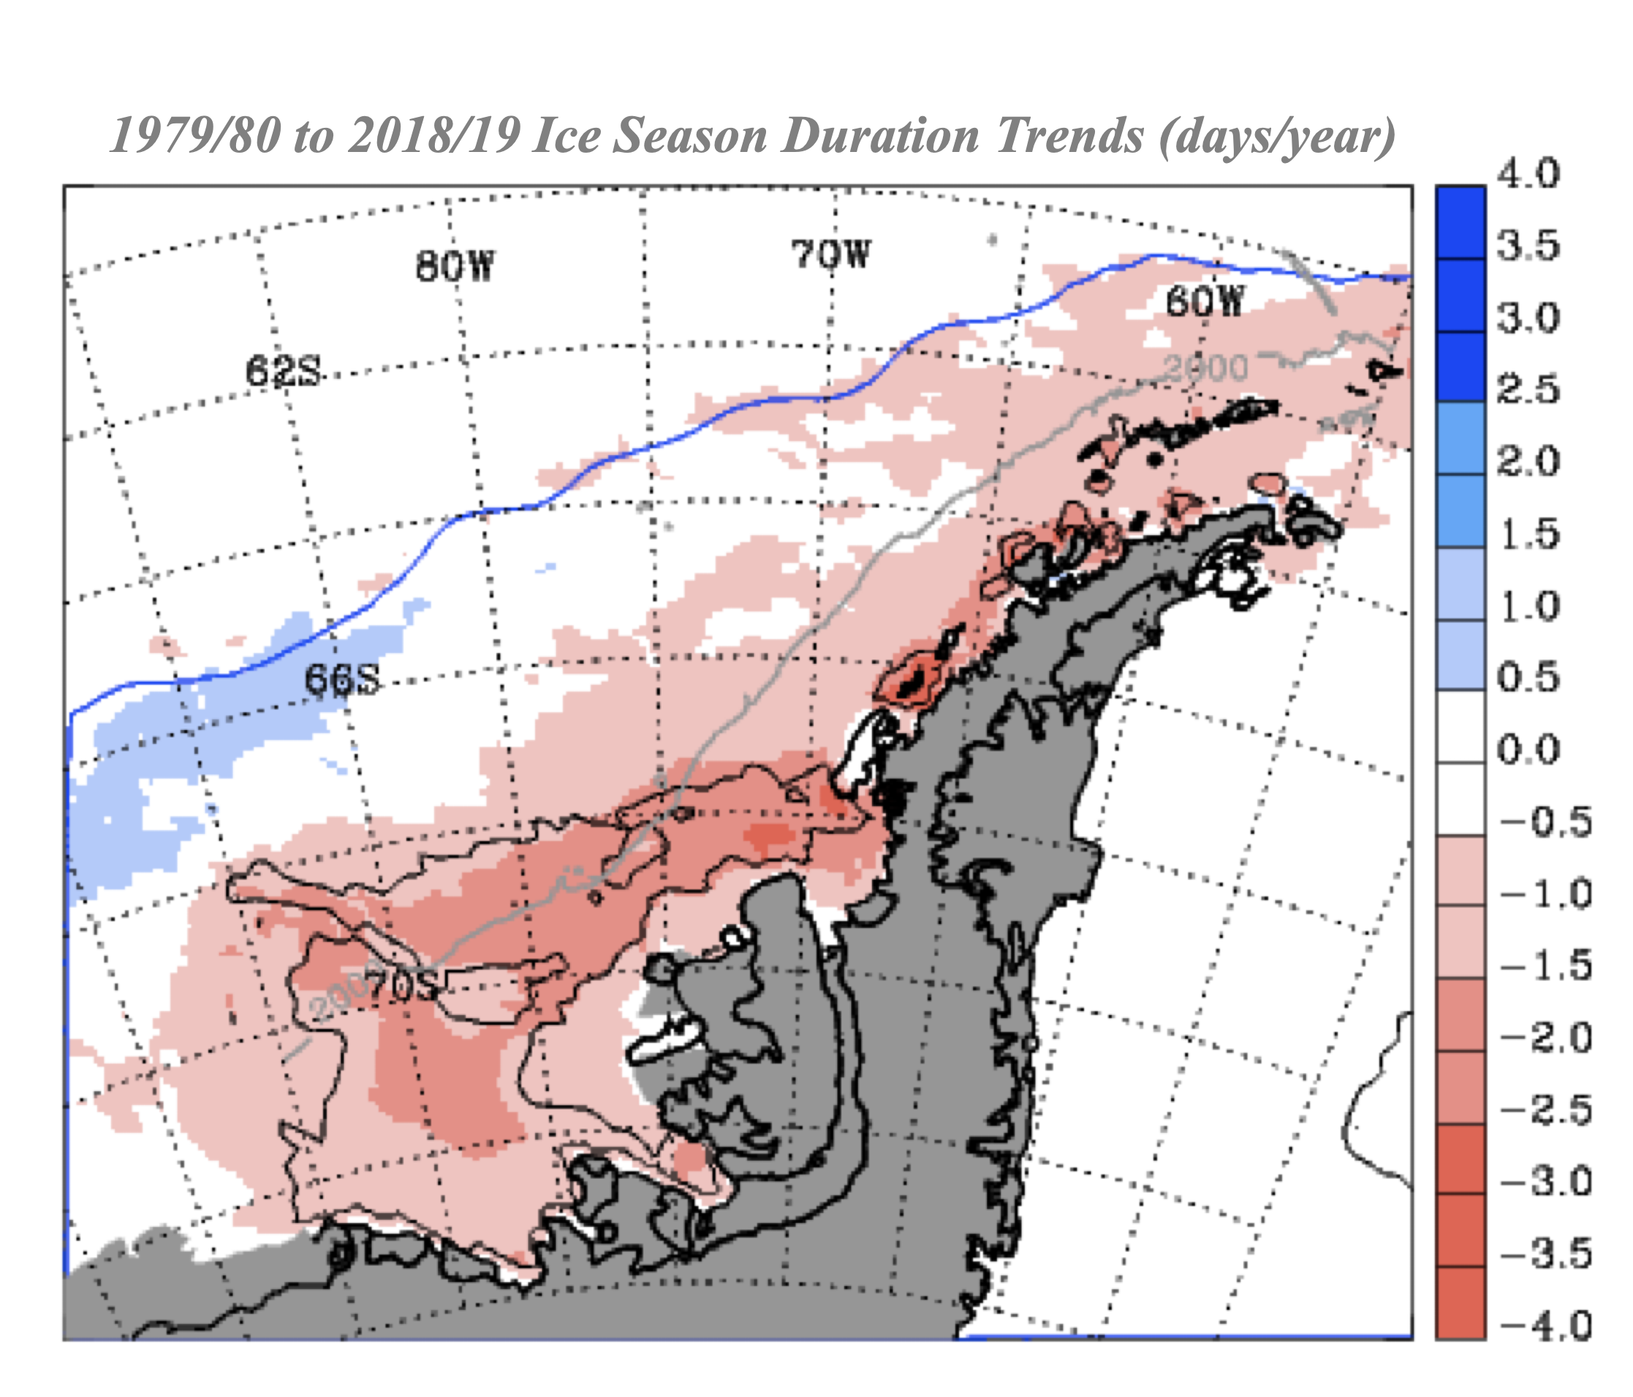
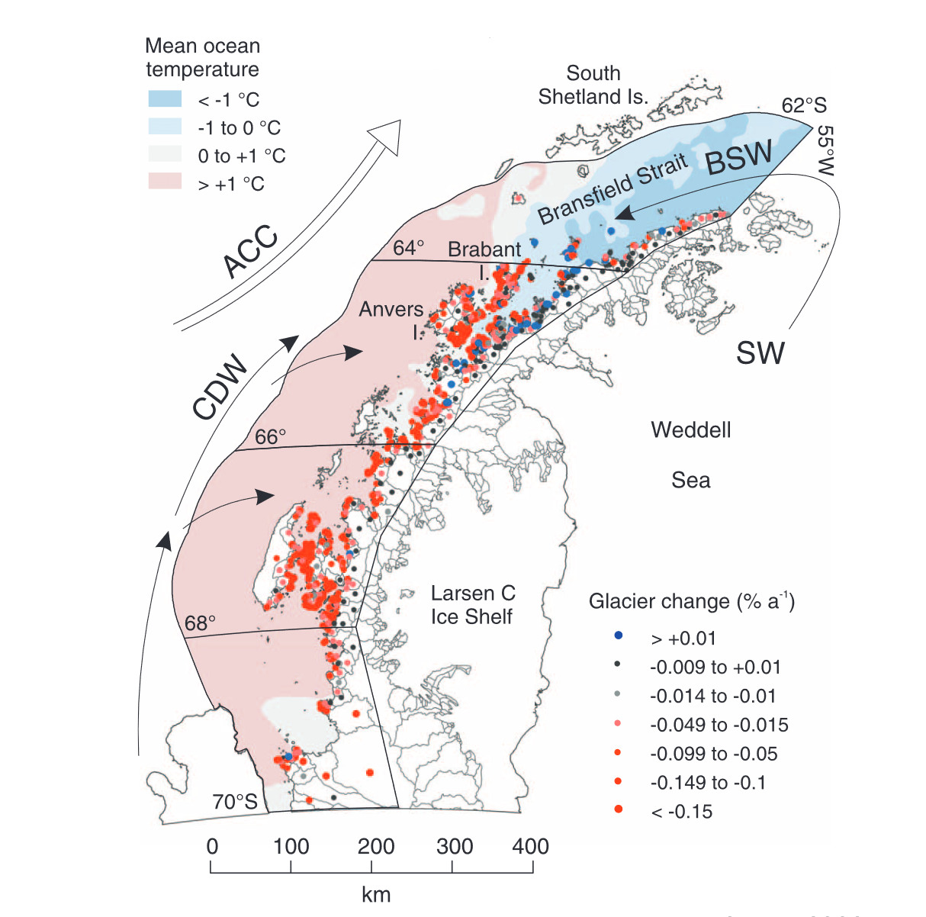
This Polar Ecosystem is in Transition from Increased Oceanic and Atmospheric Warmth.
Shortening Sea Ice Seasons
Widespread Glacial Retreat
Figure adapted from: Stammerjohn, S. and Maksym, T. (2017), updated. Gaining (and losing) Antarctic sea ice: variability, trends and mechanisms. In Sea Ice, D.N. Thomas (Ed.). https://doi.org/10.1002/9781118778371.ch10
Figure adapted from: Cook, A. J., Holland, P. R., Meredith, M. P., Murray, T., Luckman, A., & Vaughan, D. G. (2016). Ocean forcing of glacier retreat in the western Antarctic Peninsula. Science, 353(6296), 283–286. https://doi.org/10.1126/science.aae0017
Notes:
1979 – 2018 the average season length declined by about 40 days
90% of marine terminating glaciers have retreated since the 1990s
In the study area, ALL marine terminating glaciers have retreated.

Slide 4
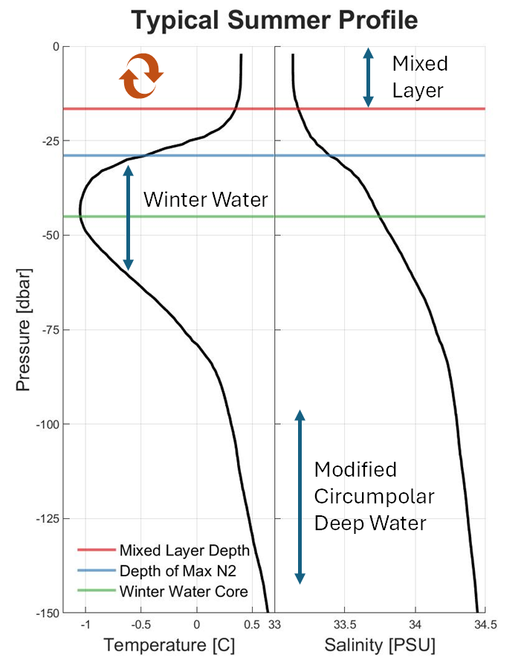
Summer Shelf Hydrographic Structure
Surface Mixed Layer
  Primary production
  Air-sea interactions
Depth of Maximum Stratification (N²)
  Where the density profile changes the fastest
  Stratification modulates vertical exchange
  Summer feature driven by freshwater input
Winter Water Layer
  Extension of the winter mixed layer into summer
    Stratification modulates warming in the summer
  Coupled to sea ice
Modified Circumpolar Deep Water (CDW)
  Warm and salty found below the Winter Water Layer

Slide 5
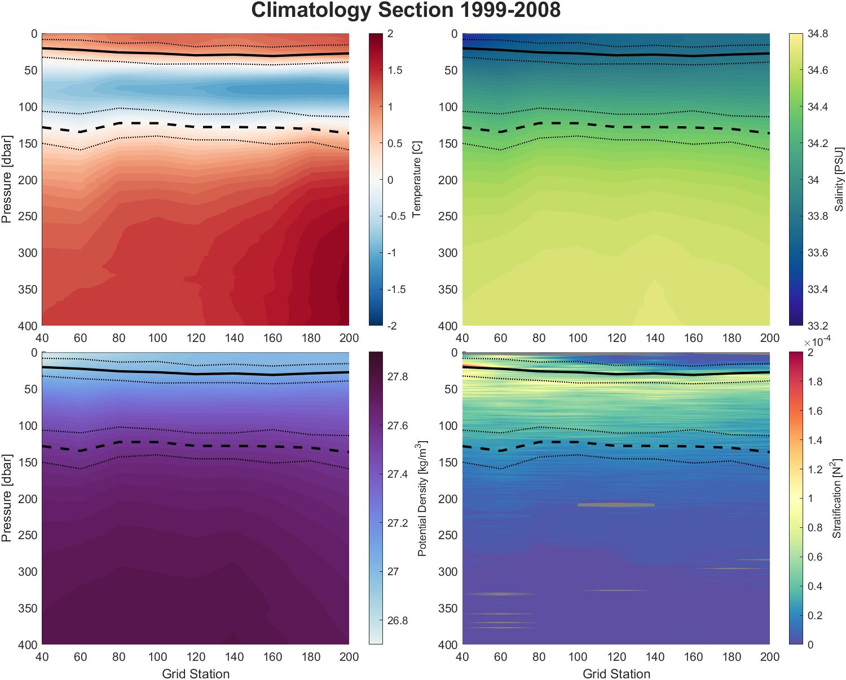
Summer Shelf Hydrographic Structure
Surface Mixed Layer
  Primary production
  Air-sea interactions
Depth of Maximum Stratification (N²)
  Where the density profile changes the fastest
  Stratification modulates vertical exchange
  Summer feature driven by freshwater input
Winter Water Layer
  Extension of the winter mixed layer into summer
    Stratification modulates warming in the summer
  Coupled to sea ice
Modified Circumpolar Deep Water (CDW)
  Warm and salty found below the Winter Water Layer

Slide 6
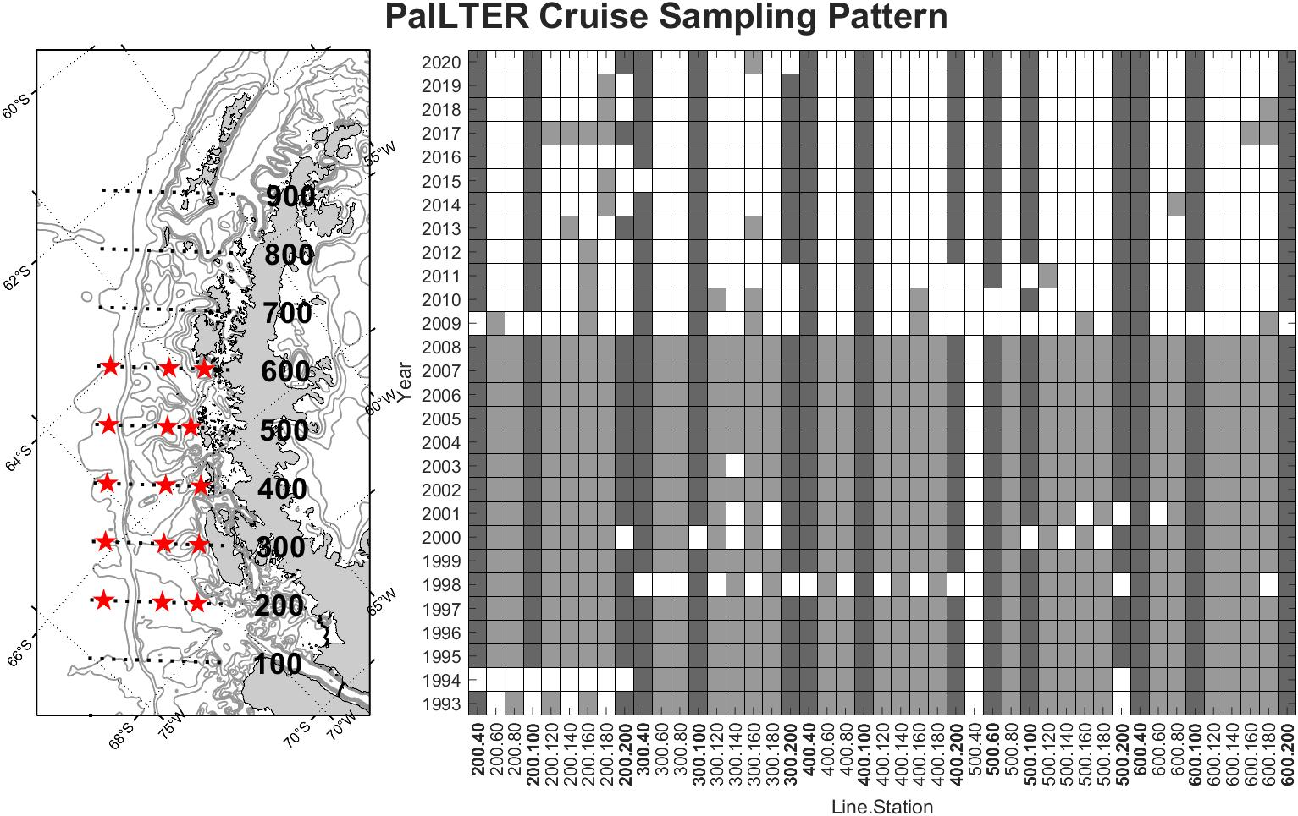

PalLTER Summer Cruise Data Distribution
1993 – Present
Austral Summer
Continuous Collection
  1993 – 2020
Core gridlines
  200-600
Sampling region extended south in 2008
Notes:
Most North of the continent. Northern islands are subantarctic
“Feeling” climate change more intensely
CTD, nutrients, lipids, carbohydrates, phytoplankton, zooplankton, marine bird, and whale surveys.

Slide 7
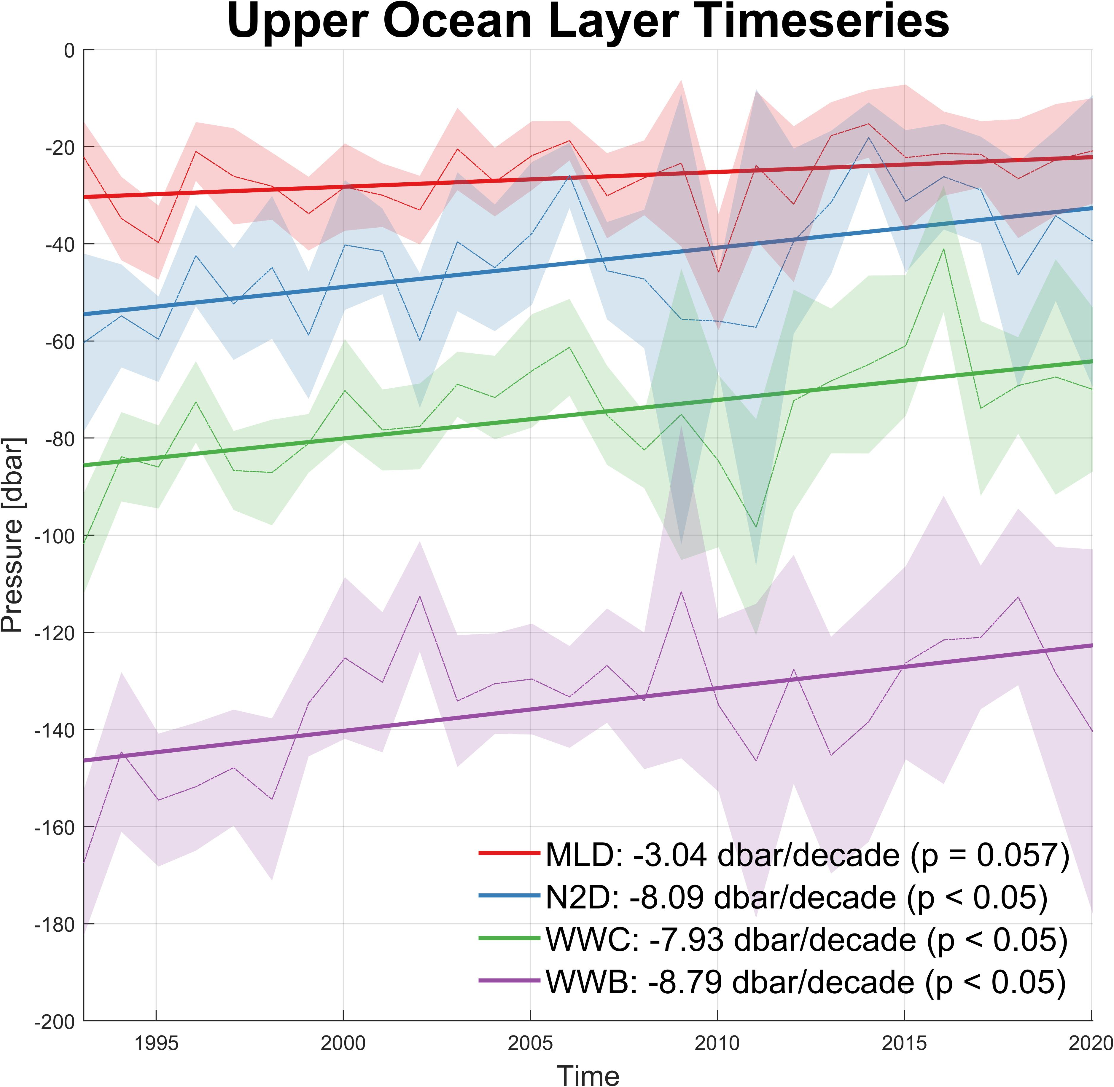
Significant Changes in Layer Depths (1993-2020)
The entire upper ocean is shoaling
  Mixed Layer Depth (MLD)
  Depth of Maximum Stratification (N2D)
  Winter Water Core (WWC)
  Winter Water Base (WWB)
Displacement of the winter water layer suggests shoaling is happening deeper as well.
  For this we look at isopycnal depths, or lines of common density, to get a sense of how Circumpolar Deep Water is changing.
Notes:
Spatial analysis shows a Coastal to Oceanic Gradient in most properties

Slide 8
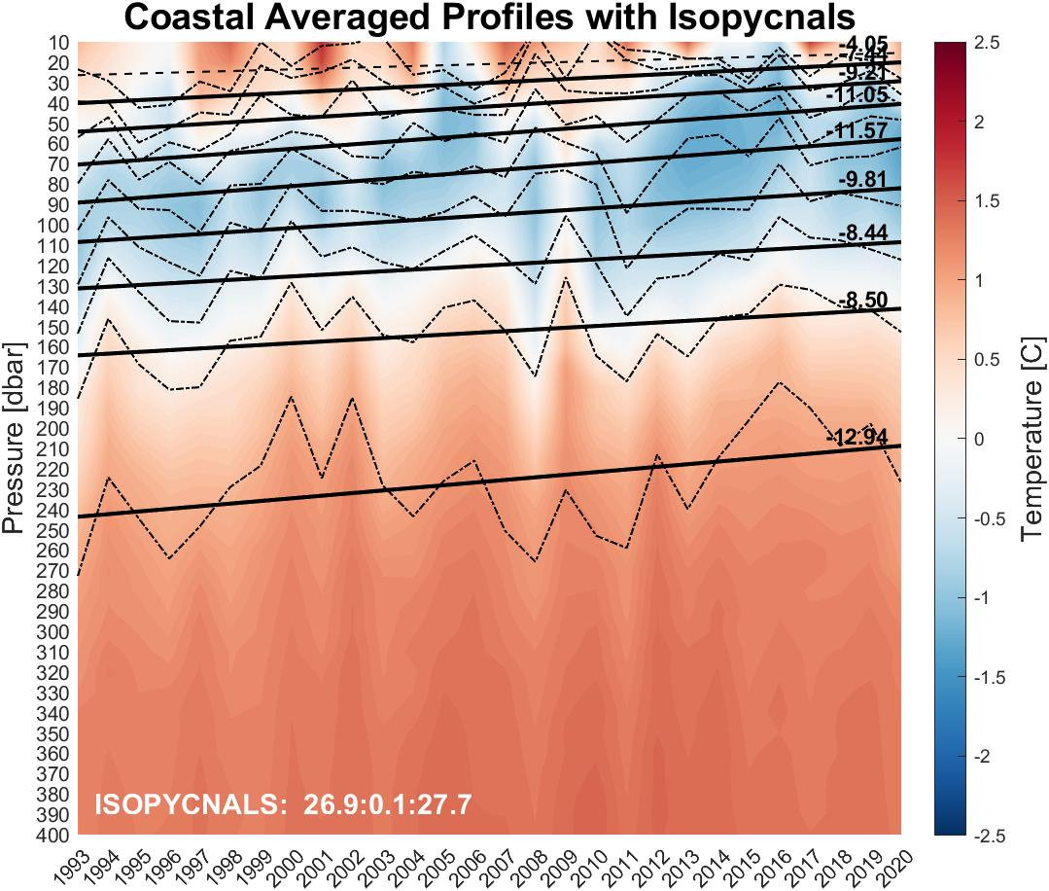
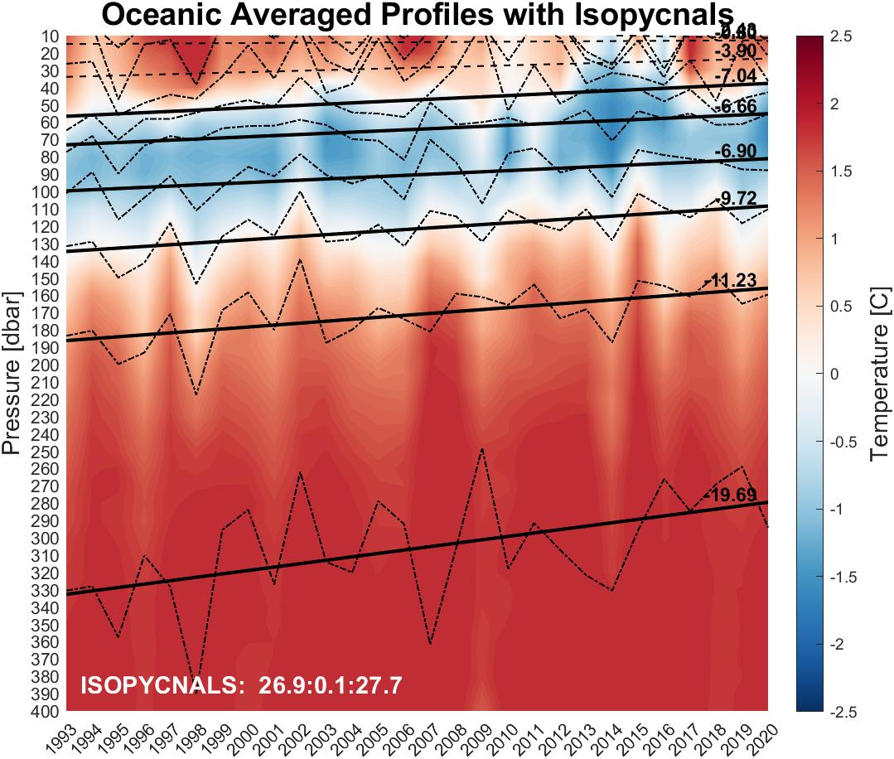
Significant Changes in Layer Depths (1993-2020)
We find that the isopycnals are shoaling significantly. Rising isopycnals suggest increased CDW presence on the shelf in modern times.
This trend is also seen in the Bellingshausen and Amundsen Seas, where it is consistent with stronger observed westerly winds which generate Ekman transport and upwelling.
  Rates are dbar/decade; Solid lines p<0.05
Notes:
Note, when including the entire study area, shoaling rates for 27.6 and 27.7 are no longer significant due to increased variability.
Note, Locally, this could also be related to weaker sea ice presence, but we don’t have the winter data to analyze this.

Slide 9
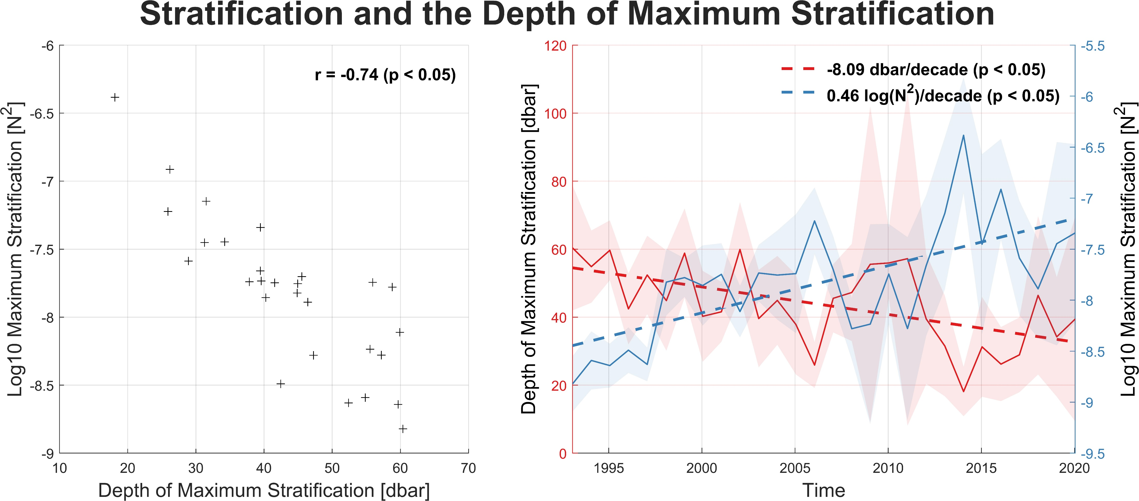
The Upper Ocean is Becoming More Stratified
Notes:
Yearly shelf averages
Note log scale. Stratification is off the charts!
Points to increased melt water
Discuss implications.
-Stratification is stronger, but shallower.
-Opens winter water below to increased variability if mixing events can overcome stratification.
-Mixing volume decreased, so flux in and out of the mixed layer should be faster/more efficient.
-Stratification is a major factor to carbon export and maintaining phytoplankton near the surface.

Slide 10
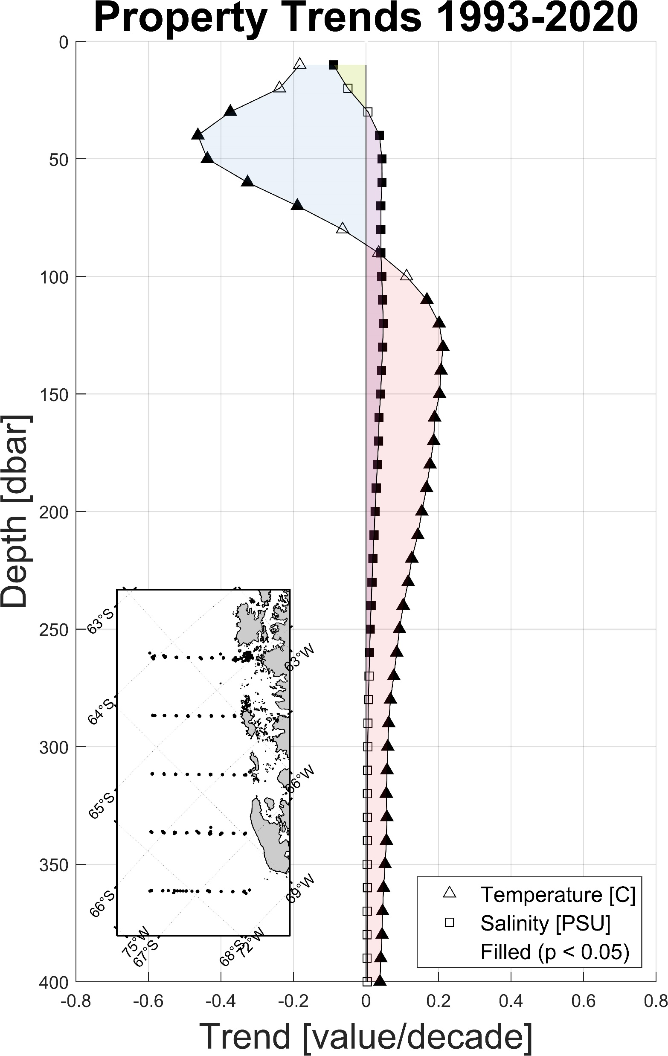
Subsurface Heat and Salt has Increased While the Upper Ocean has Cooled and Freshened
Cooling
Mixed layer
  Cooling -0.17 C/decade (p = 0.208)
  Freshening -0.08 PSU/decade (p = 0.066)
Winter Water:
  Cooling -0.12 C/decade (p < 0.05)
Circumpolar Deep Water:
  Warming 0.10 C/decade (p < 0.05)
  Salinifying 0.015 PSU/decade (p < 0.05)
The dynamic layers are changing in thickness though. It is more informative to look at how properties are changing with respect to depth.
Warming
Notes:
Analyzing the bulk property trends is difficult when the layers are changing depth and thickness

Slide 11
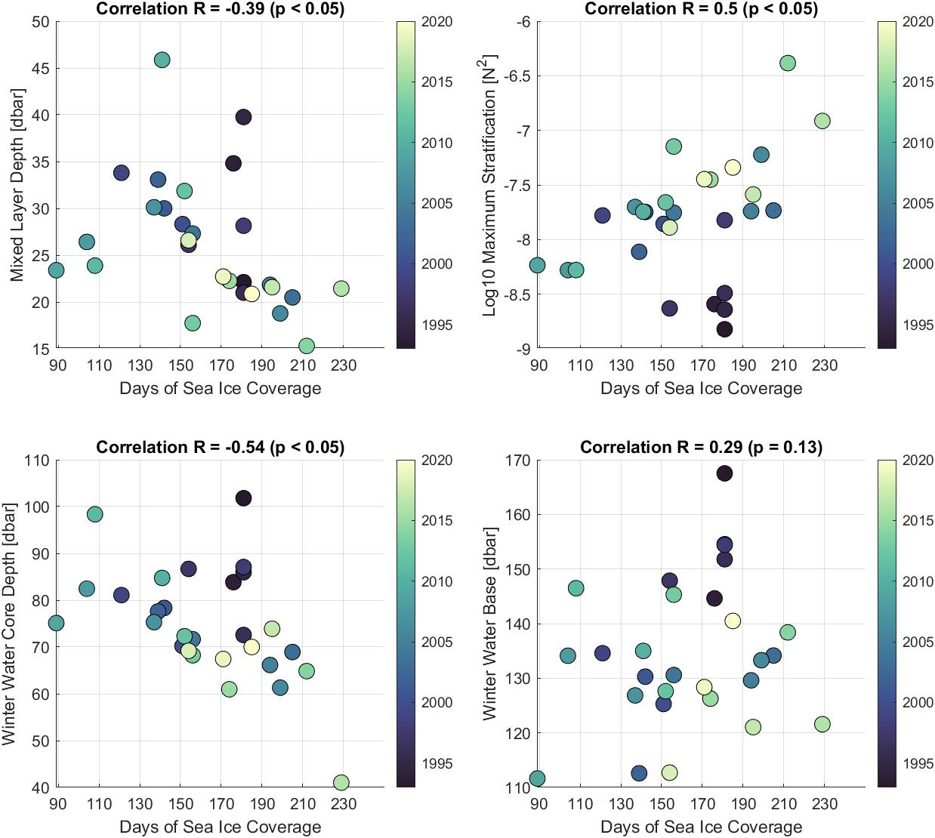
Sea Ice Cannot Explain Trends Seen in the Upper Ocean (1993 – 2020)
In interannual time-scales, shorter sea ice seasons result in:
  Deeper upper ocean layers
  Weaker Stratification
  Warmer layers
  Saltier layers
  This is consistent with increased wind driven mixing and less spring sea ice melt water during short and weak sea ice seasons.
But from 1979 – 2018 the average season length declined by about 39 days on the shelf, and the long-term upper ocean trends are instead:
  Shallower, fresher upper ocean layers
  Cooler and more stratified upper ocean.

Slide 12
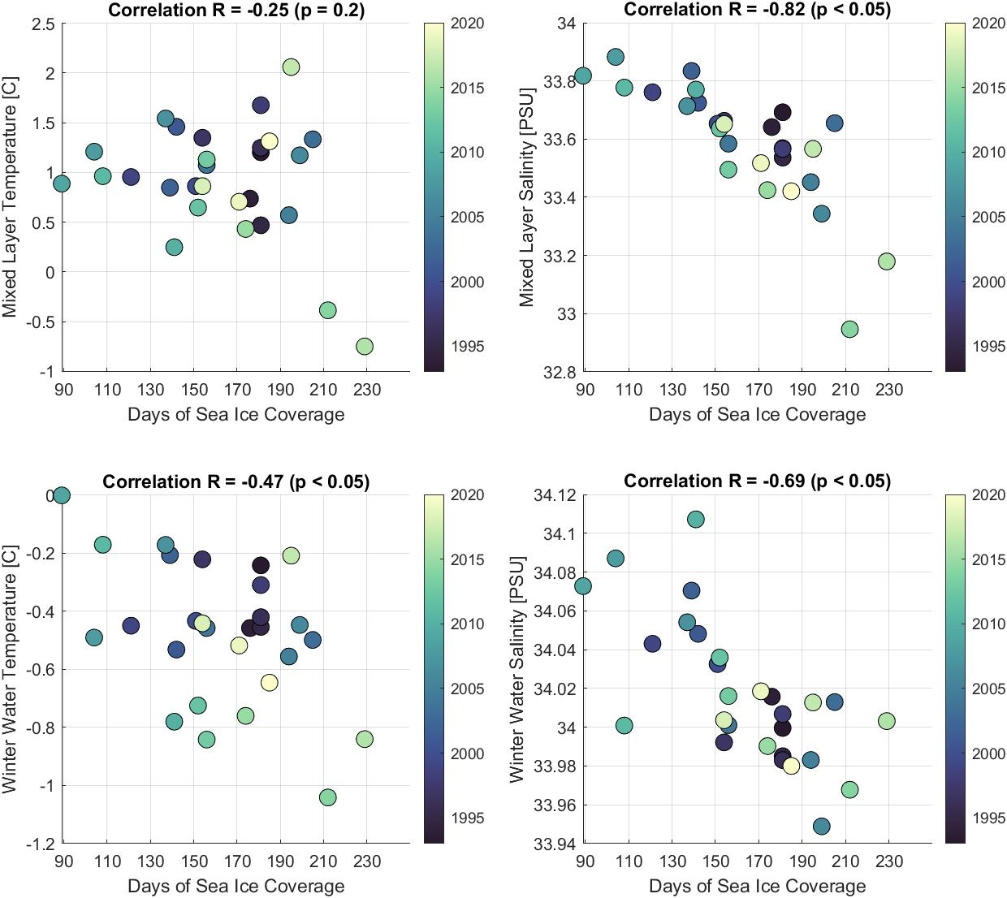
Sea Ice Cannot Explain Trends Seen in the Upper Ocean (1993 – 2020)
In interannual time-scales, shorter sea ice seasons result in:
  Deeper upper ocean layers
  Weaker Stratification
  Warmer layers
  Saltier layers
  This is consistent with increased wind driven mixing and less spring sea ice melt water during short and weak sea ice seasons.
But from 1979 – 2018 the average season length declined by about 39 days on the shelf, and the long-term upper ocean trends are instead:
  Shallower, fresher upper ocean layers
  Cooler and more stratified upper ocean.
Notes:
Discuss how this suggests a press vs pulse, with press winning in the long term.

Slide 13
Conclusions
The Western Antarctic Peninsula Summer upper ocean layers, from 1993 – 2020, have significantly shallowed, freshened, cooled, and become more stratified.
During this same period, we see shoaling of Circumpolar Deep Water, as well as an increase in heat and salt at depth.
These upper layer property trends are likely driven by increased melt water derived from the peninsula’s marine terminating glaciers, nearly all of which are in retreat.
This suggests a competition between winter sea-ice variability (winning in interannual time-scales) and long-term decreases in continental ice (winning in the long-term timescales) in setting summer upper ocean properties.

Slide 14
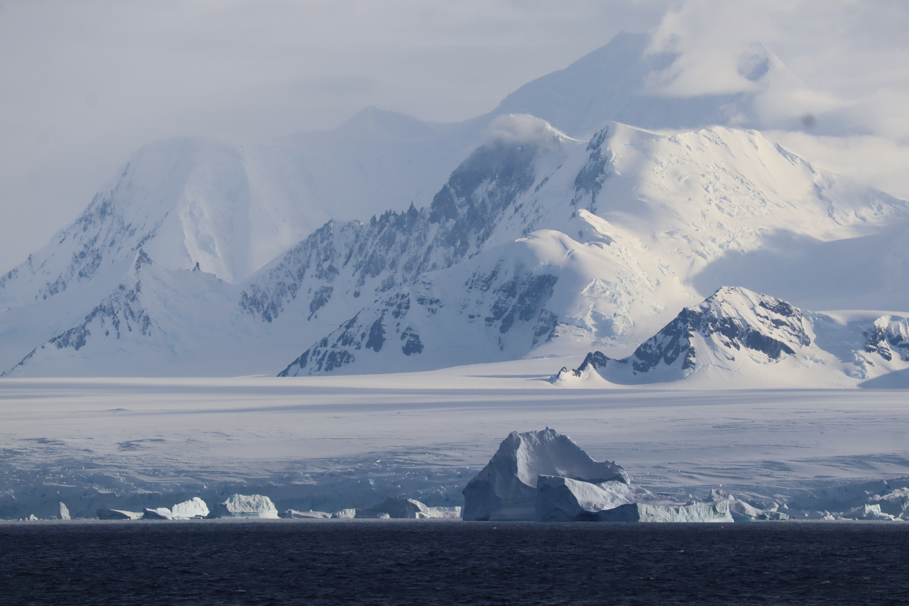
Questions?
Thank you!

Slide 15
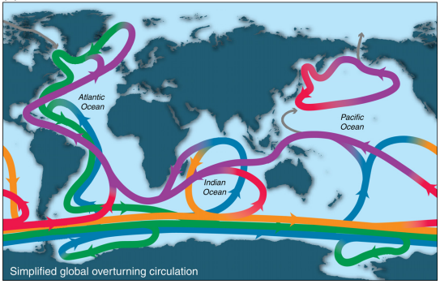
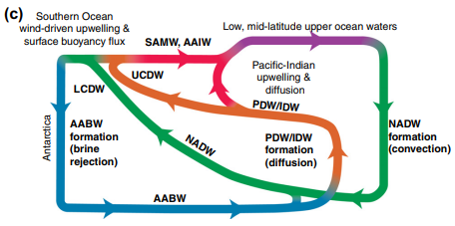
Antarctica is Connected to Global Circulation
Upper Circumpolar Deep Water (UCDW)
Lower Circumpolar Deep Water (LCDW)
Upwelled in the southern ocean

Slide 16
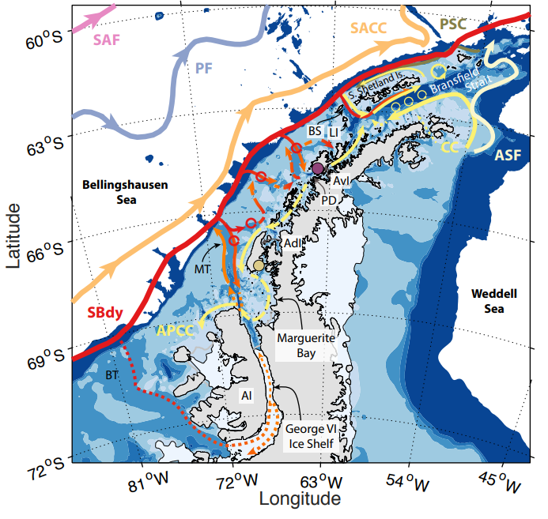
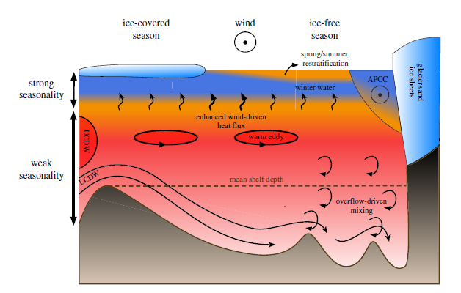
The West Antarctic Peninsula (WAP) is a “Warm Shelf”
Modified Circumpolar Deep Water (mCDW)
  Source of heat and salt to the shelf
  Troughs act as pathways guiding eddies onto the shelf
  This supply of heat drives marine terminating glacier melt
Figures adapted from: Moffat, C., and M. Meredith. “Shelf–Ocean Exchange and Hydrography West of the Antarctic Peninsula: A Review.”
Philosophical Transactions of the Royal Society A: Mathematical, Physical and Engineering Sciences 376, no. 2122
(June 28, 2018): 20170164. https://doi.org/10.1098/rsta.2017.0164.
Notes:
Area between the black lines is what most of my data looks like

Slide 17
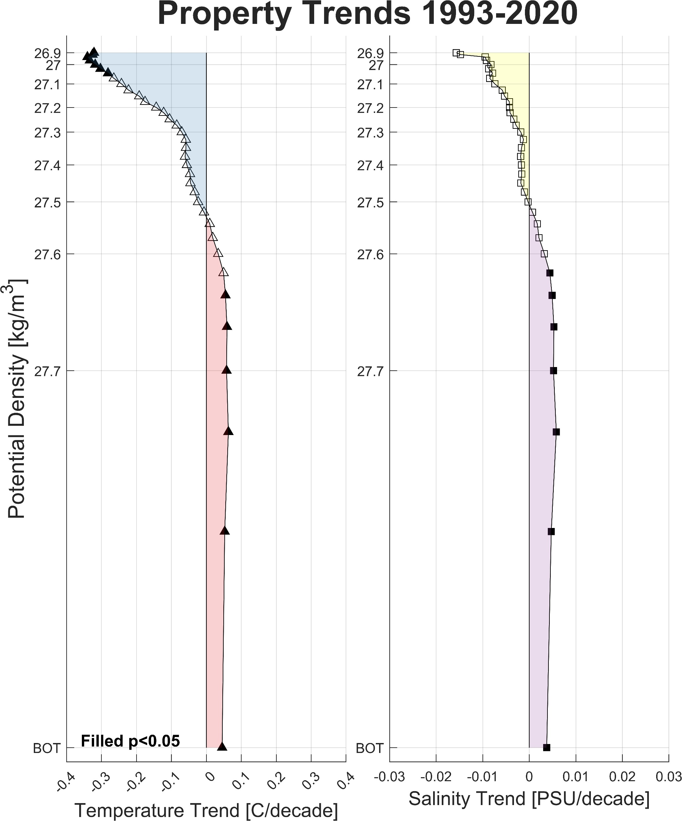
Subsurface Heat and Salt has Increased While the Upper Ocean has Cooled and Freshened
It is even more informative to organize these trends by isopycnal, or common density layers
Fluid can move freely along isopycnals, so this is a natural way to think about this system.
Trends above isopycnal 27.5 are cooling and freshening, while below it are warming and salinifying.
  This is typically where the winter water base is found

