Slide 1


Trophic transfer of fats through the food web at Palmer Station
Shavonna bent
Palmer lter
Mid-term review 2024

Slide 2
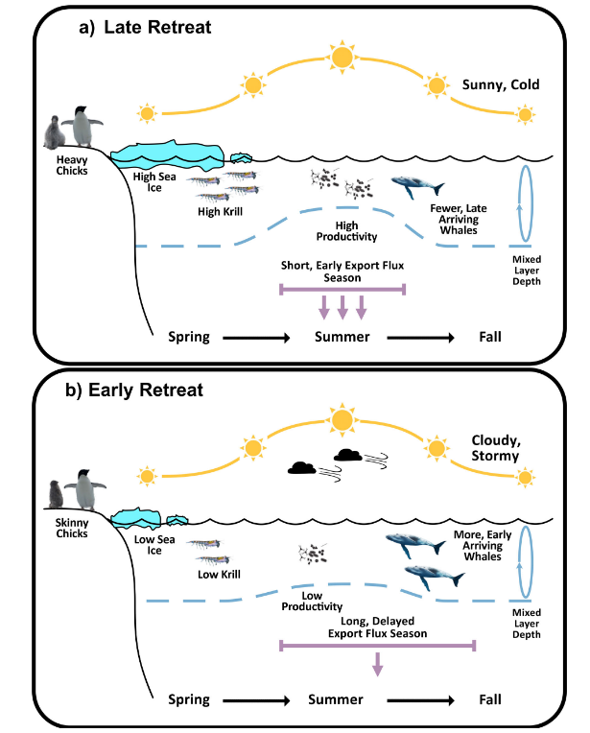
Background: influences on penguins in the Palmer region
Cimino et al. 2023*

Slide 3
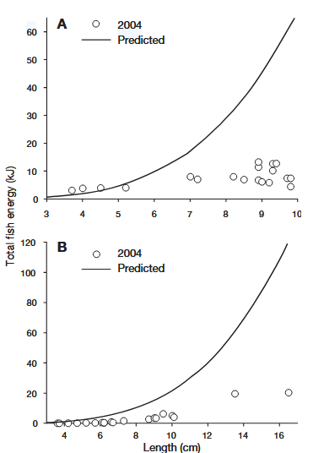
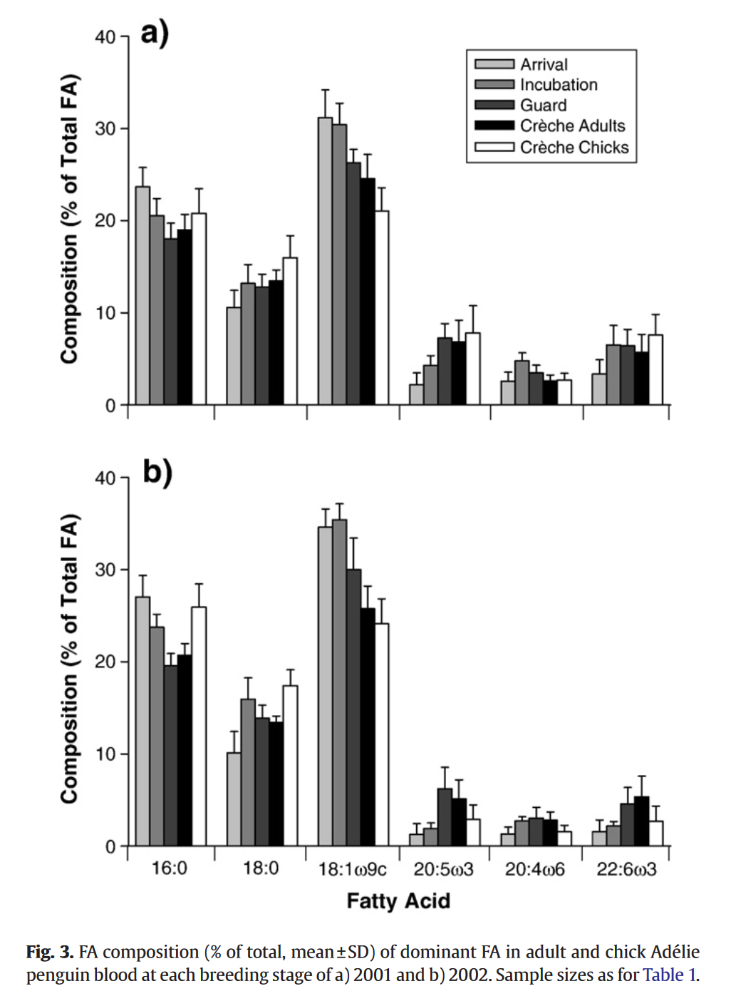
Background: importance of dietary lipids for seabirds
Wanless et al. 2005
Tierney et al. 2008

Slide 4
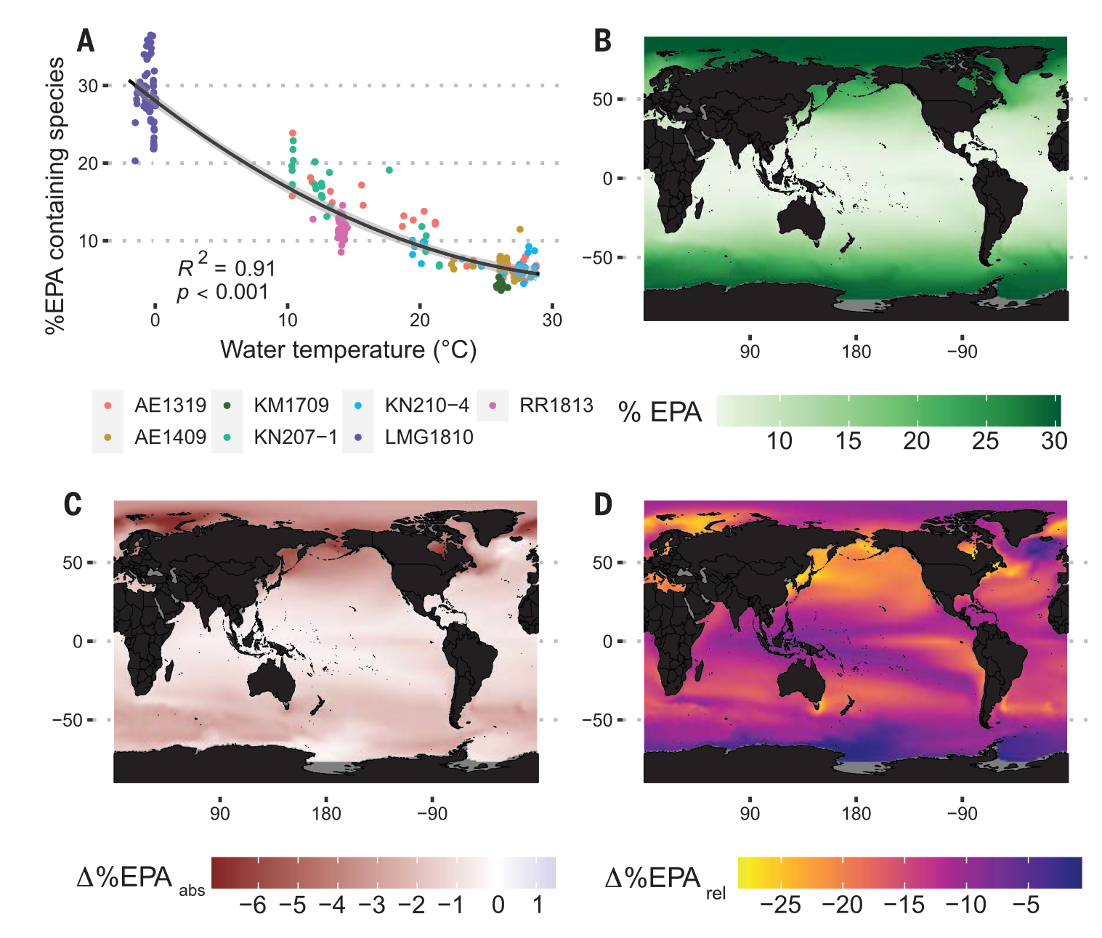
Background: PUFAs in a warming climate
Holm et al. 2022*

Slide 5
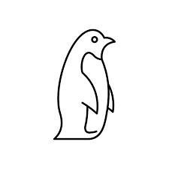

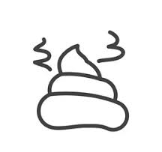
Study overview: trophic transfer along the WAP
Simple Box Models
Adults
Krill
-
Digestion
=
Poop
Chicks
Barf
-
Digestion
=
Poop
Potential pitfalls:
  Processing time
  Limited (direct) temporal sampling of krill
Notes:
Diving into the meat of things: chapter two will be focused on trophic transfer along the WAP, particularly in the area around Palmer Station.
For this chapter I will be looking primarily at two species of penguins, located across four islands in the Palmer regional area. In addition to having diet samples from the birds themselves, we also have whole krill collected from the penguin foraging area, as well as penguin fecal samples.
Using all of these sample types, we can start to build simple box models for the transfer of lipids within the food web.
For adults, we have the input, whole fresh krill, and the output, poop, and we can then say something about how much lipid is digested.
For penguin chicks and fledglings, we have what they are fed, which is regurgitated diet from the parent (or, barf), as well as their output, also in the form of poop. We can then look at chick digestion, and determine if we see differences between the three age classes, or across species, in digestion efficiency.
There are a few potential pitfalls that I’ll highlight as we go through the questions that I will be focusing on for this chapter, but just briefly, we need to consider sample processing time, because it often can take a day or two before diet samples have been counted and are ready for homogenization and storage. Secondly, we have fairly limited temporal coverage of prey throughout the seasons, although we have strategies to overcome this.
So with this general framework in mind, I want to walk through some of the questions that I am asking, and how I will be answering them.

Slide 6
Chapter 2: Schematic Summary of Samples
Number of Samples:
73
149
214
58
83
+49 (fledgling)
Notes:
So a brief visual overview, before jumping to the nitty gritty of sample breakdown.
We have 73 krill, 21 from PAL2223, 30 from PAL2324, and 22 from along the grid that were collected during the 2023 cruise.
I have 149 penguin diets that have been processed, extracted, and run, although there are even more in the freezer from Avian Island a couple hundred kilometers south of Palmer Station.
And finally I have over 200 poop samples, from adults, chicks, and fledglings, which are a specific age group of chicks that have left the nest and are just about to get into the water for the first time, when they have lost more than 90% of their fluff.
These samples are taken across islands, species, and season. Just to give some context, we can take a look at the Palmer regional area where these samples were collected.

Slide 7
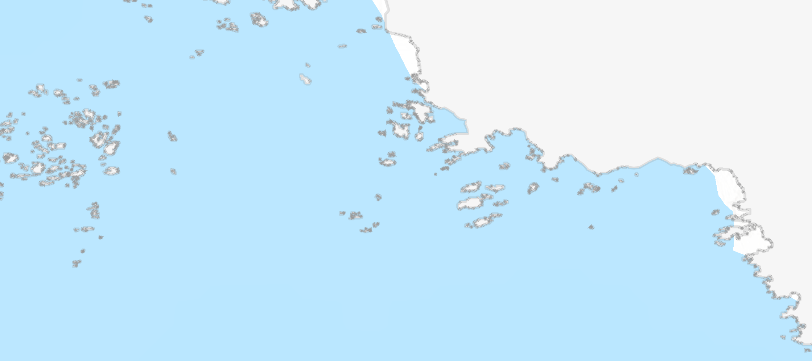
Chapter 2: Sampling Locations
Adelie Colony
Gentoo Colony
Humble
Palmer Station
Joubins
Torgerson
Biscoe

Slide 8
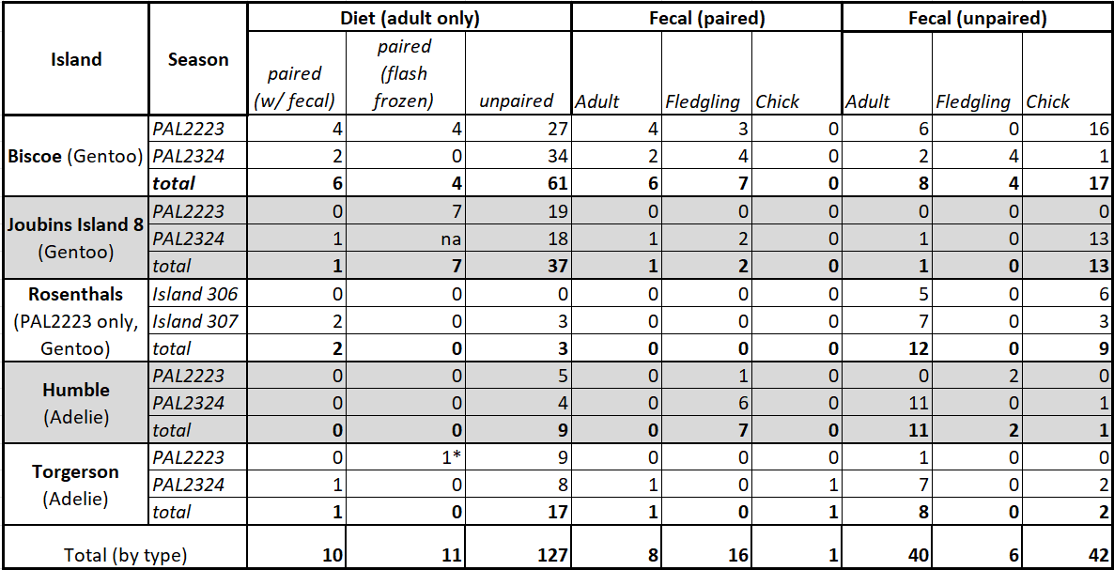
Chapter 2: Summary of Samples
Notes:
So! There is clearly a lot going on here, so let’s break some of this down and look at it via the lens of what questions we’re asking.
We have two species of penguins, Gentoos and Adelies. Within the gentoo populations there are two main islands of interests, Biscoe and the Joubins. We also have a third island, that is completely outside of the Palmer regional area that we have a few samples for, for comparison.
For the Adelie penguins, we also have two islands, Humble and Torgerson.
Within this, we have 8 really high value samples, meaning that we have paired diets and poops. When I say paired, I mean that the bird defacated while the stomach contents were being sampled, usually onto whoever was holding it, and they scraped it off their foul weather gear into a test tube (which helps explains why there are so few).
We also have 11 (and a half) flash frozen samples, where Ben was kind enough to go out into the field and split diets in two with a Fulsome splitter, freezing half in liquid nitrogen and saving the other for birder processing. That will help us build that comparison for how much processing time impacts the sample. You’ll note the star, which is the sample that broke my wrist; I was meant to collect these but clearly, the universe, bird poop, and too large shoes conspired against me.
We also have other types of poops that are paired, so fledgling birds and chicks are not subjected to the diet collection process, but they do get measured and weighed, and we have some paired samples from those age groups.
And finally, to help understand a broad distribution of lipids throughout the region, we have poops that are unpaired. The requirement for these samples were that someone had to observe a bird pooping, and then be able to collect that specific sample from the rock or snow, so we tried to reduce contamination from the surrounding fecal matter which is…pervasive. We wanted to know our samples were fresh and which species of birds they came from, hence this requirement!
With all of these samples, 463 in total, if we add in the krill, we are really well poised to answer those questions that I went over.
And with that, I want to jump into some very (very) preliminary data. A lot of my summer was spent processing these 463 samples, as well running them on our instrument, doing method development, and I have just started to do data clean up and quantification.

Slide 9
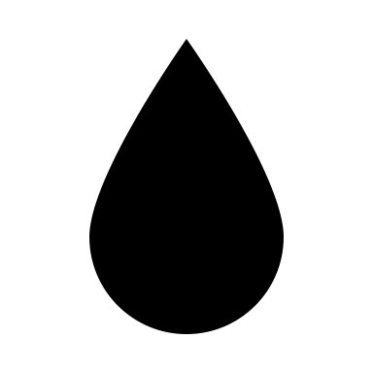




Methods overview:
Record FSW added
Count krill & other prey
Blend to homogenize
Crush krill & weigh
Subsample & weigh
Subsample & weigh
Extract
Extract
$$\frac{mg lipid}{mg biomass}$$
% biomass correction
Extract
$$\frac{mg lipid}{mg sample}$$
$$\frac{mg lipid}{mg sample}$$

Slide 10
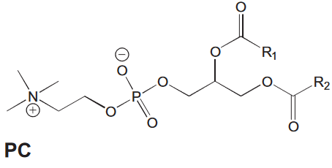
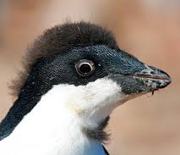
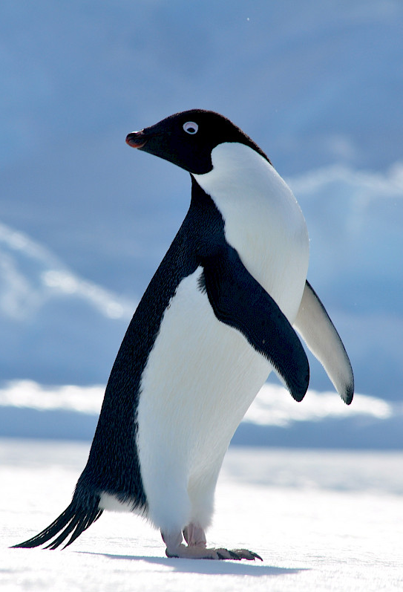
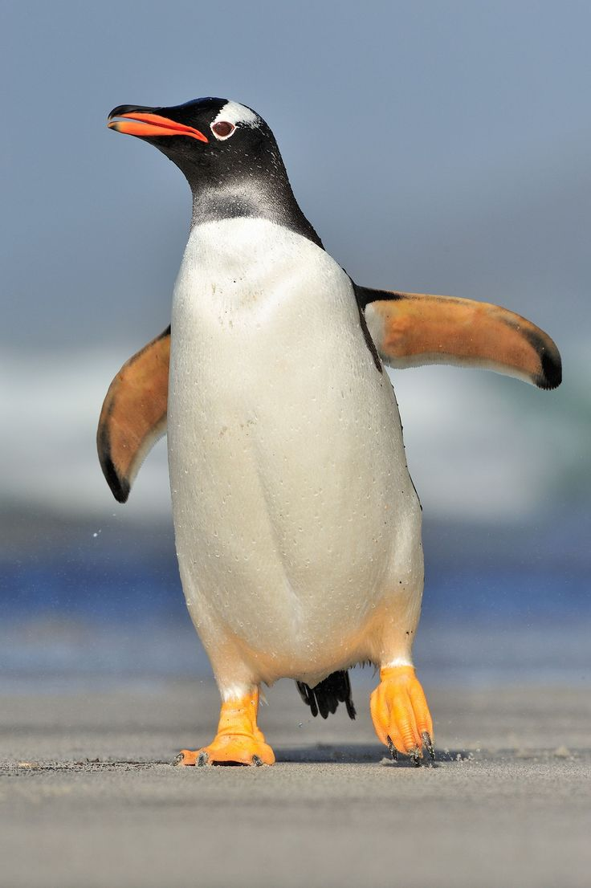
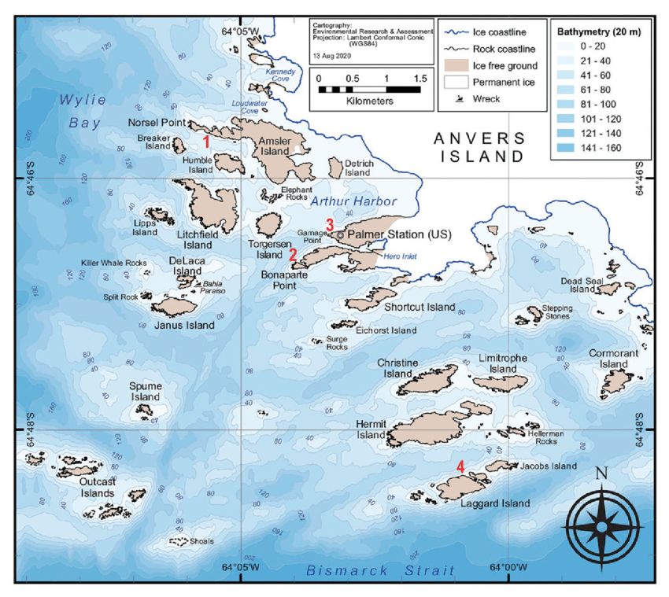
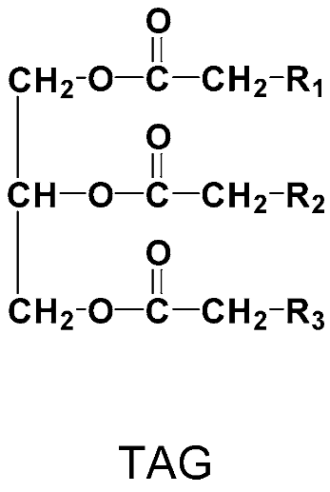
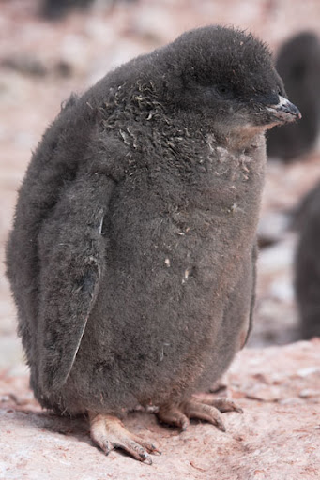
Driving Questions
How efficient is penguin digestion?
  Do we see differences between species?
  Islands (geomorphology)?
  With age class (adult, fledgling, chick)?
  Between groups of lipids?
Notes:
First and foremost, I aim to determine how efficient penguin digestion is with respect to lipids. Some studies have used fatty acids to look at seabird, and even penguin, diet, but few, if any, have quantified the efficiency of the digestion process.
Knowing seabird diet is important to understanding the ecosystem as a whole from an apex predator and key stone species perspective. However, it also may be critical to understand how well predator is able to utilize existing resources, particularly if there are differences in how efficiently different groups of lipids are digested.
For example, polyunsaturated fatty acids, PUFAs, are critical lipids to obtain through diet. Vertebrates in general, and seabirds in particular, are unable to biosynthesize many of these PUFAs, and are extremely limited in their ability to make them via chain elongation and desaturation, and thus the main source of PUFA is from diet. A 2008 study by Tierney and others found that chicks fed a diet rich in fish, but lower in PUFA, had reduced recruitment, despite fish being a more energetically rich diet than krill.
This is not to say that energy richness is not also important – another study in Arctic seabirds by Wanless and others in 2005 described recruitment failure because chicks were being fed the equivalent of junk food: the quantity of the food was approximately the same but the energetic density of that prey was not enough to successfully position the chicks for survival.
For this question, we have many angles from which to address this: are there differences between Gentoo and Adelie penguins? What about between different subpopulations of those species, sampled from different islands within the region? How does trophic transfer efficiency differ by penguin life history stage?

Slide 11
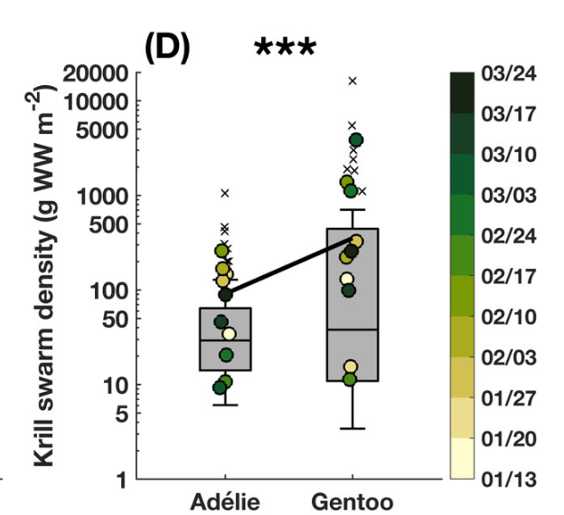
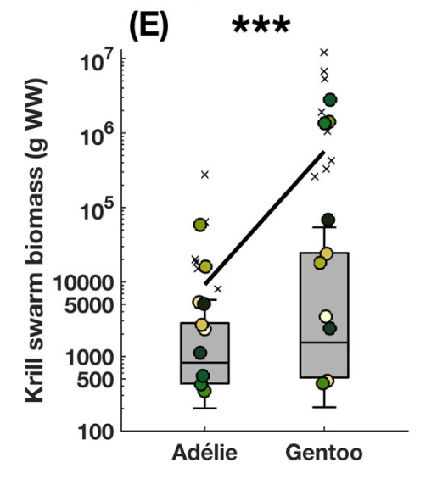
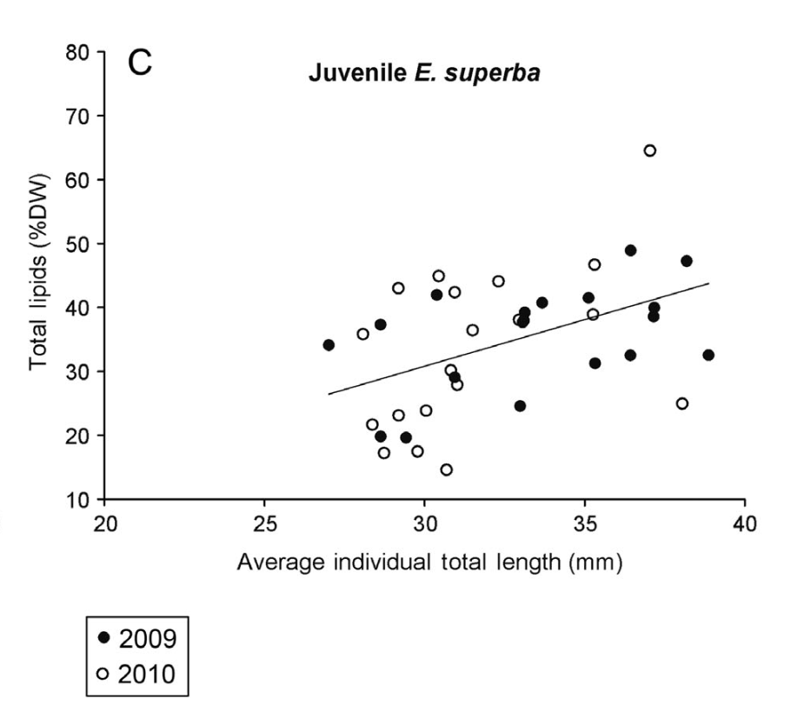
Driving Questions
Are the differences in prey quality across the Palmer region?
  Can we relate these differences to prey size?
  Can we relate these differences to previous observations of krill swarms and penguin foraging behavior?
Ruck et al. 2014
Nardelli et al. 2021
Notes:
As mentioned before, one of the potential pitfalls of this dataset is we have fairly limited temporal coverage of krill from within the study region. We have a great sample size from each season, but these krill were all collected on the same day, or from outside the direct foraging area.
However, we have the ability to do what many studies of krill in the region have done, and correlate our relationship of lipid content with prey size, in this case wet weight and length, as well as maturity status (we have recorded if krill were gravid females). We can then use this relationship, as well as previous observations of krill throughout the study region to begin to get at changes in the prey quality available at Palmer station.
We can also use the diets of penguins, who are much, much more efficient at catching krill than any net tow, but we some caveats that we’ll discuss with the next two sets of questions.

Slide 12
Driving Questions
How efficient is penguin digestion?
  Do we see differences between species?
  Islands (geomorphology)?
  With age class (adult, fledgling, chick)?
  Between groups of lipids?
Are the differences in prey quality across the Palmer region?
  Can we relate these differences to previous observations of krill swarms and penguin foraging behavior?
  Can we relate these differences to prey size?
How degraded are krill in penguin stomachs, compared to fresh krill (i.e. prey quality available to chicks)?
  Is there a relationship to diet freshness (measured by birders) and caloric content?
  Which lipids are lost first?
  Are there potential implications for chick health (i.e. loss of PUFA first)?
Field methodology: comparison of flash frozen samples vs. samples processed by birder team.
  Can we quantify differences between samples and apply this correction to other samples?

Slide 13
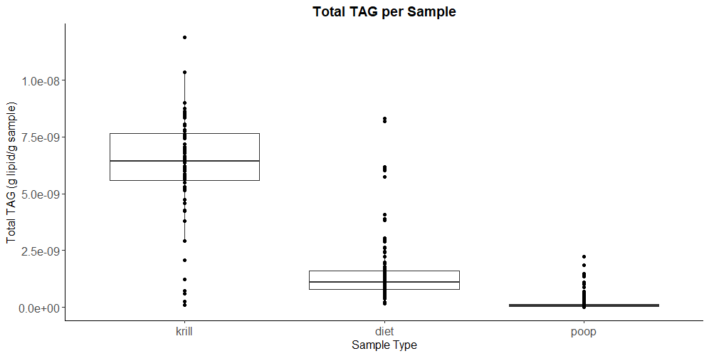
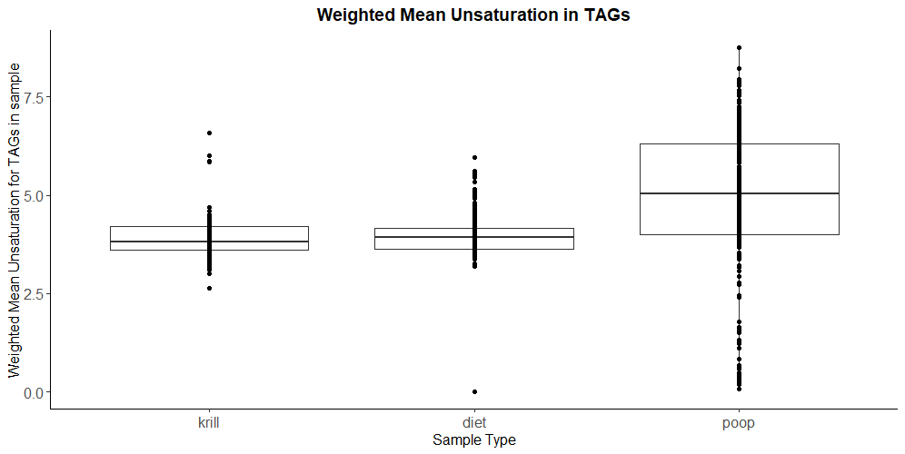
Preliminary Results

Slide 14
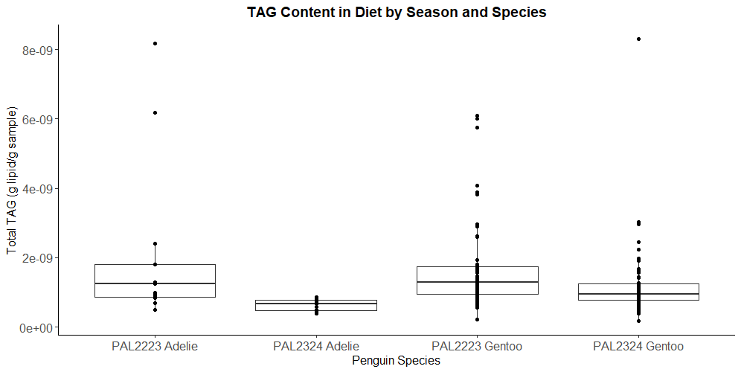
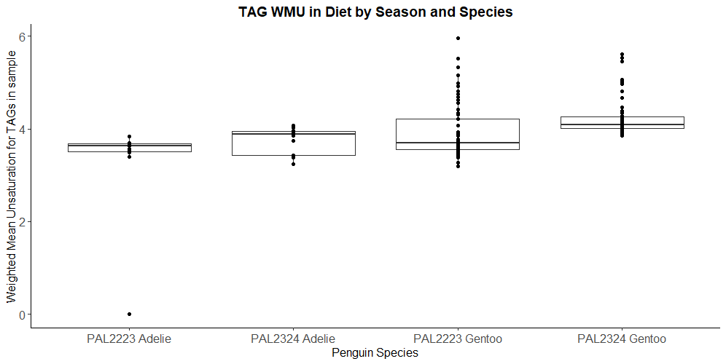
Preliminary Results

Slide 15
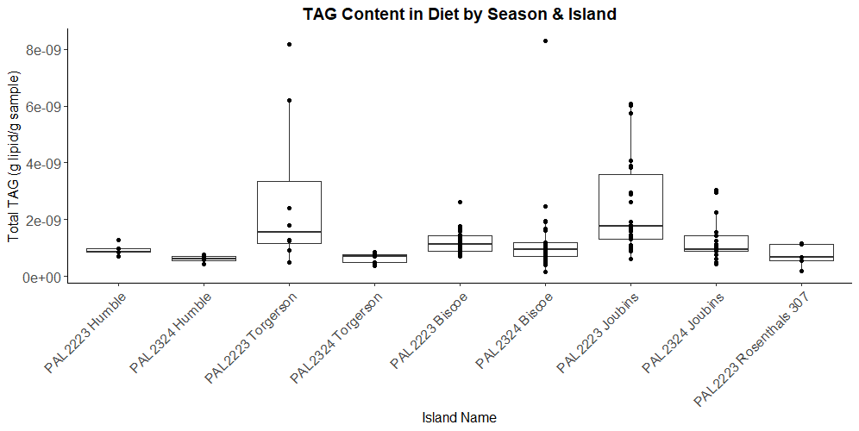
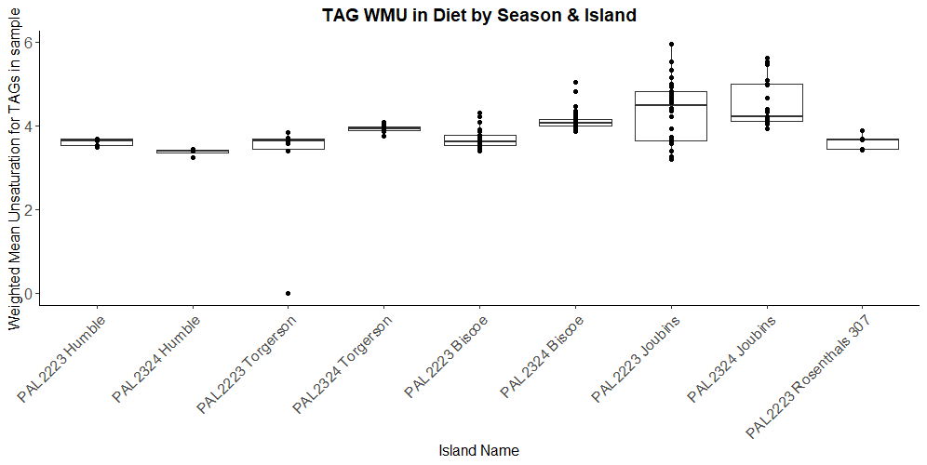
Preliminary Results

Slide 16
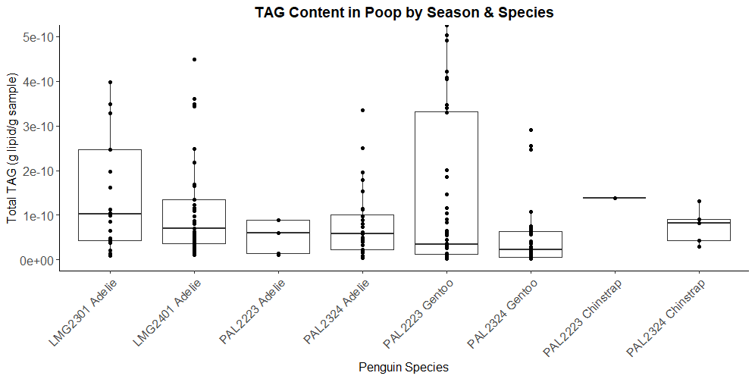
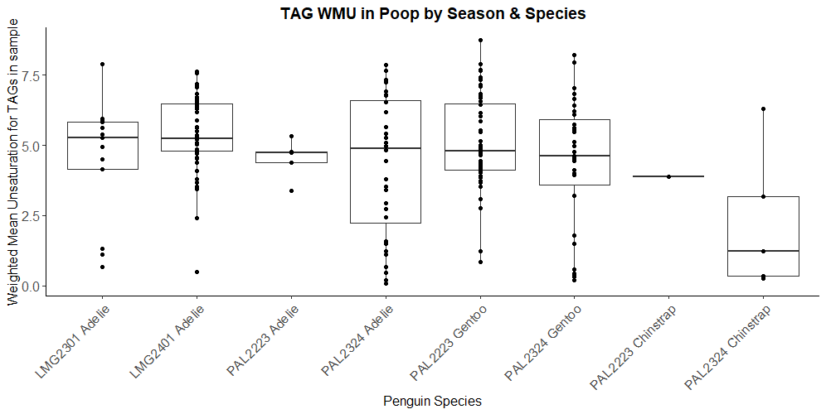
Preliminary Results

Slide 17
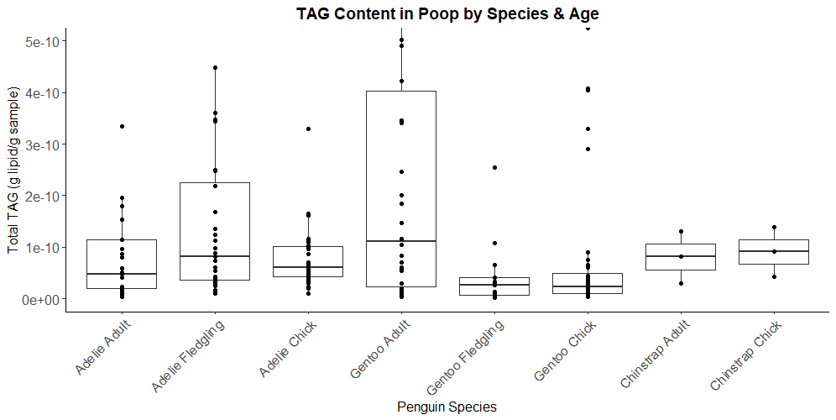
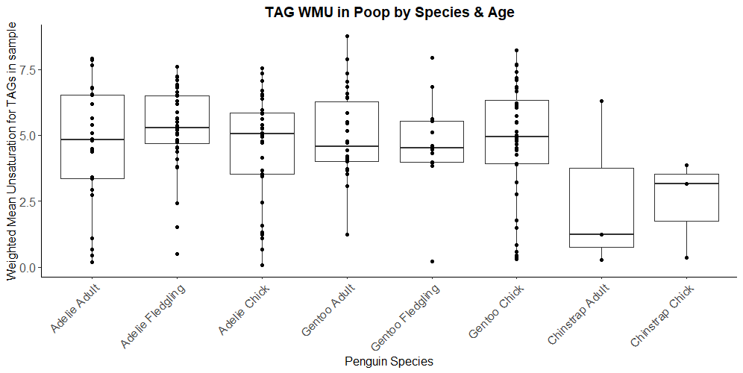
Preliminary Results

Slide 19
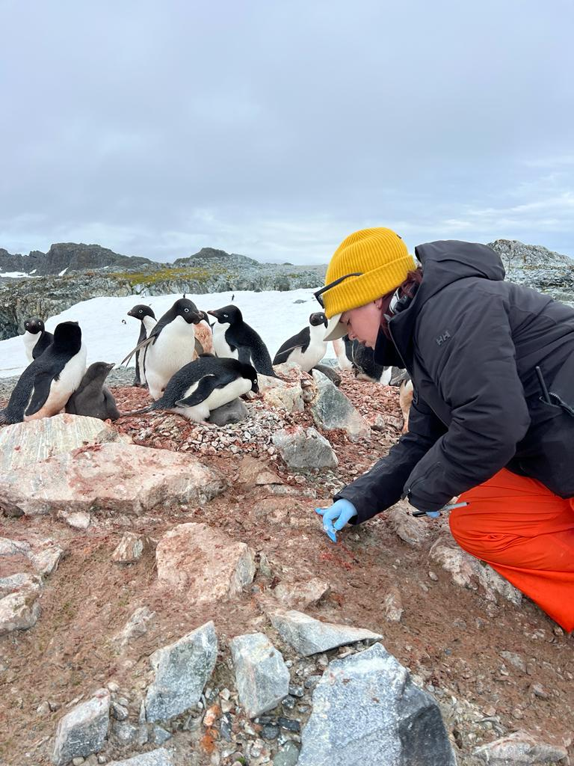
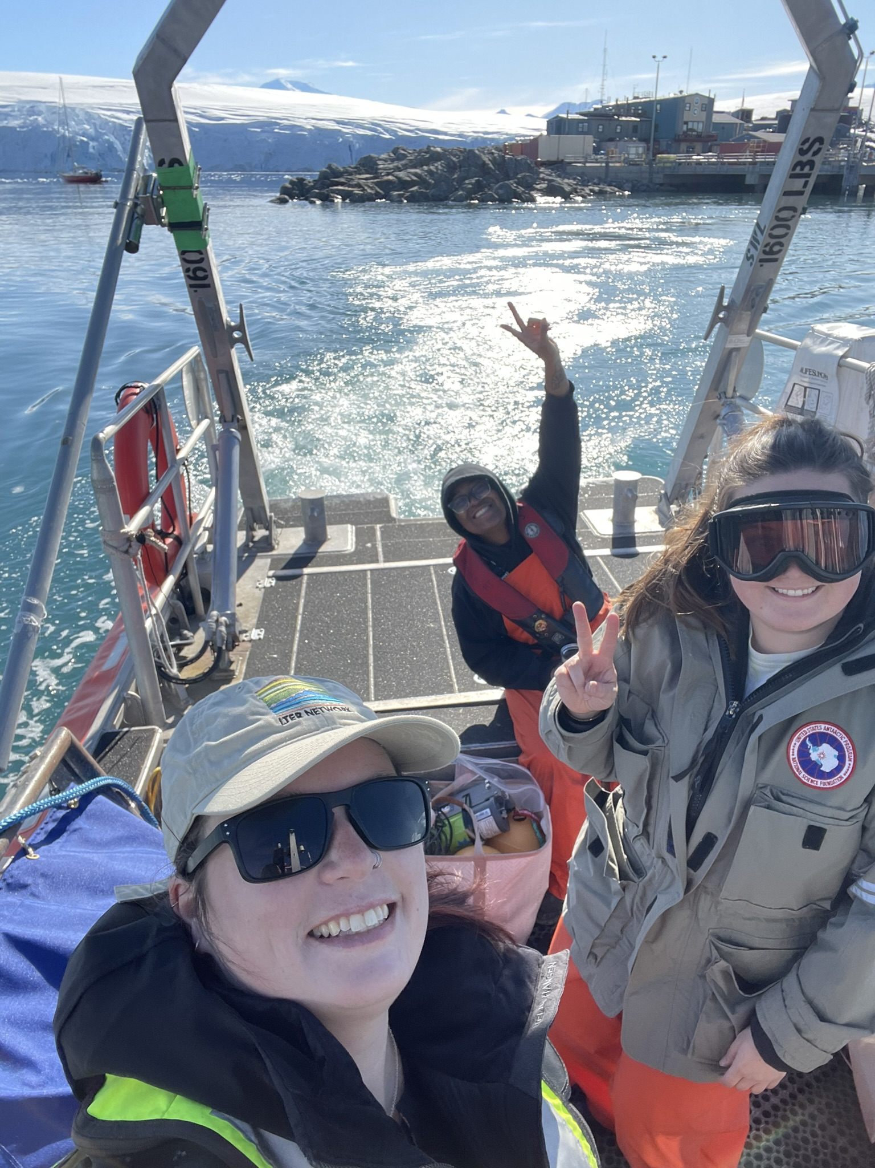
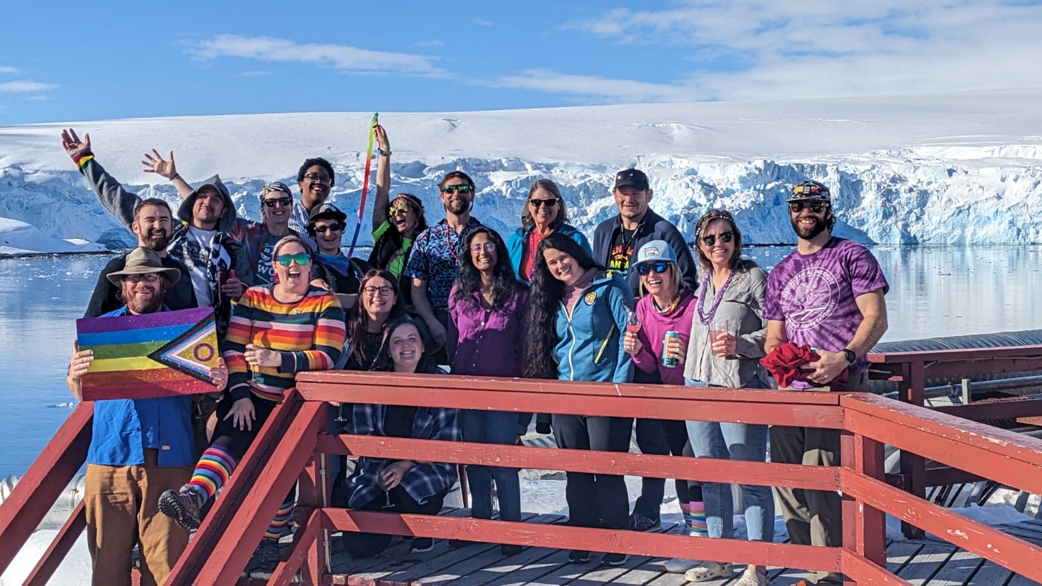
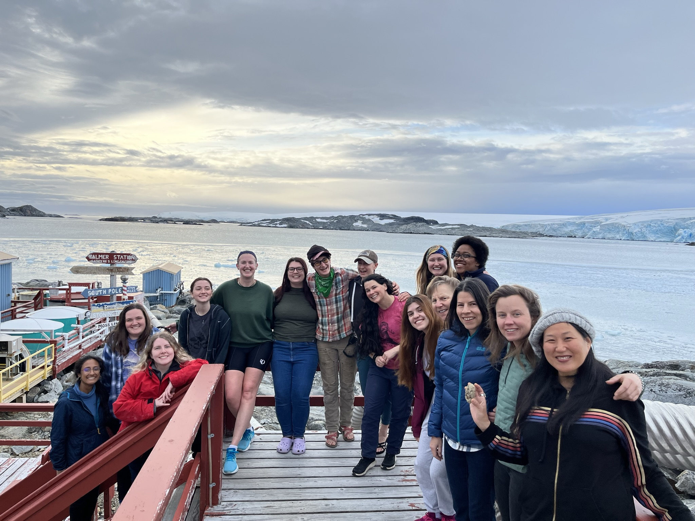
Questions?

Slide 20
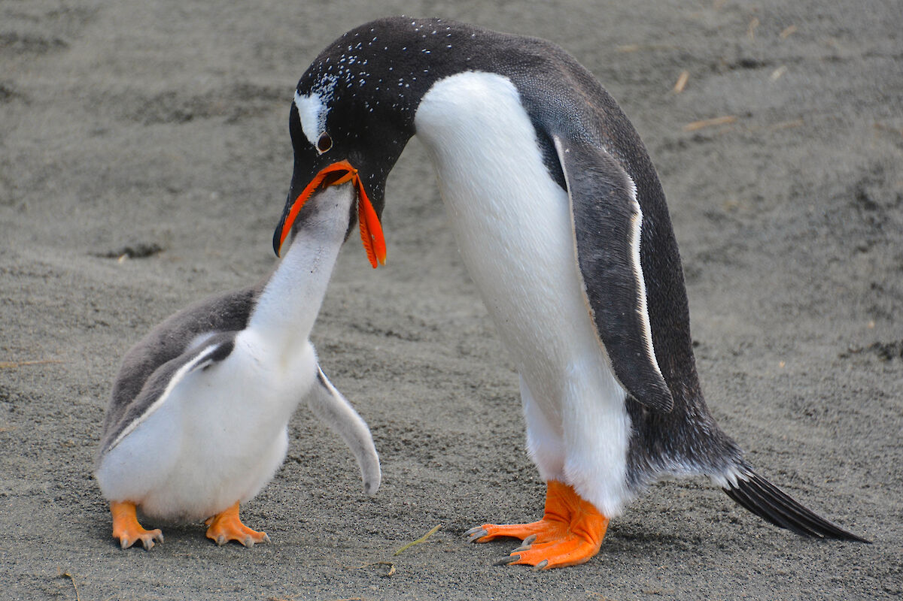
Driving Questions
How degraded are krill in penguin stomachs, compared to fresh krill (i.e. prey quality available to chicks)?
  Is there a relationship to diet freshness (measured by birders) and caloric content?
  Which lipids are lost first?
  Are there potential implications for chick health (i.e. loss of PUFA first)?
Birder
Degradation
Index
Lipid Degradation Index
Weighted Mean Saturation of Lipids
Notes:
Provisioning chicks is not as simple as going hunting and immediately returning to the colony. Depending on the island location, foraging grounds, and prey density, some penguins may travel further than others to obtain adequate food to feed their chicks.
As penguins return to the colony, digestion of diet has already begun. As part of the standard processing that occurs by the birder team, they give a semi-qualitative metric of diet degradation status. We can leverage this metadata to begin to determine general quality of the diet that is delivered to chicks, and ask similar questions as above: are there differences between species, islands.
By comparing with the whole krill, we can also look at which lipids are lost first, and determine the potential implications for the chicks (for example if the PUFAs are digested first).

Slide 21
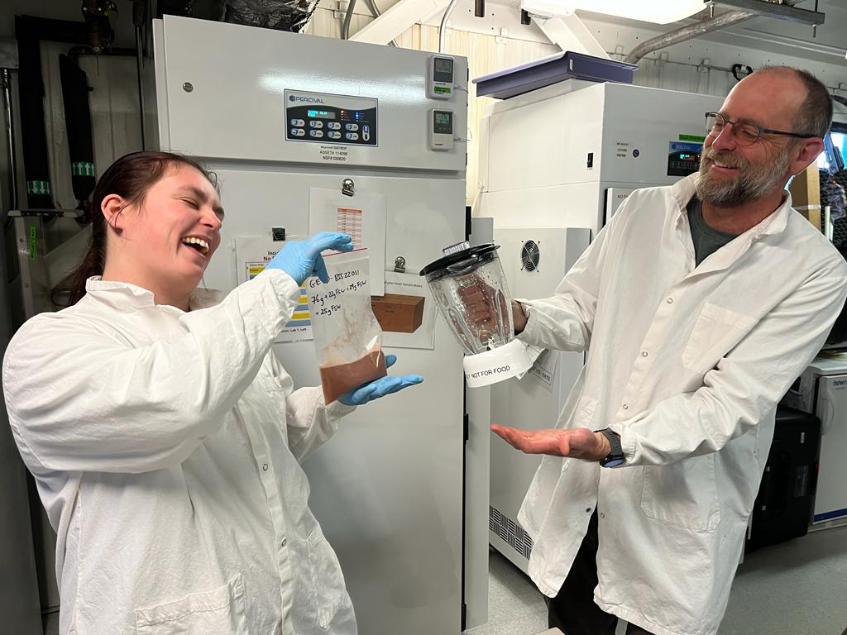
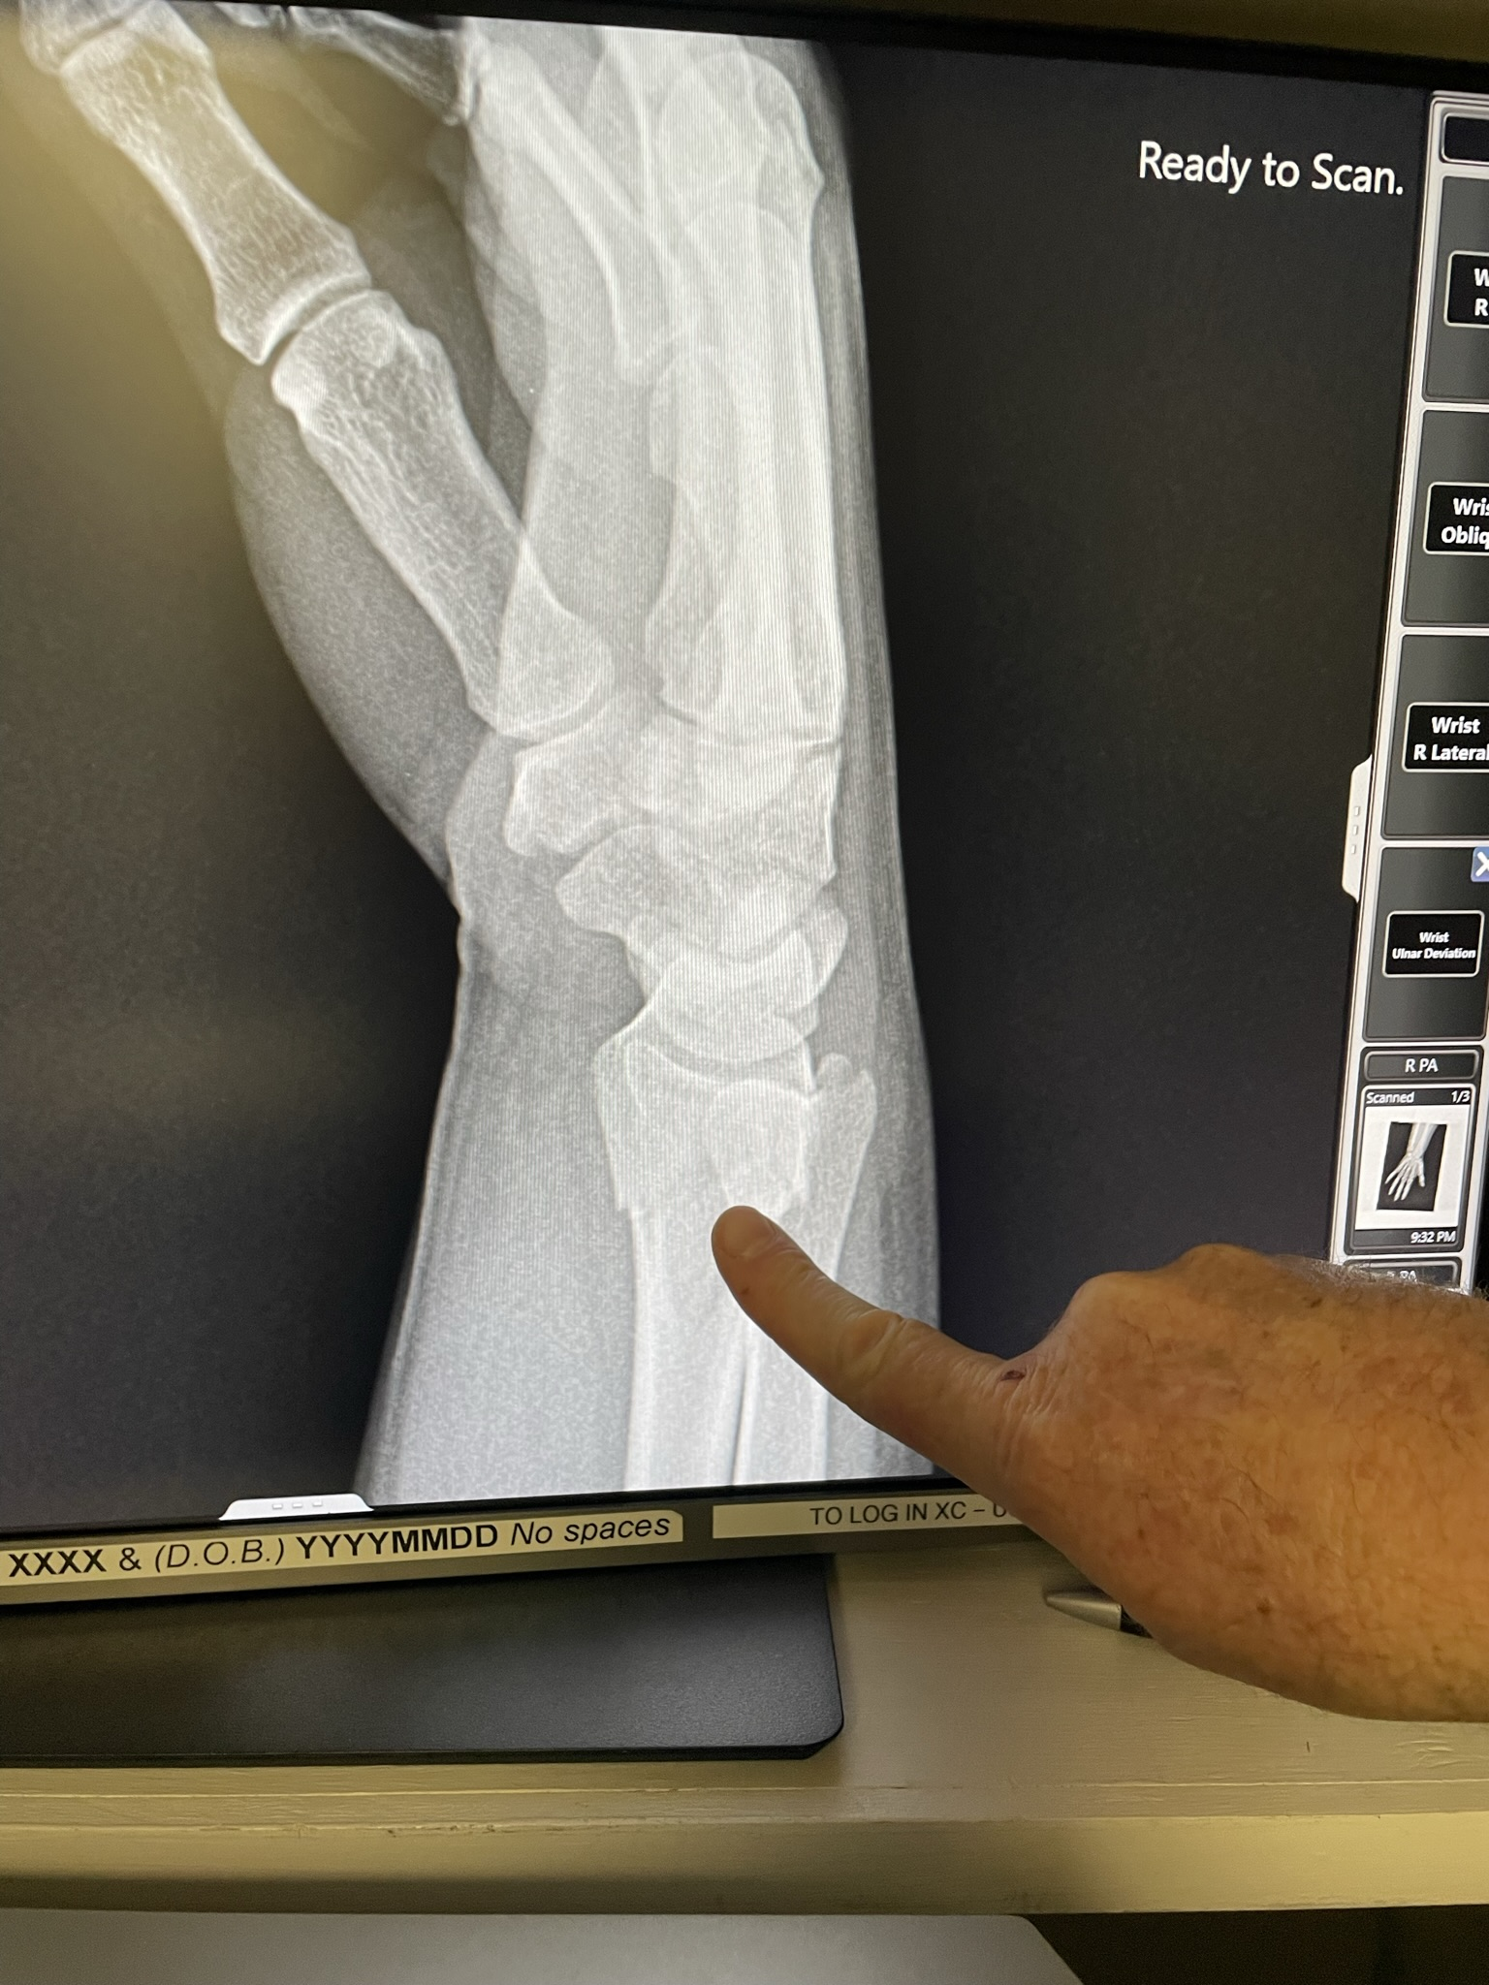
Driving Questions
Field methodology: comparison of flash frozen samples vs. samples processed by birder team.
  Can we quantify differences between samples and apply this correction to other samples?
Time Spent Processing
Lipid Degradation Index
Notes:
Finally, we can attempt to quantify the impacts from the required sample processing time. Because of the schedule that they maintain to collect all these samples, it often takes a few days for all of the krill and other prey to be counted.
To combat this, during the PAL2223 season we (and by that I mean Ben, because I broke my wrist attempting to collect one of these), were able to flash freeze samples in the field right after they were collected from the birds. This will allow us to determine what changes were due to sitting between sample processing and subsequent storage.

