Slide 1


Site/program assets including collaborative projects and funding agencies; new technologies and approaches
Palmer LTER
Mid-Term Review 2024

Slide 2
Background
Beginning in 1990, PAL LTER seeks to understand how a sea-ice influenced marine ecosystem is driven by forcing across a range of spatio-temporal scales.
  Three current focus themes:
    Drivers of disturbance across time and space scales: ecological and latitudinal response
    Vertical and alongshore connectivity as drivers of ecological change on local to regional scales
    Changing food webs and carbon cycling

Slide 3
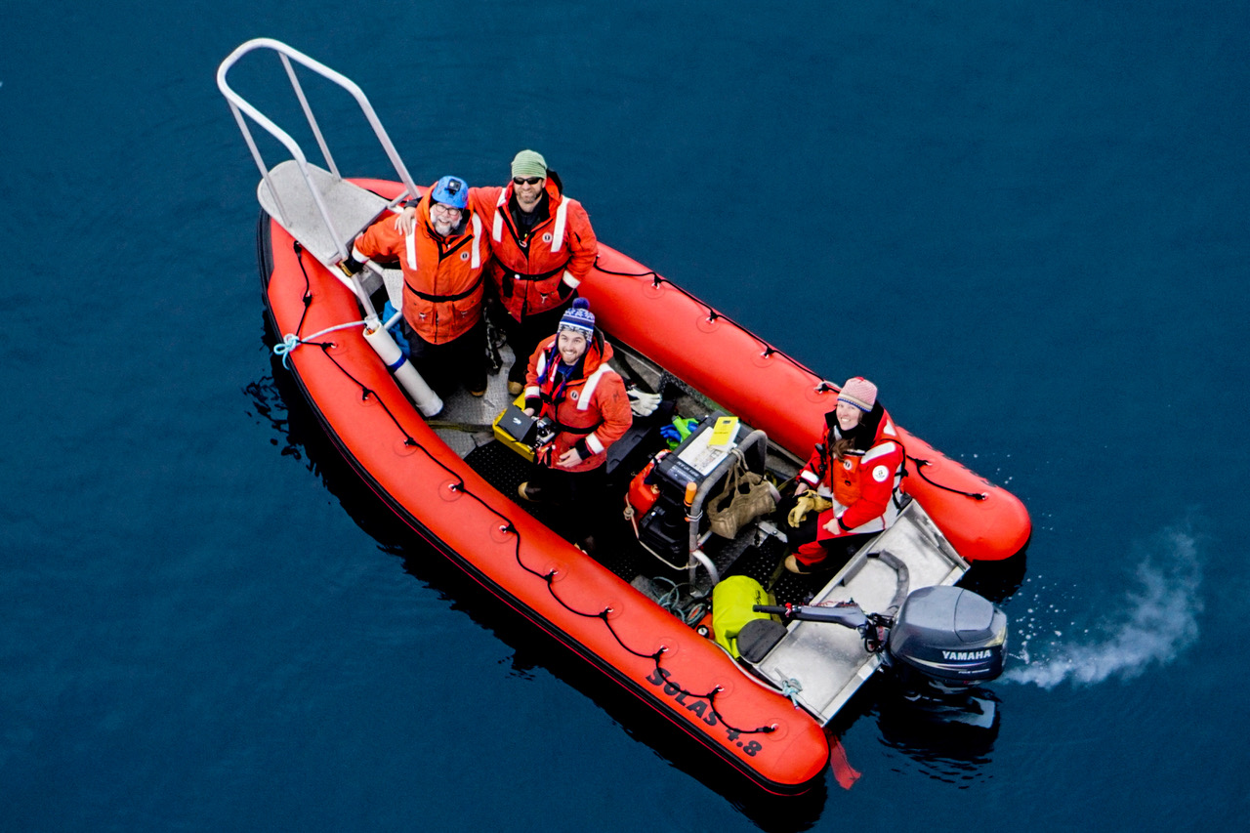
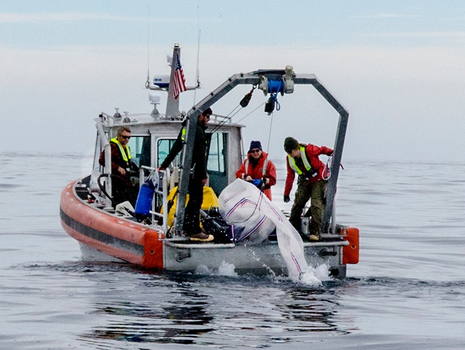
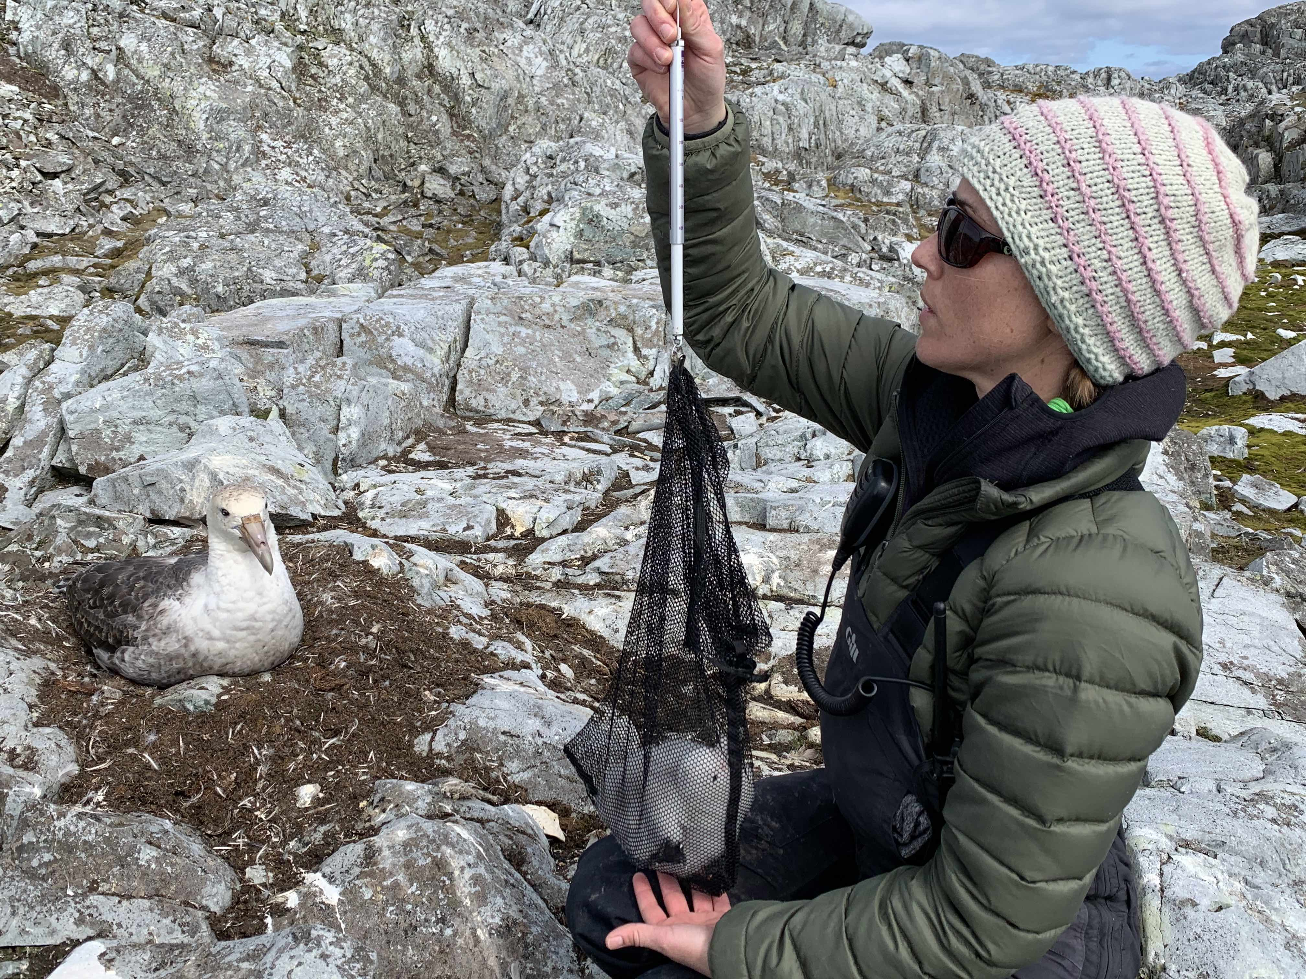
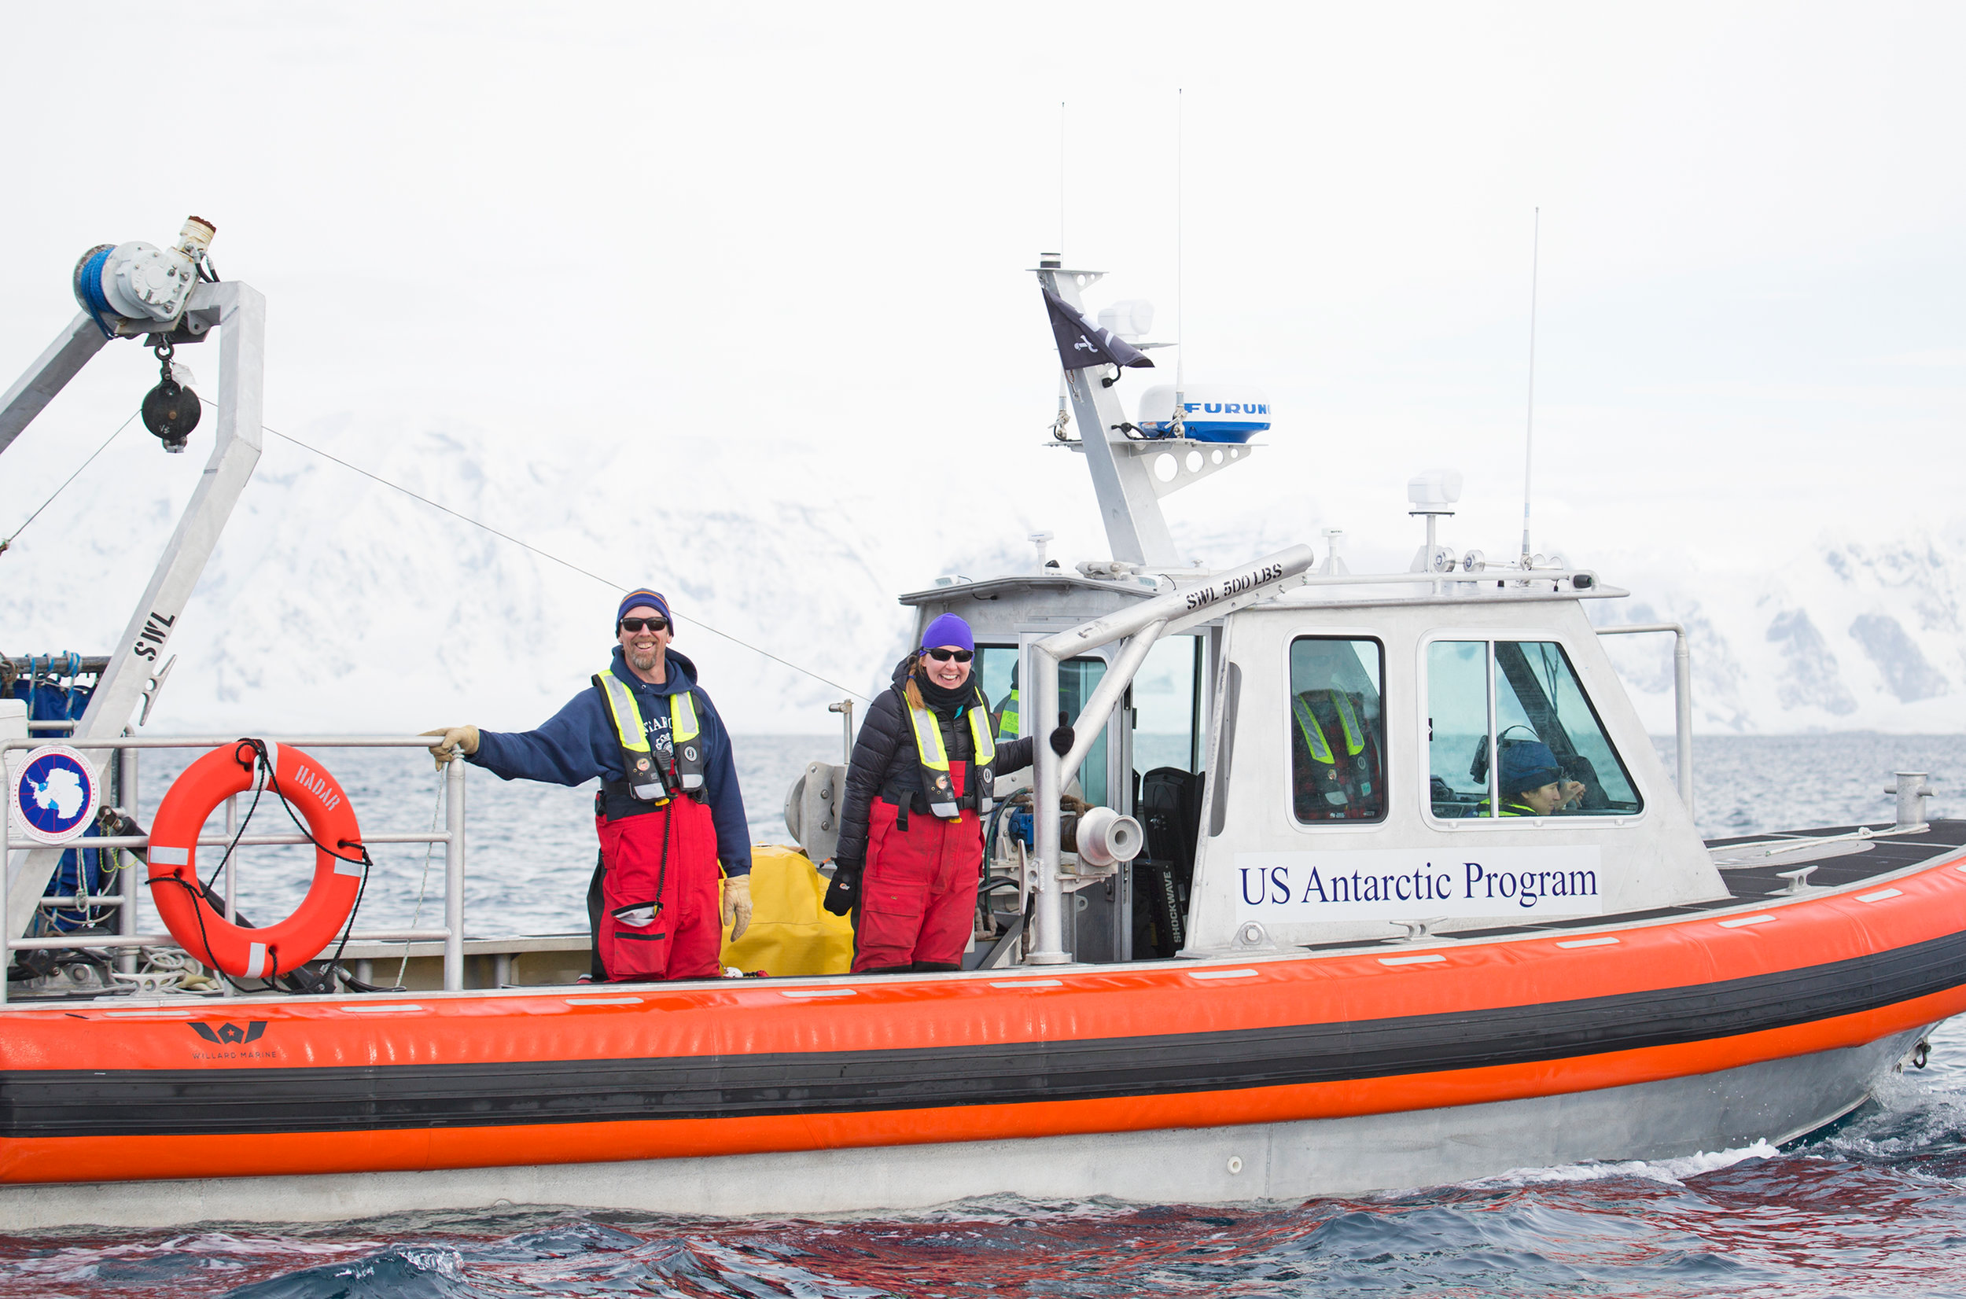
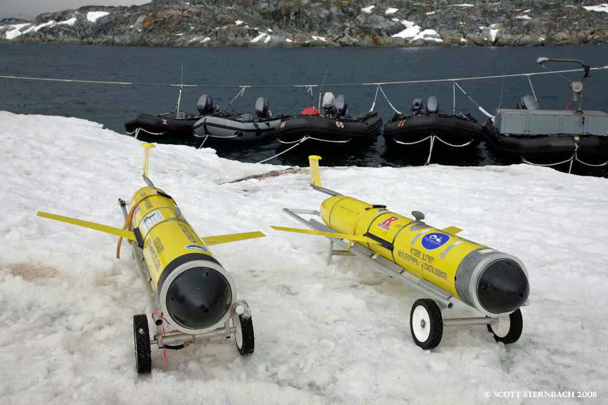
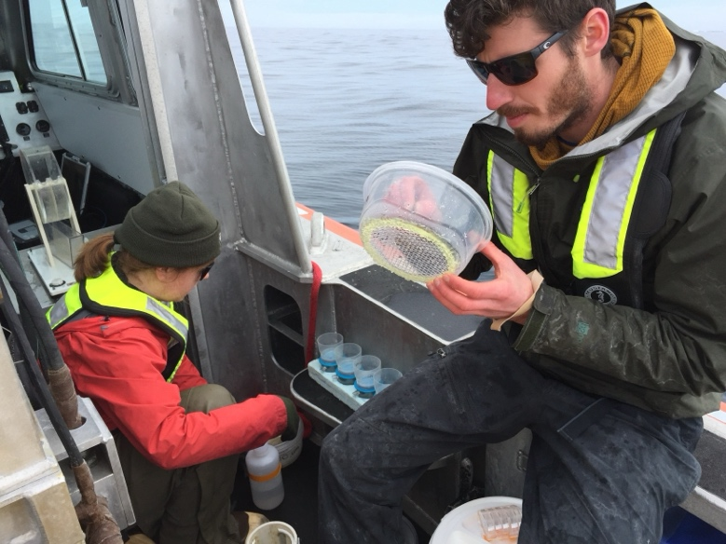
Assets: Palmer Station
Supporting field work on land and at sea
RHIBs
  Oceanographic sampling
  Net tows & sample collection
  Prey mapping and krill predator surveys
  Mooring deployment/recovery
  Glider deployment/recovery
  Whale tagging/biopsy/UAS/survey
  Penguin and seabird support
  Transport to land-based sampling locations
Station
  Weather/meteorological data
  Wet/dry labs for sample processing/analysis
  Tanks/incubators for experiments
  Computing storage/connectivity
  Science support/boat house
  Starlink
  Video Teleconferencing capacity for outreach

Slide 4
Assets: Palmer Station
Changes over time:
Increased small boating capacity
Increased environmental sampling capacity
(e.g. echosounders)
Greater working range for science operations
Increased technology for ocean sampling
Less predictable LTER capacity annually
Decreased options for changeover
Decreased boating support personnel
Decreased capacity for science support
Decreased quality control and usable station-managed data

Slide 5
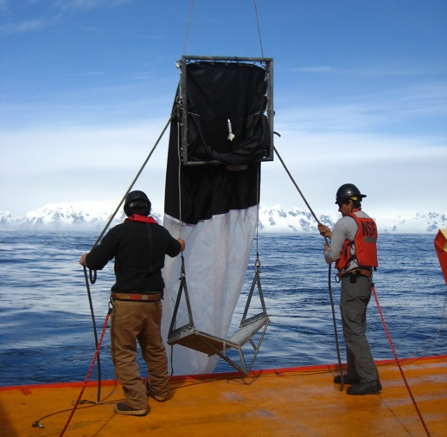
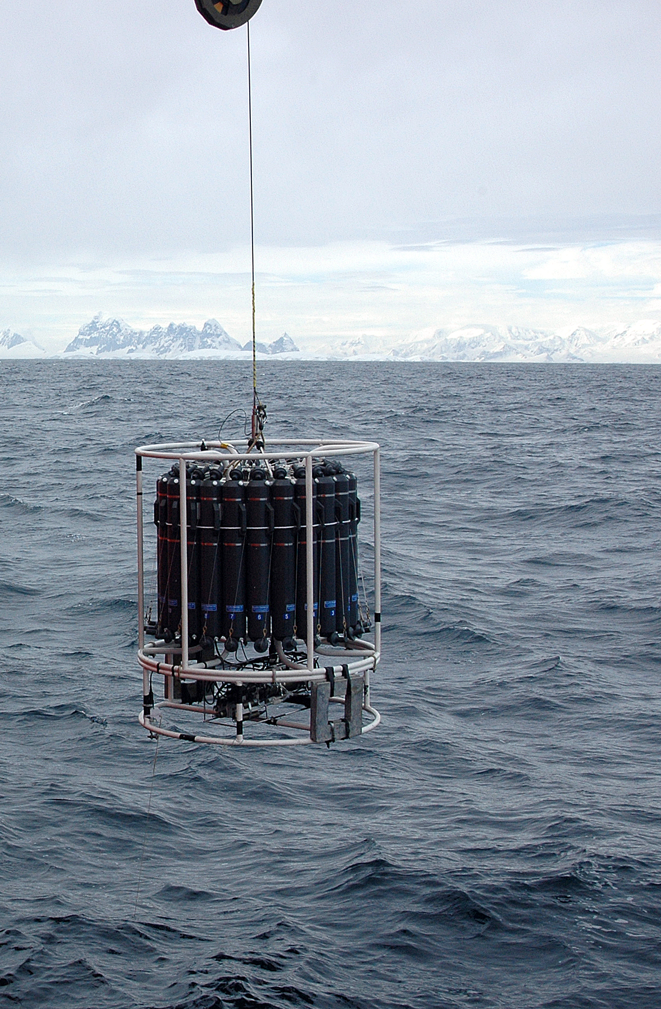
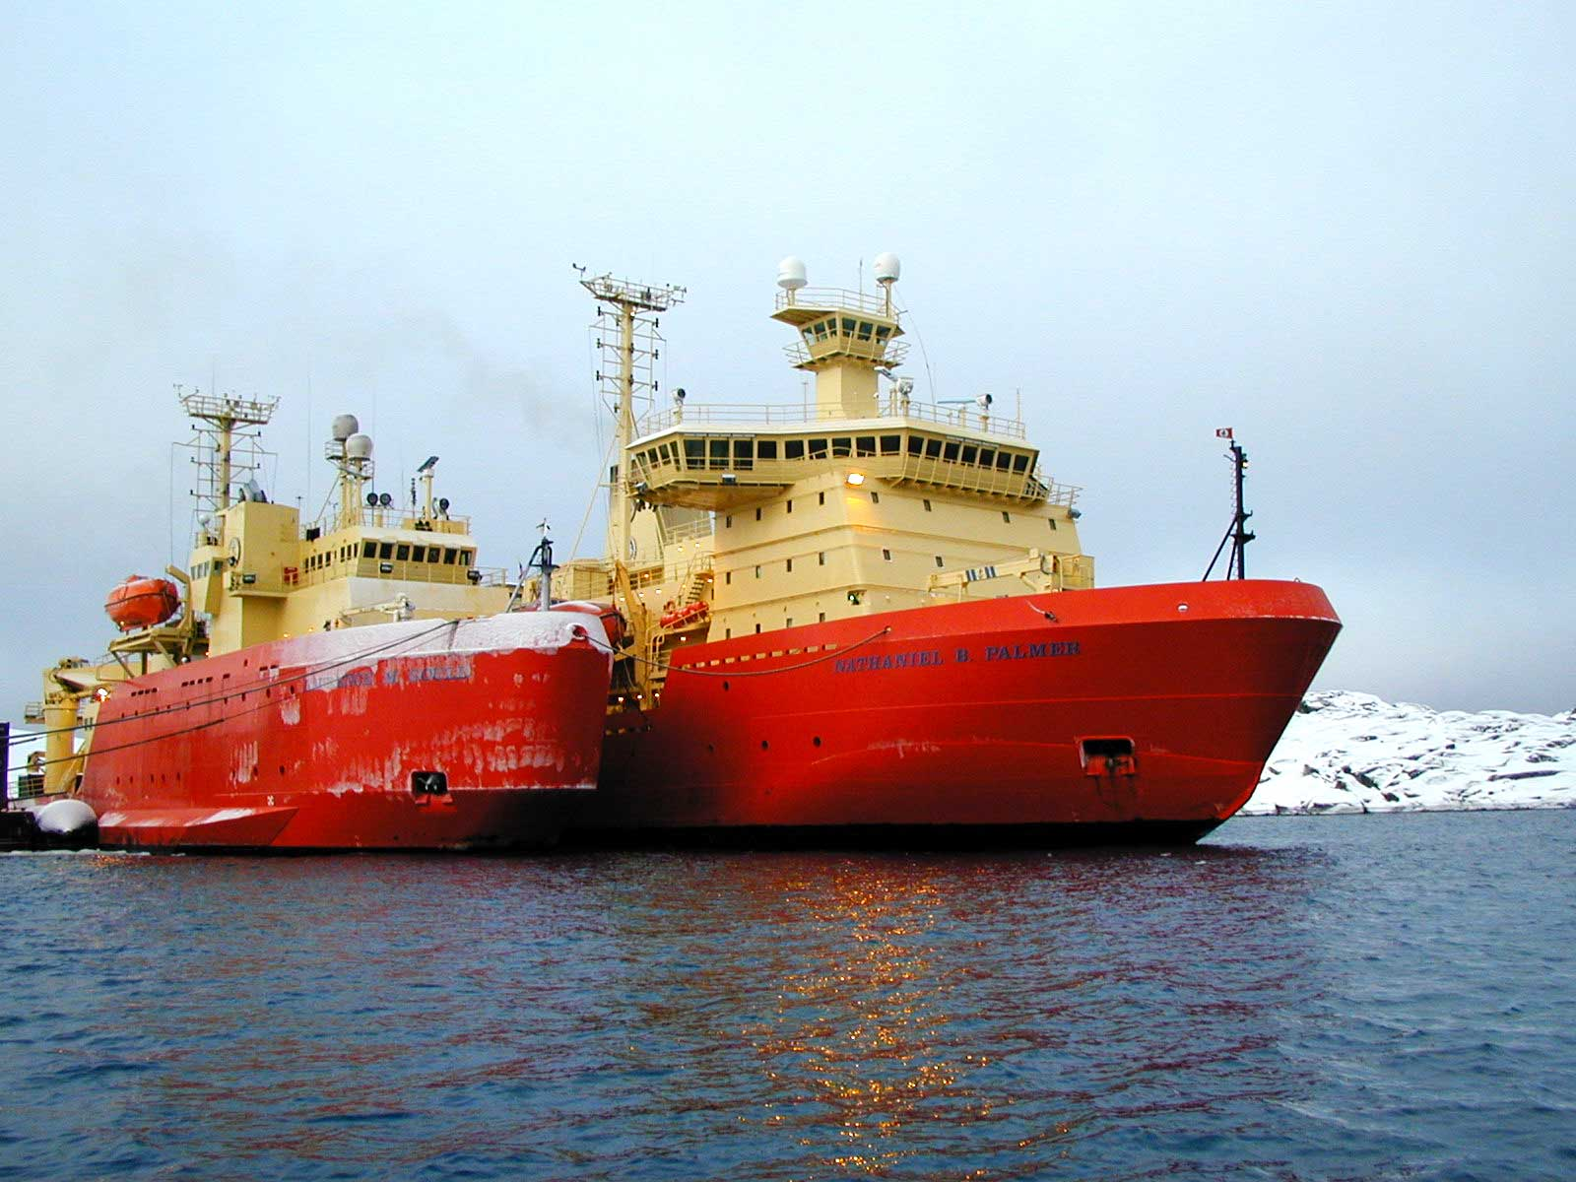
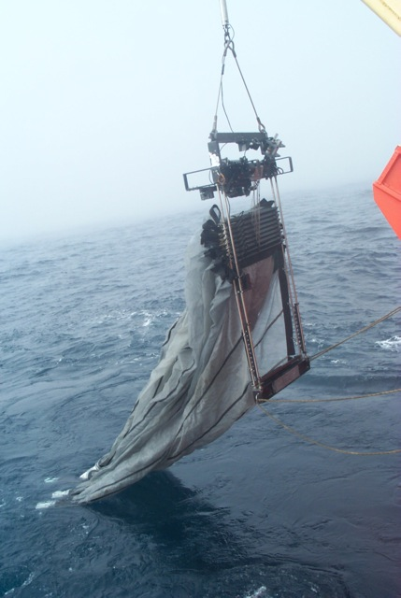
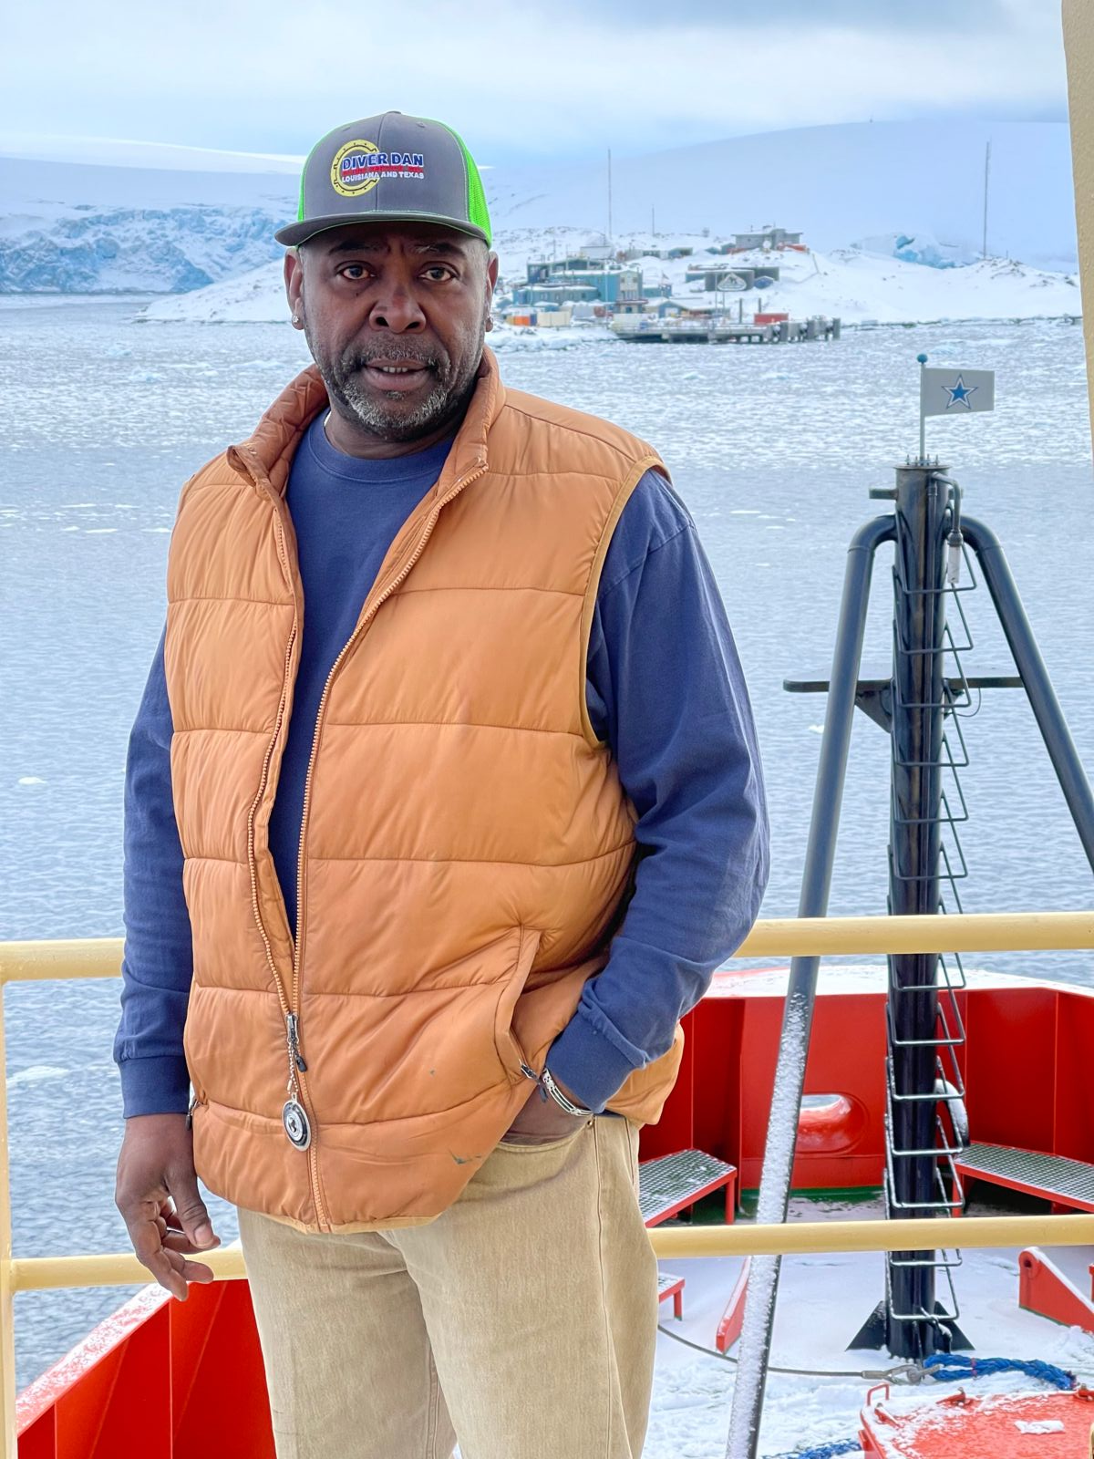
Assets: LM Gould/ NB Palmer
Core development and maintenance of broad-scale time-series across the entire LTER study region
Underway/continuous oceanographic sampling/surveys
Station-based water sampling
Station-based net tows
Recovery/deployment of moorings, sediment traps, gliders, UAVs
Support small-boat work for whale tagging/sampling
Support land-based penguin colony work
Transport and movement of equipment and scientists
Captain Ernest…

Slide 6
Assets: LM Gould/ NB Palmer
Changes over time:
Increased small boat capacity
Increased environmental sampling capacity
Decreased frequency of ‘annual’ cruise
Changes in timing of future cruises relative to time-series (1-2 week change is huge)
Decreased science support personnel and capacity
Loss of operational/ship knowledge of LTER cruise logistics and science

Slide 7

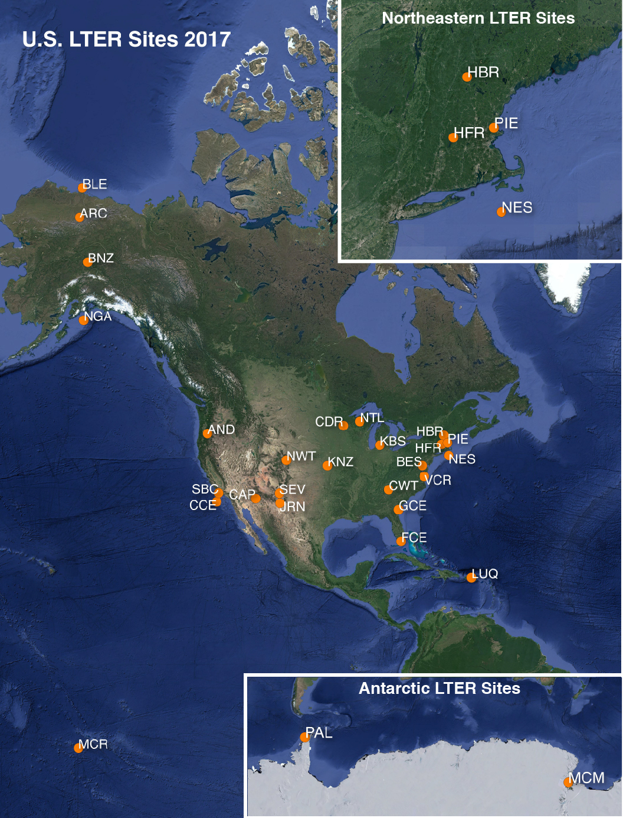
Collaborative Projects
ALL science in the PAL LTER is collaborative
Domestic and International Partners
Physical Oceanography
microbes
particle export
remote sensing
cetacean population dynamics
krill availability
Cross-site LTER network synthesis:
‘Interannual variability and long-term change in pelagic
community structure across a latitudinal gradient’
—NGA, CCE, NES, PAL
OCEAN:ICE program
-BAS, AWI (Germany), National Antarctic Scientific Center of Ukraine
New project to collect hydrographic data
COUPLING-II project
University of Las Palmas de Gran
-bio-physical interactions in the Weddell Sea

Slide 8
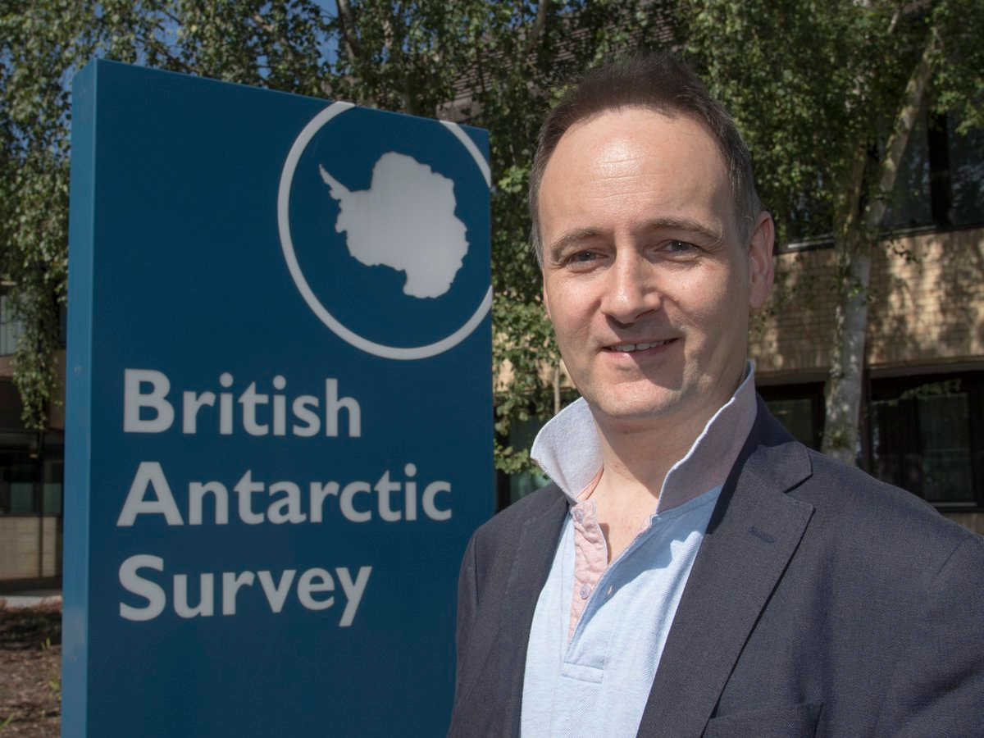
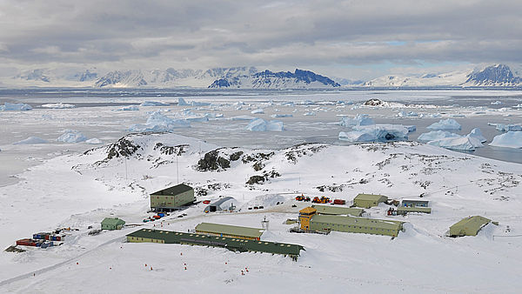
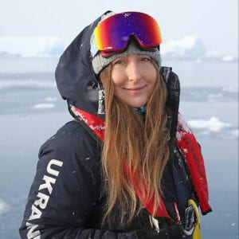
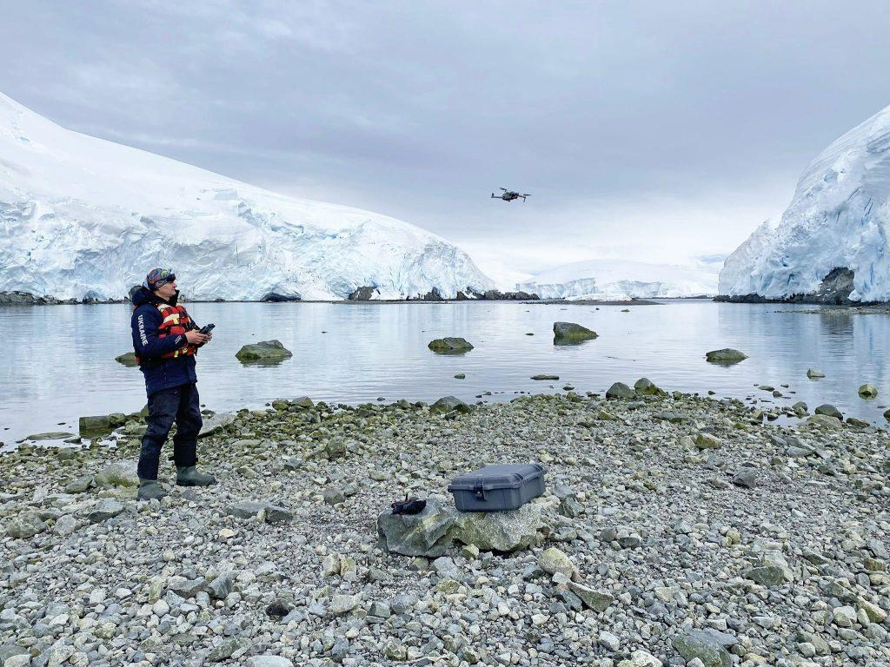
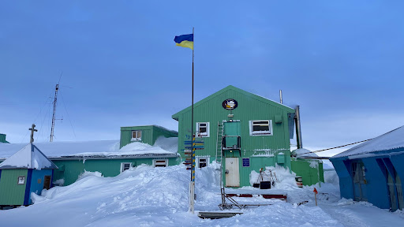
Collaborative Projects
Long-term collaboration with BAS since 1998
Annual port call/data/calibration at Rothera
Carlos Moffat Sabbatical
Mike Meredith, Oxygen isotope data construct freshwater budgets to distinguish glacial and sea ice sources of water over time
National Antarctic Science Center of Ukraine
Vernadsky Station
Oksana Savenko, Fulbright Fellowship
Vadym Tkachenko, Cetacean population dynamics and health

Slide 9
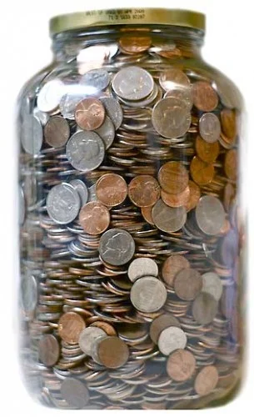
Funding Agencies
NASA ROSES
NASA IDS
NASA Rapid Response Program
NSF SOCCOM
NSF CAREER
NSF RAPID
NSF GRFP
NSF Polar Literacy
NSF OPP Postdoctoral Fellowship
Abercrombie and Kent
Hurtigruten Expeditions
Southern Ocean Research Partnership
International Whaling Commission
Scientific Committee for Antarctic Research
International Association of Antarctic Tour Operators
World Wildlife Fund for Nature
Schmidt Ocean Institute
Antarctic Wildlife Research Institute

Slide 10
New Technologies & Approaches
New technologies
Enable more, better, faster data collection/processing
Provide increased capacity for hypothesis testing
Allow for greater multidisciplinary collaboration
Offer opportunities for new spatio-temporal scales
Offset challenges associated with changing logistic support
Approaches
End-to-end food web representation
Loss of annual cruises requires rethinking and reframing
Use remote/autonomous sampling when possible
Decide on critical elements of historic time-series
Shift focus to more process studies

Slide 11
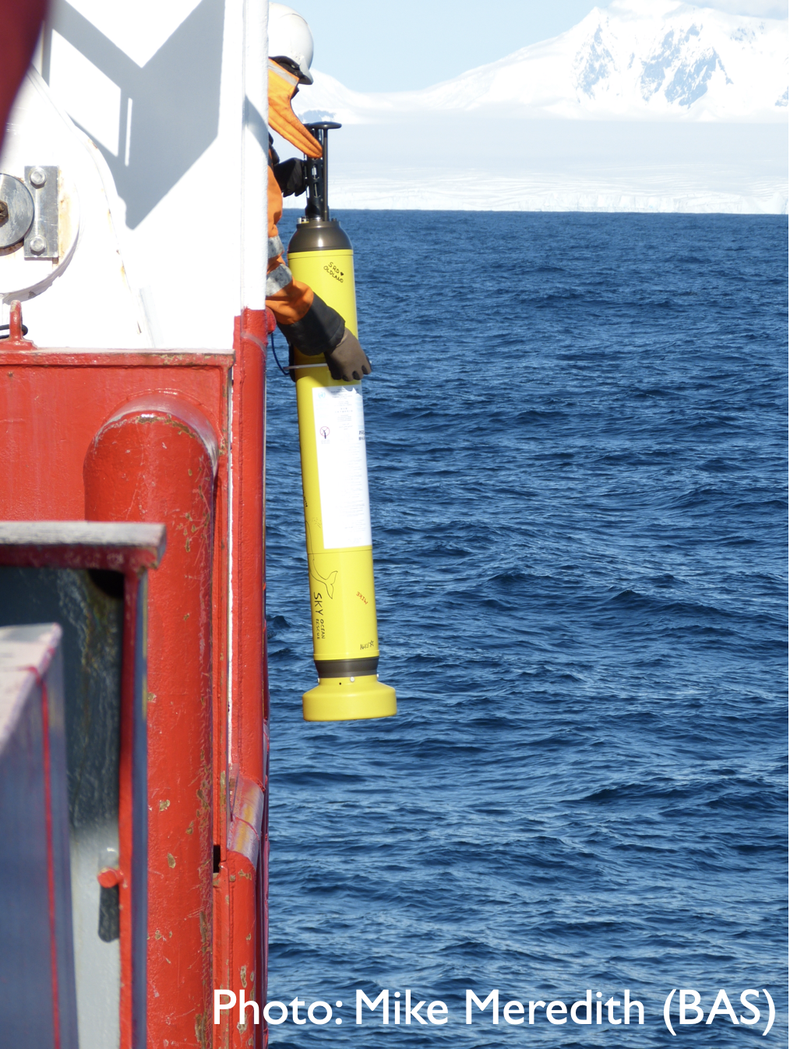
New Technologies & Approaches
Moffat et al. (in prep)
Coastal ARGO Floats: as “virtual moorings”
Time series of physical properties: full-depth, year round
Possible to add biogeochemical properties
Multi-year endurance
Plan to deploy starting in January 2026

Slide 12
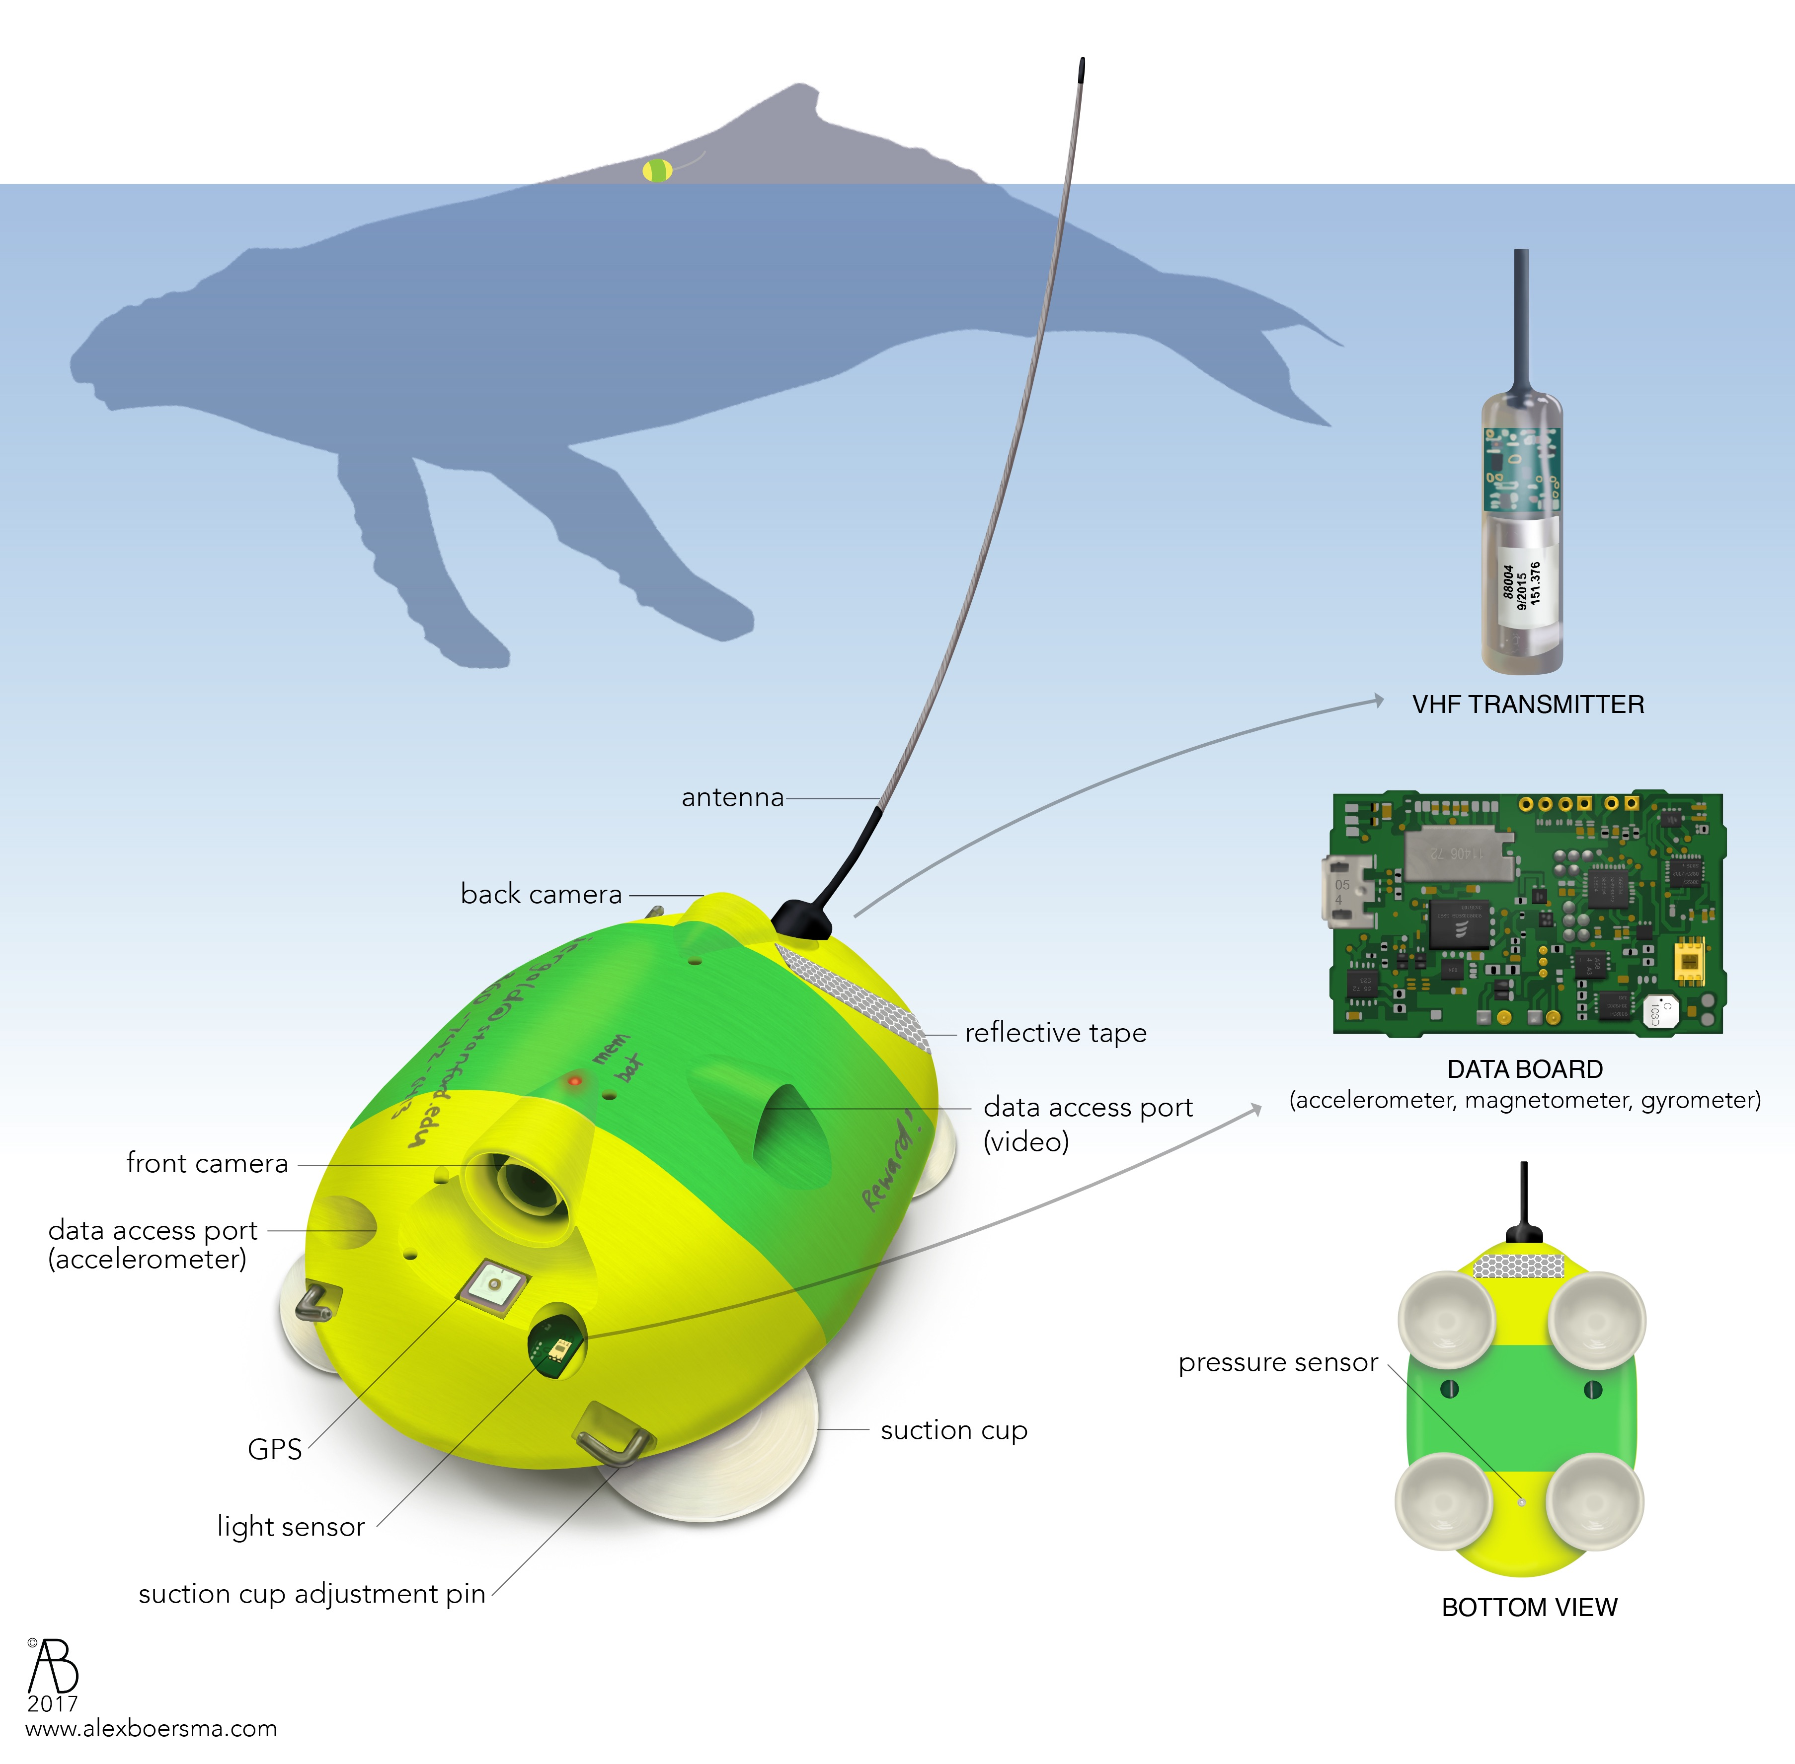
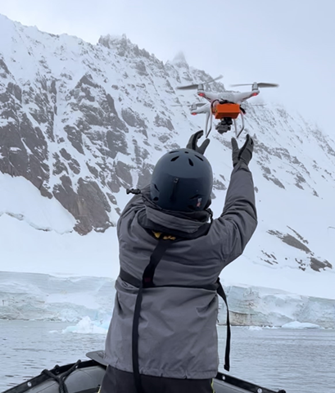
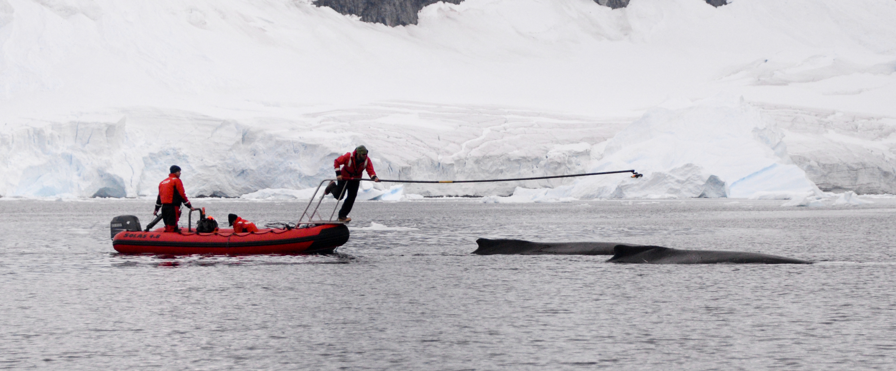
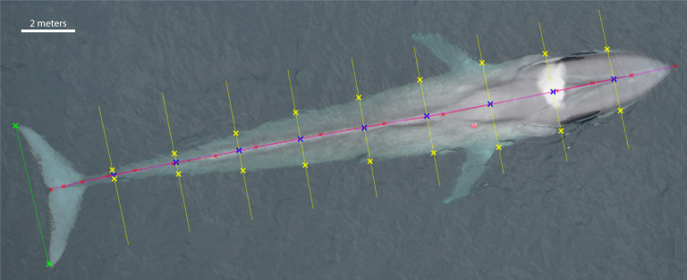
New Technologies & Approaches
Nichols et al. 2022, Beirlich et al. 2021, Friedlaender et al. 2021, Allen et al. 2023

Slide 13
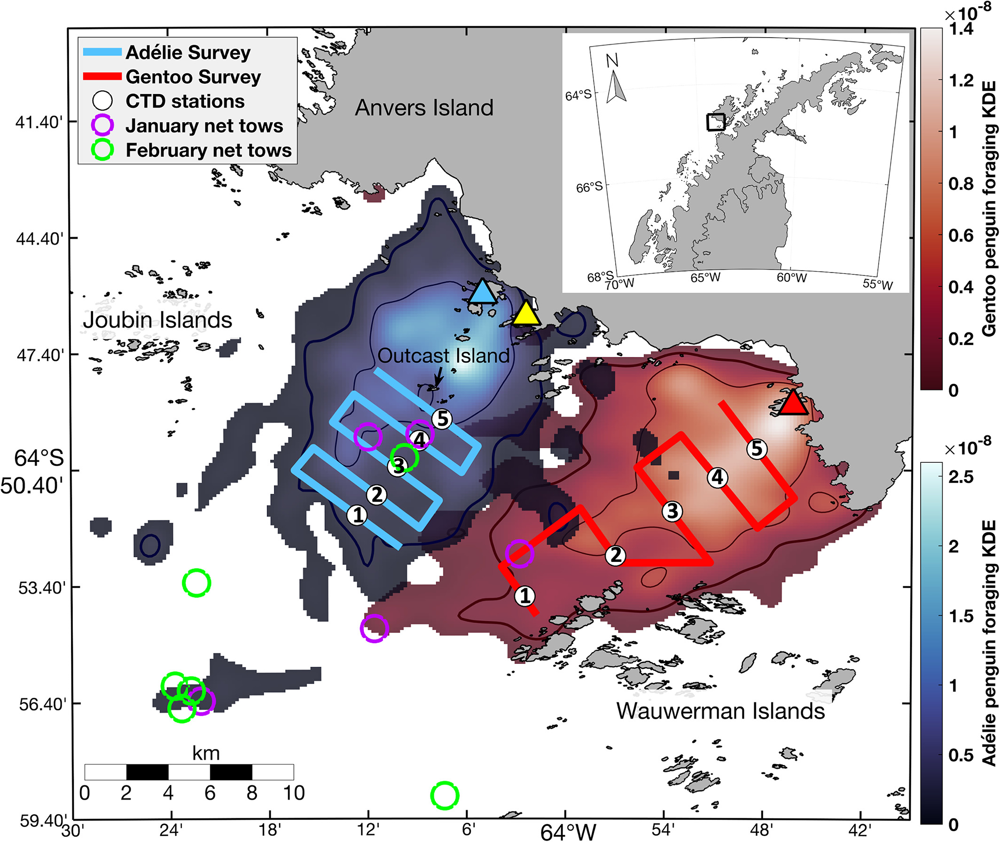
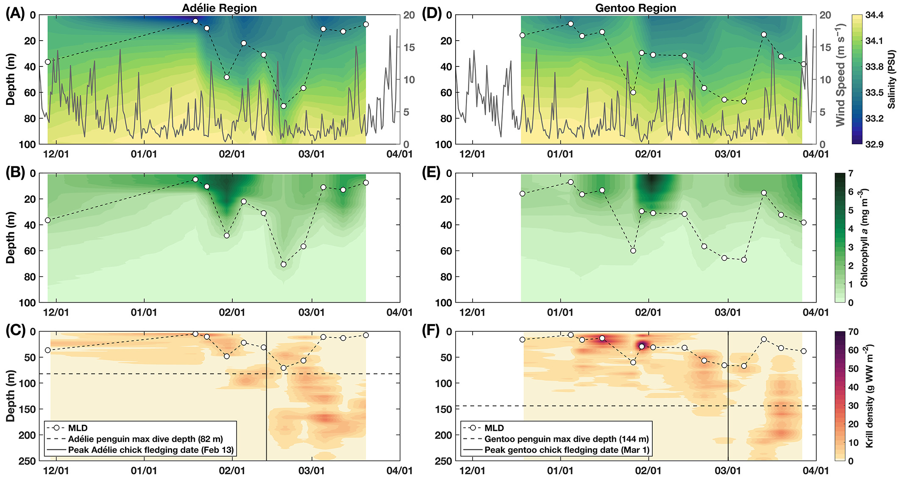
New Technologies & Approaches
Nardelli et al. 2021
Novel approach to measuring in situ prey and oceanographic
Parameters concurrent with krill predator tagging studies

Slide 14
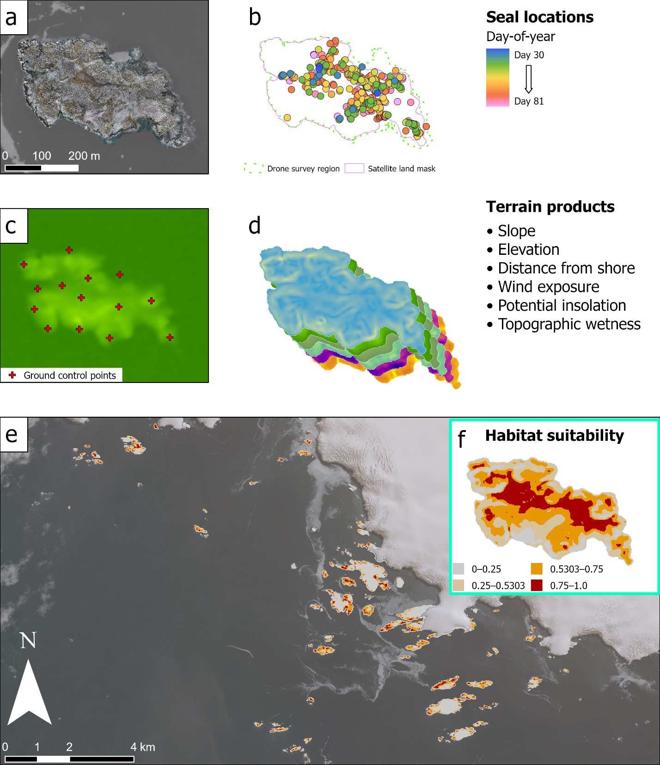
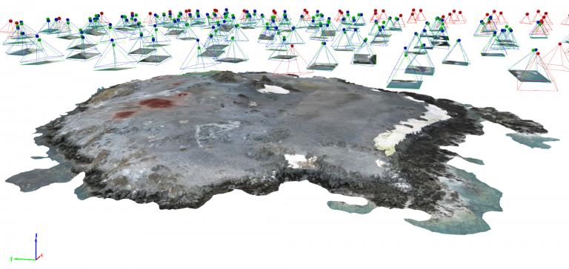
New Technologies & Approaches
Larsen et al. 2023
Fixed-wing and VTOL UAS capacity
Terrestrial habitat assessment and spatial modeling
Animal abundance and distribution

